Slide 1
Using Deep Learning for Image-Based Plant Disease Detection

Slide 2
The Problem
Plant diseases are not only a threat to food security at the global scale, but can also have disastrous consequences for smallholder farmers whose livelihoods depend on healthy crops
Independent of the approach, identifying a disease correctly when it first appears is a crucial step for efficient disease management
Smartphones in particular offer very novel approaches to help identify diseases because of their computing power, high resolution displays, and extensive built-in sets of accessories, such as advanced HD cameras.

Slide 3
Solution
Here, we demonstrate the technical feasibility using a deep learning approach utilizing 54,306 images of 14 crop species with 26 diseases (or healthy) made openly available through the project PlantVillage
Neural net works provide a mapping between an input - such as an image of a diseased plant – to an output – such as a crop-disease pair
In order to develop accurate image classifiers for the purposes of plant disease diagnosis, we needed a large, verified dataset of images of diseased and healthy plants

Slide 4
Solution II
Until very recently, such a dataset did not exist, and even smaller datasets were not freely available. To address this problem, the PlantVillage project has begun collecting tens of thousands of images of healthy and diseased crop plants (Hughes and Salathé, 2015), and has made them openly and freely available.
Here, we report on the classification of 26 diseases in 14 crop species using 54,306 images with a convolutional neural network approach. We measure the performance of our models based on their ability to predict the correct crop-diseases pair, given 38 possible classes.

Slide 5
Dataset Description
54,306 images
38 class labels
Each class label is a crop-disease pair
We make an attempt to predict the crop-disease pair given just the image of the plant leaf.
256 × 256 pixels

Slide 6
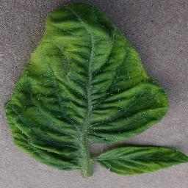
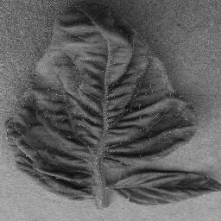
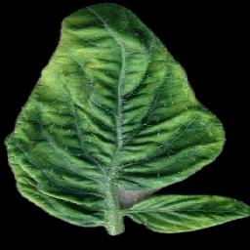
Images
3 versions of the dataset:
Color
Gray scale
Segmented

Slide 7
Measurement of Performance
80–20 (80% of the whole data set used for training, and 20% for testing)
60–40 (60% of the whole data set used for training, and 40% for testing)
50–50 (50% of the whole data set used for training, and 50% for testing)
40–60 (40% of the whole data set used for training, and 60% for testing)
20–80 (20% of the whole data set used for training, and 80% for testing)

Slide 8
Approach
AlexNet
AlexNet consists of 5 convolution layers,
followed by 3 fully connected layers, and finally ending with a softMax layer.
GoogLeNet The GoogleNet architecture on the other hand is a much deeper and wider architecture with 22 layers, while still having considerably lower number of parameters (5 million parameters)

Slide 9
60 experimental configurations
Choice of deep learning architecture:
AlexNet
GoogLeNet
Choice of training mechanism:
Transfer Learning
TrainingfromScratch
Choice of dataset type:
Color
Grayscale
LeafSegmented
Choice of training-testing set distribution:
Train:80%, Test:20%
Train:60%, Test:40%
Train:50%, Test:50%
Train:40%, Test:60%
Train:20%, Test:80%

Slide 10
Standardize the hyper-parameters across all the experiments
Solver type: Stochastic Gradient Descent
Base learning rate:0.005
Learning rate policy: Step(decreasesbyafactorof10every 30/3epochs)
Momentum: 0.9
Weight decay: 0.0005
Gamma: 0.1
Batch size: 24(incase of GoogLeNet), 100(incase of AlexNet).

Slide 11
RESULTS
Random guess 1/38 class: 2.63%
the overall accuracy we obtained on the PlantVillage dataset varied from 85.53%
AlexNet::TrainingFromScratch::GrayScale::80–20
To 99.34% in case of
GoogLeNet::TransferLearning::Color::80–20
The models perform the best in case of the colored version of the dataset.

Slide 12
Considerations about other version of the dataset
gray-scaled version to test the model’s adaptability in the absence of color information, and its ability to learn higher level structural patterns typical to particular crops and diseases. Performance did decrease but score was 0.8524
The segmented versions of the whole dataset was also prepared to investigate the role of the background of the images in overall performance, better than gray scale but lower than colored version of the image.

Slide 13
Results on Real Plant images
Bing Image Search and IPM Images with a visual verification step, we obtained two small, verified datasets of 121 (dataset 1) and 119 images (dataset 2)
Using the best model on these datasets, we obtained an overall accuracy of 31.40% in dataset 1, and 31.69% in dataset 2, in successfully predicting the correct class label from among 38 possible class labels.

Slide 14
Results with a different assumption
all results have been reported under the assumption that the model needs to detect both the crop species and the disease status. It is not realistic, we shod change the problem and assume that the crop specie is known
Random guessing in such a dataset would achieve an accuracy of 0.225, while our model has an accuracy of 0.478.

