Slide 1
Robust Deep-Learning-based Detector for Real-Time Tomato Plant Diseases Recognition
Understand the best solutions for diseases recognition

Slide 2
Features
Detect up to 9 possible disease or pest
Consider the possibility that a plant can have more than one disease or pest simultaneosly
Different resolution images
Different illumination condition, size and background

Slide 3
Classification and object detection
Try to analyze WHAT are the disease present in a picture and WHERE it is localized using red boxes that contains the infected area
Can also identify other things:
Location in the plant (leaves, steam…)
Side of leaves (Front, back …)
Status of infection (early, last….)

Slide 4
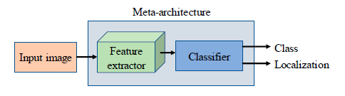

Slide 5
Techniques
Faster Region-Based Convolutional Neural Network (Faster R-CNN)
Single Shot Multibox Detector (SSD)
Region-Based Convolutional Neural Network (R-FCN)
VGG
Residual Network ResNet

Slide 6
Faster R-CNN
Detection in 2 phases:
Region Proposal Network (RPN) takes an image as input and process it by a feature extractor. Feature at intermdiate level are used to predict object proposals with score. For training RPNs, the system considers anchors containg or not an object, based on the Intersection Over Union between the object proposal and the ground-truth
Box proposals previously generater are used to crop features from the same feature map. Then this cropped features are consequently fed into remainig layers of the feature extractor in order to predict the class and bounding box in the region proposal

Slide 7
SSD
Object recognition with feed forward convolutiona network.
Produces a fixed-size collection of bounding boxes and scores for the presence of an object class in each box.
This network is able to deal with objects of various sizes by combining predictions from multiple feature maps with different resolutions.

Slide 8
R-FCN
Similar to Faster R-CNN
Instead of cropping features from the same layer where region proposals are predicted, features are cropped from the last layer of features prior to prediction.
This method minimizes the amount of memory utilized in region computation.

Slide 9
Feature extractors
AlexNet
ZFNet
VGG-16
GoogLeNet
ResNet-50
ResNet-101
ResNetXt-101

Slide 10
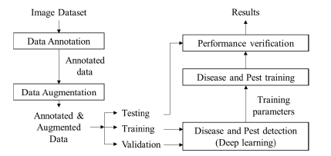
System Overview

Slide 11
How use techniques explained before…

Slide 12
Faster R-CNN
Extended to add the ability to recognize objects.
For each object proposal extract the features with an RoI (Region of Interest) Pooling layer and perform object classification and bounding-box regression to obtain the estimated targets.

Slide 13
SSD
Added a sequence of convolutional layer containing each detection per class.
So SSD can deal with objects of various sizes contained in the same images.
A Non-Maximum Suppression method is used to compare the estimated results with the ground-truth.

Slide 14
R-FCN
Follow the same implementation for Faster R-CNN
Used batch normalization for each feature extractor, and train end-to-end using an ImageNet Pretrained Network

Slide 15
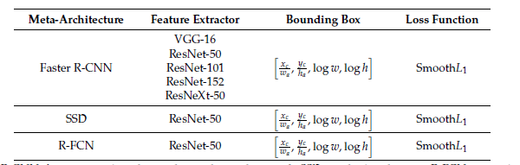

Slide 16
Experimental Setup
Extensive Data Augmentation
Dataset divided in 80% training, 10% validation and 10% test
More than 200,000 iterations on the systems (i7 + 2 Titan X )

Slide 17
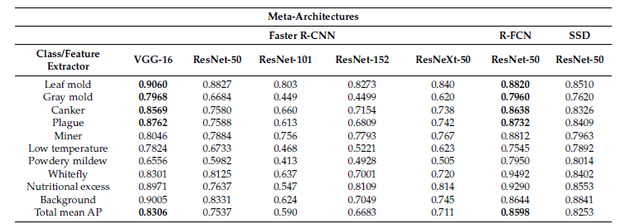
Results
Performance evaluated in terms of Intersection-over-Union and Average Precision (introduced in Pascal VOC Challange)

Slide 18
Results
They consider leaf mold, gray mold, canker, and pest as the most complex and main classes.
So they say that the best choice is to choose Faster R-CNN with VGG-16 due to best results in the classes above.
They also prove that data augmentation improves a lot their network.

Slide 19
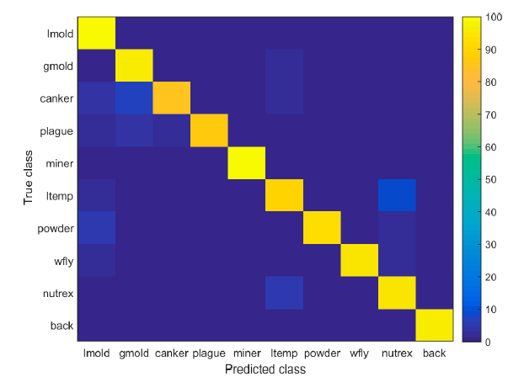
Results

