Slide 1
Deep Neural Networks Based Recognition of Plant Diseases by Leaf Image Classification
Research Article, 2016

Slide 2
Problem
The problem of efficient plant disease protection is closely related to the problems of sustainable agriculture and climate change.
Climate change:
alters stages and rates of pathogen development
modifies host resistance → physiological changes of host-pathogen interaction
Globalization: diseases spread is easier → some areas have not local experts for never seen diseases
Inexperienced pesticide usage causes long-term resistance of pathogens.

Slide 3
Needs
Timely and sophisticated diagnosis (most of the diseases just require trained professional eye examination)
Prevention of unnecessary waste of financial and other resources
Healthier production
Automated tool to identify plant diseases by the plant’s appearance and visual symptoms that could help amateurs (as support for gardening process) and experts (as verification system)

Slide 4
Goal
Development of plant disease recognition model, based on leaf image classification, by means of deep convolutional networks.

Slide 5
Procedure and Framework
Gathering of images assessed by agricultural experts
Creation of a database
Caffe, a deep learning framework developed by Berkley Vision and Learning Centre, was used to perform the deep CNN training.

Slide 6
Achieved Results
Model is able to recognize 13 different types of plant diseases out of healthy leaves, with the ability to distinguish plant leaves from their surroundings.
Experimental results: between 91% and 98%, for separate class tests, on average 96.3%.

Slide 7
Old approaches
Double-stranded ribonucleic acid (RNA) analysis, nucleic acid probes, and microscopy
Issues: they miss the objective of a rapid, cost-effective, and reliable health monitoring

Slide 8
State of the Art for Plant Disease Recognition
Artificial Neural Networks (classification only)
FeedForward
Particle Swarm Optimization (PSO)
Ensemble
+ Clustering
Support Vector Machines (classification only)
Different methods of image:
spectroscopic and imaging-based and volatile profiling-based plant disease detection methods
YcbCr, HSI, and CIELB colour models: disease spots successfully detected and remained unaffected by the noise from different sources, such as camera flash
shape features extraction: threshold segmentation to determine leaf area and triangle threshold for lesioning area
texture features such as inertia, homogeneity, and correlation obtained by calculating the gray level cooccurrence matrix on image
they are well-known and conventional methods for feature extraction
consequences of their use: robust feature set for image improvement and better classification

Slide 9
Our work

Slide 10
General approach
Digital image processing: color analysis and thresholding for detection and classification
Deep Convolutional Neural Network
Data retrieval: database of plant’s leaves that was gathered independently for diverse plant diseases
Healthy leaves and background images are in line with other classes, enabling the model to distinguish between diseased leaves and healthy ones or from the environment
Focus on the CNN part at the expense of hand-crafted feature extraction

Slide 11
Detailed Procedure
Dataset
Image Preprocessing and Labelling
Augmentation Process
Neural Network Training
Performed Tests
Fine-Tuning
Equipment

Slide 12
Dataset
Downloaded from various sources on the Internet, searched by disease and plant name
13 classes representing plant diseases that can be visually determined from leaves
1 healthy leaves class + 1 background class
Duplicated images were removed with an automatic script + human expert verification
Data Augmentation: using more augmented images, the chance for the network to learn the appropriate features has been increased (remember: the goal is to train the network to learn the features that distinguish one class from the others)

Slide 13
Image Preprocessing and Labelling
Heterogeneous images in quality and resolution from the Internet were preprocessed to gain consistency
Square around plant leaves
256x256 images
Images labelled by experts

Slide 14
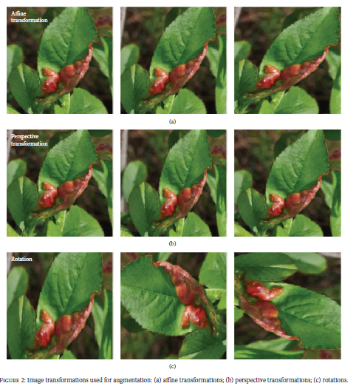
Augmentation Process
Purpose: increase the dataset and introduce slight distortion to help reducing overfitting
Transformation techniques:
affine transformation → to express translations and rotations (3 points needed)
perspective → 3x3 transformation matrix
simple image rotations on different axis by various degrees

Slide 15
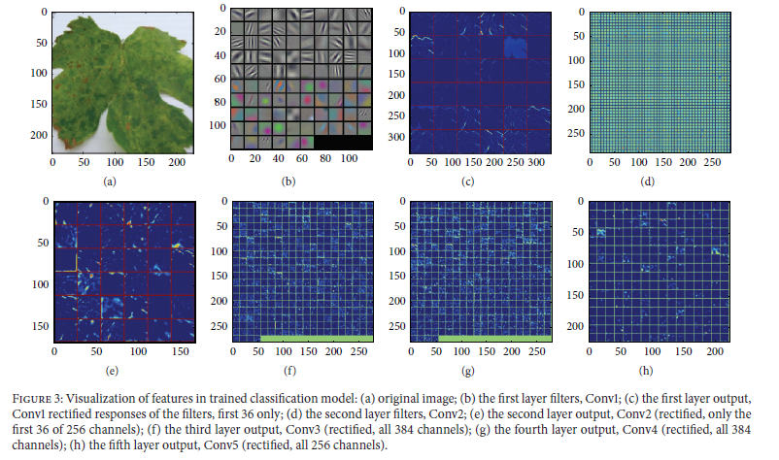
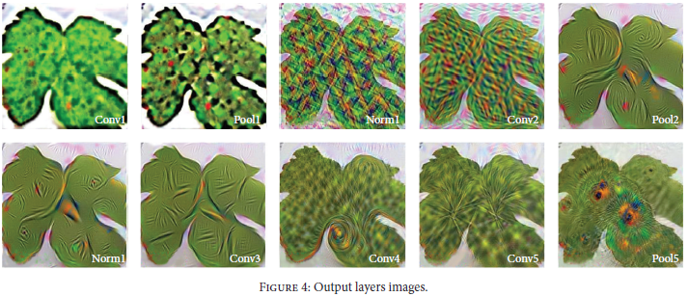
Neural Network Training
CaffeNet as starting point: 8 layers → 5 convolutional and 3 fully connected
Last layer altered to fit 15 classes requirement

Slide 16
Performed Tests
Training and validation sets
2589 images for the validation set
30880 images for the training set
10-fold cross-validation every 1000 iterations
Top-1 and top-5 error (target label is in one of the top-5 predictions)

Slide 17
Fine Tuning
CaffeNet has 1000 classes output learned from ImageNet
Softmax classifier was completely replaced
Due to smaller dataset, overfitting was constrained using 10 as the top layer’s learning rate, 0.1 learning rate for the other seven learning layers.
Backpropagation ran for 100’000 iterations.

Slide 18
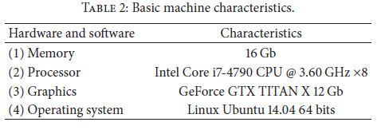
Equipment
Single PC in GPU mode, eight hours computation for a single training.

Slide 19
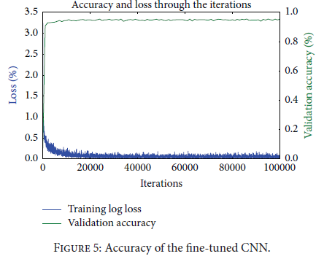
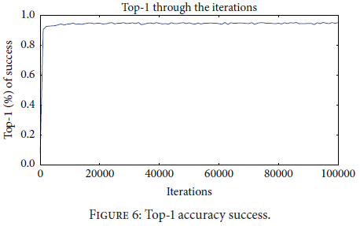
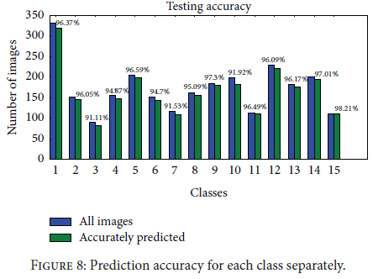
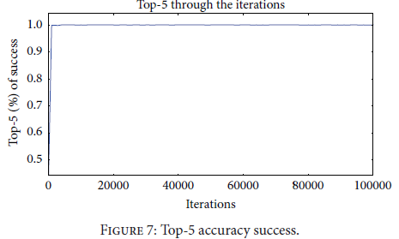
Results and Discussion
After fine tuning, overall achieved accuracy: 96.3%
With no fine tuning, 95.8%

