Slide 1
segmented_train
AlexNet pretrained=True
Normalization over normal_train
0.974941268598 validation accuracy

Slide 2
segmented_train

Slide 3
segmented_train normal_test
Number of samples: 5554
Accuracy: 0.6179330212459488
Macro precision: 0.7301970116584449
Macro recall (Trues Rate): 0.4941253697415004
Falses Rate: 0.5058746302584997
Macro F1: 0.4869402638229018

Slide 4
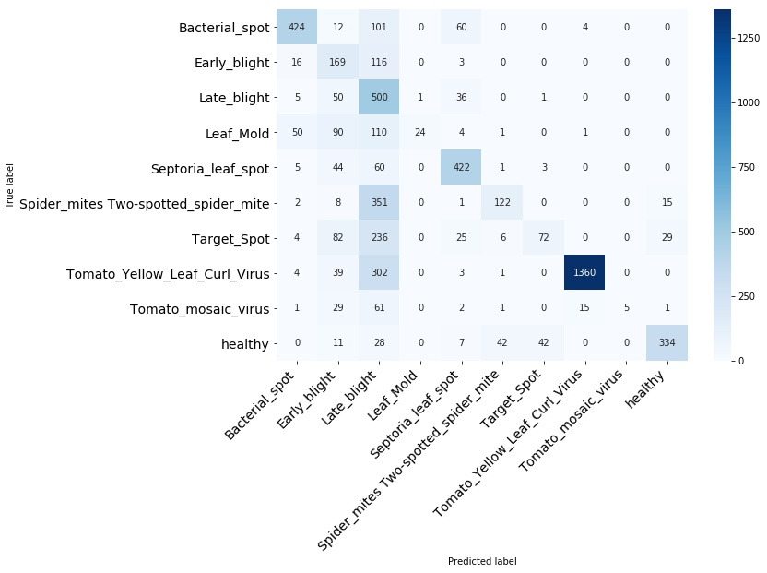
segmented_train normal_test

Slide 5
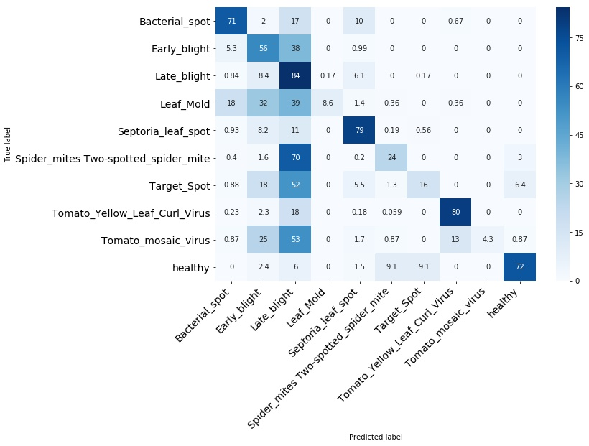
segmented_train normal_test

Slide 6
segmented_train normal_test
Bacterial_spot

Slide 7
segmented_train normal_test
Early_blight

Slide 8
segmented_train normal_test
Late_blight

Slide 9
segmented_train normal_test
Leaf_Mold

Slide 10
segmented_train normal_test
Septoria_leaf_spot

Slide 11
segmented_train normal_test
Spider_mites Two-spotted_spider_mite

Slide 12
segmented_train normal_test
Target_Spot

Slide 13
segmented_train normal_test
Tomato_Yellow_Leaf_Curl_Virus

Slide 14
segmented_train normal_test
Tomato_mosaic_virus

Slide 15
segmented_train normal_test
healthy

Slide 16
segmented_train segmented_test
Number of samples: 5554
Accuracy: 0.9665106229744328
Macro precision: 0.9595167544556528
Macro recall (Trues Rate): 0.9568936411609342
Falses Rate: 0.043106358839065724
Macro F1: 0.958018790849459

Slide 17
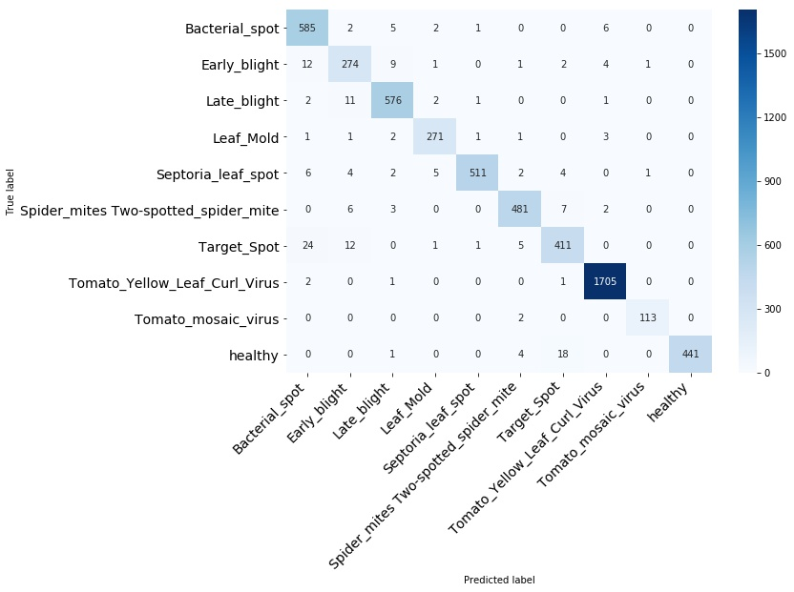
segmented_train segmented_test

Slide 18
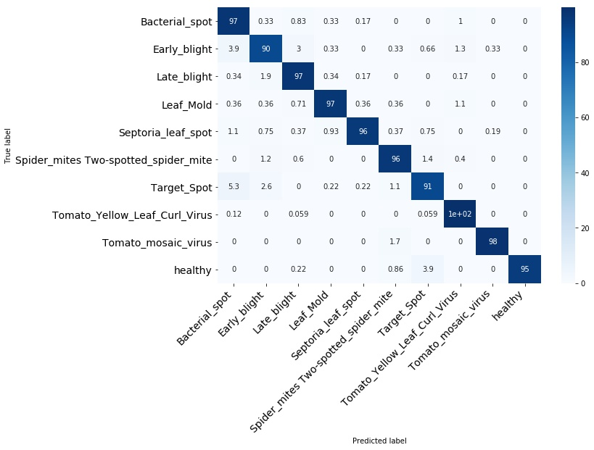
segmented_train segmented_test

Slide 19
segmented_train segmented_test
Bacterial_spot

Slide 20
segmented_train segmented_test
Early_blight

Slide 21
segmented_train segmented_test
Late_blight

Slide 22
segmented_train segmented_test
Leaf_Mold

Slide 23
segmented_train segmented_test
Septoria_leaf_spot

Slide 24
segmented_train segmented_test
Spider_mites Two-spotted_spider_mite

Slide 25
segmented_train segmented_test
Target_Spot

Slide 26
segmented_train segmented_test
Tomato_Yellow_Leaf_Curl_Virus

Slide 27
segmented_train segmented_test
Tomato_mosaic_virus

Slide 28
segmented_train segmented_test
Healthy

