Slide 1
per_image_normalization_new
AlexNet pretrained=True
Normalization over per_image_normalization_new
0.9496215087444532 validation accuracy
/

Slide 2
per_image_normalization_new
/

Slide 3
per_image_normalization_new normal_test
Number of samples: 5554
Accuracy: 0.9776737486496219
Macro precision: 0.9751804234481912
Macro recall (Trues Rate): 0.9669077305631109
Falses Rate: 0.03309226943688915
Macro F1: 0.9704198546046056
/

Slide 4
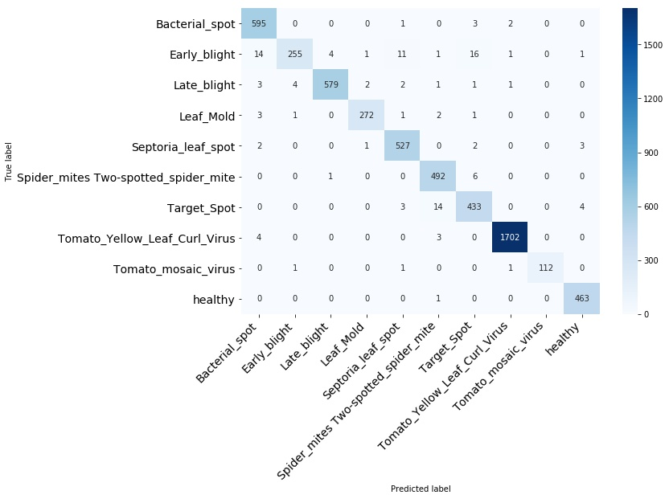
per_image_normalization_new normal_test
/

Slide 5
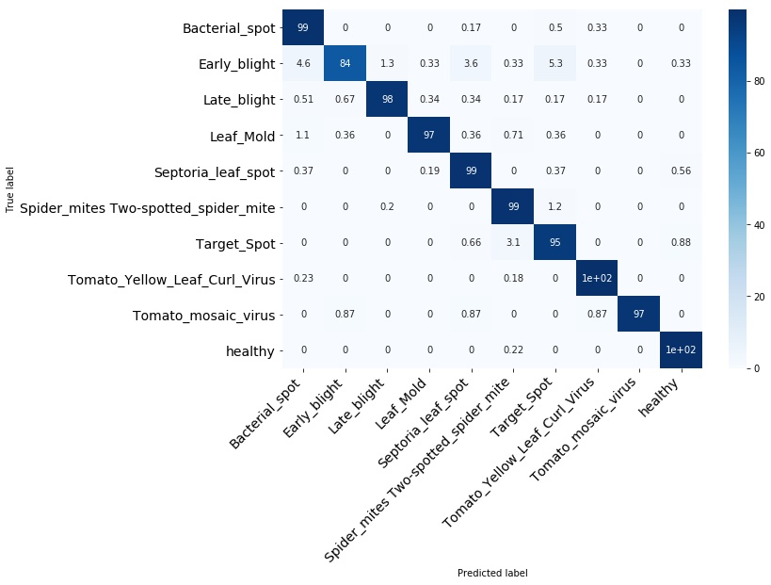
per_image_normalization_new normal_test
/

Slide 6
per_image_normalization_new normal_test
Bacterial_spot
/

Slide 7
per_image_normalization_new normal_test
Early_blight
/

Slide 8
per_image_normalization_new normal_test
Late_blight
/

Slide 9
per_image_normalization_new normal_test
Leaf_Mold
/

Slide 10
per_image_normalization_new normal_test
Septoria_leaf_spot
/

Slide 11
per_image_normalization_new normal_test
Spider_mites Two-spotted_spider_mite
/

Slide 12
per_image_normalization_new normal_test
Target_Spot
/

Slide 13
per_image_normalization_new normal_test
Tomato_mosaic_virus
/

Slide 14
per_image_normalization_new normal_test
Tomato_Yellow_Leaf_Curl_Virus
/

Slide 15
per_image_normalization_new normal_test
healthy
/

