Slide 1
random_noise_train
AlexNet pretrained=True
Normalization over normal_train
0.9634560167058 validation accuracy

Slide 2
random_noise_train

Slide 3
random_noise_train normal_test
Number of samples: 5554
Accuracy: 0.5788620813827872
Macro precision: 0.6667537950263049
Macro recall (Trues Rate): 0.49009939917639583
Falses Rate: 0.5099006008236042
Macro F1: 0.4993044320838055

Slide 4
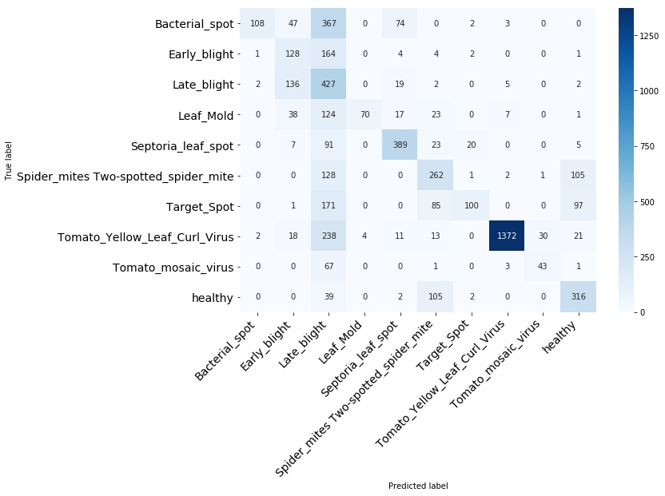
random_noise_train normal_test

Slide 5
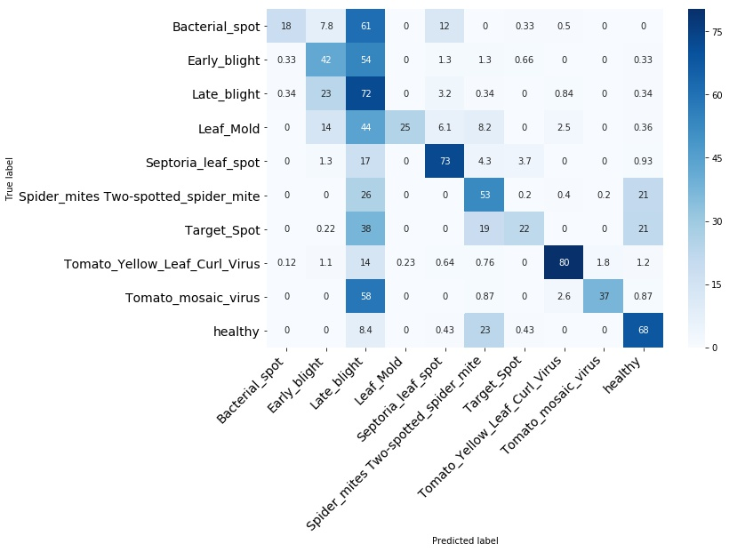
random_noise_train normal_test

Slide 6
random_noise_train normal_test
Bacterial_spot

Slide 7
random_noise_train normal_test
Early_blight

Slide 8
random_noise_train normal_test
Late_blight

Slide 9
random_noise_train normal_test
Leaf_Mold

Slide 10
random_noise_train normal_test
Septoria_leaf_spot

Slide 11
random_noise_train normal_test
Spider_mites Two-spotted_spider_mite

Slide 12
random_noise_train normal_test
Target_Spot

Slide 13
random_noise_train normal_test
Tomato_mosaic_virus

Slide 14
random_noise_train normal_test
Tomato_Yellow_Leaf_Curl_Virus

Slide 15
random_noise_train normal_test
healthy

