Slide 1
normal_train
AlexNet pretrained=True
Normalization over normal_train
0.9936524728 validation accuracy

Slide 2
normal_train

Slide 3
normal_train normal_test
Number of samples: 5554
Accuracy: 0.9985595966870724
Macro precision: 0.9983387178118982
Macro recall (Trues Rate): 0.9981732624841392
Falses Rate: 0.0018267375158607898
Macro F1: 0.9982537737496158

Slide 4
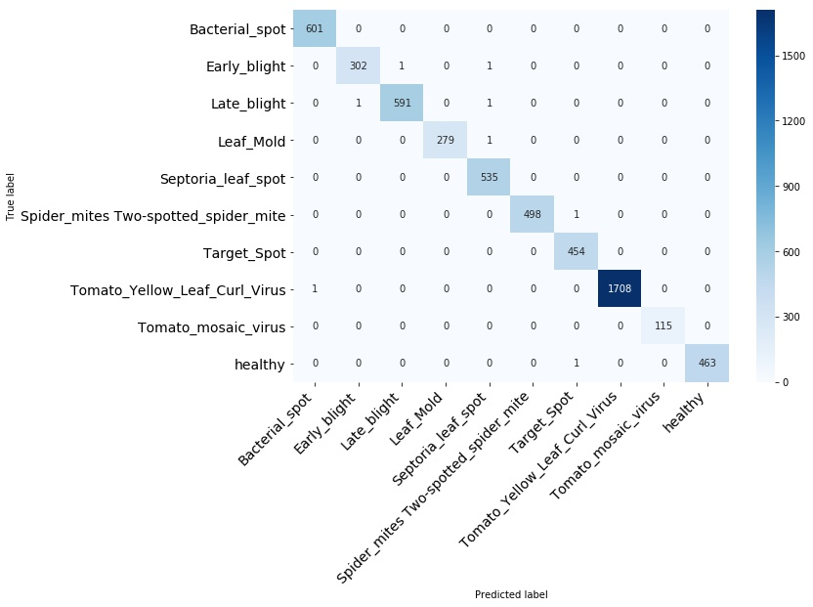
normal_train normal_test

Slide 5
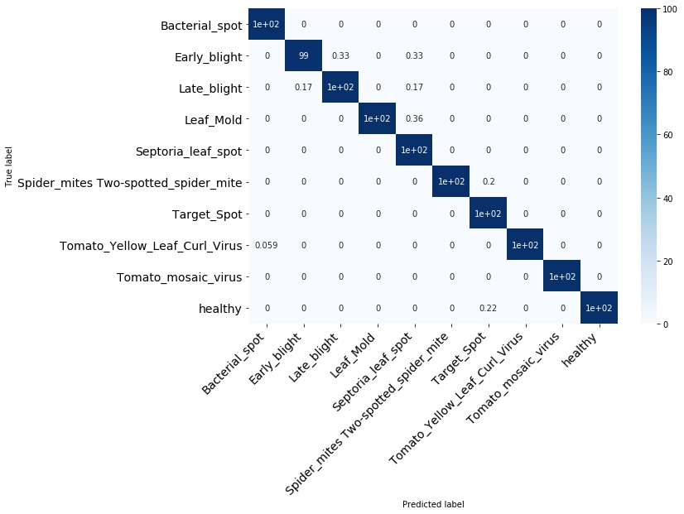
normal_train normal_test

Slide 6
normal_train normal_test
Bacterial_spot

Slide 7
normal_train normal_test
Early_blight

Slide 8
normal_train normal_test
Late_blight

Slide 9
normal_train normal_test
Leaf_Mold

Slide 10
normal_train normal_test
Septoria_leaf_spot

Slide 11
normal_train normal_test
Spider_mites Two-spotted_spider_mite

Slide 12
normal_train normal_test
Target_Spot

Slide 13
normal_train normal_test
Tomato_Yellow_Leaf_Curl_Virus

Slide 14
normal_train normal_test
Tomato_mosaic_virus

Slide 15
normal_train normal_test
healthy

Slide 16
normal_train segmented_test
Number of samples: 5554
Accuracy: 0.390169247389269
Macro precision: nan
Macro recall (Trues Rate): 0.28587678980013226
Falses Rate: 0.7141232101998677
Macro F1: nan

Slide 17
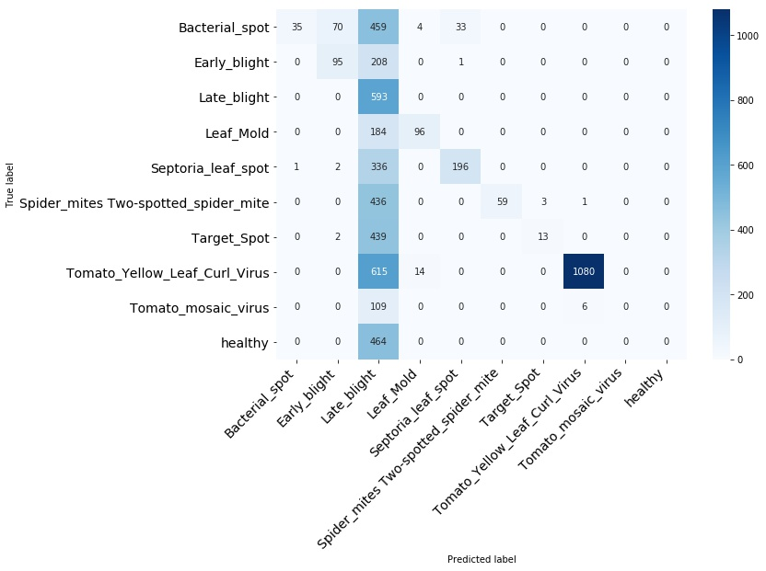
normal_train segmented_test

Slide 18
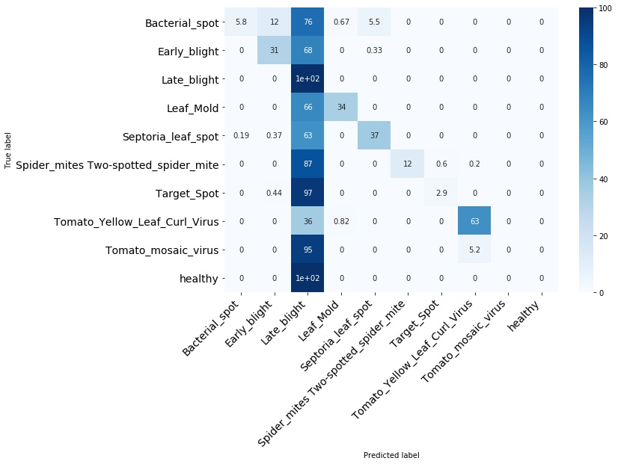
normal_train segmented_test

Slide 19
normal_train segmented_test
Bacterial_spot

Slide 20
normal_train segmented_test
Early_blight

Slide 21
normal_train segmented_test
Late_blight

Slide 22
normal_train segmented_test
Leaf_Mold

Slide 23
normal_train segmented_test
Septoria_leaf_spot

Slide 24
normal_train segmented_test
Spider_mites Two-spotted_spider_mite

Slide 25
normal_train segmented_test
Target_Spot

Slide 26
normal_train segmented_test
Tomato_Yellow_Leaf_Curl_Virus

Slide 27
normal_train segmented_test
Tomato_mosaic_virus

Slide 28
normal_train segmented_test
healthy

