Slide 1
image_normalization_train
AlexNet pretrained=True
Normalization per image
0.982119551 validation accuracy

Slide 2
image_normalization_train

Slide 3
image_normalization_train normal_test
Number of samples: 5554
Accuracy: 0.9827151602448686
Macro precision: 0.9810601560394691
Macro recall (Trues Rate): 0.9773620057353387
Falses Rate: 0.02263799426466118
Macro F1: 0.9790585607825915

Slide 4
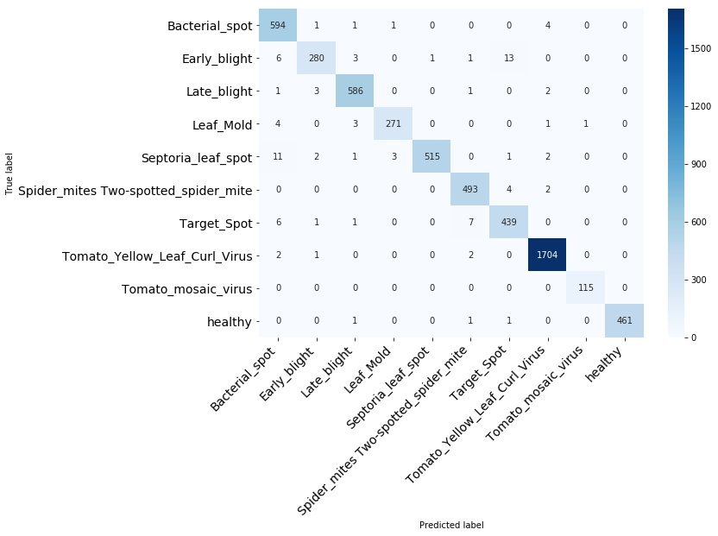
image_normalization_train normal_test

Slide 5
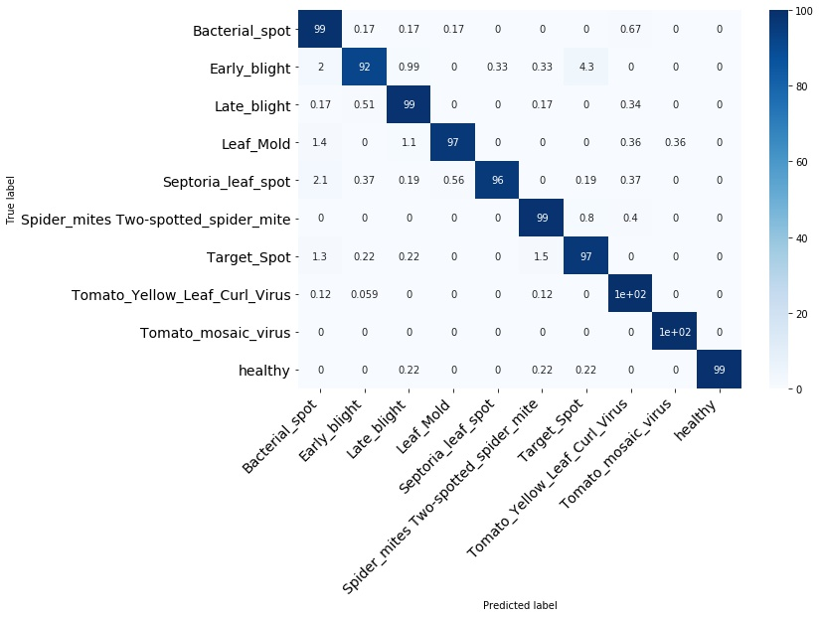
image_normalization_train normal_test

Slide 6
image_normalization_train normal_test
Bacterial_spot

Slide 7
image_normalization_train normal_test
Early_blight

Slide 8
image_normalization_train normal_test
Late_blight

Slide 9
image_normalization_train normal_test
Leaf_Mold

Slide 10
image_normalization_train normal_test
Septoria_leaf_spot

Slide 11
image_normalization_train normal_test
Spider_mites Two-spotted_spider_mite

Slide 12
image_normalization_train normal_test
Target_Spot

Slide 13
image_normalization_train normal_test
Tomato_Yellow_Leaf_Curl_Virus

Slide 14
image_normalization_train normal_test
Tomato_mosaic_virus

Slide 15
image_normalization_train normal_test
healthy

Slide 16
image_normalization_train segmented_test
Number of samples: 5554
Accuracy: 0.390169247389269
Macro precision: nan
Macro recall (Trues Rate): 0.28587678980013226
Falses Rate: 0.7141232101998677
Macro F1: nan

Slide 17
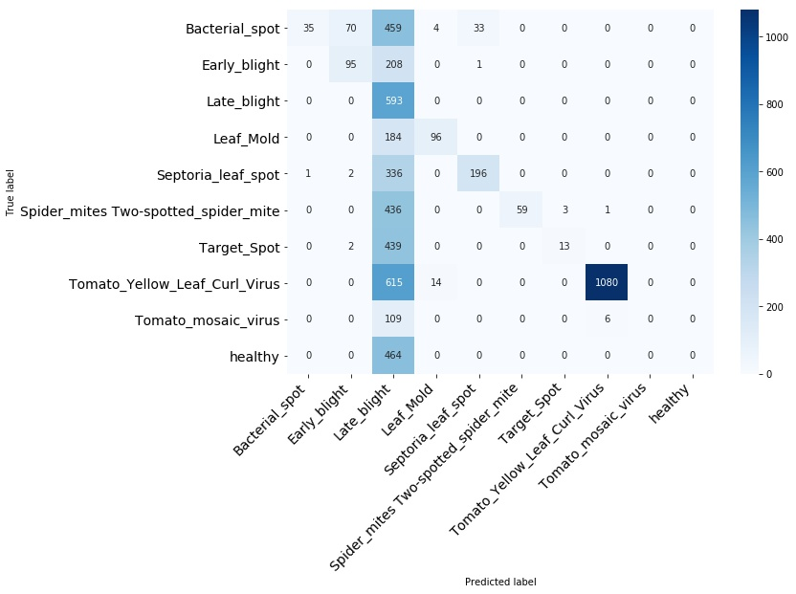
normal_train segmented_test

Slide 18
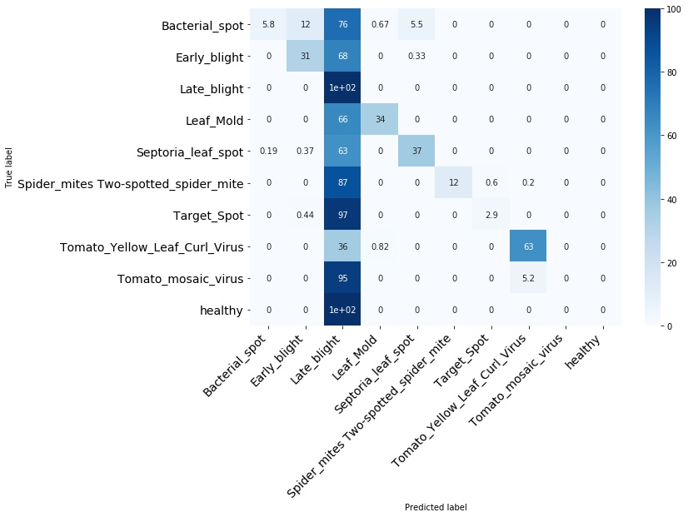
normal_train segmented_test

Slide 19
normal_train segmented_test
Bacterial_spot

Slide 20
normal_train segmented_test
Early_blight

Slide 21
normal_train segmented_test
Late_blight

Slide 22
normal_train segmented_test
Leaf_Mold

Slide 23
normal_train segmented_test
Septoria_leaf_spot

Slide 24
normal_train segmented_test
Spider_mites Two-spotted_spider_mite

Slide 25
normal_train segmented_test
Target_Spot

Slide 26
normal_train segmented_test
Tomato_Yellow_Leaf_Curl_Virus

Slide 27
normal_train segmented_test
Tomato_mosaic_virus

Slide 28
normal_train segmented_test
healthy

