Slide 1
image_normalization_train
AlexNet pretrained=True
Normalization per image
0.982119551 validation accuracy
/

Slide 2
image_normalization_train
/

Slide 3
image_normalization_train normal_test
Number of samples: 5554
Accuracy: 0.9827151602448686
Macro precision: 0.9810601560394691
Macro recall (Trues Rate): 0.9773620057353387
Falses Rate: 0.02263799426466118
Macro F1: 0.9790585607825915
/

Slide 4
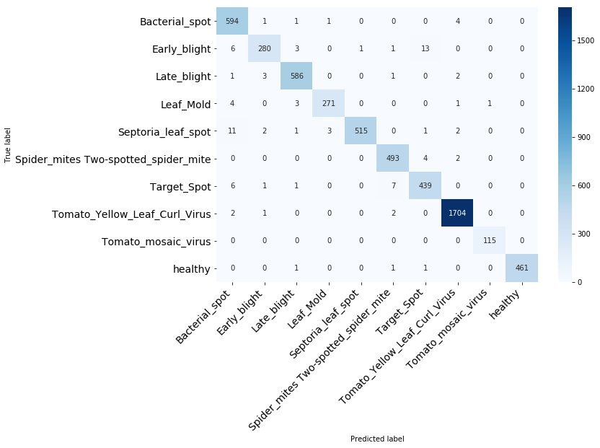
image_normalization_train normal_test
/

Slide 5
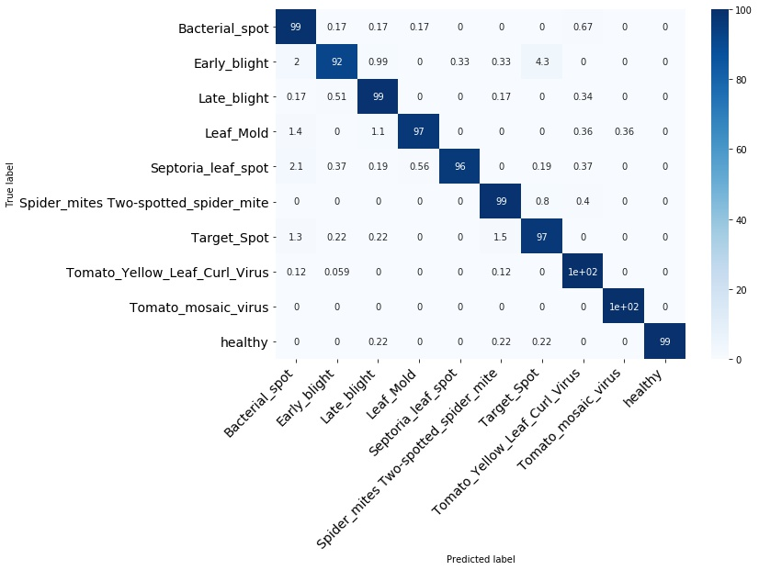
image_normalization_train normal_test
/

Slide 6
image_normalization_train normal_test
Bacterial_spot
/

Slide 7
image_normalization_train normal_test
Early_blight
/

Slide 8
image_normalization_train normal_test
Late_blight
/

Slide 9
image_normalization_train normal_test
Leaf_Mold
/

Slide 10
image_normalization_train normal_test
Septoria_leaf_spot
/

Slide 11
image_normalization_train normal_test
Spider_mites Two-spotted_spider_mite
/

Slide 12
image_normalization_train normal_test
Target_Spot
/

Slide 13
image_normalization_train normal_test
Tomato_Yellow_Leaf_Curl_Virus
/

Slide 14
image_normalization_train normal_test
Tomato_mosaic_virus
/

Slide 15
image_normalization_train normal_test
healthy
/

Slide 16
image_normalization_train segmented_test
Number of samples: 5554
Accuracy: 0.5527547713359741
Macro precision: 0.8243354532088749
Macro recall (Trues Rate): 0.41409285709328275
Falses Rate: 0.5859071429067173
Macro F1: 0.41129353538339664
/

Slide 17
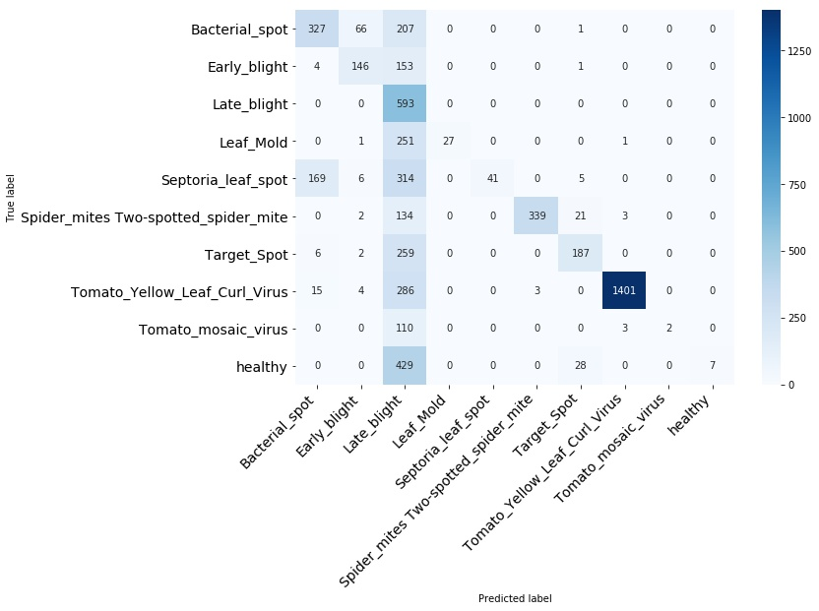
image_normalization_train segmented_test
/

Slide 18
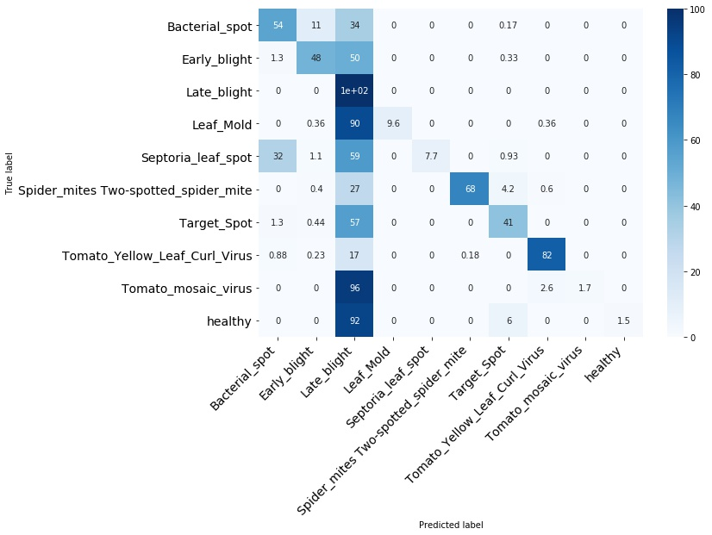
image_normalization_train segmented_test
/

Slide 19
image_normalization_train segmented_test
Bacterial_spot
/

Slide 20
image_normalization_train segmented_test
Early_blight
/

Slide 21
image_normalization_train segmented_test
Late_blight
/

Slide 22
image_normalization_train segmented_test
Leaf_Mold
/

Slide 23
image_normalization_train segmented_test
Septoria_leaf_spot
/

Slide 24
image_normalization_train segmented_test
Spider_mites Two-spotted_spider_mite
/

Slide 25
image_normalization_train segmented_test
Target_Spot
/

Slide 26
image_normalization_train segmented_test
Tomato_Yellow_Leaf_Curl_Virus
/

Slide 27
image_normalization_train segmented_test
Tomato_mosaic_virus
/

Slide 28
image_normalization_train segmented_test
healthy
/

