Slide 1
random_background_image
AlexNet pretrained=True
Normalization over random_image_background
0.9496215087444532 validation accuracy
/

Slide 2
random_background_image
/

Slide 3
random_background_image normal_test
Number of samples: 5554
Accuracy: 0.5183651422398271
Macro precision: 0.5056492168175747
Macro recall (Trues Rate): 0.5133787440725307
Falses Rate: 0.48662125592746946
Macro F1: 0.4198608279266933
/

Slide 4
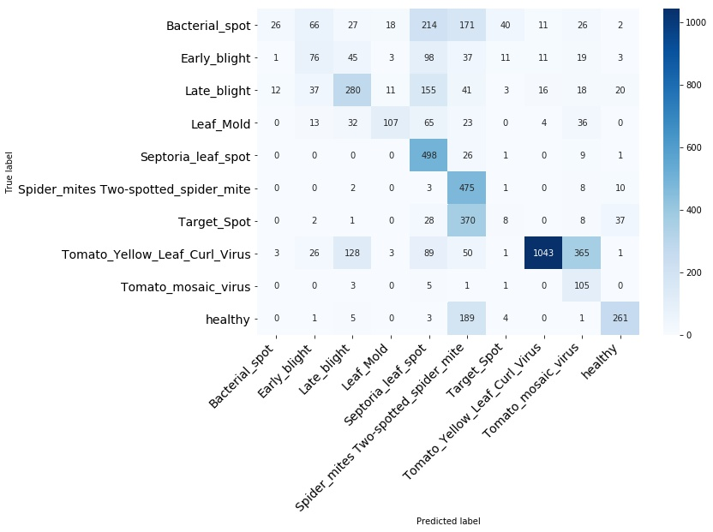
random_background_image normal_test
/

Slide 5
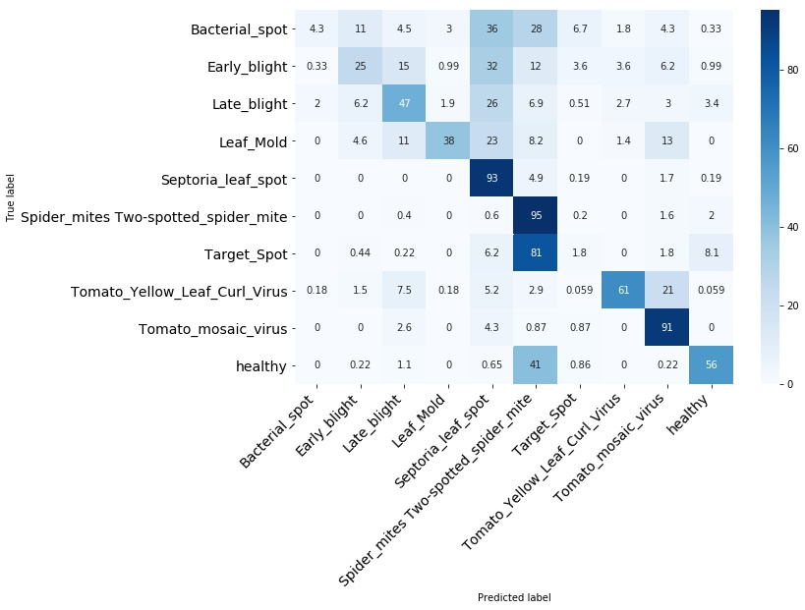
random_background_image normal_test
/

Slide 6
random_background_image normal_test
Bacterial_spot
/

Slide 7
random_background_image normal_test
Early_blight
/

Slide 8
random_background_image normal_test
Late_blight
/

Slide 9
random_background_image normal_test
Leaf_Mold
/

Slide 10
random_background_image normal_test
Septoria_leaf_spot
/

Slide 11
random_background_image normal_test
Spider_mites Two-spotted_spider_mite
/

Slide 12
random_background_image normal_test
Target_Spot
/

Slide 13
random_background_image normal_test
Tomato_mosaic_virus
/

Slide 14
random_background_image normal_test
Tomato_Yellow_Leaf_Curl_Virus
/

Slide 15
random_background_image normal_test
healthy
/

