Slide 1
random_crops_train
AlexNet pretrained=True
Normalization over normal_train
0.9658052727747 validation accuracy

Slide 2
random_crops_train

Slide 3
random_crops_train normal_test
Number of samples: 5554
Accuracy: 0.7691753691033489
Macro precision: 0.7943445225846811
Macro recall (Trues Rate): 0.673085317753261
Falses Rate: 0.3269146822467389
Macro F1: 0.6715272138432171

Slide 4
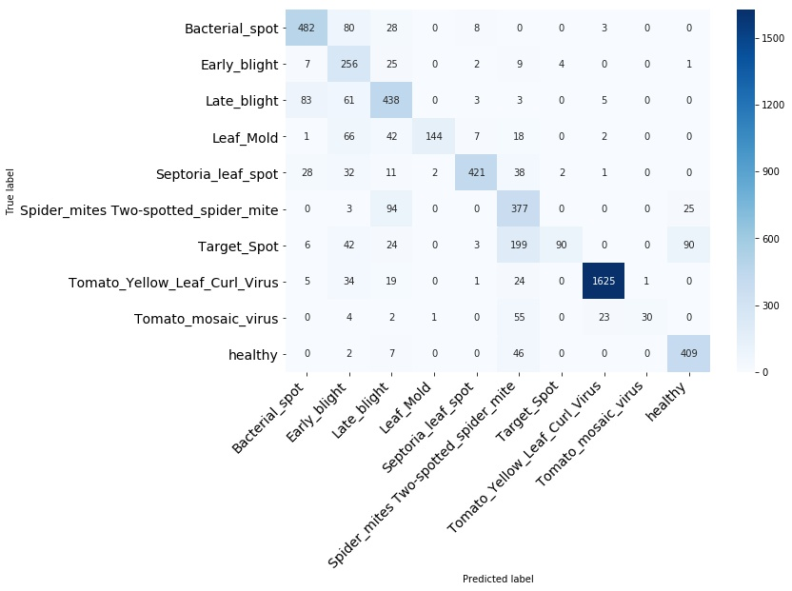
random_crops_train normal_test

Slide 5
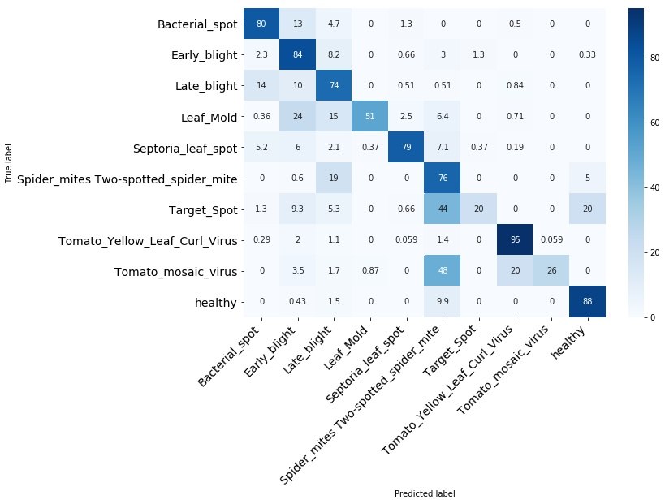
random_crops_train normal_test

Slide 6
random_crops_train normal_test
Bacterial_spot

Slide 7
random_crops_train normal_test
Early_blight

Slide 8
random_crops_train normal_test
Late_blight

Slide 9
random_crops_train normal_test
Leaf_Mold

Slide 10
random_crops_train normal_test
Septoria_leaf_spot

Slide 11
random_crops_train normal_test
Spider_mites Two-spotted_spider_mite

Slide 12
random_crops_train normal_test
Target_Spot

Slide 13
random_crops_train normal_test
Tomato_Yellow_Leaf_Curl_Virus

Slide 14
random_crops_train normal_test
Tomato_mosaic_virus

Slide 15
random_crops_train normal_test
healthy

Slide 16
random_crops_train segmented_test
Number of samples: 5554
Accuracy: 0.8480374504861361
Macro precision: 0.8855440150561821
Macro recall (Trues Rate): 0.7374316837681061
Falses Rate: 0.26256831623189403
Macro F1: 0.7399687715004285

Slide 17
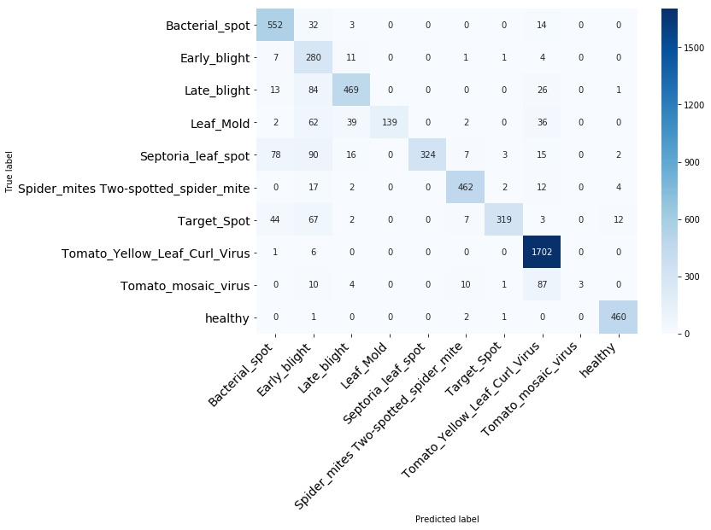
random_crops_train segmented_test

Slide 18
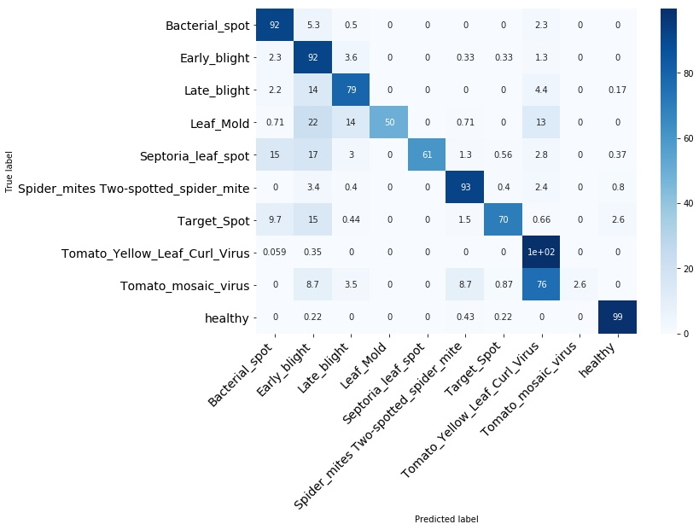
random_crops_train segmented_test

Slide 19
random_crops_train segmented_test
Bacterial_spot

Slide 20
random_crops_train segmented_test
Early_blight

Slide 21
random_crops_train segmented_test
Late_blight

Slide 22
random_crops_train segmented_test
Leaf_Mold

Slide 23
random_crops_train segmented_test
Septoria_leaf_spot

Slide 24
random_crops_train segmented_test
Spider_mites Two-spotted_spider_mite

Slide 25
random_crops_train segmented_test
Target_Spot

Slide 26
random_crops_train segmented_test
Tomato_Yellow_Leaf_Curl_Virus

Slide 27
random_crops_train segmented_test
Tomato_mosaic_virus

Slide 28
random_crops_train segmented_test
healthy

