Slide 1
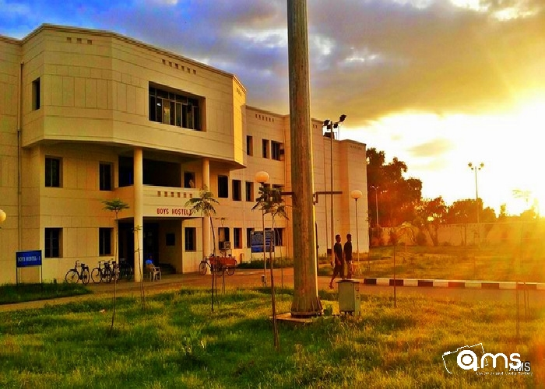

Slide 2
Project Report On Hostel Management System
Submitted to :-
Dr. Amrita chaturvedi
28-04-2017
Notes:
2
Hostel Management System

Slide 3
DBMS Project
…
Nimish Dusad(IIT2015509)
Raghav Tayal(ISM2015007)
Ankit Singh(ITM2015009)
Mritunjay Chaudhary(BIM2015004)

Slide 4
Acknowledgements
We would like to express our heartfelt gratitude to our Professor Dr. Amrita Chaturvedi as well as our TA’s who gave us this opportunity to work on the project on the topic Hostel Management System.
A shoutout to everyone who contributed directly or indirectly towards building the project.
28-04-2017

Slide 5
Introduction
In general in all institutions’ hostels are managed manually by the hostel office and hence there is a lot of strain on the person who are running the hostel and software’s are not usually used in this context. This particular project deals with the problems on managing a hostel and designing of computerized system that will be compatible to the existing system with the system which is more user friendly and more GUI oriented.
28-04-2017

Slide 6
Scope:-
The software can be implemented in any academic institution for hostel management system. Student registration, meal options and account books for individual students can be managed accordingly.
28-04-2017

Slide 7

Tools we’ve Used
This project is designed as a desktop application on Windows 10.
Java Swing and JavaFX(Front end).
PHP and MYSQL(Back End).
Google :P

Slide 8
Overview
This Java application uses PHP and MySQL for backend operations.
Main facilities available in this project are :-
Managing Student Fee and meal options.
View seat availability in different hostels.
Student Registration for hostel and room allotment.
Details of Account status to be checked by student.
Option for fee extension application and meal change options
28-04-2017

Slide 9
Salient Features
Student Login
Student login is used by students to login to their individual account and check their account status, meal selection, fee extension application and logout.
2. Admin Login
Admin login is provided for administrative purposes. The username and password are validated on server and user is provided access. The user is provided with four options seat allotment, mess corner, accounts and logout.
28-04-2017

Slide 10
3. Seat Availability
This option is provided in the home panel to check if there is seat available in hostels. The benefit of this is user (either student or admin) don’t have to go through the trouble of logging in to check this. Students can check for seat prior to going for registration.
4. About
This section provides an overview of functionalities of project and technologies used.
28-04-2017

Slide 11
Functionalities Offered
Student panel
1. Account Book
Students can check their registration details.
They can check the dates till their fees are paid for hostel and mess.
They can view the next due date for payment of fees.
2. Meal Corner
Students are provided with 3 options for meal decision for current day.
Veg meal
Non-veg meal
Meal off for the day
3. Fee Extension
Students can upload an application for fee extension and send it to admin for review.
4. Logout
When user presses logout he is returned to the home panel and session is closed.

Slide 12
Admin Panel
1. Seat Allotment
The Administrator is provided with a registration form with all the necessary details to be filled. Once he clicks the allot button all necessary changes are made to the database on server.
2. Accounts
Administrator can manage the accounts of individual students. The functions provided in there are:
Search student by name.
Open accounts of particular student by roll number.
View and approve fee extension application of students.
Update the accounts of students.
3. Mess Corner
Hostel authorities can check how many student have selected vegetarian, non-vegetarian or meal off option.
4. Logout
When user presses logout he is returned to the home panel and session is closed.
28-04-2017

Slide 13
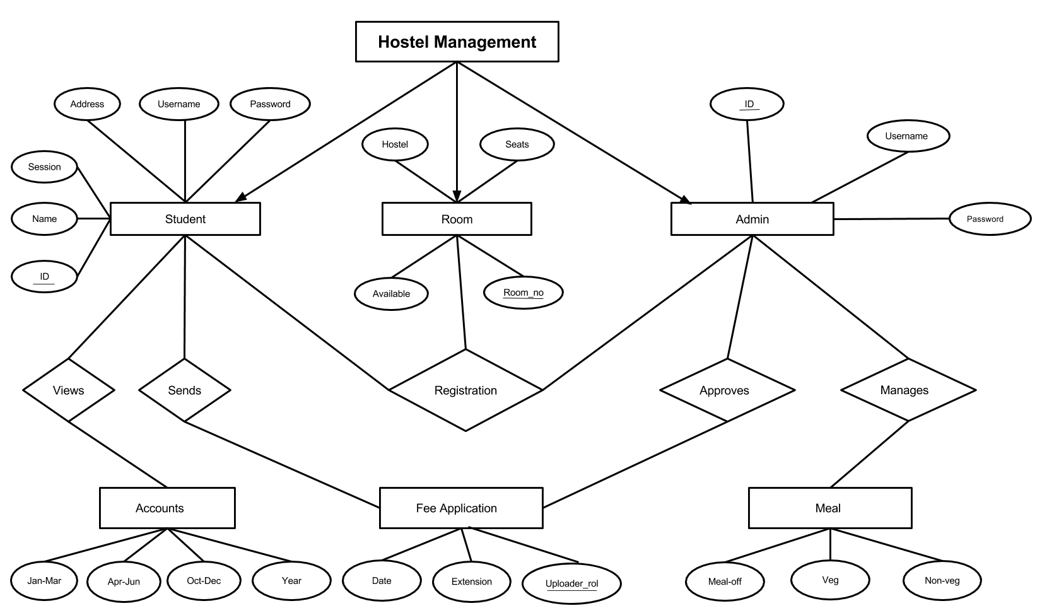
E-R Diagram
28-04-2017

Slide 14
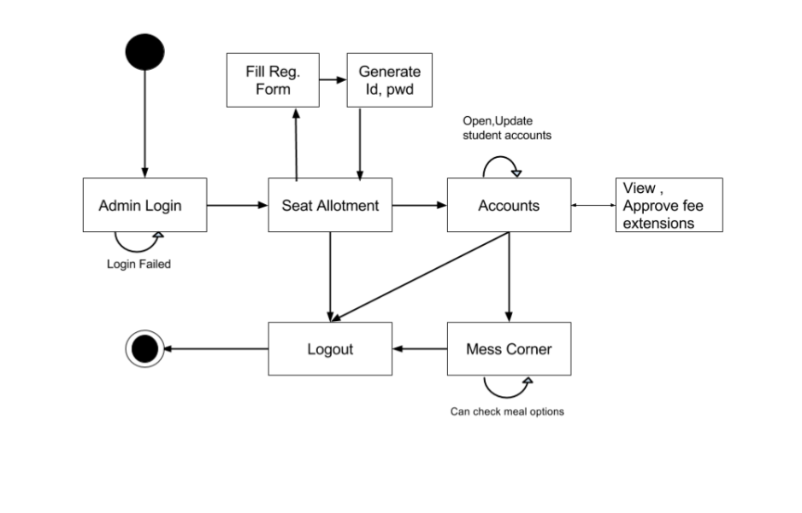
State Chart Diagram Server End

Slide 15
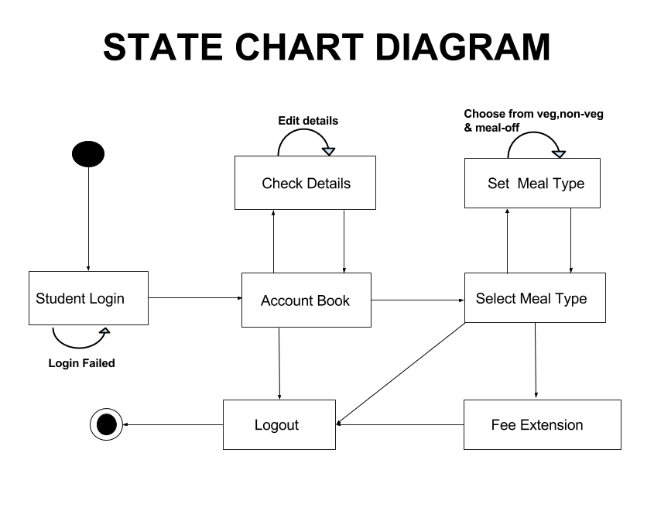
StateChart Diagram For Client End

Slide 16
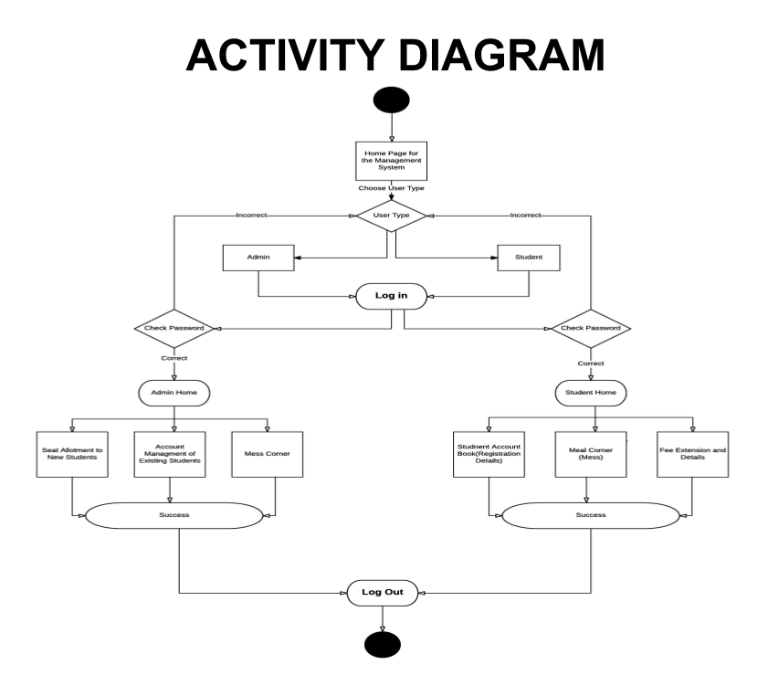
Activity Diagram

Slide 17
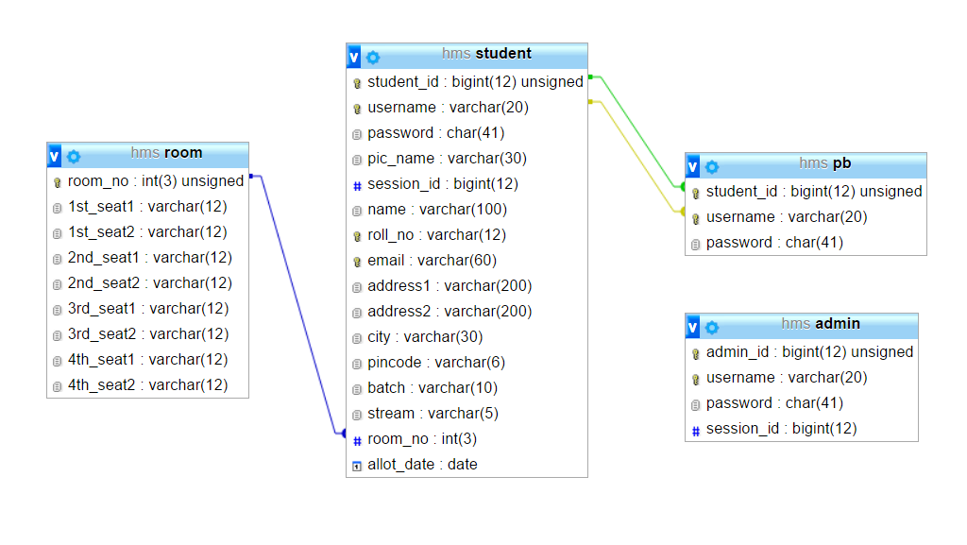
Relational Schema Of The Project

Slide 18
Functional Dependencies
Functional dependencies (FDs)
Are used to specify formal measures of the "goodness" of relational designs
And keys are used to define normal forms for relations
Are constraints that are derived from the meaning and interrelationships of the data attributes.

Slide 19
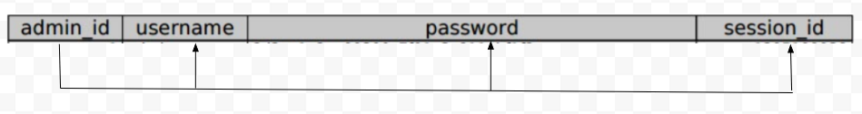
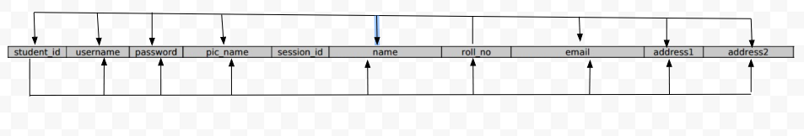
Dependencies in The Project
Admin Table
Student Table

Slide 20

SCREEN SHOTS
Here are some ScreenShots From The Working Application

Slide 21
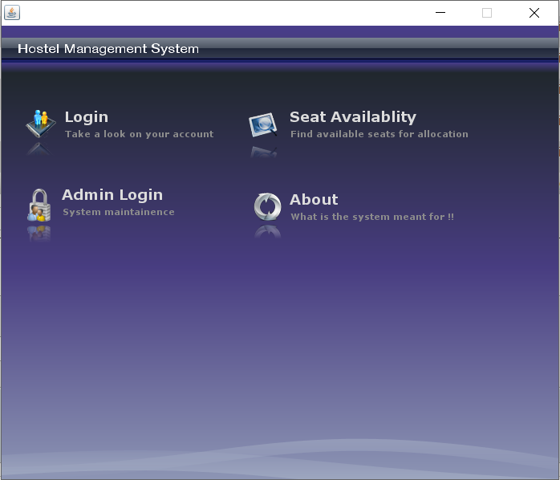
StartUp Panel

Slide 22
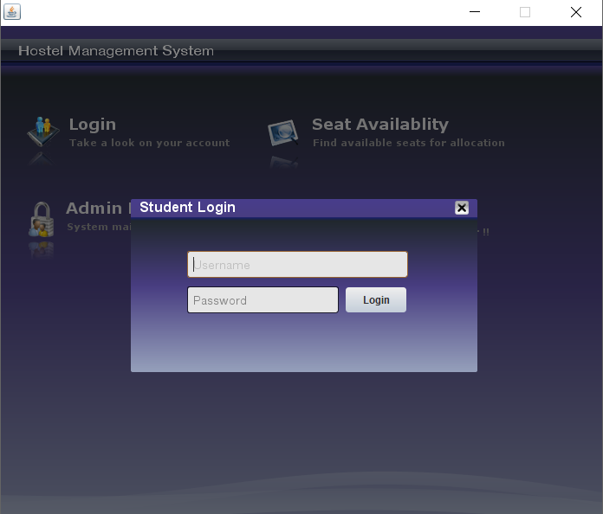
Student Login Panel

Slide 23
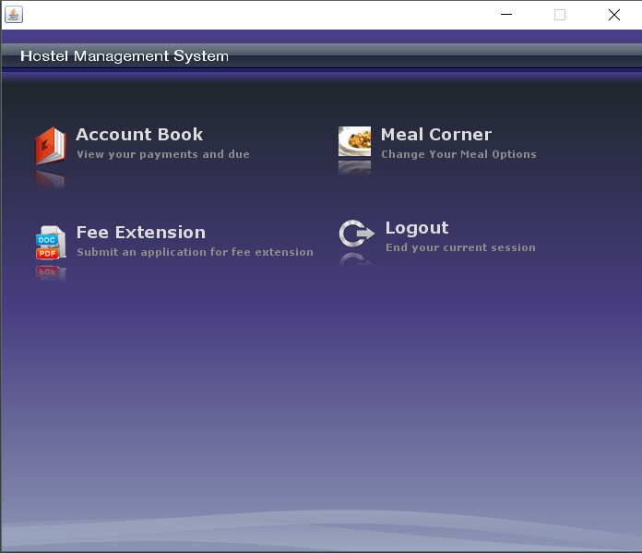
Student Logged Panel

Slide 24
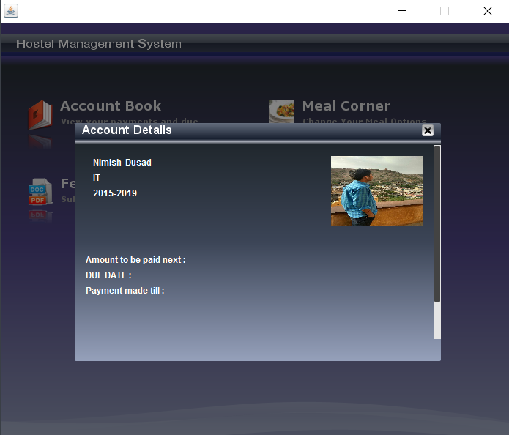
Student Account’s Section

Slide 25
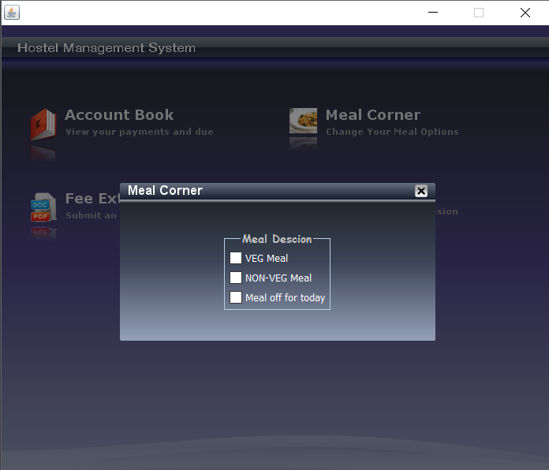
Meal Corner for Students

Slide 26
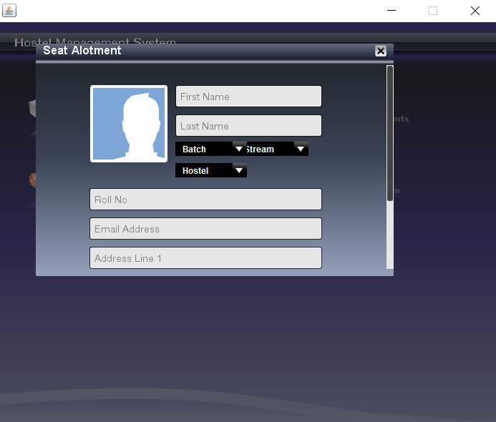
Seat Allotment Panel

Slide 27
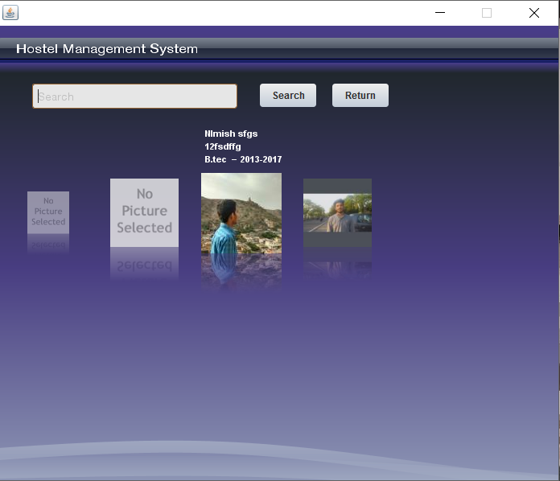
SEARCH AND ACCOUNT MANAGEMENT

Slide 28
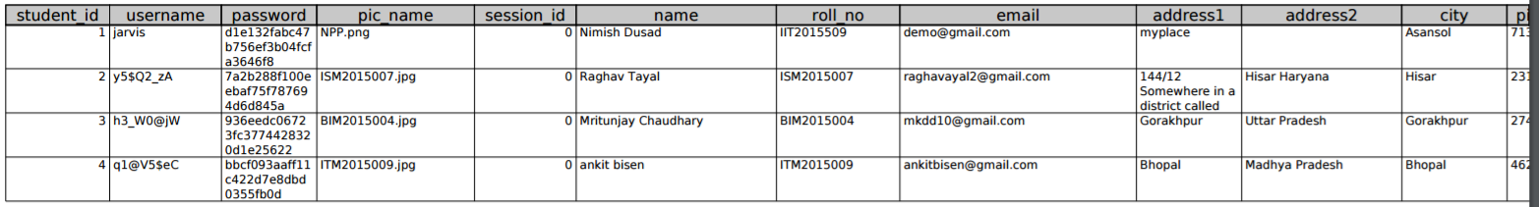
Tables Created in The Database
Admin Table
Student Table

Slide 29
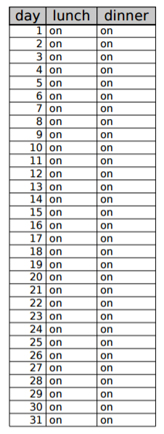
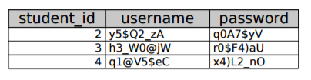
Tables Created in The Database
Meal Table
Password Table

Slide 30
Tables Created in The Database
Fee Table

Slide 31
Normalization Of Tables
Normalization:
The process of decomposing unsatisfactory "bad" relations by breaking up their attributes into smaller relations
Normal form:
Condition using keys and FDs of a relation to certify whether a relation schema is in a particular normal form
First normal form (1NF)
Second normal form (2NF)
Third normal form (3NF)
Boyce-Codd normal form (BCNF)

Slide 32
1st NORMAL FORM
Disallows :-
composite attributes
multivalued attributes
nested relations; attributes whose values for an individual tuple are non-atomic.
We’ve created all the tables such that No duplicate entry of data is Allowed, thus ensuring that the tables are in 1NF.

Slide 33
2nd Normal Form
A relation schema R is in second normal form (2NF) if every non-prime attribute A in R is fully functionally dependent on the primary key
R can be decomposed into 2NF relations via the process of 2NF normalization
All the Tables have a Single Primary key Attribute , thus Ensuring a 2-NF for the relational schema.

Slide 34
3rd Normal Form
A relation schema R is in third normal form (3NF) if it is in 2NF and no non-prime attribute A in R is transitively dependent on the primary key
R can be decomposed into 3NF relations via the process of 3NF normalization .

Slide 35
FUTURE PLANS
Extension of the Offline Database System to an Online Linkage via extrinsic Server Handling.
Improvisation in the Seat Allotment Procedure used .
Mailing Facility for every event related to an Enrolled Student on the Database.

Slide 36
Bibliography
www.google.com
www.bing.com
Java swing O’REILLY
A definitive guide to java swing by John Zukowski
Database System Concepts by SilberSchatz
Java Complete Reference by Herbert Schildt
www.stackoverflow.com

