Slide 1
9/9/2020
ArchUnit
ArchUnit
1/33

Slide 2
Overview
ArchUnit
Motivation Challenges
Continuous Architecture How ArchUnit can help Demo
Try it yourself
http://localhost:8080/?print-pdf#/ 2/33

Slide 3
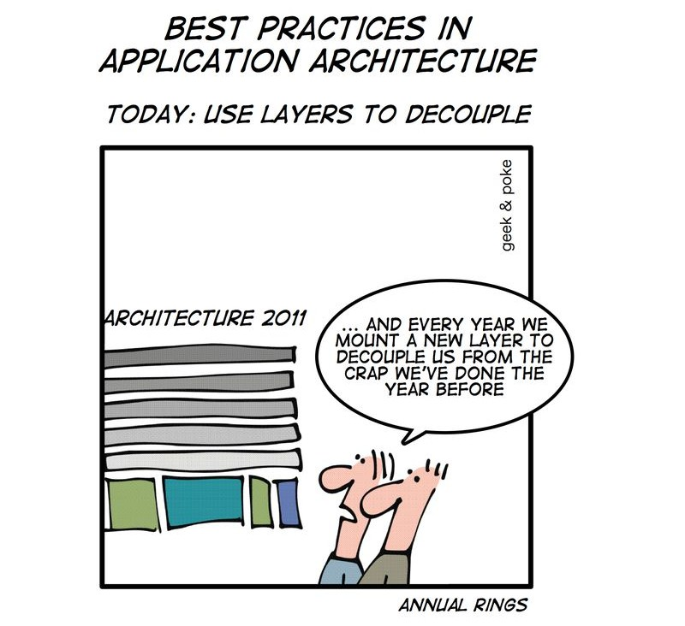
6/2/2018 ArchUnit
http://localhost:8080/?print-pdf#/ 3/33

Slide 4
Aspects affected by software
6/2/2018 ArchUnit
http://localhost:8080/?print-pdf#/ 4/33
architecture
Maintainability/Extensibility Reusability
Onboarding

Slide 5
Evolution of software
6/2/2018 ArchUnit
http://localhost:8080/?print-pdf#/ 5/33
Features Technical Dept Bugs
Costs
1
2
3
4
5
6
7
8
9
10

Slide 6
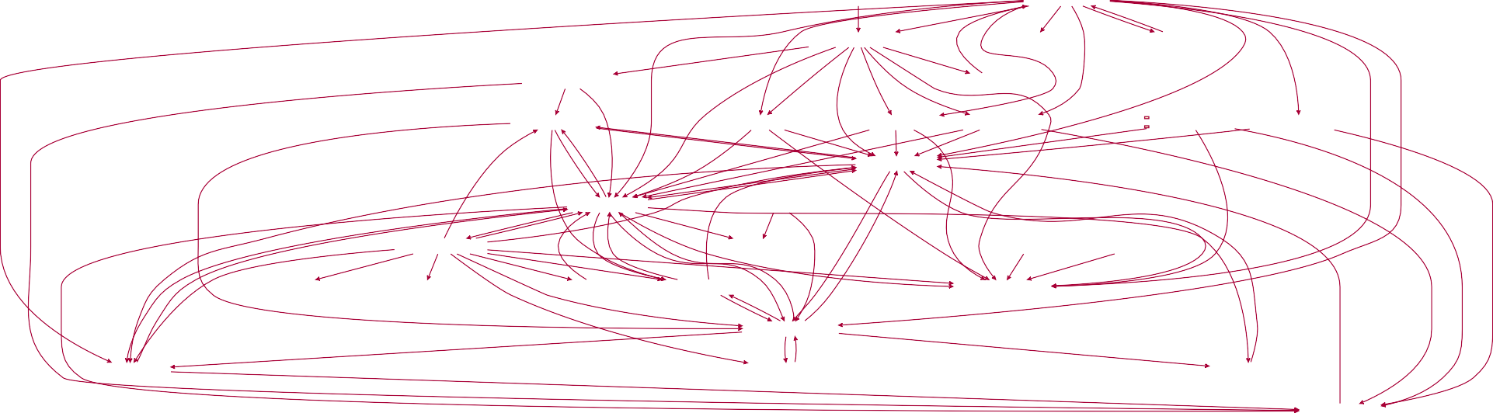
Dependencies
6/2/2018 ArchUnit
http://localhost:8080/?print-pdf#/ 6/33
edu.umd.cs.findbugs.anttask
edu.umd.cs.findbugs.gui2
edu.umd.cs.findbugs.workflow
edu.umd.cs.findbugs.gui
edu.umd.cs.findbugs.sourceViewer
edu.umd.cs.findbugs.model
edu.umd.cs.findbugs.launchGUI
edu.umd.cs.findbugs.bcel
edu.umd.cs.findbugs.config
edu.umd.cs.findbugs.cloud
edu.umd.cs.findbugs.filter
edu.umd.cs.findbugs.tools edu.umd.cs.findbugs.updates
edu.umd.cs.findbugs.util
edu.umd.cs.findbugs.ba
edu.umd.cs.findbugs.plan
edu.umd.cs.findbugs.detect
edu.umd.cs.findbugs.graph
edu.umd.cs.findbugs.jaif
edu.umd.cs.findbugs.bugReporter
edu.umd.cs.findbugs.formatStringChecker edu.umd.cs.findbugs.annotations
edu.umd.cs.findbugs.props
edu.umd.cs.findbugs.visitclass
edu.umd.cs.findbugs.charsets
edu.umd.cs.findbugs.classfile
edu.umd.cs.findbugs.log
edu.umd.cs.findbugs.asm
edu.umd.cs.findbugs.io
edu.umd.cs.findbugs.xml

Slide 7
Reusability
6/2/2018 ArchUnit
http://localhost:8080/?print-pdf#/ 7/33
6/2/2018 ArchUnit
http://localhost:8080/?print-pdf#/ 8/33
Product A
Product B
Shared Components
Components A
Components B
Search
XML Messages
Persistence A
Web UI
Persistence B

Slide 8
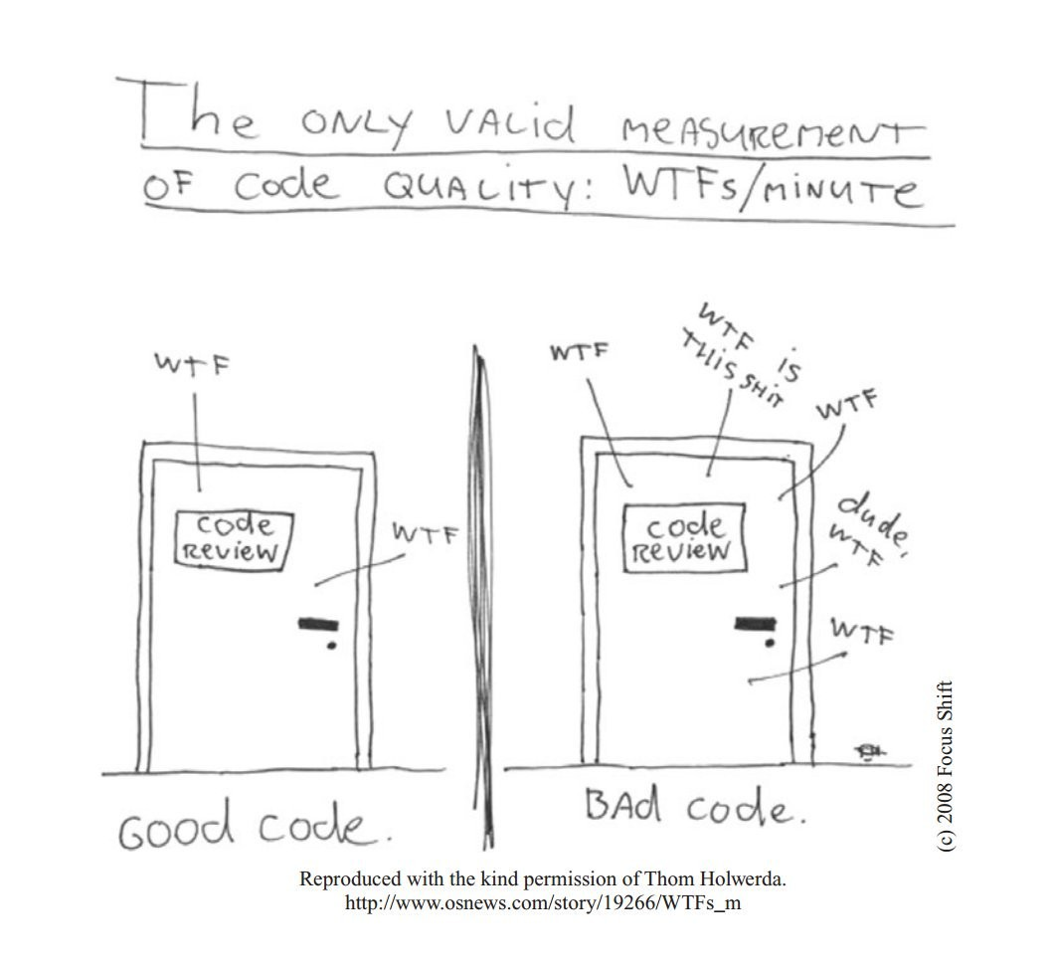
Onboarding
6/2/2018 ArchUnit
http://localhost:8080/?print-pdf#/ 9/33

Slide 9
6/2/2018 ArchUnit
http://localhost:8080/?print-pdf#/ 10/33
Overview Motivation Challenges
Continuous Architecture How ArchUnit can help Demo
Try it yourself

Slide 10
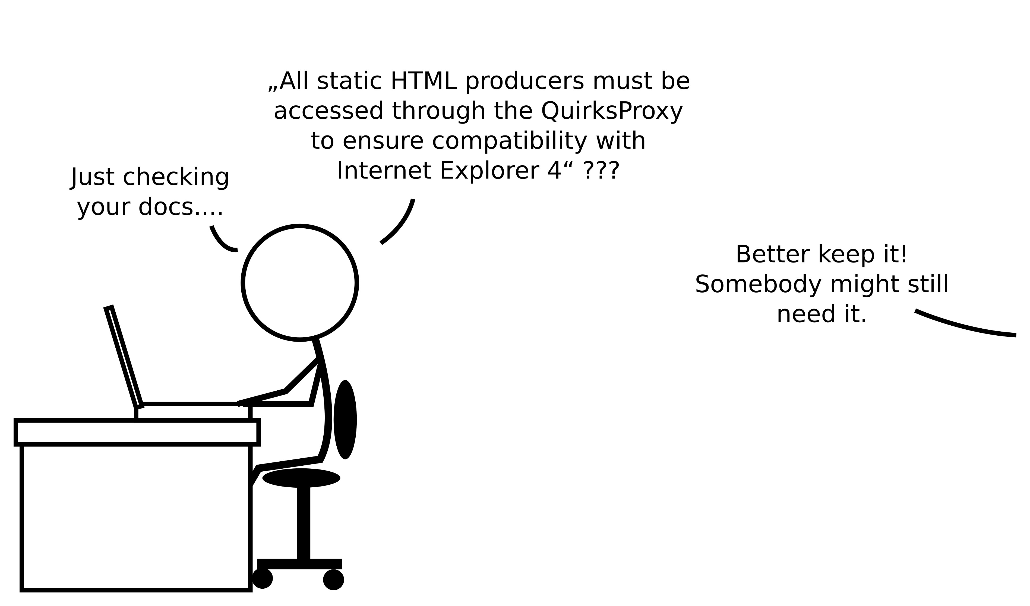
Documentation
6/2/2018 ArchUnit
http://localhost:8080/?print-pdf#/ 11/33

Slide 11
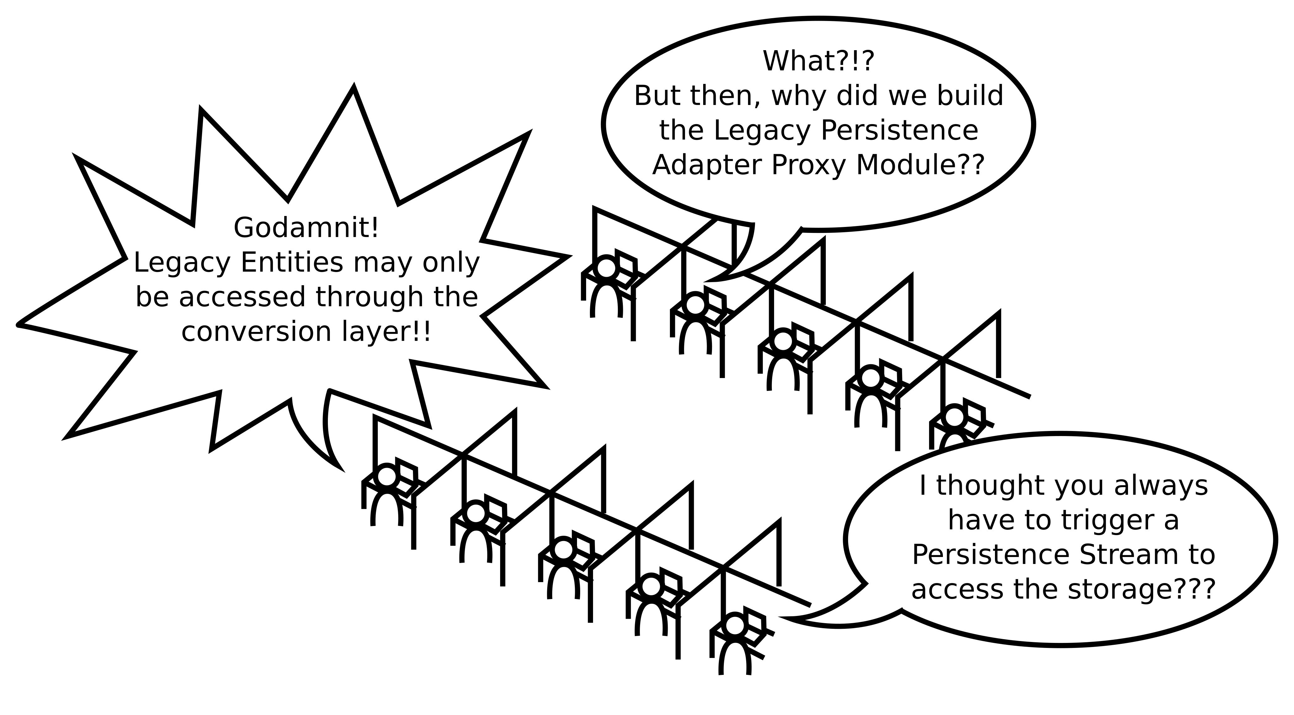
Communication
6/2/2018 ArchUnit
http://localhost:8080/?print-pdf#/ 12/33

Slide 12
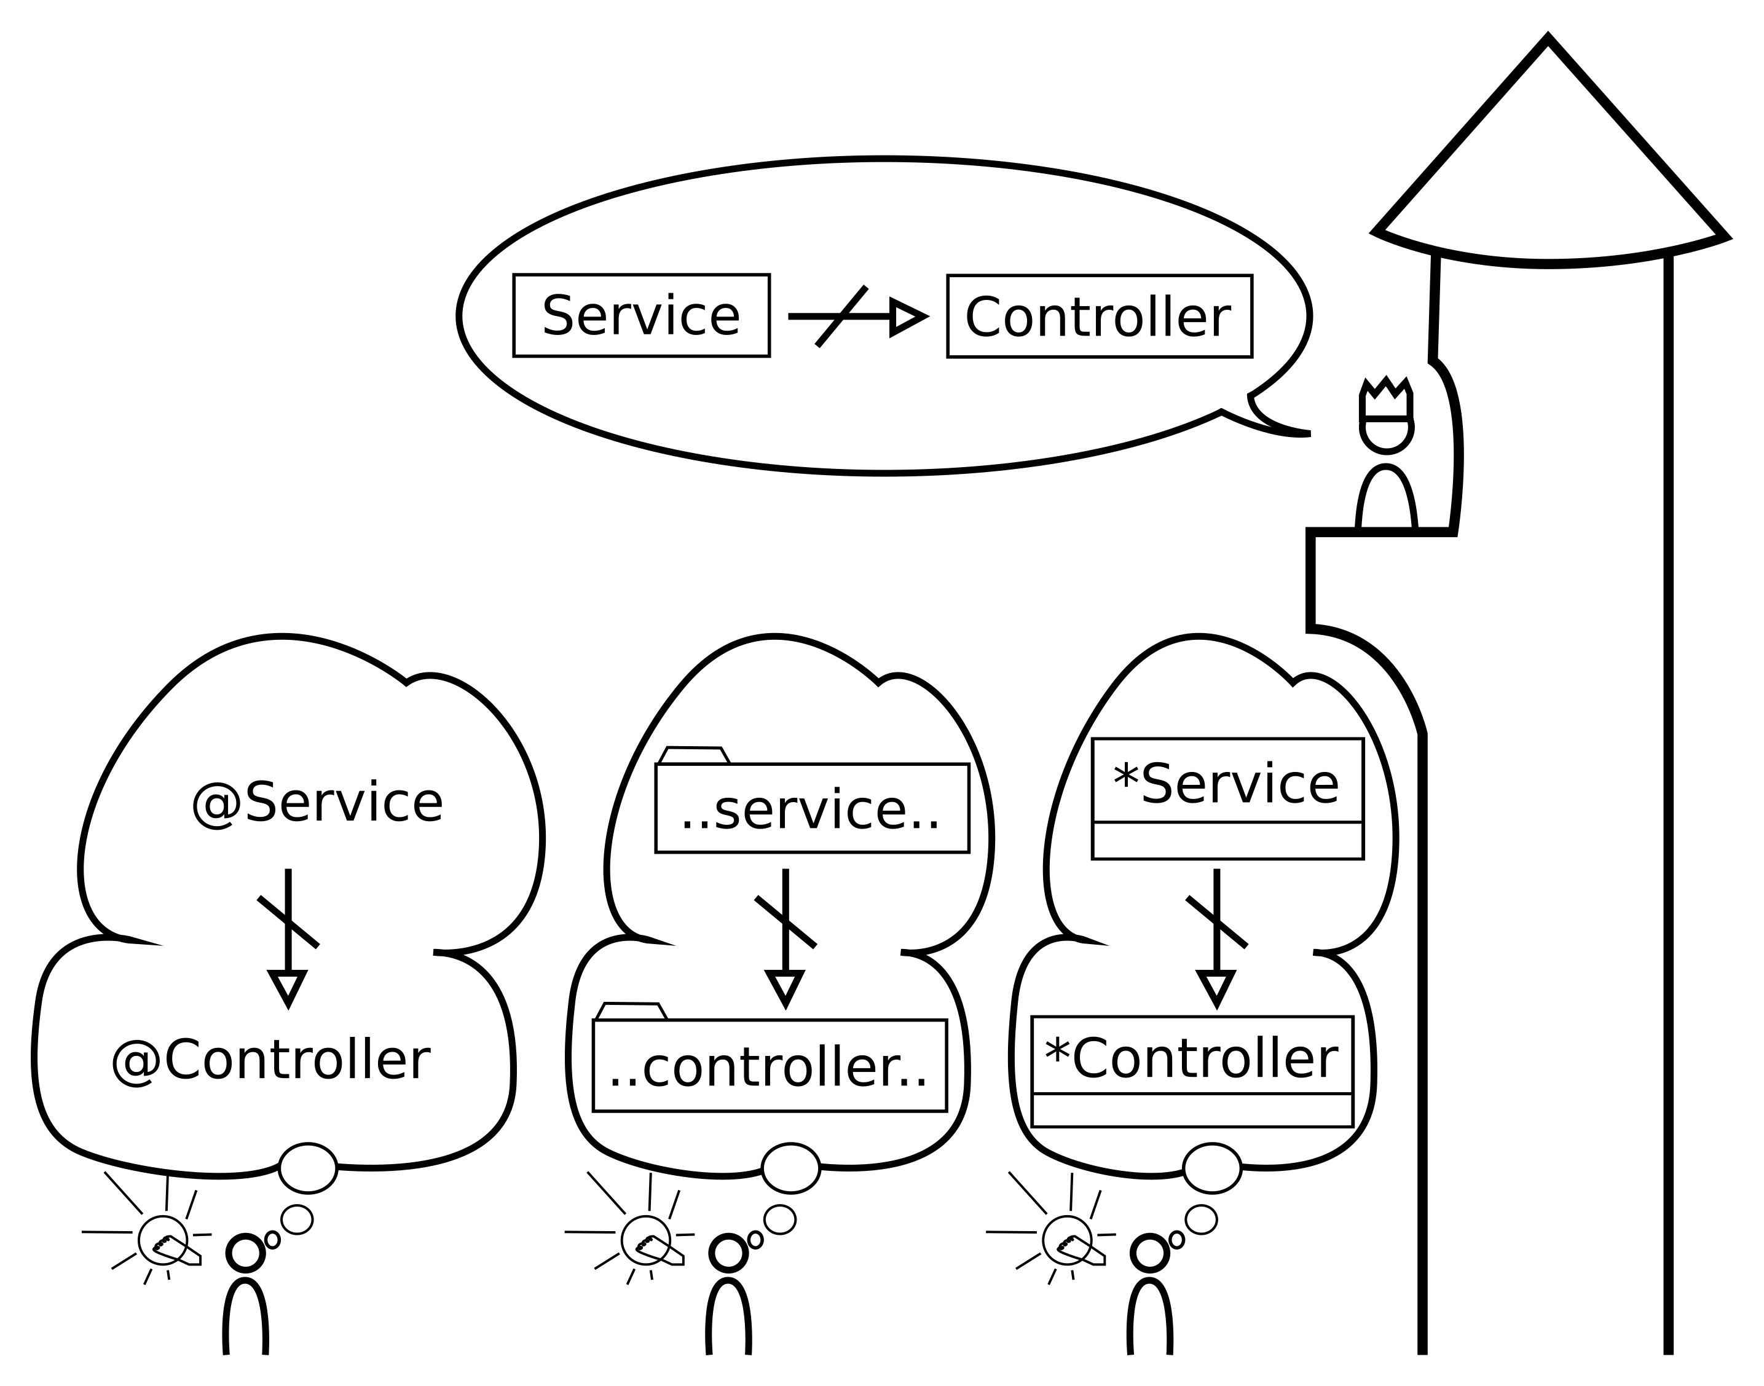
Mapping Spec to Code
6/2/2018 ArchUnit
http://localhost:8080/?print-pdf#/ 13/33

Slide 13
6/2/2018 ArchUnit
http://localhost:8080/?print-pdf#/ 14/33
Overview Motivation Challenges
Continuous Architecture How ArchUnit can help Demo
Try it yourself

Slide 14
6/2/2018 ArchUnit
http://localhost:8080/?print-pdf#/ 15/33
So how do we tackle these problems?

Slide 15
6/2/2018 ArchUnit
http://localhost:8080/?print-pdf#/ 16/33
By treating them like any other part of software development

Slide 16
With automated tests
6/2/2018 ArchUnit
http://localhost:8080/?print-pdf#/ 17/33

Slide 17
Violate the architecture...
... build server complains
6/2/2018 ArchUnit
http://localhost:8080/?print-pdf#/ 18/33

Slide 18
6/2/2018 ArchUnit
http://localhost:8080/?print-pdf#/ 19/33
Satisfying the architecture is
torture...
... update the architecture

Slide 19
Keep the architecture
6/2/2018 ArchUnit
http://localhost:8080/?print-pdf#/ 20/33
Present
Open to change Closed to volatility

Slide 20
6/2/2018 ArchUnit
http://localhost:8080/?print-pdf#/ 21/33
Overview Motivation Challenges
Continuous Architecture How ArchUnit can help Demo
Try it yourself

Slide 21
ArchUnit enables automatic
6/2/2018 ArchUnit
http://localhost:8080/?print-pdf#/ 22/33
architecture tests
It imports Java bytecode
It provides an easy but ﬂexible Java API for rules
It integrates well with existing test frameworks

Slide 22
ArchUnit follows some simple
6/2/2018 ArchUnit
http://localhost:8080/?print-pdf#/ 23/33
design goals
Simple Setup
Easy and familiar to developers
Powerful customization

Slide 23
6/2/2018 ArchUnit
http://localhost:8080/?print-pdf#/ 24/33
Overview Motivation Challenges
Continuous Architecture How ArchUnit can help Demo
Try it yourself

Slide 24
Demo
6/2/2018 ArchUnit
http://localhost:8080/?print-pdf#/ 25/33

Slide 25
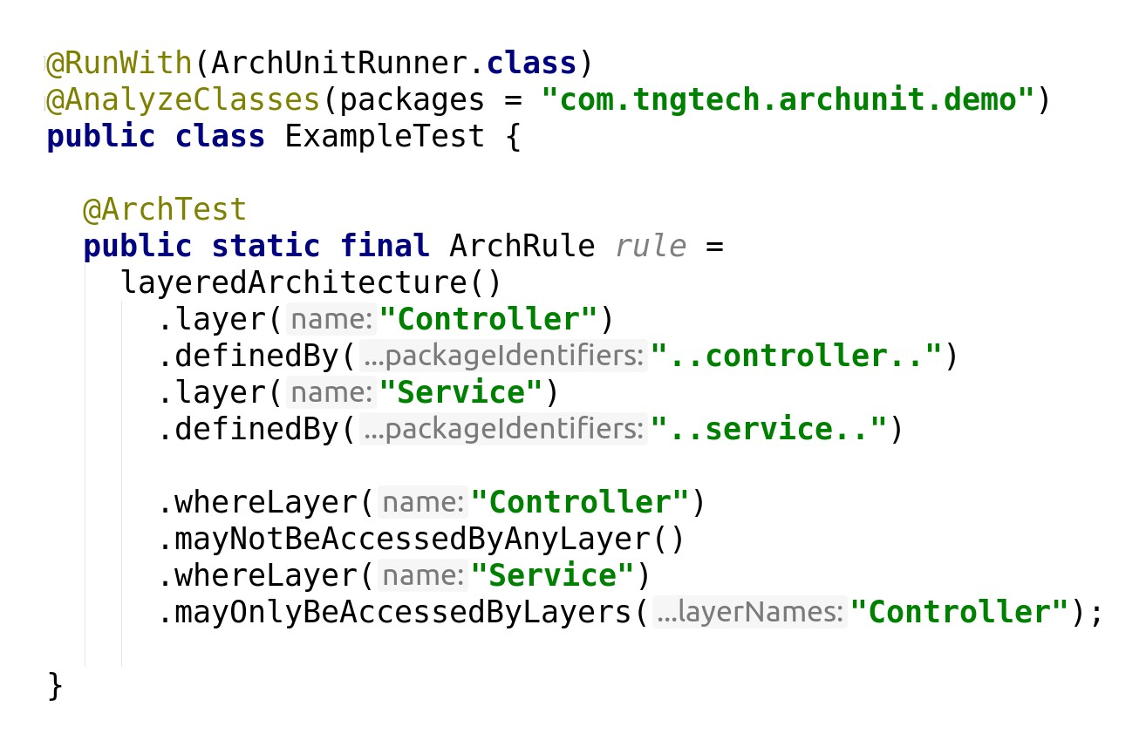
Layered Architecture
6/2/2018 ArchUnit
http://localhost:8080/?print-pdf#/ 26/33

Slide 26
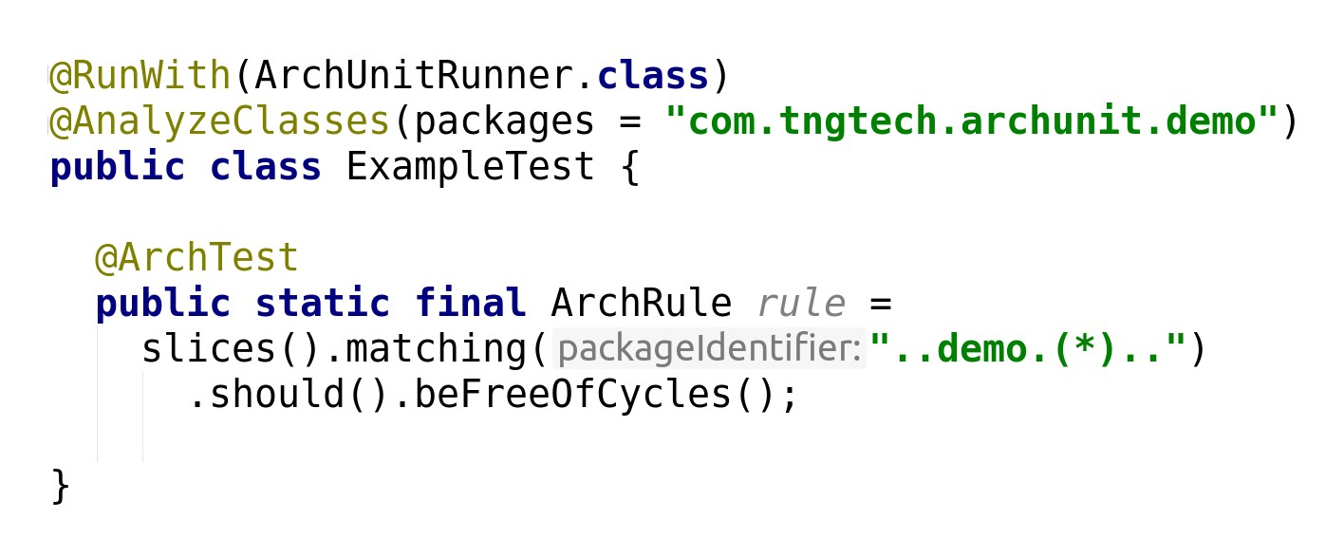
Checking for Cycles
6/2/2018 ArchUnit
http://localhost:8080/?print-pdf#/ 27/33

Slide 27
6/2/2018 ArchUnit
http://localhost:8080/?print-pdf#/ 28/33
Overview Motivation Challenges
Continuous Architecture How ArchUnit can help Demo
Try it yourself

Slide 28
Website
6/2/2018 ArchUnit
http://localhost:8080/?print-pdf#/ 29/33
http:/ archunit.org
Maven Central
com.tngtech.archunit:archunit:0.8.0 com.tngtech.archunit:archunit-junit:0.8.0

Slide 29
Thank you !

