Slide 1
CS4244 Programming Assignment
Due to 28 February 2016
Sunday, 11:59 pm

Slide 2
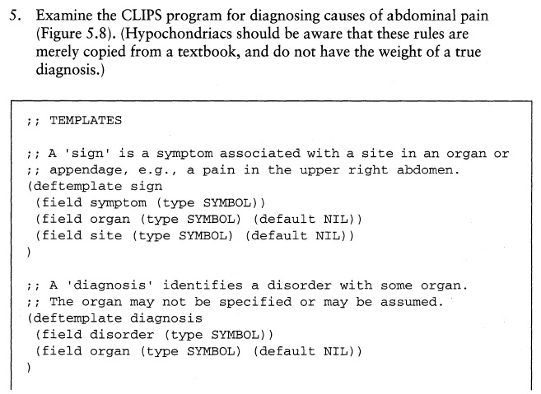
Program in textbook on p.97

Slide 3
Download program from IVLE
Download diagnosis.clp (which is based on the program in textbook on p.97) from IVLE’s “Assignments” Folder in the Workbin.
This program requires the user to first tell the symptoms before running. On running, it asks “Where is the pain?” and gives diagnosis based on symptoms earlier given.
The program only runs one session. Needs to reset to run again.
If no diagnosis is found, the program keeps asking: “Where is the pain?”

Slide 4
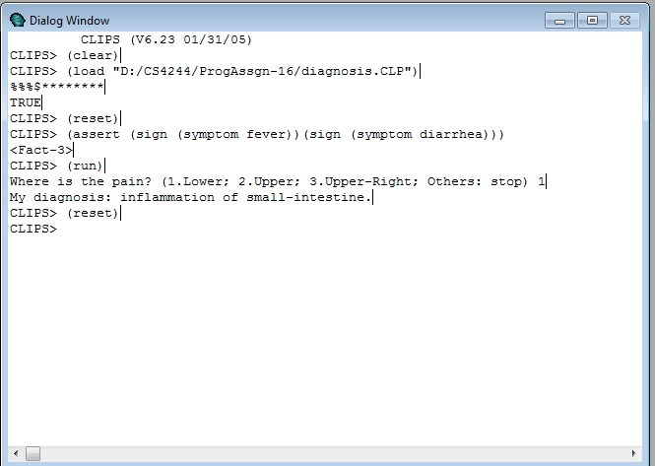

Slide 5
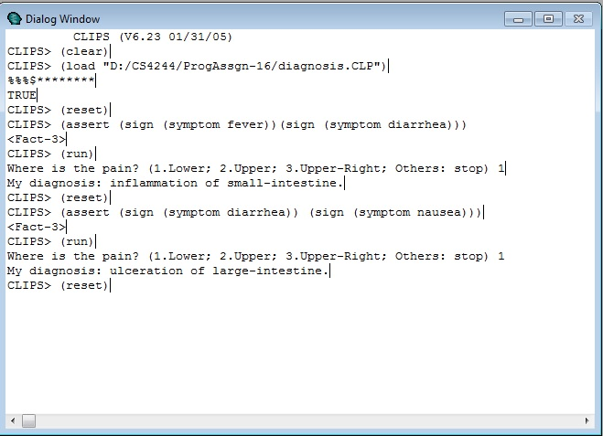

Slide 6
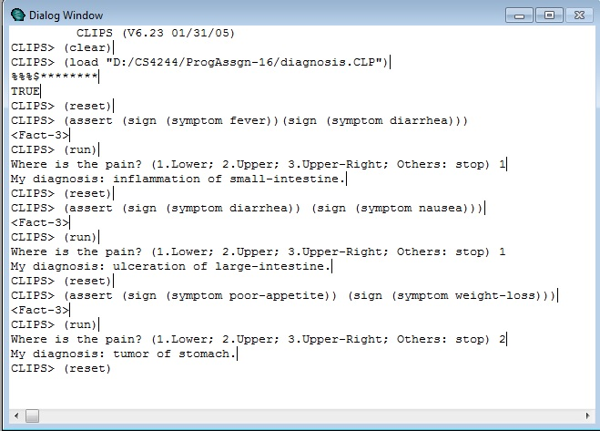

Slide 7
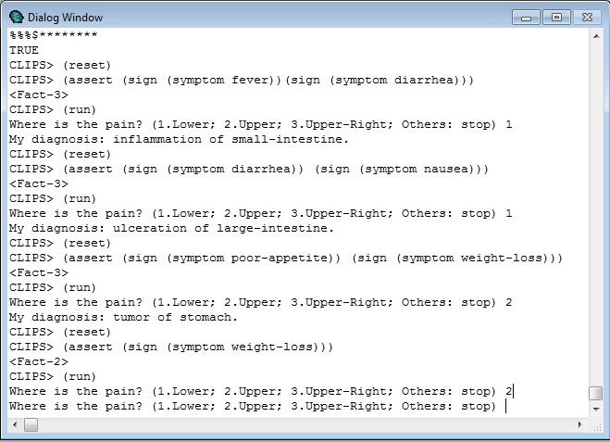

Slide 8
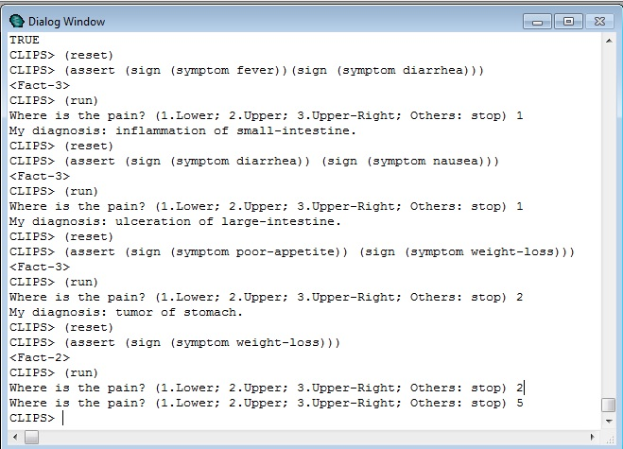

Slide 9
Programming Assignment
Modify diagnosis.clp and rename it XXXX.clp (XXXX is your name).
Your program should ask for symptoms according to site of pain.
A “question” template has already been added in diagnosis.clp.
Your program should also allow multiple sessions.
Your program should have appropriate response on failure to diagnose.
Your program should behave like the model program shown in the following slides.

Slide 10
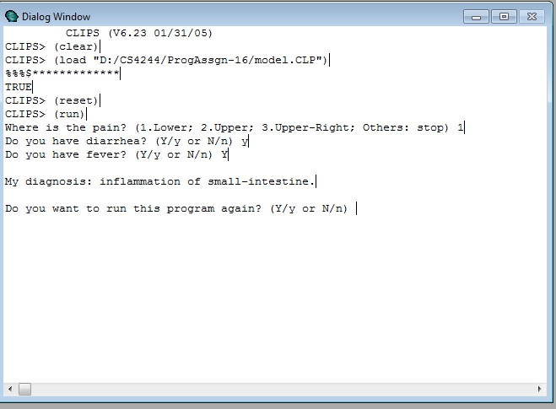

Slide 11
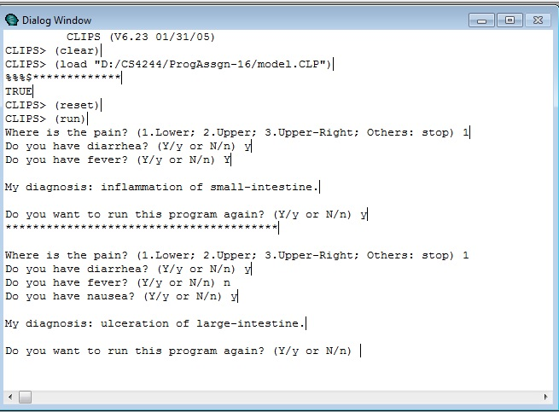

Slide 12
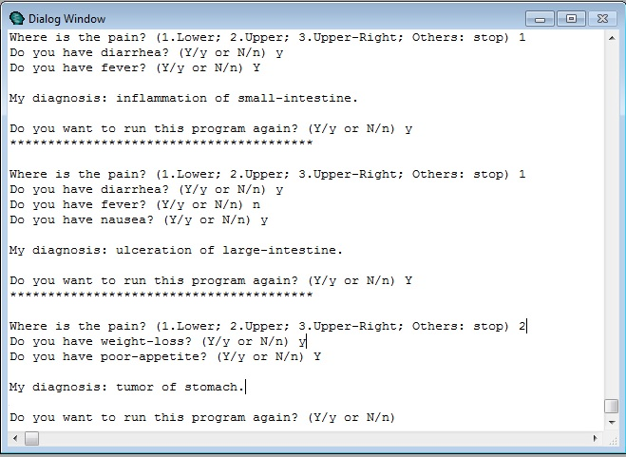

Slide 13
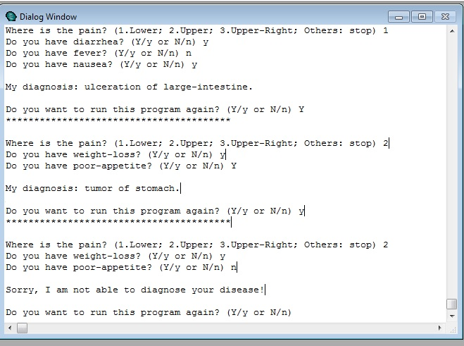

Slide 14
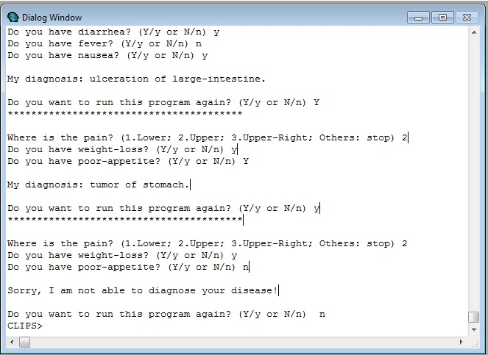

Slide 15
Submission of Assignment
Submit your program XXXX.clp to IVLE → Workbin → Student Assignments
Due Date: 28 Feb 2016 (Sunday), 11:59 pm
When running your program, use Default Strategy (i.e. Depth Strategy)
Use CLIPS vers 6.23 available from IVLE to ensure consistency of your output with tester program.
Do not add in other diagnosis rules as they may interfere with the existing diagnosis.

