Slide 1
Day 4
iPhone Training

Slide 2
位置與地圖功能
Location & GPS

Slide 3
位置與地圖功能
透過主要的地圖功能 – MapKit，可以開發以下的程式
協助用家尋找朋友的程式
尋找地區資源的程式，例如：附近的食肆
以所在地為核心，提供個人化的資訊
Notes:
Cookbook P. 689

Slide 4

怎樣取得用戶的位置
GPS 定位
支援 iPhone 3G / 3GS / iPhone 4
由衛星發放用戶的位置訊息
適用於戶外，較少高樓大廈和樹木的地方

Slide 5
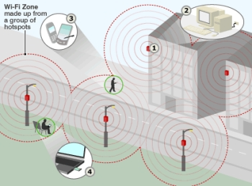
怎樣取得用戶的位置
Wifi 熱點定位
由 Wifi 的 MAC Address 結合 GPS 定位
取得用戶的位置訊息

Slide 6
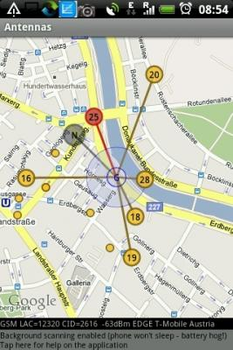
怎樣取得用戶的位置
訊號發射站的定位
iPhone 可以找到 4-5 個鄰近的訊號發射站
透過發射站的訊號強弱，取得用戶的位置
不支援 iPod Touch

Slide 7
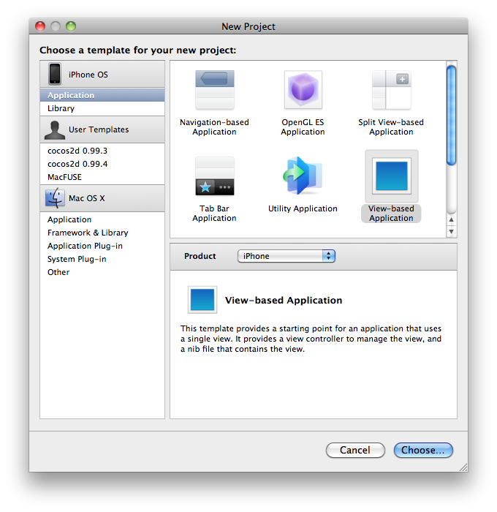
開發 GPS 定位程式教程
開啟新 iOS Project
File -> New Project
iPhone OS -> Application
View-based Application
CoreLocationDemo
Notes:
http://www.vellios.com/2010/08/16/core-location-gps-tutorial/

Slide 8
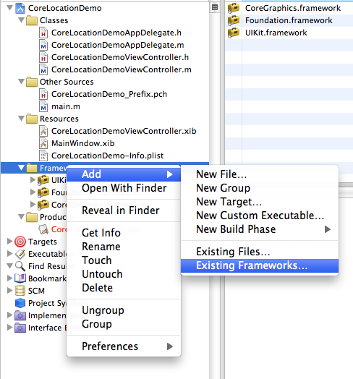
開發 GPS 定位程式教程
Frameworks -> Add -> Existing Frameworks
Notes:
http://www.vellios.com/2010/08/16/core-location-gps-tutorial/

Slide 9
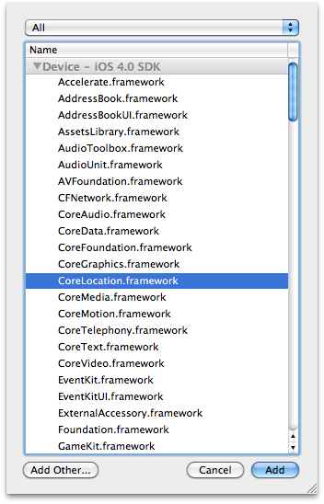
開發 GPS 定位程式教程
選擇 CoreLocation.framework
Notes:
http://www.vellios.com/2010/08/16/core-location-gps-tutorial/

Slide 10
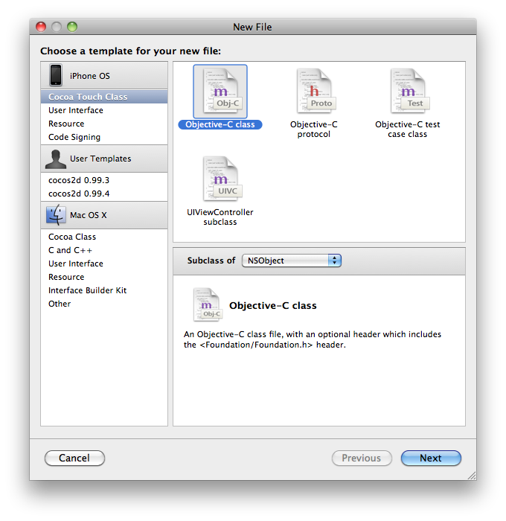
開發 GPS 定位程式教程
創建 Class - Core Location Manager Delegate
可以將原始的位置資訊傳送到 View Controller Class
開新檔案 File -> New File
iPhone OS -> Cocoa Touch Class -> Objective-C class (Subclass of NSObject)
Name: CoreLocation Controller
Notes:
http://www.vellios.com/2010/08/16/core-location-gps-tutorial/

Slide 11
開發 GPS 定位程式教程
加入 Core Location
CoreLocationController.h
#import <CoreLocation/CoreLocation.h>
Notes:
http://www.vellios.com/2010/08/16/core-location-gps-tutorial/

Slide 12
開發 GPS 定位程式教程
Protocol 用作接收和更新 Core Location data
CoreLocationController.h
@protocol CoreLocationControllerDelegate
@required
- (void)locationUpdate:(CLLocation *)location;
// 發送位置更新
- (void)locationError:(NSError *)error;
// 接收錯誤訊息
@end
Notes:
http://www.vellios.com/2010/08/16/core-location-gps-tutorial/

Slide 13
開發 GPS 定位程式教程
Define class to CLLocationManagerDelegate protocol
CoreLocationController.h
@interface CoreLocationController : NSObject <CLLocationManagerDelegate>
{
CLLocationManager *locMgr;
id delegate;
}
@property (nonatomic, retain) CLLocationManager *locMgr;
@property (nonatomic, assign) id delegate;
@end
Notes:
http://www.vellios.com/2010/08/16/core-location-gps-tutorial/

Slide 14
開發 GPS 定位程式教程
同步 Instance Variables – locMgr, delegate
CoreLocationController.m
@synthesize locMgr, delegate;
Notes:
http://www.vellios.com/2010/08/16/core-location-gps-tutorial/

Slide 15
開發 GPS 定位程式教程
CoreLocationController.m
- (id)init {
self = [super init];
if(self != nil) {self.locMgr = [[[CLLocationManager alloc] init] autorelease];
// Create new instance of locMgr
self.locMgr.delegate = self;
// Set the delegate as self.
}
return self;
}
Notes:
http://www.vellios.com/2010/08/16/core-location-gps-tutorial/

Slide 16
開發 GPS 定位程式教程
取得 Core Location data 的更新
CoreLocationController.m
﹣(void)locationManager:(CLLocationManager *)manager didUpdateToLocation:(CLLocation *)newLocation fromLocation:(CLLocation *)oldLocation {
if([self.delegate conformsToProtocol:@protocol(CoreLocationControllerDelegate)]) {
[self.delegate locationUpdate:newLocation];
}
}
Notes:
http://www.vellios.com/2010/08/16/core-location-gps-tutorial/

Slide 17
開發 GPS 定位程式教程
處理 Core Location data 的錯誤訊息
CoreLocationController.m
﹣(void)locationManager:(CLLocationManager *)manager didFailWithError:(NSError *)error {
if([self.delegate conformsToProtocol:@protocol(CoreLocationControllerDelegate)]) {
[self.delegate locationError:error];
}
}
Notes:
http://www.vellios.com/2010/08/16/core-location-gps-tutorial/

Slide 18
開發 GPS 定位程式教程
用 IBOutlet 的 UILabel 顯示資訊
CoreLocationDemoViewController.h
#import "CoreLocationController.h”
@interface CoreLocationDemoViewController : UIViewController <CoreLocationControllerDelegate> {
CoreLocationController *CLController;
IBOutlet UILabel *locLabel;
}
@property (nonatomic, retain) CoreLocationController *CLController;
@end
Notes:
http://www.vellios.com/2010/08/16/core-location-gps-tutorial/

Slide 19
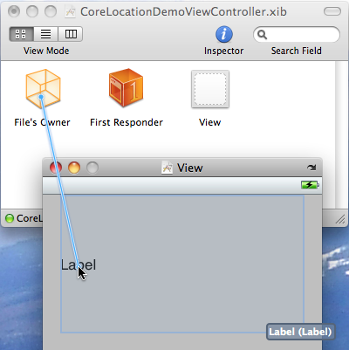
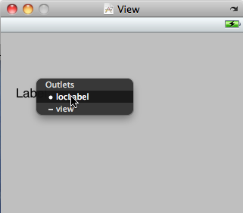
開發 GPS 定位程式教程
開啓 CoreLocationDemoViewController.xib
創建 UILabel
選取 IBOutlet
離開 Interface Builder
Notes:
http://www.vellios.com/2010/08/16/core-location-gps-tutorial/

Slide 20
開發 GPS 定位程式教程
Create CoreLocationController
Set delegate
startUpdatingLocation
Add locationUpdate function
Add locationError functoin
Notes:
http://www.vellios.com/2010/08/16/core-location-gps-tutorial/

Slide 21
與伺服器連結
ASIHttpRequest
http://allseeing-i.com/ASIHTTPRequest/

Slide 22
Configure
Add ASIHTTPRequest
Add MobileCoreServices.framework
Add SystemConfiguration.framework
Add CFNetwork.framework
Add /Developer/SDKs/MacOSX10.6.sdk/usr/lib/libz.1.2.3.dylib

Slide 23
Steps
ASIHTTPRequestDelegate
Create ASIHTTPRequest object
Set delegate to self
requestFinished function
requestFailed function

Slide 24
解讀 XML
xpath
XPathQuery class
libxml famework

Slide 25
XPath
Example : http://www.w3schools.com/xpath/xpath_examples.asp
bookstore/book/title/text()
bookstore/book[1]/title/text()
bookstore/book[id>10]/title/text()

Slide 26
解讀 XML 例子
[[PerformXMLXPathQuery([request responseData], xpathStr) objectAtIndex:0] objectForKey:@"nodeContent"]

Slide 27
運用多媒體功能
Take photo from camera
Open photo in gallery

Slide 28
運用多媒體功能
UIImagePickerControllerDelegate
UINavigationControllerDelegate

Slide 29
呼叫 Browser
[[UIApplication sharedApplication] openURL:[NSURL URLWithString:URL]];

Slide 30
呼叫 Email Client
[[UIApplication sharedApplication] openURL:[NSURL URLWithString:emailurl]];
Email URL format : mailto:?subject=%@&body=%@

Slide 31
撥打電話
[[UIApplication sharedApplication] openURL:[NSURL URLWithString:telurl]];
Telephone URL format : tel:XXXXXXX

Slide 32
顯示 AlertDiaglog
UIAlertView *someError = [[UIAlertView alloc] initWithTitle:title message:message delegate:ad cancelButtonTitle:cancelStr otherButtonTitles:okStr, nil];
[someError show];
[someError release];

Slide 33
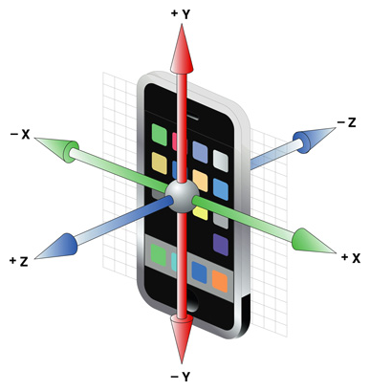
感應器的應用
Accelerometer
X, Y and Z values

Slide 34
感應器的應用
UIAccelerometerDelegate
-(void)accelerometer ( UIAccelerometer *) accelerometer didAccelerate: (UIAcceleration *) acceleration

Slide 35
開始感應器
UIAccelerometer accelerometer = [UIAccelerometer sharredAccelerometer];
accelerometer.updateInterval = .1;
Accelerometer.delegate = self;

