Slide 1
Day 5
iPhone Training

Slide 2
藍牙應用
GameKit framework
Finding other devices
Select connection type
Sending / receiving data

Slide 3

多語言支援
Localiszlable.strings
en
zh_TW
zh_CN
Load localiszable string
NSLocalizedString(@”XXX”, nil)

Slide 4
效果應用
UIViewAnimation
Example:
[UIView beginAnimations:@”name” context:nil];
[UIView steAnimationDuration:1.0f];
[UIView setAnimationDelegate:self];
[UIView setAnimationDidStopSelector:@selector(animationCompleted)];
** View final state **
[UIView commitAnimation];

Slide 5
In-App Purchases
Prepare your iTune Connect account
1) Create App ID
2) Create provisioning file
3) Create app in iTune Connect and upload binary later
4) go to “Manage In-App Purchases”
Consumable / Non-Consumable
Consumable : will charge every purchases
Notes:
http://blog.mugunthkumar.com/coding/iphone-tutorial-%E2%80%93-in-app-purchases/
MKStoreKit 4.0

Slide 6
Implement in Code
Apple Reference Site : http://developer.apple.com/library/ios/#documentation/NetworkingInternet/Conceptual/StoreKitGuide/AddingaStoretoYourApplication/AddingaStoretoYourApplication.html
Use MKStoreKit 4.0
http://blog.mugunthkumar.com/coding/using-mkstorekit-in-your-apps/
http://blog.mugunthkumar.com/coding/mkstorekit-4-0-supporting-auto-renewable-subscriptions/

Slide 7
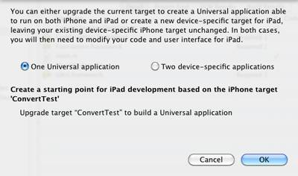
Universal App (iPhone & iPad)
Update project to support iPad

Slide 8
Two Sets of Resources
Resources~iPad folder
Icon~ipad.png
Plist file add “Icon files” array “CFBundleIconFiles“
Item 0 : Icon.png
Item 1 : Icon~ipad.png
Plist file add “Main nib file base name (iPad)
MainWindow~iPad

Slide 9
Detect Device Type
Detect device type (iPad)
If(UI_USER_INTERFACE_IDIOM() == UIUserInterfaceIdiomPad)

Slide 10
iPad Controler
UIPopoverController
SplitViewController
Notes:
Popover : http://www.jannisnikoy.nl/index.php/2010/04/ipad-tutorial-creating-a-popoverviewcontroller

Slide 11
Retina Display
Double resolution : 640 X 960
Image file name add @2x for retina display
>= iOS 4

