Slide 1


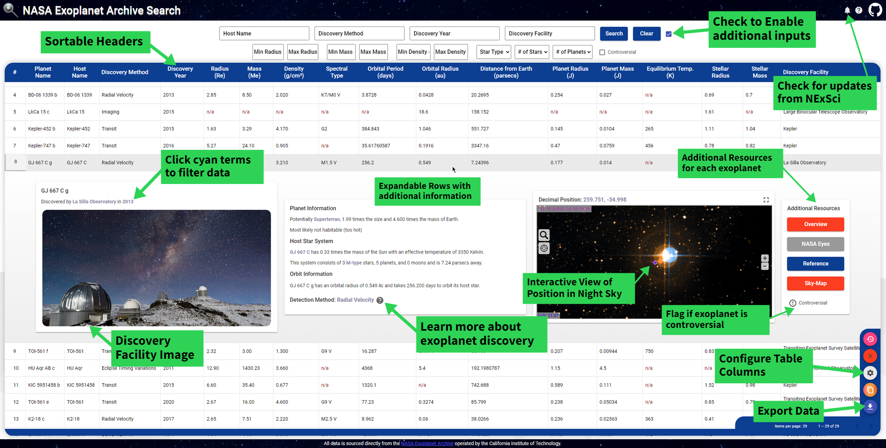
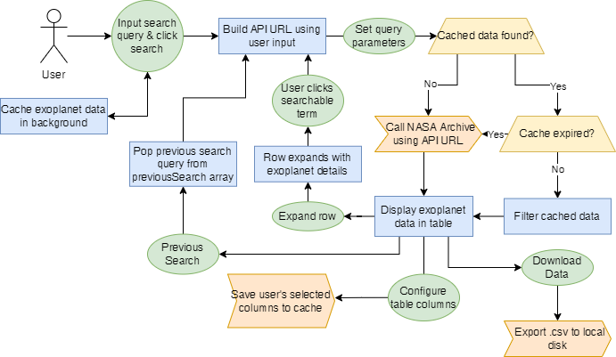



NASA Exoplanet Archive Search
By Adam Jarvis & William Leithauser | Advisor: Dr. Fred Annexstein | University of Cincinnati
Abstract
Development Process
Implemented Features
Our Angular-powered Exoplanet Archive Search simplifies the process of querying and retrieving data from NASA's exoplanet database, providing an intuitive and responsive experience with enhanced readability and user interaction.
Step 1
Initial web design and API testing
Step 2
Build core UI elements such as input and table
Step 3
Test and enhance performance and functionality
Step 4
Implement responsive styling and dynamic sizing
Material Design
Material Design is used throughout the web application giving it a consistent and modern look and feel
Interactive Table
Aladin Lite Sky Atlas
Expand an exoplanet’s row to view its position in Aladin Lite's interactive sky visualization.
Table headers are sortable and resizable, with the ability to configure which columns are displayed.
Progressive Web App Support
PWA’s are web applications designed to function like a native app on mobile devices and desktops.
Streamlined Data Retrieval
With pagination and conditional rendering, the table loads instantly once exoplanet data is cached in the background.
Exportable Data
Use the download button to export the table data to the local disk in .csv format
User Interface
Design Diagram
Data Source & Stack
This web app was built using Angular 14 and is a Progressive Web App (PWA) that can be installed on most devices with a modern browser.
This project utilizes Table Access Protocol (TAP) to request and return data from the Exoplanet Archive. TAP is a protocol developed by IVOA that allows access and querying of table data on remote servers, including astronomical data.
This project also uses my Express.js CORS Proxy to add necessary headers to the HTTP response from the Exoplanet Archive
Conclusion & Final Thoughts
Core Project Layout
Overall, our Angular-powered Exoplanet Archive Search provides a user-friendly and efficient way to access and search NASA's exoplanet database and view the data in an interactive table.
With an intuitive interface, responsive design, and streamlined data retrieval, users can easily query and retrieve the data they need. We hope this web app will serve as a valuable resource for astronomers and researchers alike.
Name | Type | Function
App | Component | Root component and container
InputBar | Component | HTML, CSS, and JavaScript for input-bar elements
Data Service | Service | Used to call the Exoplanet Archive and return/cache data
Table | Component | Angular component for data table (includes table buttons & paginator)
Exodetail | Component | Angular component for expanded exoplanet row (includes Aladin visualization)
Loading & Interceptor | Service | HTTP interceptor used to conditionally render the loading spinner in AppComponent
Sort & Resize | Directive | Used to enable sorting and resizing on table headers in table component
Download | Service | Converts current table data to .csv format and exports to user’s local disk
Angular Concepts & Features
Developers
Components
Building blocks of Angular applications
Services
Provide functionality that can be shared across components
Create reusable behavior
Directives
Contains HTML templates, CSS styles, and JavaScript logic
Used for tasks such as data retrieval
Can apply behavior(s) to multiple existing elements or components
Examples include Table component & InputBar component
Example includes Sort directive in table
Examples include Data service and Loading service
Adam Jarvis
Computer Science
William Leithauser
Computer Science
Notes:
Created for CS5002

