Slide 1
NASA Exoplanetary Query
Adam Jarvis & William Leithauser

Slide 2
Project Members
Adam Jarvis
Computer Science
jarvisar@mail.uc.edu
William Leithauser
Computer Science
leithawj@mail.uc.edu
Project Advisor
Dr. Fred Annexstein
annexsfs@ucmail.uc.edu

Slide 3
Project Abstract
The main objective of this project is to develop and build a website capable of querying data from NASA's Exoplanetary Archive using user input. After entering a valid query, the website will build an API URL using the user's input to call NASA's archive and return the requested data. After returning the data, the website will then format the data into a readable form and will give the user the option to export the formatted data to the user's local disk. We will use Angular TypeScript to build the site and utilize HTTP requests and Table Access Protocol (TAP) to call NASA's Archive.

Slide 4

User Stories
1. As a website user I want to search and query NASA's exoplanet database so that I can gather the planetary data I need.
2. As a novice astronomer I want to learn what each piece of data means/represents so I can better understand the data.
3. As a website user, I want to be able to filter the data with valid parameters so I can better find the data I need.
4. As a researcher I want to export the returned data so that I can use the returned data on academic projects.
5. As a researcher, I would the site to provide the source of the data to ensure the returned data is accurate and up to date.

Slide 5
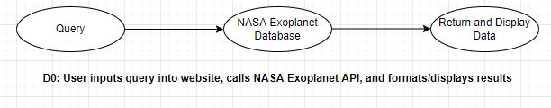
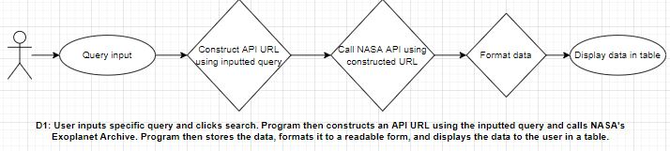
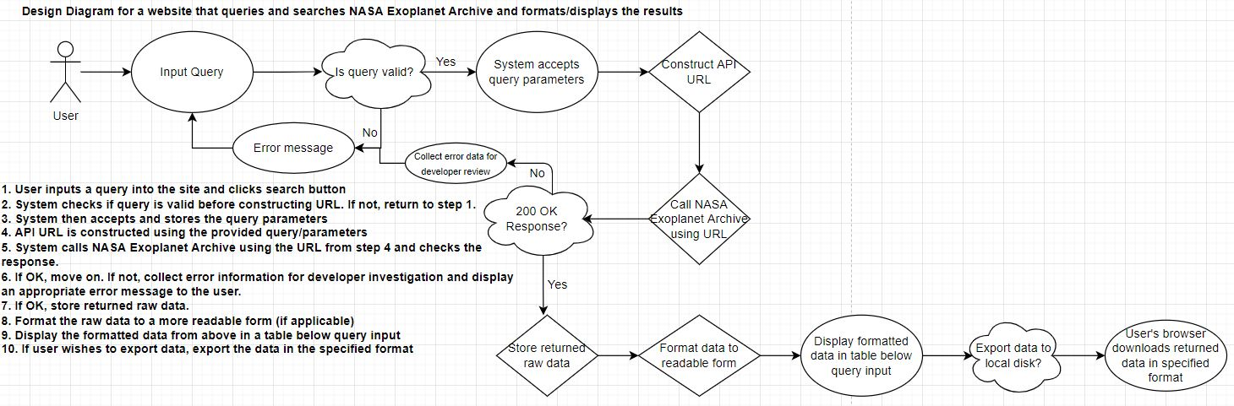
Design Diagrams

Slide 6
Major Project Constraints
Economic
Economic cost is an important constraint to consider, since our budget is relatively low. However, most of the technologies and languages we will use are free to use and won't cost any money. Some of the tools we plan on using for debugging and testing such as Postman charge for the premium version, but fortunately they provide a student version with the same capabilities for free.
Time
One of the biggest constraints for this project is time. While we have a good understanding of our project and what needs to be done, we still need to research and start to learn some of the languages and software we need to use. Given that our project's prototype should be completed after this semester and the project should be completely finished by the spring, time is our biggest constraint.

Slide 7
Major Project Constraints (cont'd)
Technical Knowledge
Even though we feel that we can develop and maintaining our website, some of the smaller features might be difficult to implement. While we have experience in front-end and back-end development, neither of us have much experience in creating a website from scratch and we will likely need to spend time researching how to do certain things.
Scope
The scope of our project is also a major constraint. In the planning stage, we kept having great ideas that we thought would be cool to implement. However, once we started recording our development plan and major milestones, we started to realize that the scope of our project might be limited due to our technical knowledge and time available (as seen above).

Slide 8
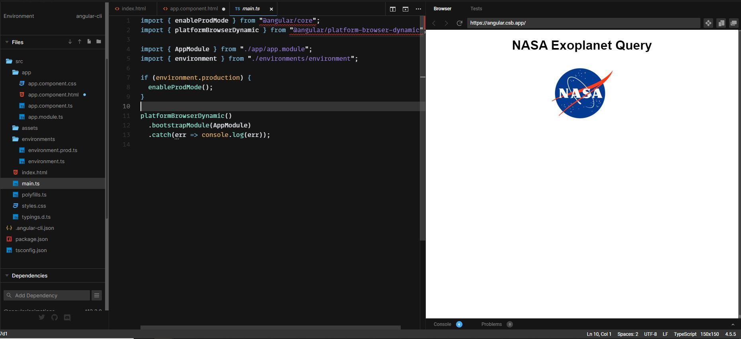
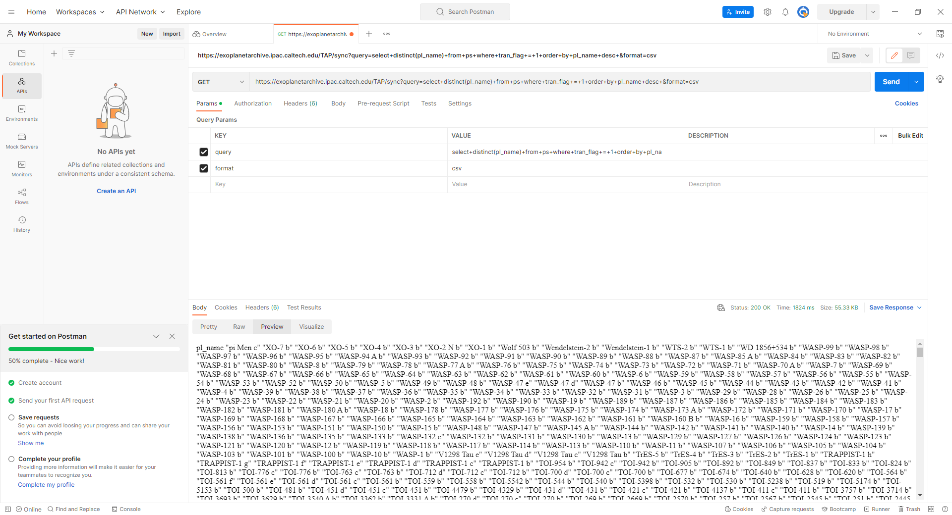
Current State of Project
As of this week, we have started building the website using Angular and have begun testing API calls to NASA's Archive

Slide 9
Expected Accomplishments
1. Fully functioning website that queries NASA's Exoplanetary Database
2. User can input year of discovery, discovery method, host name, and/or discovery facility
3. Call NASA's Archive to retrieve specified data
4. Format data into a modern and well-designed table
5. Ability to export data to user's local disk
6. Page that explains the data and what it means/represents

Slide 10
Division of Work
Adam
Research front-end programming languages (ASP.NET or Angular) and determine viability for project
Test NASA Exoplanet Archive data retrieval and URL construction with Postman
Begin creating front-end UI using feedback from designers (search button, query input, data explanation, etc.)
Add functionality to front-end elements
Ensure data is formatted correctly before outputting to screen
Output data to the screen in a user-friendly table
Will
Start coding back-end of program to call NASA API
Add code to store data results efficiently (most likely utilize a data structure)
Implement error codes and handling if NASA API returns error
Implement "export data" feature so users can export the returned data to their local machine
Add bonus features to front-end if possible (graphics, animations, direct links from table to NASA planet overview, etc.)

Slide 11
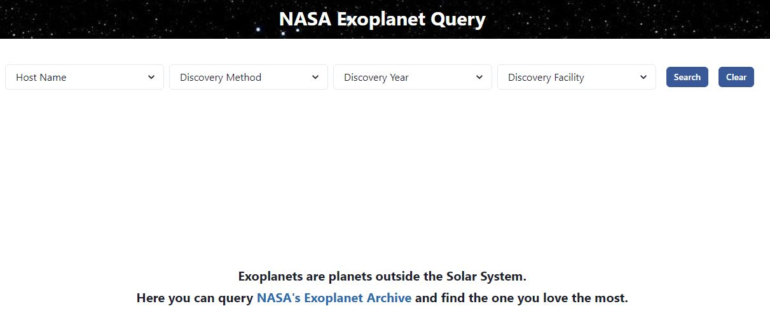
Expected Demo

