Slide 1
Data Analysis of
London Gift Show
Executive Presentation — Proof of Concept
Prepared by: Frede
Jarvis Consulting

Slide 2
01 · BUSINESS PROBLEM
Why This Analysis Was Needed
The Problem
Analytics Objectives
LGS is a UK-based online giftware retailer serving wholesalers and retail customers for over 10 years.
Despite a decade of operation, revenue growth has stagnated.
LGS lacks the internal analytics resources to understand why — and what to do next.
Identify top-selling products and revenue drivers
Understand who the highest-value customers are
Segment customers by purchasing behaviour
Detect seasonal revenue patterns
Surface product return issues
LGS Data Analytics — Jarvis Consulting · Confidential

Slide 3
02 · ARCHITECTURE
Data Pipeline & Engineering Overview
Data Source
PostgreSQL
Jupyter Notebook
Python Analytics
Insights
SQL file · 2009–2011
~500K+ rows
Docker container
Data warehouse
Docker container
psycopg2 connection
Pandas · NumPy
Matplotlib
LGS marketing
team
Scalability Notes
Data Quality Observations
Transformations Applied
Current pipeline: Pandas in-memory (local)
Cancelled invoices flagged (invoice_no beginning with 'C')
Revenue derived: Quantity × Unit Price
Feasible for PoC scale (~500K rows)
Null customer IDs removed from customer-level analysis
Timestamp parsed into month / year columns
Production path: Apache Spark or Databricks
Negative quantities filtered from revenue calculations
Data types cast to correct formats
Recommend cloud warehouse (Snowflake / BigQuery)
Duplicate entries identified and removed
Cancellations isolated into separate column
Inconsistent product descriptions noted
Customer and product dimensions structured
ETL automation required before productionization
LGS Data Analytics — Jarvis Consulting · Confidential

Slide 4
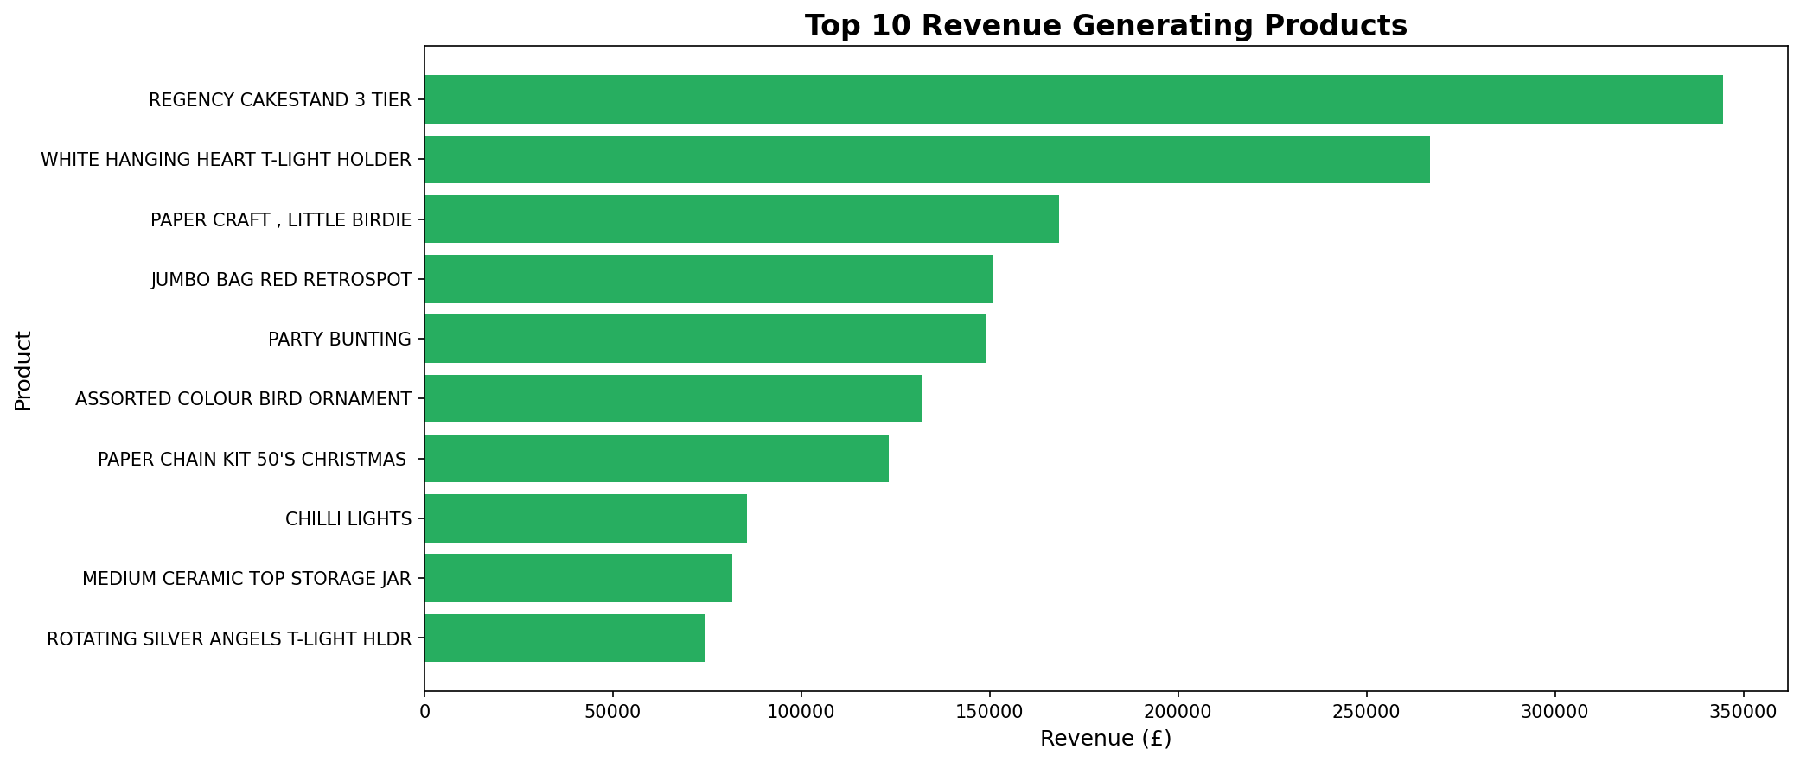
03 · INSIGHT 1
Top Products Drive Disproportionate Revenue
📌 Finding: A small number of SKUs account for the majority of total revenue — the rest generate minimal return.
[Insert: Bar chart — Top 10 SKUs by Revenue]
How we found it
Grouped all transactions by StockCode, summed revenue (qty × price), ranked descending. Filtered cancellations before aggregation.
Business Impact
→ Prioritize top SKUs in all marketing campaigns
→ Expand inventory depth for high-performers
→ Review and consider retiring low-revenue SKUs
→ Bundle high-revenue items to lift average order value
LGS Data Analytics — Jarvis Consulting · Confidential

Slide 5
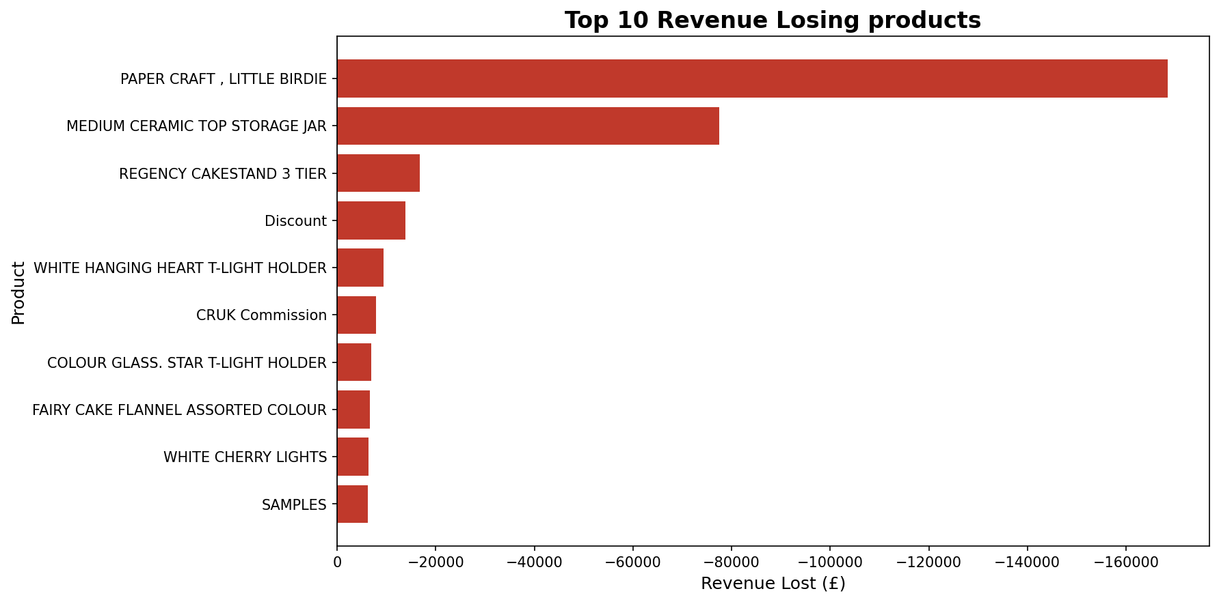
03 · INSIGHT 1
Products Costing LGS Revenue
📌 Finding: A small number of SKUs account for the majority of total revenue — the rest generate minimal return.
How we found it
Grouped all transactions by StockCode, summed revenue (qty × price), ranked descending. Filtered cancellations before aggregation.
Business Impact
→ Prioritize top SKUs in all marketing campaigns
→ Expand inventory depth for high-performers
→ Review and consider retiring low-revenue SKUs
→ Bundle high-revenue items to lift average order value
LGS Data Analytics — Jarvis Consulting · Confidential

Slide 6
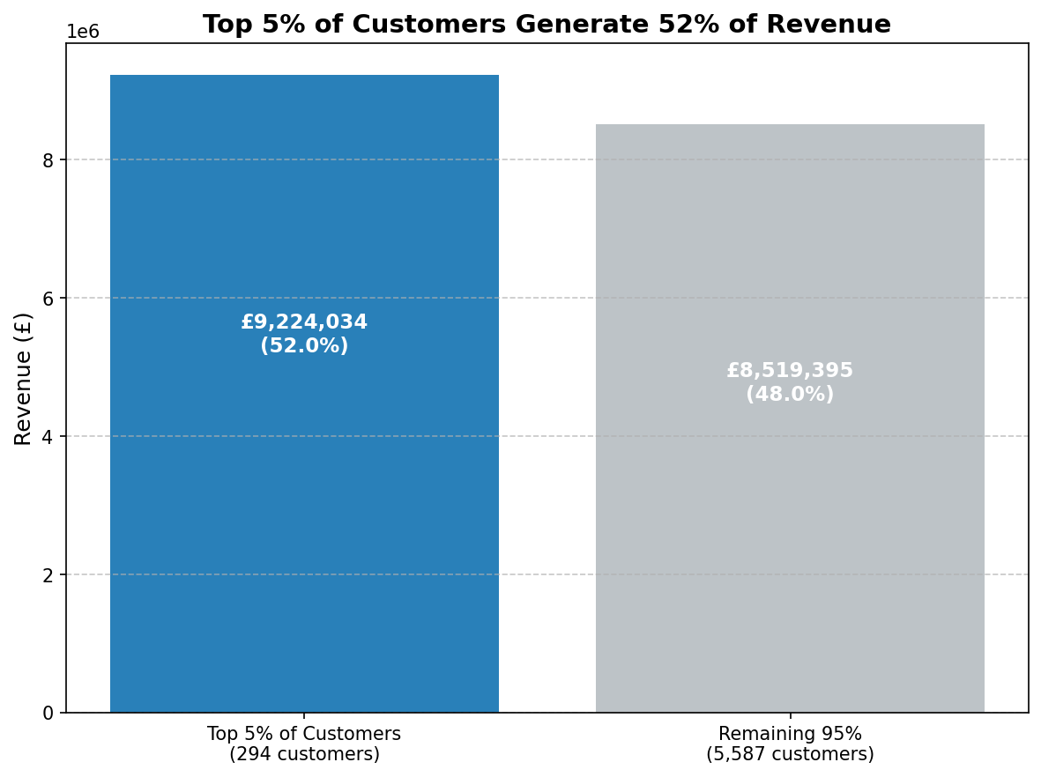
03 · INSIGHT 2
A Small Customer Segment Drives Most Revenue
📌 Finding: The top customer segment generates a disproportionate share of total revenue — losing any one of them has outsized impact.
[Insert: Bar or pie chart — Revenue by Customer Segment / Top N Customers]
How we found it
Grouped transactions by CustomerID, summed revenue, ranked top N. Compared revenue share of top segment vs. rest of base.
Business Impact
→ Build a VIP retention programme for top customers
→ Identify shared traits to find lookalike prospects
→ Target personalised email campaigns to high-value tier
→ Monitor churn risk signals within this segment
LGS Data Analytics — Jarvis Consulting · Confidential

Slide 7
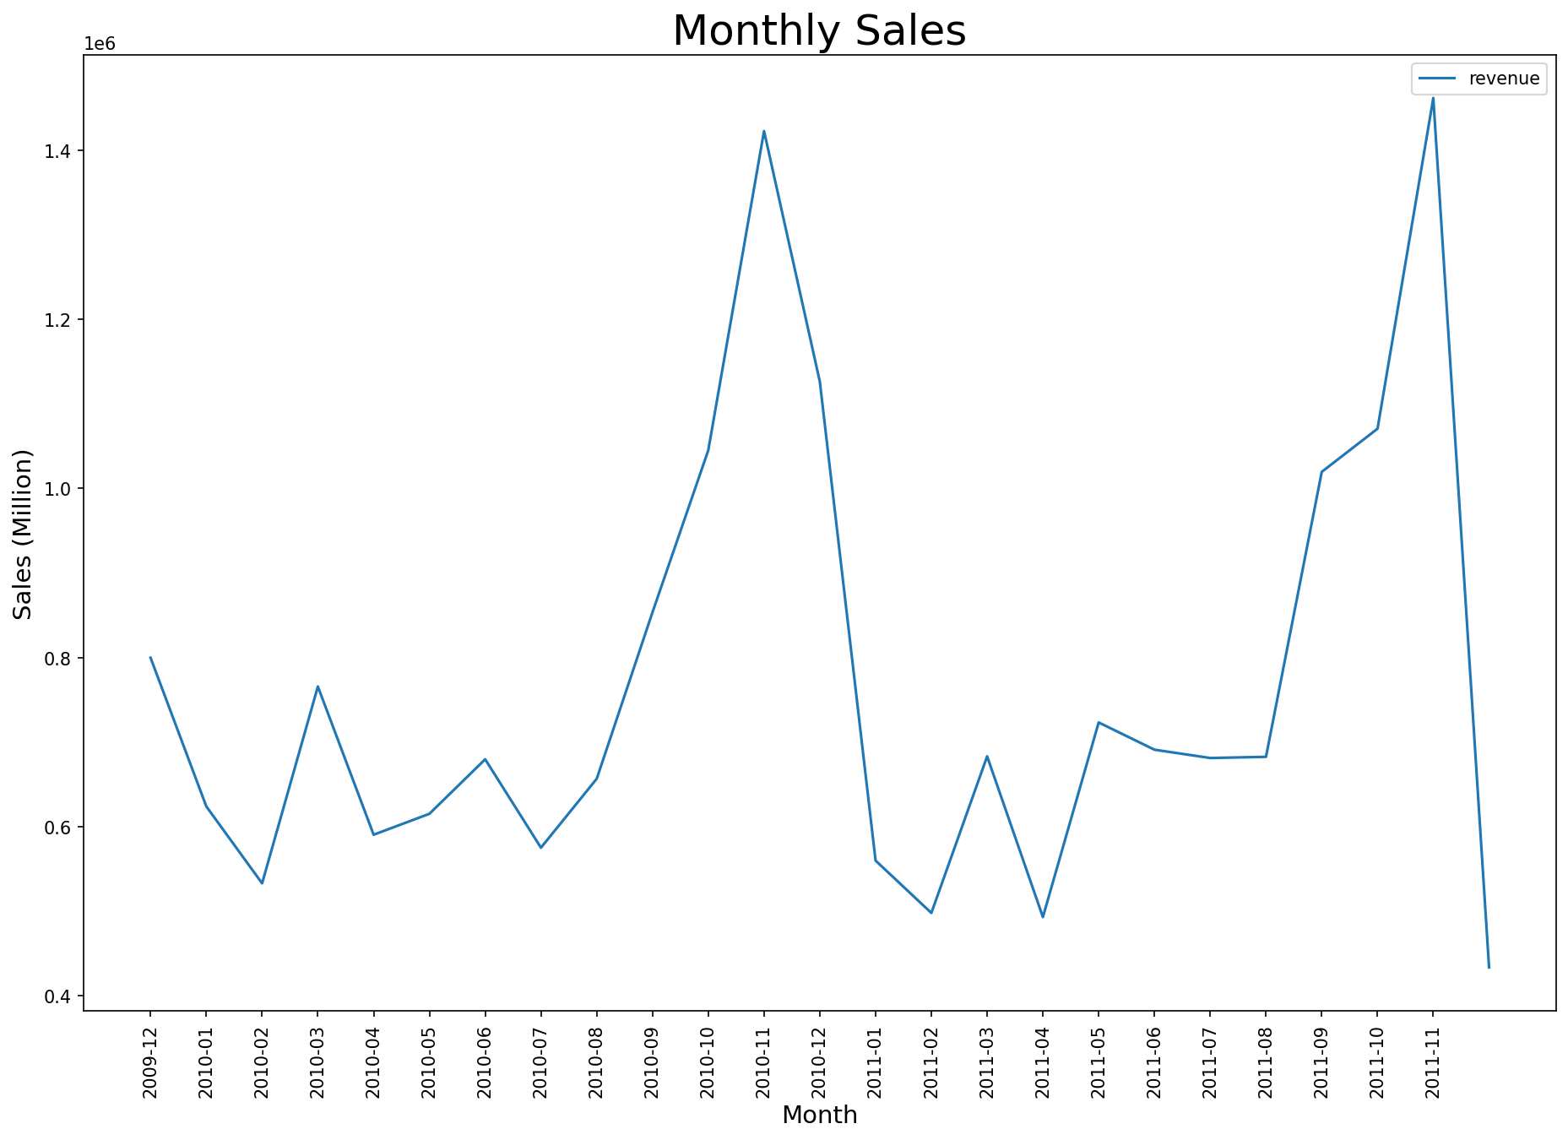
03 · INSIGHT 3
Revenue Has Clear Seasonal Peaks
📌 Finding: Revenue spikes predictably in specific months — marketing and inventory decisions are currently not aligned with these peaks.
[Insert: Line chart — Monthly Revenue Trend 2009–2011]
How we found it
Parsed InvoiceDate into month/year, aggregated revenue per period, plotted trend line. Cross-referenced peaks against calendar events.
Business Impact
→ Align promotional spend with peak-demand months
→ Pre-position inventory ahead of seasonal spikes
→ Launch targeted campaigns in lead-up to peak periods
→ Use off-peak months for retention and re-engagement
LGS Data Analytics — Jarvis Consulting · Confidential

Slide 8
03 · INSIGHT 3
Revenue Has Clear Seasonal Peaks
📌 Finding: Revenue spikes predictably in specific months — marketing and inventory decisions are currently not aligned with these peaks.
How we found it
Parsed InvoiceDate into month/year, aggregated revenue per period, plotted trend line. Cross-referenced peaks against calendar events.
Business Impact
→ Align promotional spend with peak-demand months
→ Pre-position inventory ahead of seasonal spikes
→ Launch targeted campaigns in lead-up to peak periods
→ Use off-peak months for retention and re-engagement
LGS Data Analytics — Jarvis Consulting · Confidential

Slide 9
04 · CONCLUSION
Takeaways & Next Steps
01
A focused product and customer strategy — targeting the top SKUs and top customers — could meaningfully move revenue without increasing ad spend.
02
Seasonal patterns are predictable. Aligning campaigns and inventory to these peaks is a low-cost, high-return operational improvement.
03
The data pipeline is PoC-grade but structurally sound. With ETL automation and a cloud warehouse, this becomes a production analytics capability.
Proposed Roadmap
0–3 months
3–12 months
12+ months
Automate ETL · Build dashboards
Clean product taxonomy
Customer segmentation models
Demand forecasting · CRM integration
Real-time pipeline · Dynamic pricing
Cloud warehouse (Spark / Snowflake)
LGS Data Analytics — Jarvis Consulting · Confidential

