Slide 1


ADD SUBTITLE ADD SUBTITLE
LGS Customer & Revenue Data Analytics PoC
Python Data Wrangling & Exploratory Analytics
Kanty Gakima – Data Engineer, Jarvis Consulting

Slide 2

Business problem & objectives
Dataset Overview & Data quality
Data quality, risks & limitations
Analytics methods & approach
Key customer & Revenue insights
Recommendations
Conclusion and Q&A
Agenda

Slide 3
Business Problem & Objectives
London Gift Shop revenue stagnating despite 10+ years of online operations
Limited understanding of customer purchasing patterns
Objectives
Analyze the transactional dataset provided by the LGS IT team to uncover meaningful purchasing patterns.
Generate insights on customer shopping behaviors, seasonality, cancellations, and geographic trends.

Slide 4

Dataset Overview
SQL dataset containing transactions from December 2009 to September 2011
The file has ~1M rows and 8 columns detailing invoices, product description, quantities, pricing, customers , and countries.
Data was exported by LGS IT team, and anonymized
Loaded into a PostgreSQL database and analyzed using Python (Pandas) for data wrangling and analytics.
Regular usage of the platform will include...
Notes:
.

Slide 5
Data quality, risks & limitations
Inconsistent and incomplete records (cancelled invoices, missing IDs) reduce reliability of customer and revenue insights.
Fragmented product data & short 2-year window limits product-level analysis and long-term forecasting.
Mitigations
Build a Product Master Table to standardize SKUs and enable meaningful product/category analytics.
Improve data capture & identification (e.g., stable customer IDs, richer event logging) to support deeper future analysis.
Notes:
SKU: (stock keeping unit) , stock code in the provided dataset

Slide 6
Data cleaning & transformations
Type casting
Derived fields created
Filtering and normalization
Standardization of column naming and formats

Slide 7
Analytics methods & approach
Time-series analysis to evaluate monthly sales, customer activity, and cancellation trends,
revealing seasonality and operational gaps.
Ranking and aggregation techniques to identify top customers, top countries, and product performance patterns.
Performed RFM segmentation (Recency, Frequency, Monetary) to classify customers into actionable
behavioral groups.
Customer lifecycle analysis by distinguishing first-time vs repeat buyers.

Slide 8
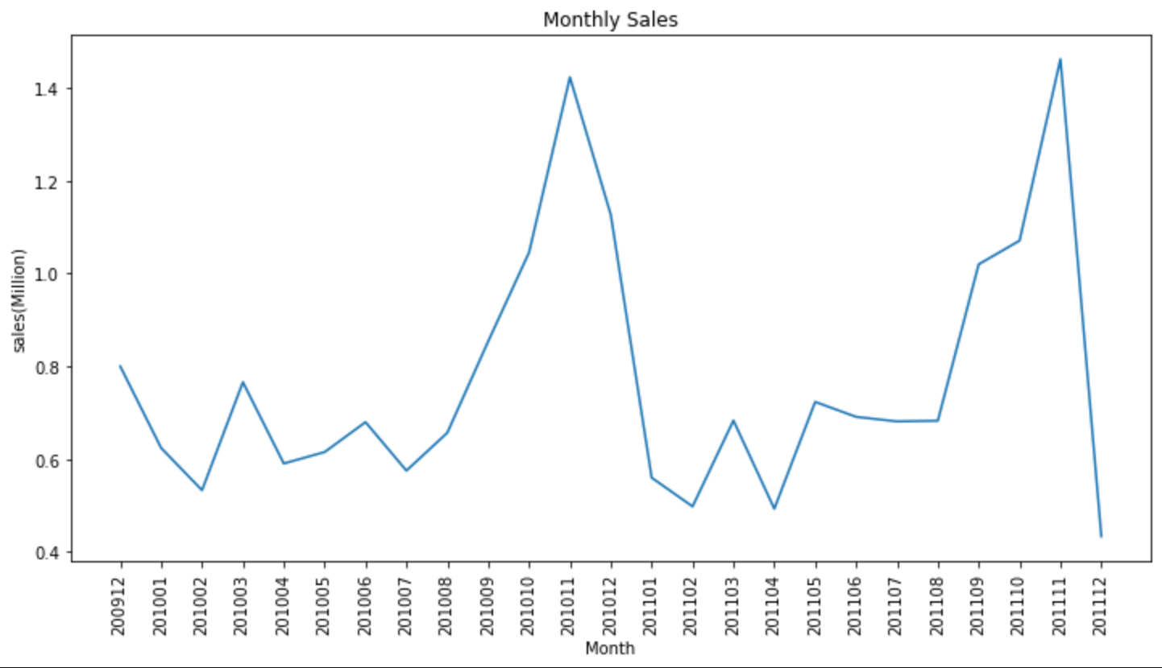
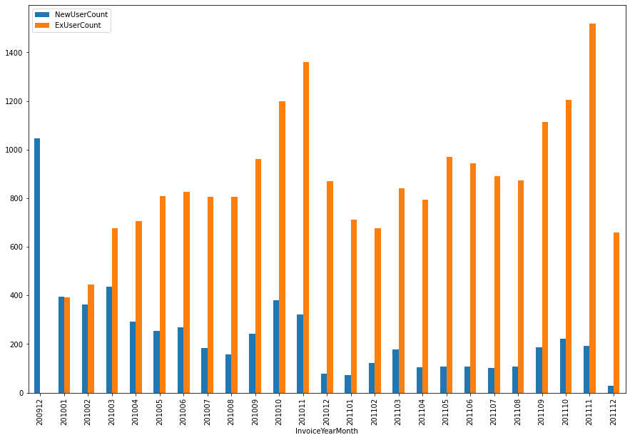
Insight 1 : Customer growth and seasonality
Business Question: How does customer purchasing behavior evolve throughout the year, and how can LGS better leverage both new and repeat customers?
Recommendation / Business Impact:
Plan early for November peaks (sales up 2–3X) by boosting inventory 2–3 months ahead.
Run targeted seasonal campaigns in Sept–Nov, when new customer acquisition rises.
Strengthen loyalty programs, since 75–90% of monthly buyers are repeat customers.
Stabilize off-season demand with retention tactics and off-season promos.
8

Slide 9
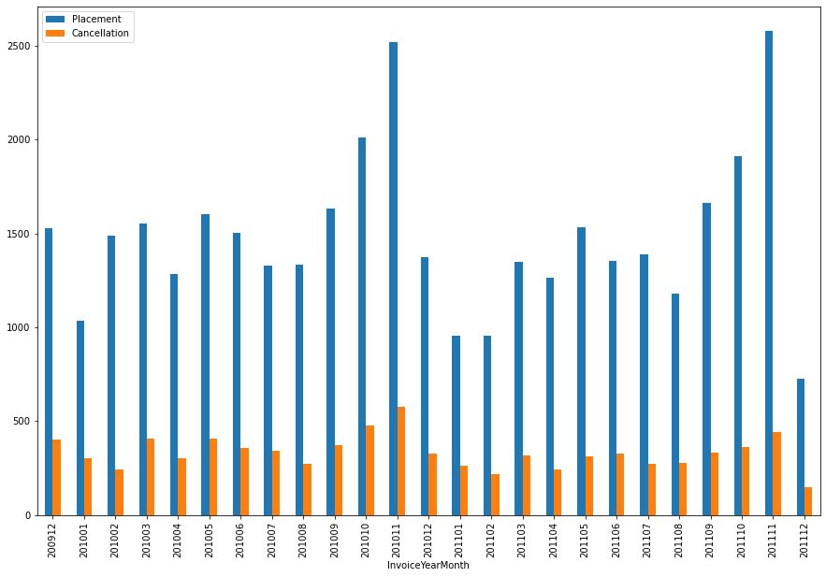
Insight 2 : Order Cancellations
trends (Placed vs Cancelled orders)
Business Question: How significant are cancellations, and do they impact LGS’s revenue?
Recommendation / Business Impact:
Investigate root causes of cancellations (stockouts, listing errors, fulfillment issues).
Strengthen inventory management and demand planning
Before seasonal peaks.
Reducing cancellations by 5 – 10% would recover meaningful revenue and improve customer satisfaction.
9

Slide 10
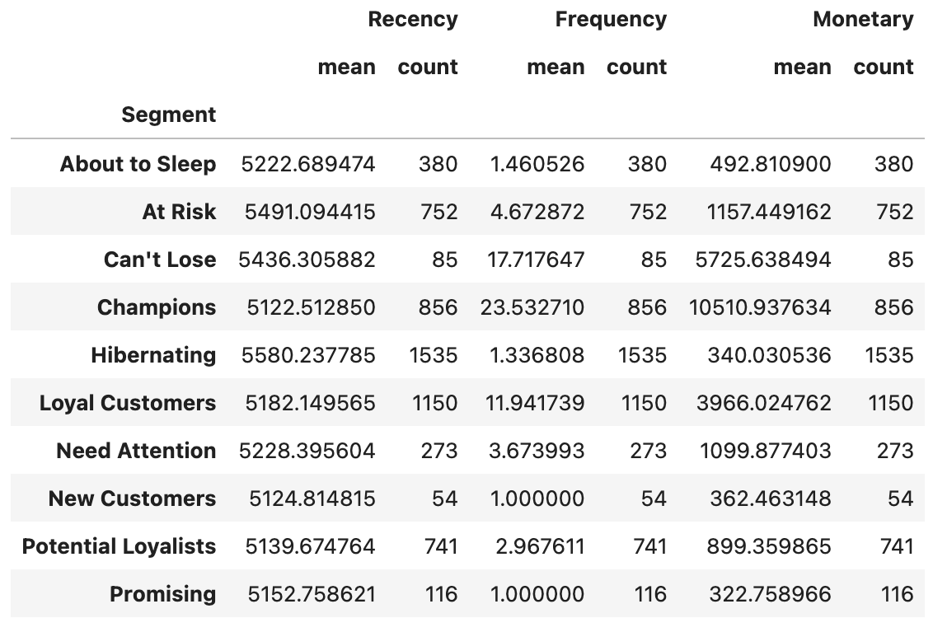
Insight 3 : RFM Segmentation for customers categorization
Analysis method that groups customers based on
their recency, frequency, and monetary value; scoring customers on these metrics to categorize them and conduct tailored campaigns
Recommendation / Business Impact:
Champions: Provide exclusive offers, early access, and loyalty perks, improves retention & lifetime value.
Can’t Lose: Re-engage immediately through personalized campaigns, replenishment reminders, and discounts.
Hibernating: Win-back campaigns focusing on past purchases and incentives to revive dormant customers.
10

Slide 11
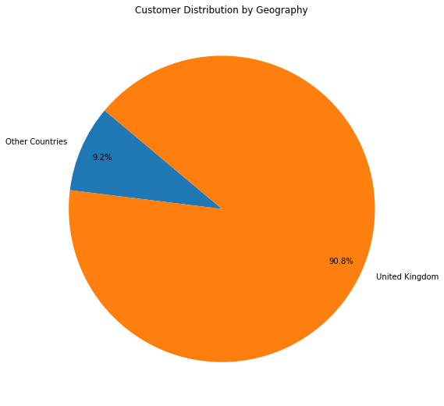
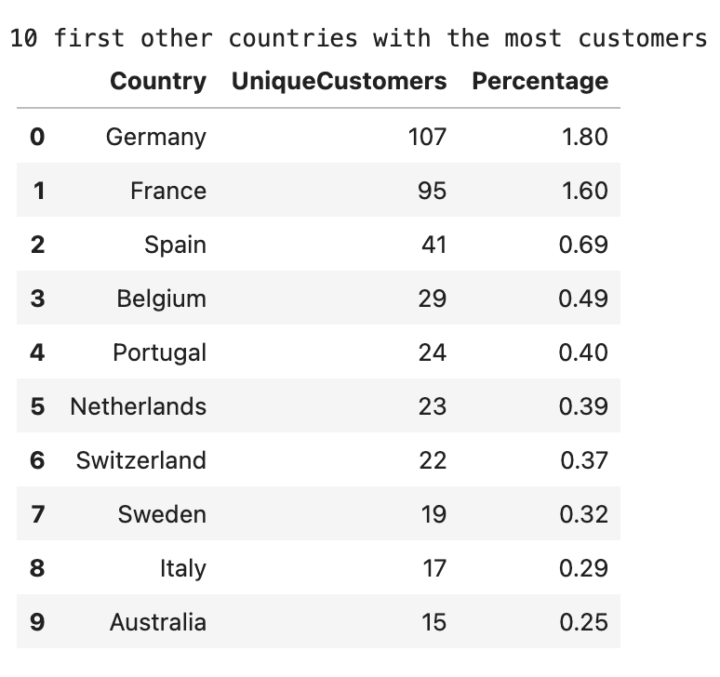
Insight 4: Geographic Market
Concentration & Expansion opportunity
Business Question: Which countries contribute the most customers, and how geographically concentrated is LGS’s customer base?
Recommendation / Business Impact:
Invest in targeted digital advertising and localized seasonal promotions to increase brand awareness in high-potential close regions(Germany, France, etc.)
Optimize shipping/logistics options
Develop geo-specific email campaigns and product recommendations tailored to local preferences.

Slide 12
Recommendations
Strengthen customer retention by activating RFM segments ,through targeted promotions, automated win-back campaigns, and personalized recommendations.
Prepare for seasonal demand by optimizing inventory, improving forecast accuracy, and launching early marketing campaigns ahead of holiday spikes.
Reduce cancellations through better product data quality, improved stock accuracy, and proactive communication workflows.
Expand internationally by prioritizing geographically close, high-potential markets with localized advertising and optimized logistics.
Build scalable analytics foundations by automating ETL flows, standardizing product data, and gradually transitioning toward real-time dashboards and distributed processing (Spark/Databricks).

Slide 13

THANK YOU
EQUALIZING OPPORTUNITY
MAXIMIZING POTENTIAL
JRVS.CA

Slide 14


Q & A

