Slide 1
Econometric Methods: Introduction
Maggie McConnell
Department of Global Health and Population
Harvard T. H. Chan School of Public Health

Slide 2
Plan of presentation
Intro to econometrics
Internal and External Validity
Examples – econometrics approach
Norms in Econometrics versus Biostatistics and Epidemiology
Learning to use a method + Continuous Development of Methods
Additional Slides
Epi-Econ Dictionary
Estimation methods: minimizing sum of squares, maximum likelihood, method of moments
Break for Questions

Slide 3
What is the point of econometrics?
Econometrics: statistical methods used by economists
The primary objective of econometrics is to identify causal effects
What differentiates econometrics from other causal inference approaches is extremely limited tolerance for confounding
This is in part due to the kinds of questions economists want to ask
What is the (causal) impact of program X on outcome Y?
What is the (causal) impact of policy X on outcome Y?
Motivating big picture questions: What should we do to try to improve outcomes? What should we spend limited resources on?

Slide 4
What is confounding to econometricians
Important types of confounding for economists
Selection: Who choses to participate in a program?
We can control for observable characteristics
But most important variables may be unobservable (such as?)
Leads to potential bias if we compare participants to non-participants
estimates may be driven by unobservable characteristics of those who chose to participate, not the program
Reverse causality: Does housing instability cause adverse health outcomes or do adverse health outcomes lead to housing instability?
Longitudinal data can help but causality often goes in both directions
People may foresee policy changes and change behavior before they occur
Why do we care?
Medicaid has fixed budget to spend – would investing in housing improve health?

Slide 5
What is the point of econometrics?
For questions of interest to economists, selection/”endogeneity” are fundamental
Underlying theoretical questions revolve around human behavior
Economics focused on making policy recommendations
Requires understanding direction of causality
Economics is less good at describing a problem
Instead of trying to model or control for confounding + selection – econometrics develops techniques to avoid

Slide 6
Econometrics: focus on internal validity
Ultimately economists require methods that ensure internal validity
Sometimes external validity is less of a focus
Internal validity
The estimates are close to the true parameter values in the sample for which we have data
If methods are not internally valid, economists not interested in results
External validity
The estimates are close to the parameter values in a population when they are used to predict outcomes
Generalizability and transportability
This really matters for thinking about scaling programs, understanding whether policy makers should use results from one setting/population to make more general policy

Slide 7
Markers of internally valid models
Unbiased estimator
Expected value of estimated parameter equals true value in the population
Consistent
An estimator that converges in probability to the population parameter as the sample size grows without bound
Efficient
An estimator with the lowest variance relative to the population parameter among all possible estimators
Correct confidence intervals
Needed for valid hypothesis testing
Often requires to thoughtfulness about what unit / cluster is treated by a program/intervention
See notes for formal definitions

Slide 8
Internal validity
Internal validity usually requires some assumptions
However, only some of the assumptions are testable
When you can’t test – rely on the feeling that assumptions are “plausible”
Plausibility “norms” differ by discipline
Where a choice of methods is available, economists always prefer the method with fewer untestable assumptions
However, extra assumptions may allow more efficient estimation if they are true
New methods sometimes have “hidden” assumptions that are stated in highly technical language --may take time and examples to uncover plausibility

Slide 9
External validity
Econometric analyses provide estimates of causal effects for specific sample at a particular time under certain conditions
Would results generalize to: similar interventions/policies? differences in implementation?
Common pattern: positive results in small trials then limited impact when scaled up
Why?
How can we design a study to make results more generalizable?
Random sample of population ensures parameters representative of the population
Special inclusion criteria for (especially common in RCTs) may limit external validity
i.e. drug trials on people with no co-morbidities, exclusion of some age groups / populations
Some econometric techniques work best in particular settings which may not always be consistent with externally valid samples
More discussion later
Break for questions

Slide 10
Econometric strategies
The objective of econometrics is to uncover causal impacts using methods with minimal assumptions
One way to overcome problems of confounding – randomized controlled trial (RCTs)
With some assumptions comparing outcomes for treated and non-treated individuals allows us to uncover causal impacts
Many econometric strategies we will cover in this segment try to “mimic” RCTs by creating a “counterfactual”
Counterfactual: what would outcomes have been in the absence of an intervention or policy change
Problem – we can’t observe the counterfactual
Methods we will cover in all represent different ways of constructing a counterfactual

Slide 11
Randomized trials: internal validity
Randomized trials often referred to as gold standard – but they also require assumptions for internal validity!
Randomization asymptotically removes correlation between treatment and potential confounders
Requires stable unit treatment value assumption
Potential outcomes for any unit don’t vary with the assignment of other units
No spillovers – treatment of one unit does not affect other units, example of a spillover?
One solution to spillovers is to change design – e.g., group randomization

Slide 12
Randomized trials: internal validity
Other threats to internal validity of trials
Was the randomization successful?
Can check by assessing balance tables
Bias in reporting
Was the trial double blind?
Are outcomes objective or self-reported?
Bias due to selective follow up – what was attrition rate? – was it differential between arms?
Very hard to fix analytically, much better to avoid
Break for questions

Slide 13
Application – evaluating the impact of interventions during pregnancy
Research question: What is the impact of home-based support during pregnancy for low-income families?
Suppose that we care about is understanding whether home-based support helps pregnant people access more prenatal care
We will:
Discuss a propensity matching approach
Look at results from an RCT on a related program in a similar population
Talk through how other causal inference approaches might be utilized

Slide 14

Propensity score matching example
Program: Midlands Healthy Start (MHS)
Objective: increasing access to prenatal care; and removing barriers to health care access
Services: case management, outreach and recruitment, health education, a local health system action plan
Evaluation strategy
Vital records data for all singleton births in counties where the program was operating
First step: compare births to families participating in MHS to those not participating
Next step: propensity score adjustment

Slide 15
Results without matching
Let’s compare the rate of “inadequate” prenatal care across participants and non-participants first
Why would program participants have higher rates of “inadequate” prenatal care?
 | Non-MHS rate (non-treated) | MHS rate (treated)
"Inadequate" prenatal care | 17.0% | 23.2%

Slide 16
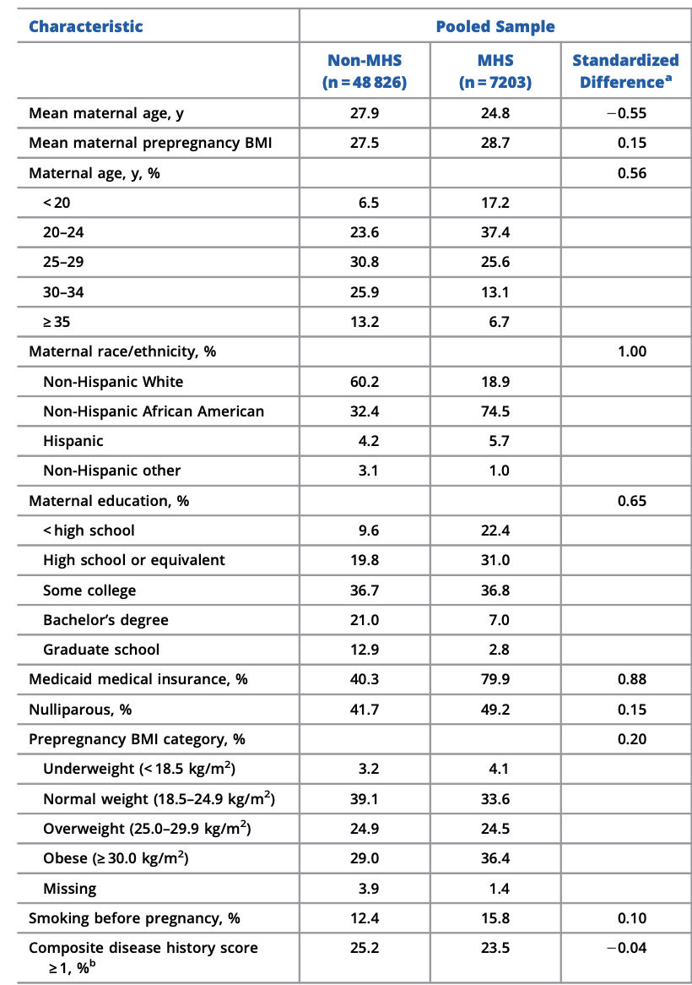
MHS are program participants
Non-MHS are non-program participants
How are they different?
Why?

Slide 17
Results with matching
They use propensity score matching to compare only those with similar observable characteristics
Conclusion: “the Healthy Start program contributed to significant improvements in prenatal care”
What do you think are the challenges to causal inference here?
What if individuals who chose to participate in the program are different on characteristics we haven’t measured?
How big of a problem do we think unobservable characteristics are in this setting?
 | Propensity Score Adjusted Odds Ratio
"Inadequate" prenatal care | 0.86 (0.80, 0.92)

Slide 18
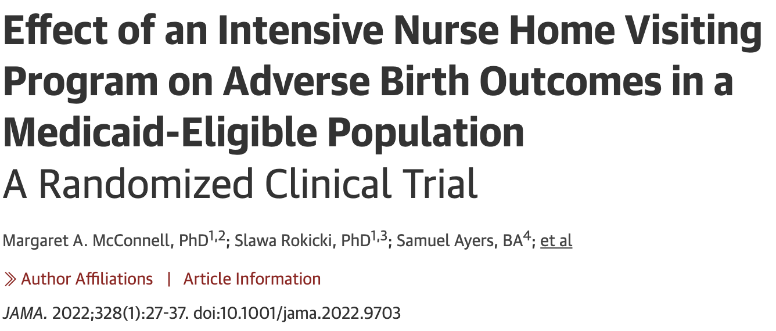
Randomized controlled trial
Program: Nurse Family Partnership
Objective: improving health outcomes during pregnancy including supporting access to health care services
Services: home visits where nurses provide case management, outreach and recruitment, health education
Evaluation strategy
Randomized controlled trial assigned eligible families to treatment or control
Vital records data from counties where the program was operating
Compare control group outcomes to treatment group outcomes

Slide 19
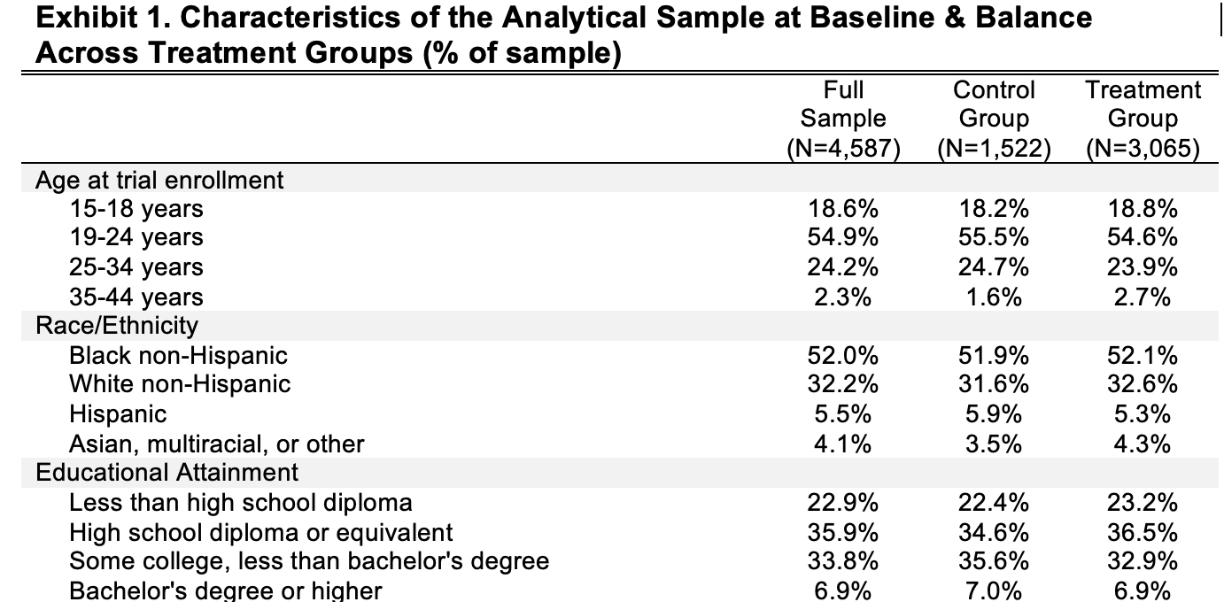
Randomization helps ensure we are balanced on observables (which we can check) AND observables (which we cannot)

Slide 20
Results
Let’s compare the treatment group and control group rates of “inadequate” prenatal care
No statistically significant difference
Previous study concluded that a similar program reduced likelihood of receiving ”inadequate” prenatal care
What are some reasons the result is different?
External validity: important programmatic differences
Internal validity: “unobserved/unmeasured characteristics” correlated with both program participation and receiving antenatal care? Examples?
 | Control group | Treatment group
"Inadequate" prenatal care | 18.70% | 19.60%

Slide 21
Results
We can use the trial to learn something about how different outcomes are for program participants compared to non-participants
Eligibility criteria: first-time birth, Medicaid eligible, >=15 years old and living in counties where program is operating
We can observe the outcome among eligibles who did not participate
Non-participants may have a) chosen not to participate or b) not been effectively reached by the program
Why might there be less prenatal care for non-participants?
 | Control group | Treatment group | Non-participant but eligible
"Inadequate" prenatal care | 18.70% | 19.60% | 27.20%

Slide 22



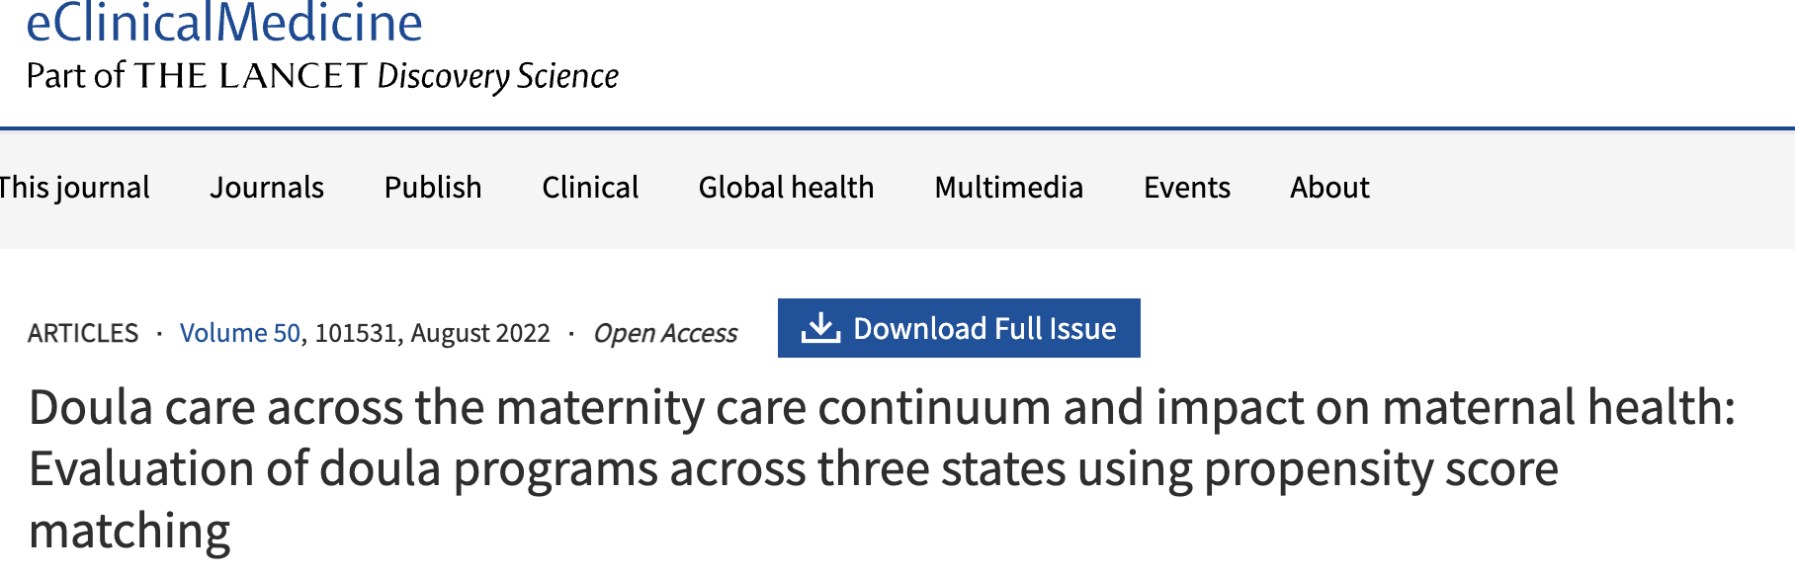
This is not a one off-example!
Analyses comparing outcome of program participants to non-participants are frequently published in high impact journals!

Slide 23
Other causal inference strategies
What if we couldn’t randomize?
We will cover several *other* econometric strategies you can use
Suppose we knew that there was a lot of variation in how much OB-GYNs serving Medicaid patients referred to NFP
Instrumental variables approach
Suppose there was policy that allowed families who had a prior birth with an infant delivered at <30 weeks gestation to receive home based services during their current pregnancy?
Regression discontinuity approach
Suppose we had a state where nurse home visiting was rolled out in some counties but not in others
Difference in differences approach

Slide 24
Approach to Econometrics in PHS2000B
Learning objectives
To understand the objectives of econometrics and how it differs from other causal inference approaches
To gain exposure to some of the econometric methods being used most often in public health research
Focus on intuition
Understand how to interpret results
Get some exposure to estimation
You will not learn 1/10 of what you would learn in a full econometrics course
Understanding of econometric techniques constantly evolving
Using these tools in your research requires a lot of learning by doing and mentorship from people familiar with using the methods
How do you set up your data, which method is the best fit, etc.

Slide 25
Learning to use a method
Assumptions: It is important to know and state the assumptions of the method that are required to establish internal validity of estimates
Testable assumptions should be tested, method only used if tests are passed
Untestable assumptions stated and discussed
Additional assumptions are required for valid confidence intervals, and these should also be stated and tested
Analysis should reflect recent developments – awareness of advances in tests of assumption validity, estimation techniques, options for estimation, post estimation presentation of results

Slide 26
Debates between different disciplines
Acceptability of untestable assumptions is based on norms
Changes over time, and history matters – impact of key papers in field
Real differences in assumptions between econometrics and epidemiology, plus differences in naming ideas
May be difficult to export a method to a different discipline if the assumptions are novel in that field: but increasingly econometrics techniques used in public health
Technical detail requirements for publication differ significantly
Break for Questions

Slide 27
Some social norms in Econometrics compared with Biostatistics and Epidemiology
Use of linear probability model rather than logistic regression for binary outcomes
Pervasive use of fixed effects but not random effects
Less emphasis on data quality and reporting of construction of analysis samples
Estimation of many models with different covariates or functional form as robustness checks
Continuous explanatory variables rather than discrete groups (e.g., age)
Estimation of marginal effects not relative risks or odds ratios
Break for Questions

Slide 28
Continuous development of methods
The literature on each method advances rapidly over time
New sources of bias always being discovered!
Valid confidence intervals
Constructing valid confidence intervals requires additional assumption to those needed for having valid (consistent) estimates
Robust standard errors, clustering, small sample corrections (i.e. bootstrapping) relax additional assumptions needed for valid standard errors
Different estimation techniques
Minimize errors, maximum likelihood, method of moments (see extra slides for more)
Can have slightly different assumptions
Monte Carlo studies of method performance
Better algorithms for estimating coefficients
Faster computers allow brute force approach without assumptions to speed computation
Break for Questions

Slide 29
Additional slides

Slide 30
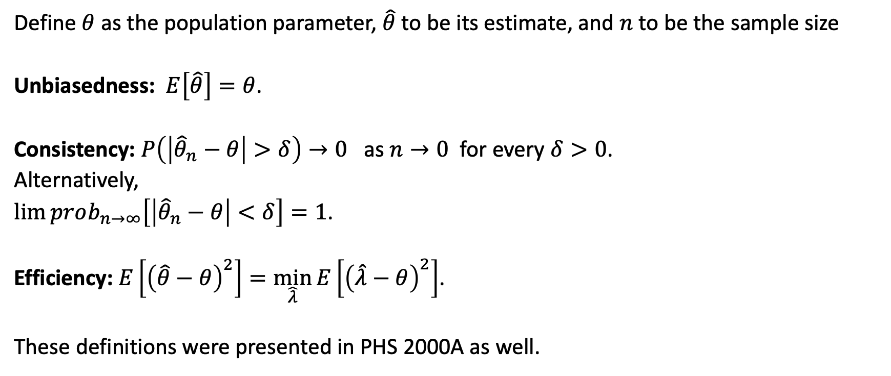
Estimator properties expressed mathematically
Define $θ$ as the population parameter, $\hat{θ}$ to be its estimate, and $n$ to be the sample size
Unbiasedness: $E\left[\hat{θ}\right]=θ$.
Consistency: $P\left(\left|{\hat{θ}}_{n}−θ\right|>δ\right)→0$ as $n→0$ for every $δ>0$.
Alternatively,
$\lim{prob_{n→∞}\left[\left|{\hat{θ}}_{n}−θ\right|<δ\right]}=1$.
Efficiency: $E\left[{\left(\hat{θ}−θ\right)}^{2}\right]=\min_{\hat{λ}}{E\left[{\left(\hat{λ}−θ\right)}^{2}\right]}$.
These definitions were presented in PHS 2000A as well.

Slide 31
I. Epi-Econ Dictionary
Developed by Emma Clarke, Doctoral Candidate, Global Health and Population Department, Harvard T. H. Chan School of Public Health

Slide 32

Omitted Variable Bias and Randomized Trials
Assume the true population model is given by:
$$Y=X_{1}β_{1}+X_{2}β_{2}+ε$$
Where we have demeaned the variables to remove the constant and we assume the error is i.i.d. random mean zero. However we estimate
$$Y=X_{1}β_{1}+u$$
Which has omitted variable bias. We have
$$u=X_{2}β_{2}+ε$$

Slide 33
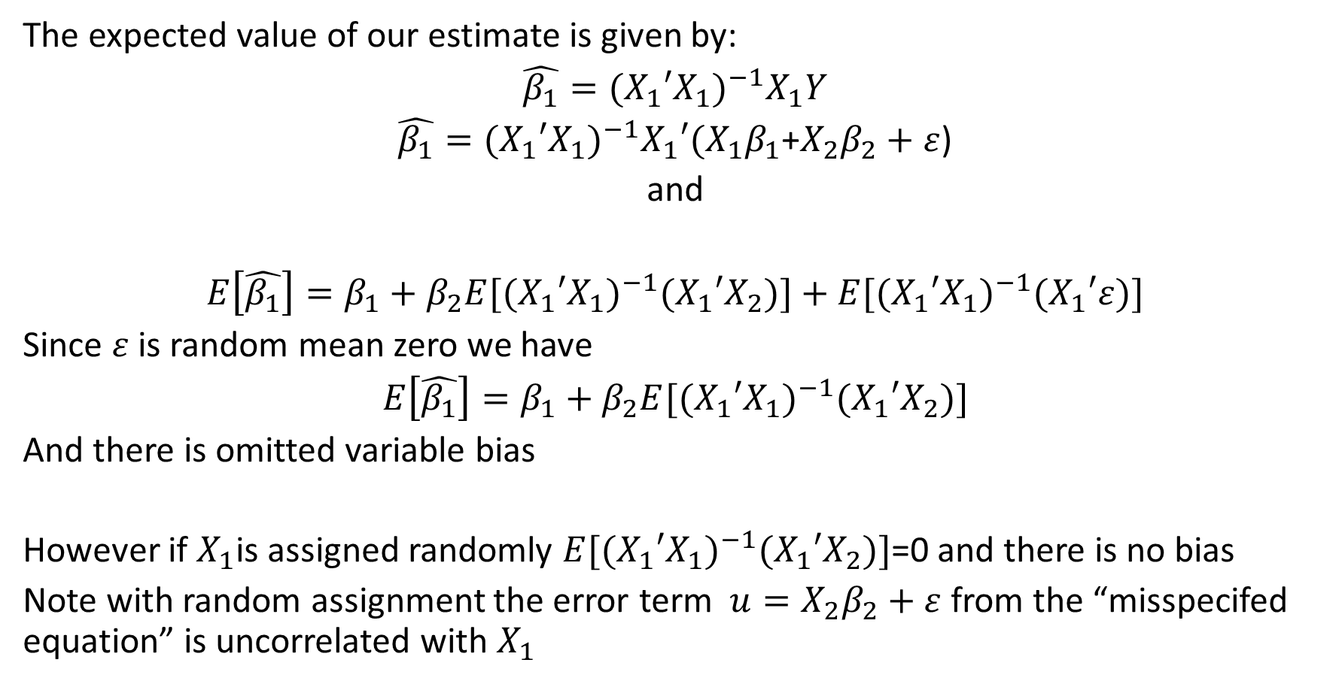
Omitted Variable Bias and Randomized trials cont’d
The expected value of our estimate is given by:
$$\hat{β_{1}}=({X_{1}{′X}_{1})}^{−1}X_{1}Y$$
$\hat{β_{1}}=({X_{1}{′X}_{1})}^{−1}X_{1}′(X_{1}β_{1}$+$X_{2}β_{2}+ε$)
and
$$E\left[\hat{β_{1}}\right]=β_{1}+β_{2}E{{[(X}_{1}{′X}_{1})}^{−1}(X_{1}{′X}_{2})]+E{{[(X}_{1}{′X}_{1})}^{−1}(X_{1}′ε)]$$
Since $ε$ is random mean zero we have
$$E\left[\hat{β_{1}}\right]=β_{1}+β_{2}E{{[(X}_{1}{′X}_{1})}^{−1}(X_{1}{′X}_{2})]$$
And there is omitted variable bias
However if $X_{1}$is assigned randomly $E{{[(X}_{1}{′X}_{1})}^{−1}(X_{1}{′X}_{2})]$=0 and there is no bias
Note with random assignment the error term $u=X_{2}β_{2}+ε$ from the “misspecifed equation” is uncorrelated with $X_{1}$

Slide 34
Term | Use in Economics | Use in Epidemiology
Selection bias | Economists think about selection bias as a problem arising from selection into the sample being studied. | Relationship between exposure and disease is different for those who participate in the study compared with all those who should have been theoretically eligible for the study. Epidemiologists think about selection bias as a problem arising from conditioning on common effects, or selection into the study.
Omitted variable bias | The bias that arises when a confounder is not included in a regression model. | Epidemiologists would typically use the term “unmeasured confounding” here instead.
Identified | A parameter is identified if different values give rise to different data distributions. It is not identified if two values generate the same distribution of the data

Slide 35
Term | Use in Economics | Use in Epidemiology
Marginal effect | Marginal refers to a derivative (e.g., the marginal benefit is the additional amount of benefit that comes from consuming one additional unit of a good). Intuitively, you can think about “tweaking at the margins”. | Marginal refers to an integral or a sum (e.g., the marginal treatment effect is the effect over the total population). Intuitively, you can think about the margins of a 2x2 table.
Endogenous | When a treatment variable is correlated with the error term in a linear regression creating bias. Usually used in the sense that (1) the dependent variable Y has a causal effect on X (simultaneity or reverse causation bias). Can also occur if there is (1) omitted variable bias; (2) measurement error. | The term is not typically used in Epidemiology.
Exogenous | Opposite of endogenous, uncorrelated with error term | This term is not typically used in Epidemiology

Slide 36
II. Comparing different estimators

Slide 37
Different estimators
Minimize a function of unexplained residuals
Choose parameters to minimize residuals from a model
Requires an explicit model
Sum of squared residuals, sum of absolute residuals
Maximum Likelihood
Choose parameters to maximize the likelihood of the observations given the parameter
Requires explicit model of how data are generated from parameters
Method of Moments
Choose parameters to equate observed, sample moments with expected moments given parameters
Many possible moments to match

Slide 38
Minimizing Residuals
Fit a model
OLS Choose parameters to minimize

Slide 39
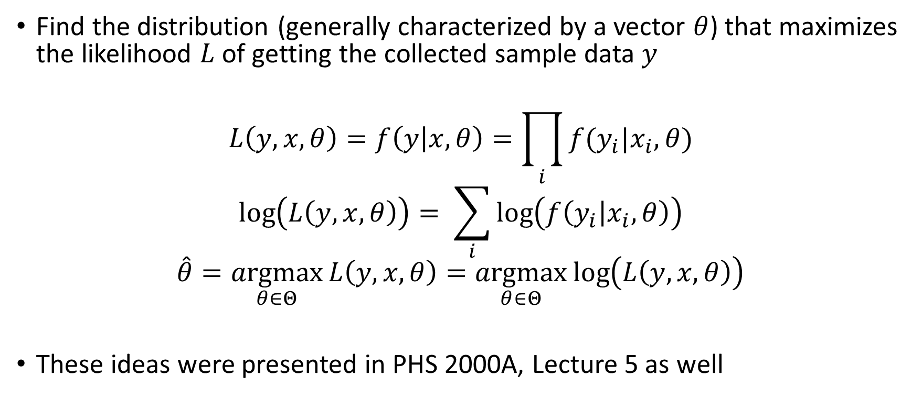
Maximum Likelihood Principle
Find the distribution (generally characterized by a vector $θ$) that maximizes the likelihood $L$ of getting the collected sample data $y$
$$L\left(y,x,θ\right)=f\left(y | x,θ\right)=\prod_{i}{f(y_{i}|x_{i},θ)}$$
$$\log\left(L\left(y,x,θ\right)\right)= \sum_{i}{\log\left(f\left(y_{i} | x_{i},θ\right)\right)}$$
$$\hat{θ}=\underset{θ∈Θ}{argmax}{L\left(y,x,θ\right)=\underset{θ∈Θ}{argmax}\log\left(L\left(y,x,θ\right)\right)}$$
These ideas were presented in PHS 2000A, Lecture 5 as well

Slide 40
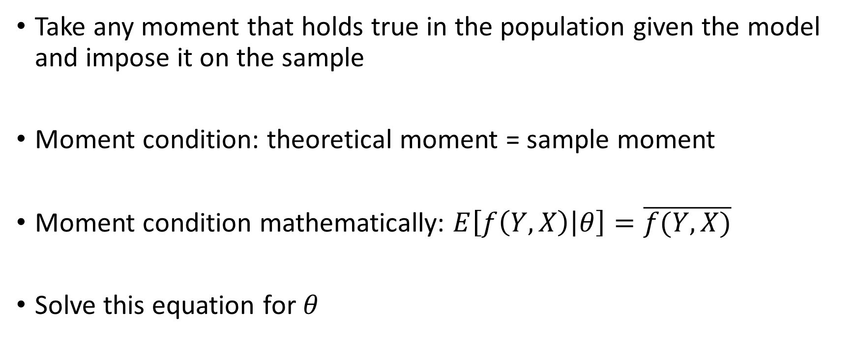
Generalized Method of Moments
Take any moment that holds true in the population given the model and impose it on the sample
Moment condition: theoretical moment = sample moment
Moment condition mathematically: $E\left[f\left(Y,X\right) | θ\right]=\overline{f(Y,X)}$
Solve this equation for $θ$

Slide 41
Coin Toss – is it a fair coin?: Estimator Comparisons
Coin flip n tosses
Outcome
Observe k heads
We want probability of a head
OLS estimate

Slide 42
Coin Toss: Maximum Likelihood
Maximum likelihood estimate

Slide 43
Coin Toss: Method of Moments
Method of moments equate model moment and observed moment
Observed moment – proportion heads
Model moment – expected proportion heads
Equating moments

Slide 44
OLS and Maximum Likelihood
Further, assume one explanatory variable no constant and errors are normally distributed

Slide 45
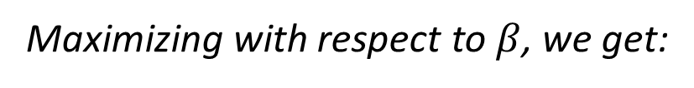
OLS and Maximum Likelihood
Maximizing with respect to $β$, we get:

Slide 46
OLS and Method of Moments
Take the sample moments one for each explanatory variable

Slide 47
Some notes on different estimators
In simple cases the three estimation approaches are equivalent. OLS is minimum sum or residuals, method of moments, and maximum likelihood estimator (for assumed normal errors )
In more complex cases they may give different estimators
Taxi problem: suppose we know taxi’s in a town are numbered 1 to N we observe one taxi numbered k. What is your estimate of N using Method of Moments and Maximum Likelihood? Actually used in WW2 where enemy tank with number k was captured.
As well as 3 different types of estimator we also have different estimators depending on details – e.g. function of residuals to minimize, functional form of error term in max likelihood, which moments we equate in method of moments

