Slide 1
Econometrics Review: PHS 2000B
Maggie McConnell
Spring 2025
Harvard T. H. Chan School of Public Health

Slide 2
Plan of presentation
Wrap-up synthetic control
Recap objectives of econometrics
Discussion of internal and external validity
Using a method
Review of Instrumental variables
Review of Interrupted Time Series
My office hours: Tuesday 1:15pm-1:50pm, Building 1 Room 1217

Slide 3
Synthetic control -- Intuition
Intuition – we are trying to find a control group that is similar to treated group in pre-treatment period
Similar covariates that affect the outcome
Similar values of the outcome
Helps with the plausibility of the counterfactual
The treatment group would have followed the path of the control group if it had not been treated in the post-intervention period
We may try to find this as a naturally occurring phenomena
Sometimes this isn’t possible – especially with just one treatment group and few control options
The idea of synthetic control is to “create” this control group using a data driven and transparent process

Slide 4
Synthetic control – How it works
To create a synthetic control we use weighted average of possible control groups as counterfactual
Choose weights to match outcome and covariates in the treated group during the pre-interventional period
Counterfactual – treated group would have continued in the same way as the synthetic control in the absence of treatment

Slide 5
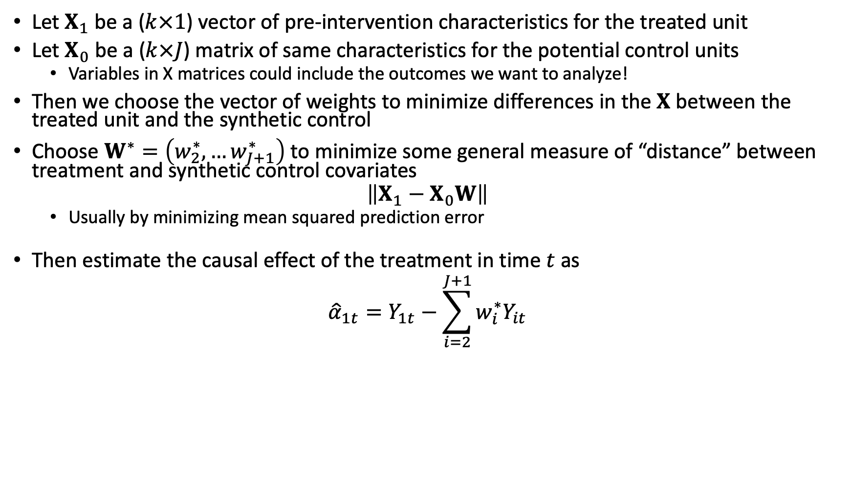
Diff-in-diff – Synthetic control
Let $X_{1}$ be a ($k×1$) vector of pre-intervention characteristics for the treated unit
Let $X_{0}$ be a ($k×J$) matrix of same characteristics for the potential control units
Variables in X matrices could include the outcomes we want to analyze!
Then we choose the vector of weights to minimize differences in the $X$ between the treated unit and the synthetic control
Choose $W^{∗}=\left(w_{2}^{∗},…w_{J+1}^{∗}\right)$ to minimize some general measure of “distance” between treatment and synthetic control covariates
$$\left\|X_{1}−X_{0}W\right\|$$
Usually by minimizing mean squared prediction error
Then estimate the causal effect of the treatment in time $t$ as
$${\hat{α}}_{1t}=Y_{1t}−\sum_{i=2}^{J+1}{w_{i}^{∗}Y_{it}}$$
Notes:
CIA

Slide 6
Overfitting and Validation
Model may be over fit – it performs very well in the pretreatment period due to chance
Particularly true if there are a lot of potential control groups and pretreatment time period is short
May bias results
Some strategies to address
Only fit model in training period subsample of the full pre-intervention period
Validate the fitted model by using it to predict outcomes in the data held back from fitting.
Use weights that preform well in both fit in training period and out of sample validation
Similar approach to machine learning approaches (i.e. causal forests)

Slide 7
Hypothesis testing
How likely is it we see the gap between treated group and synthetic control due to chance ?
Placebo approach – time dimension and space dimension
Try setting different random placebo “intervention” groups and times in control units
Estimate the “effect” of these fake intervention by creating synthetic controls form them from the other control groups.
Under assumption of no effect of the placebo “interventions” we get a distribution of observed “effects” under the null of no effect
Reject the null of no effect if estimated effect size for the treatment is outside the 95% confidence interval generated by the placebo effect distribution

Slide 8
Assumptions for Synthetic control methods
Availability of donor groups to construct controls. Similar to treatment group – driven by similar shocks
But did not get the treatment
Did not get large idiosyncratic shocks in the post-intervention period that did not affect the treatment group
Synthetic control matches actual outcome data closely in the pre-intervention period – testable
Size of the effect is large relative to noise
No anticipation of treatment
No spillovers of treatment effect between groups

Slide 9
Example
Research question: What was the effect of California’s Proposition 99 on cigarette sales?
Increased cigarette tax by 25 cents/pack
Tax revenues earmarked for anti-smoking education
Funded anti-smoking media campaigns
Clean indoor-air ordinances
Passed in 1988
Policy passed in only one state
Are there any states that make good “controls” for California?
Synthetic Control Methods for Comparative Case Studies: Estimating the Effect of California’s Tobacco Control Program (Abadie et al 2010)
Notes:
CIA

Slide 10
Synthetic Control Example
Step 1: Throw out 11 other states that passed similar tobacco control legislation (contaminates control)
Step 2: Decide which covariates predict post-period outcomes and should be used for determining synth control weights (minimize MSPE)
Step 3: Look at the weights assigned by the MSPE minimization
Are they “reasonable”? What might you consider reasonable?
If not, might reconsider whether you’re using the right variables to construct weights
Notes:
CIA

Slide 11
Synthetic Control Example

Slide 12
Synthetic control example
Synthetic control uses high-tech methods to get “right” counterfactual but you can still make nice visuals

Slide 13
Synthetic control example – event study

Slide 14
ITS and Synthetic Control example
You can also use synthetic control methods within ITS – situations where we might have just one treatment group
Example: Impact of tobacco taxes in South Africa
South Africa increased tobacco taxes considerably after 1994.
Advertising and smoking bans were implemented in 2001.
What was the effect on tobacco consumption?
Counterfactual – synthetic control from similar countries
Chelwa, Grieve, Corné van Walbeek, and Evan Blecher. "Evaluating South Africa's tobacco control policy using a synthetic control method." Tobacco Control 26.5 (2017): 509-517.

Slide 15
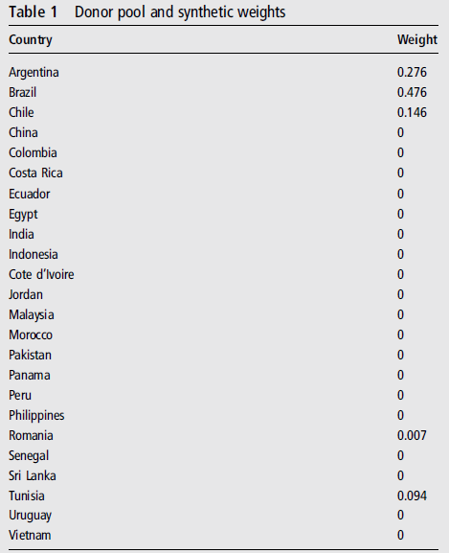
Synthetic Weights
Donor pool: other low and middle-income countries
Pattern of increasing affordability of cigarettes over the period (price/income per capita)
Donor pool excludes Thailand (and South Africa) and any countries with missing data
Variables: Per capita cigarette consumption (the outcome variable), real price of cigarettes, per capita real GDP, per capita alcohol consumption and the proportion of adults in the total population.
24 control countries

Slide 16
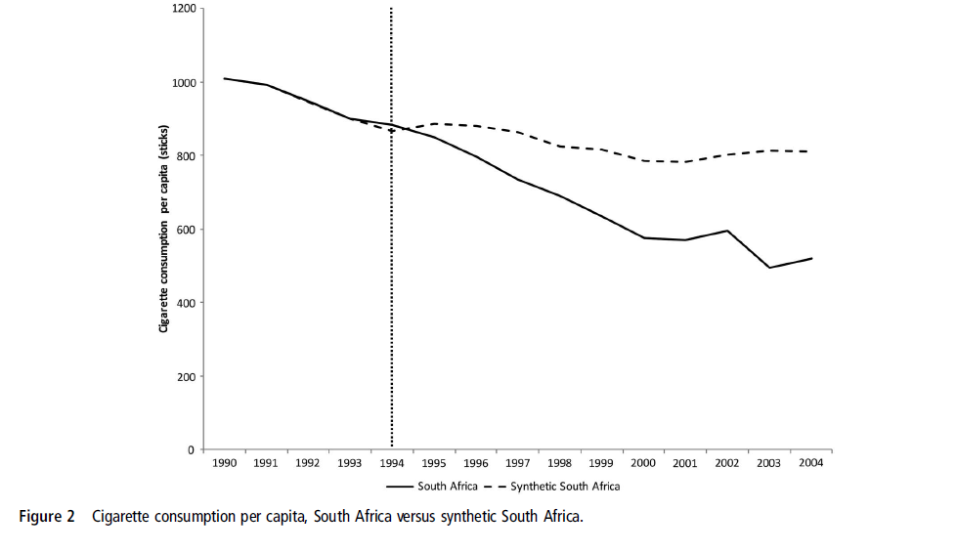

Slide 17
Summary – Synthetic Control
In settings with few treated units and few control units, synthetic control can be a powerful way to improve on diff-in-diff
Weights can be estimated before an intervention even begins; allows for pre-specification of counterfactual
If used to complement diff-in-diff or ITS: Be transparent! Show regular diff-in-diff / ITS and synth control estimates
Weights can be sensitive to specification choices – good to show different options
Requires a lot of high-quality pre-treatment data to get a good fit
Inference requires a variety of methods: placebo methods, randomization inference

Slide 18
Example
Research question: What was the effect of California’s Proposition 99 on cigarette sales?
Increased cigarette tax by 25 cents/pack
Tax revenues earmarked for anti-smoking education
Funded anti-smoking media campaigns
Clean indoor-air ordinances
Passed in 1988
Policy passed in only one state
Are there any states that make good “controls” for California?
Synthetic Control Methods for Comparative Case Studies: Estimating the Effect of California’s Tobacco Control Program (Abadie et al 2010)
Notes:
CIA

Slide 19
Synthetic Control Example
Step 1: Throw out 11 other states that passed similar tobacco control legislation (contaminates control)
Step 2: Decide which covariates predict post-period outcomes and should be used for determining synth control weights (minimize MSPE)
Step 3: Look at the weights assigned by the MSPE minimization
Are they “reasonable”? What might you consider reasonable?
If not, might reconsider whether you’re using the right variables to construct weights
Notes:
CIA

Slide 20
Synthetic Control Example

Slide 21
Synthetic control example
Synthetic control uses high-tech methods to get “right” counterfactual but you can still make nice visuals

Slide 22
Synthetic control example – event study

Slide 23
ITS and Synthetic Control example
You can also use synthetic control methods within ITS – situations where we might have just one treatment group
Example: Impact of tobacco taxes in South Africa
South Africa increased tobacco taxes considerably after 1994.
Advertising and smoking bans were implemented in 2001.
What was the effect on tobacco consumption?
Counterfactual – synthetic control from similar countries
Chelwa, Grieve, Corné van Walbeek, and Evan Blecher. "Evaluating South Africa's tobacco control policy using a synthetic control method." Tobacco Control 26.5 (2017): 509-517.

Slide 24
Synthetic Weights
Donor pool: other low and middle-income countries
Pattern of increasing affordability of cigarettes over the period (price/income per capita)
Donor pool excludes Thailand (and South Africa) and any countries with missing data
Variables: Per capita cigarette consumption (the outcome variable), real price of cigarettes, per capita real GDP, per capita alcohol consumption and the proportion of adults in the total population.
24 control countries

Slide 26
Summary – Synthetic Control
In settings with few treated units and few control units, synthetic control can be a powerful way to improve on diff-in-diff
Weights can be estimated before an intervention even begins; allows for pre-specification of counterfactual
If used to complement diff-in-diff or ITS: Be transparent! Show regular diff-in-diff / ITS and synth control estimates
Weights can be sensitive to specification choices – good to show different options
Requires a lot of high-quality pre-treatment data to get a good fit
Inference requires a variety of methods: placebo methods, randomization inference
Synthetic control versus matching strategies
Individual versus group level data
Interpolation versus extrapolation bias
In theory could be combined, see Kellog et al 2021

Slide 27
Review: Econometrics

Slide 28
What is the point of econometrics?
The primary objective of econometrics is to identify causal effects
What differentiates econometrics from other causal inference approaches is extremely limited tolerance for confounding
Very unwilling to imagine that we could model sources of confounding
Human behavior is unpredictable and interesting and full of agency – people can choose how to react to policies/program and anticipate policy changes
Many of the things that economists care about are hard to measure/not typically available in datasets
Your beliefs, preferences, motivations, past experiences, etc
Economists love to imagine alternative theories – plausible or not!
Very hard to imagine you could model/“control for” all possible theories of behavior

Slide 29
Econometrics: focus on internal validity
Ultimately economists require methods that ensure internal validity
Sometimes external validity is less of a focus
Internal validity
The estimates are close to the true parameter values in the sample for which we have data
If methods are not internally valid, economists not interested in results
External validity
The estimates are close to the parameter values in a population when they are used to predict outcomes
Generalizability and transportability
One thing to practice as you study different methods is knowing how to differentiate between concerns related to internal vs external validity

Slide 30
Internal validity
Internal validity usually requires some assumptions BUT only some of the assumptions are testable
When we can’t directly test, economists favor methods that can:
provide transparent visualizations (RDD, ITS, DiD when presented as event study) OR
settings where we know enough about the institutional setting to be confident about the assignment to ”treatment” (IV)
I.e. designs that use the assignment of a case worker, judge, etc
Where a choice of methods is available, economists always prefer the method with fewer untestable assumptions
New methods sometimes have “hidden” assumptions that are stated in highly technical language --may take time and examples to uncover plausibility
Example – the discovery that two-way fixed effects models in difference in difference estimates using already treated units as controls – people used this for decades before realizing it can bias results toward the null

Slide 31
External validity
When we use econometric methods we get estimates of “treatment effects” for specific sample at a particular time under certain conditions
How much can we generalize these findings? what about similar interventions/policies? differences in implementation?
While trials provide excellent internal validity – they may have external validity challenges
Special inclusion criteria: i.e. restricting trials to populations that are not likely to move away, those above a certain age, etc
Trial conditions that minimize attrition may limit external validity
i.e. many trials provide substantial financial payments for ongoing participation
Populations that historically have been excluded from trials may be the policy relevant population (i.e. women, Black birthing women, pregnant people)
Quasi-experimental techniques we have learned may be
more externally valid
For example if they take place in more naturalistic or policy-relevant settings, use naturally occurring administrative records that don’t require follow-up data collection and include data from a wide variety of states and settings
less externally valid
For example when they take place at a specific time/setting or the estimated treatment effect is only valid for a narrow group (i.e. those affected by an instrumental variable or near a threshold)

Slide 32
Improving Internal and External Validity
Empirical work usually does not settle a research question – new papers continue to be published
Contribution is to advance knowledge – can we improve internal and external validity?
Some questions are hard to answer – can we improve on existing estimates even if we do not have perfection?

Slide 33
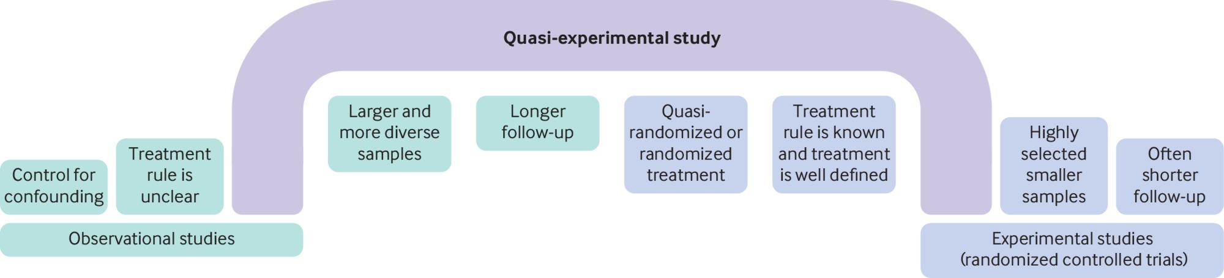
Rationale – quasi-experimental studies
Calonico S, Jawadekar N, Kezios K, Zeki Al Hazzouri A. Regression discontinuity design studies: a guide for health researchers. BMJ. 2024 Feb 27;384:e072254.

Slide 34
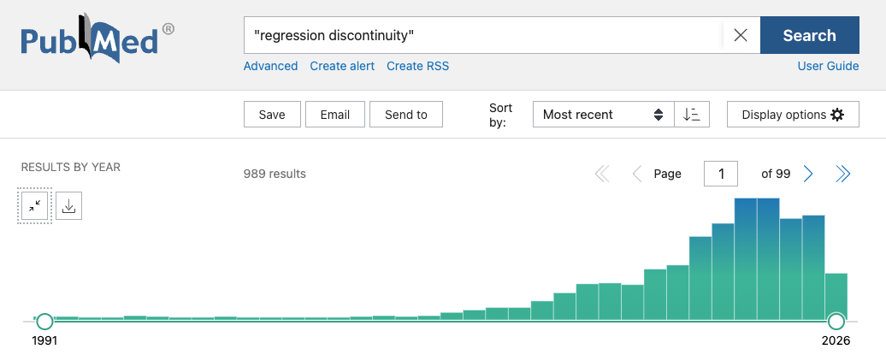
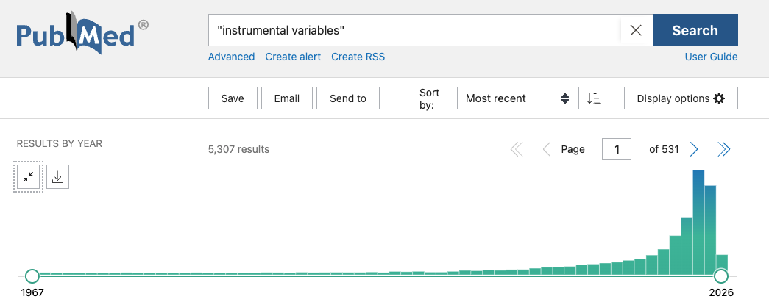
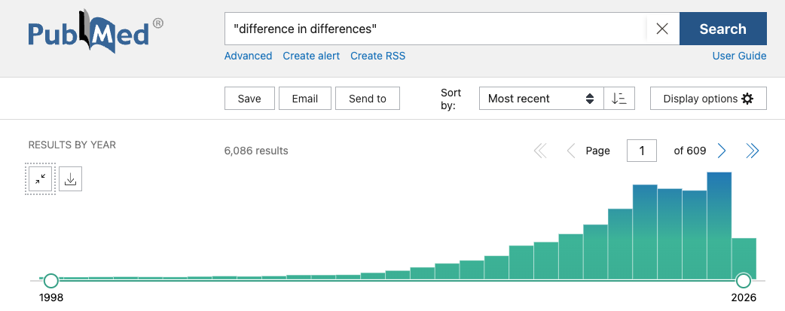
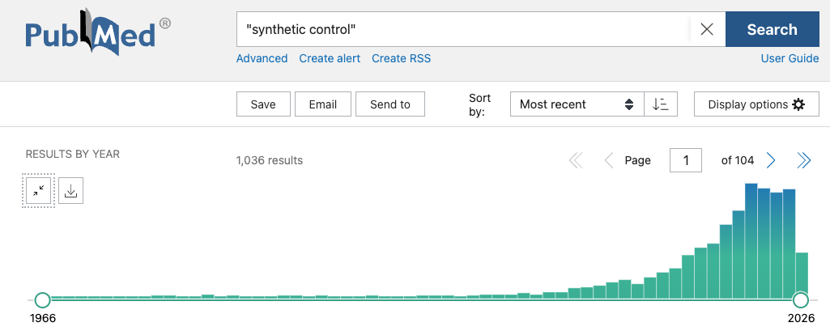

Slide 35
Learning to use a method
Assumptions: we should know and state the assumptions of the method that are required to establish internal validity of estimates
Testable assumptions should be tested, proceeding only if these tests are passed
Additional assumptions are required for valid confidence intervals, and these should also be stated and tested
Analysis should reflect recent developments – awareness of advances in tests of assumption validity, estimation techniques, options for estimation, post estimation presentation of results
Increasingly, success in publishing relies on making compelling and transparent figures to go along with your estimates

Slide 36
Instrumental variables recap
W
X
Y
Z

Slide 37
When does this work?
There are FOUR key requirements for IV inference
Relevance: The instrument must be highly correlated with the variable of interest
Excludability: The instrument must NOT have a direct causal effect on the outcome Y
Independence: The instrument cannot be correlated with any other unobserved determinant of the outcome Y
Homogeneity: The treatment effect is homogenous across all study subjects
If we think this isn’t plausible, we can still estimate LOCAL average treatment effects relevant for those affected by the instrument if we assume monotonicity
Assignment to a treatment unit does not make anyone less likely to be a member of their treatment unit than they are supposed to be - when treatment is binary this means no defiers

Slide 38
Condition 1: Relevance
The relevance assumption is relatively easy to both satisfy and verify
In most contexts, other factors are correlated with the variable of interest
The “strength” of the instrument is determined by its predictive power in a multivariate setting
A good instrument explains a significance part of the variation in the endogenous variable once we control for all other factors in our empirical model

Slide 39
Conditions 2/3: Excludability/Independence
The excludability/independence conditions are more complex since orthogonality to (i.e., being uncorrelated with) the error requires that:
The instrument does not have a direct effect on the dependent variable
The instrument is not correlated with other omitted variables that have a direct effect
The instrument is not correlated with measurement error
The instrument is not “caused” by the dependent variable
This assumption is not testable
We can only discuss its conceptual plausibility

Slide 40
Local Average Treatment Effect (LATE)
Local average treatment effect:
Average causal effect of the treatment among a subset of individuals, known as compliers, who are induced to comply with the treatment assignment due to the instrument
LATE may be different from the Average Treatment Effect (ATE)
LATE will converge to ATE with very good adherence (i.e. when if the instrument is a randomized treatment assignment if all those assigned to treatment receive the intervention and all those assigned to control do not)

Slide 41
Heterogeneity of effect and the Local Average Treatment Effect (LATE)
Relevant heterogeneity might be as follows:
Compliers: only take the treatment if assigned to treatment group
Always-takers: always take the treatment even if assigned to the control group
Never-takers: always refuse treatment, even if assigned to the treatment group
Defiers: do the opposite of their treatment assignment
If any of the last 3 are meaningfully different from the compliers and they are populations of interest for policy-makers → LATE estimates not very helpful
Can we observe who are always takers and who are compliers?
Note: we are focused here on heterogeneity that is related to the likelihood of receiving the treatment there are OTHER kinds of heterogeneity that may be important (as with all designs identifying treatment effects)

Slide 42
Terminology
Reduced form: effect of the instrument on the outcome
In some cases this is actually the policy relevant research question
First stage: effect of the instrument on the treatment
Weak instruments: when our first stage relationship isn’t very strong (we test this using F-statistics)

Slide 43
Examples: instruments
Research question: What is the effect of placement in foster care on subsequent use of emergency department care?
Instrument: assignment of placement officer
Research question: What is the relationship between the number of children a family has and the amount of education children receive?
Instrument: indicator of whether first child is male in a context with strong son preference
Research question: What is the impact of requiring workers to be physically present on COVID-19 death rates?
Instrument: index of how many local workers pre-pandemic can work from home, based on differences in county occupational mix

Slide 44
Regression Discontinuity

Slide 45
Under what conditions can we estimate RDD?
Conditions
A continuous eligibility index: a continuous measure on which the population of interest is ranked (i.e. test score, health indicator, age, vote share)
Often called “running variable”
A clearly defined cutoff point: a point on the index above or below which the population is determined to be eligible for the program
Sometimes referred to as the “threshold”

Slide 46
What assumptions required for RDD to be valid?
Key assumption
Continuity assumption: The only thing that causes a discontinuity above and below the threshold is the likelihood of program participation/eligibility
Implications of this assumption
Individuals can’t be able to manipulate the running variable in order to increase the chances of being included / excluded
Individuals close to the threshold should be very similar, on average, in observed and unobserved characteristics
There’s no other competing intervention or policy change occurring around the threshold

Slide 47
RDD, RCTs, and IV estimation
Under ideal conditions, RDDs are very similar conceptually to RCTs: if it is true that treatment assignment is close to “random” within the analyzed range, then RDDs become a quasi-experiment
RDDs can also be seen as a special case of IV estimation
Under the RDD assumption, we know that there is an increase in the treatment at the cutoff, and we explore this exogenous variation in the treatment to identify the causal effect of interest
Key question: How plausible is it that the cutoff affects the outcome only through treatment?
Recall, this is the similar to the exclusion assumption in an IV setting

Slide 48
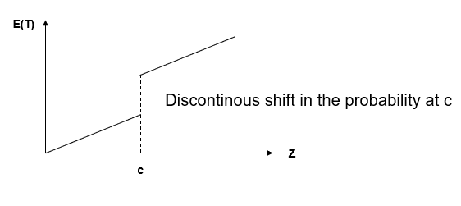

The critical threshold
Assume that there is a continuous variable z which determines eligibility for treatment discontinuously at some cutoff ($c$)
$$\lim_{Z↓c}\operatorname{Pr}\left(T_{i}=1\right)≠\lim_{Z↑C} Pr⁡(T_{i}=1)$$

Slide 49
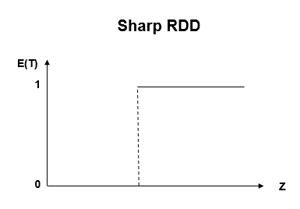
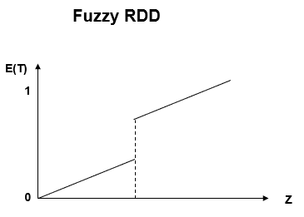
Sharp discontinuities vs. fuzzy discontinuities
With sharp discontinuities, the probability of receiving treatment at the cutoff goes from 0 to 1
With fuzzy discontinuities, the change in probability of receiving treatment at the cutoff is less than 1

Slide 50
Assessment of Validity of RDD
We want the distribution of the running variable to be smooth around the threshold
No bunching (i.e. no signs of manipulation)
We want to see a jump in the probability of receiving treatment at the threshold
For sharp RD this jump goes from 0 to 1
For fuzzy RDD this jump is somewhere in the range 0<p<1
We want the characteristics of those just above and below the threshold to be similar

Slide 51
Practical Tips: Assessing the Validity of RDD
Show characteristics (SES, age...) are balanced around cutoff.
One way to do this is to estimate the same main regression as RD but your “outcomes” are the covariates. Look for jumps near the cutoff.
Similar to balance tables in RCTs
2) Look for “bunching” in the running variable around cutoff
Should not be extra mass in distribution near cutoff
Can use McCrary 2008 density test to test this formally
3) Estimate causal effect using different bandwidths and check stability of estimates — instability suggests wrong functional form
can use formal procedures to choose “optimal” bandwidth (Imbens and Kalyanaraman 2009)
4) Estimate “false threshold”
Should not find significant effects at the wrong threshold

Slide 52
IV vs. RDD
Both IV and RDD strategies explore random variations generated by specific programs or thresholds
While this variation could be randomly distributed across the entire population (like the variation in exposure generated by an RCT), most IVs and RDD explore variations generated by government laws or other quasi-random rules
If treatment impact is heterogeneous, the estimates are not necessarily the average treatment effects for the population.
We refer to RDD estimates as ACE or CACE, and to IV estimates as LATE.
Big advantage of RDD – relies on continuity of missing covariates with z, not on no correlation between covariates and z.

Slide 53
Strength of RDDs
RDD models have many potential applications
The assumption that treatment assignment is discontinuous around a very specific threshold is plausible in many settings and can be tested
The degree to which populations are the same to the “left” and “right” of the threshold can be tested empirically – test balance of observables
The plausibility of RDD is possible to assess visually – can lend strength to conclusions
RDD estimate the causal effect of treatments in practice, which may be very different from the controlled environments generated for RCTs

Slide 54
Interrupted Time Series

Slide 55
Logic of interrupted time series analysis
Time series data allows us to carefully model the general trends in our outcome of interest
Most programs/treatments are introduced at a very specific time point: if the program worked, we should observe that the outcome shifts onto a different trajectory after the policy change happened
The main assumption of this interrupted time series (ITS) approach is that the pre-intervention trend can be continued after the intervention as the counterfactual

Slide 56
ITS counterfactual
In a randomized trial the counterfactual is what happens in the control group – we think this is what would have happened without the treatment
In ITS we fit a trend to the data in the pre intervention period – the counterfactual is that the data would have follows this trend in the post intervention period without the trend
Requires that no other new interventions happening in the post intervention period that could affect the outcome
This is a big assumption – not likely to be true when we know the policy landscape changing at the same time

Slide 57
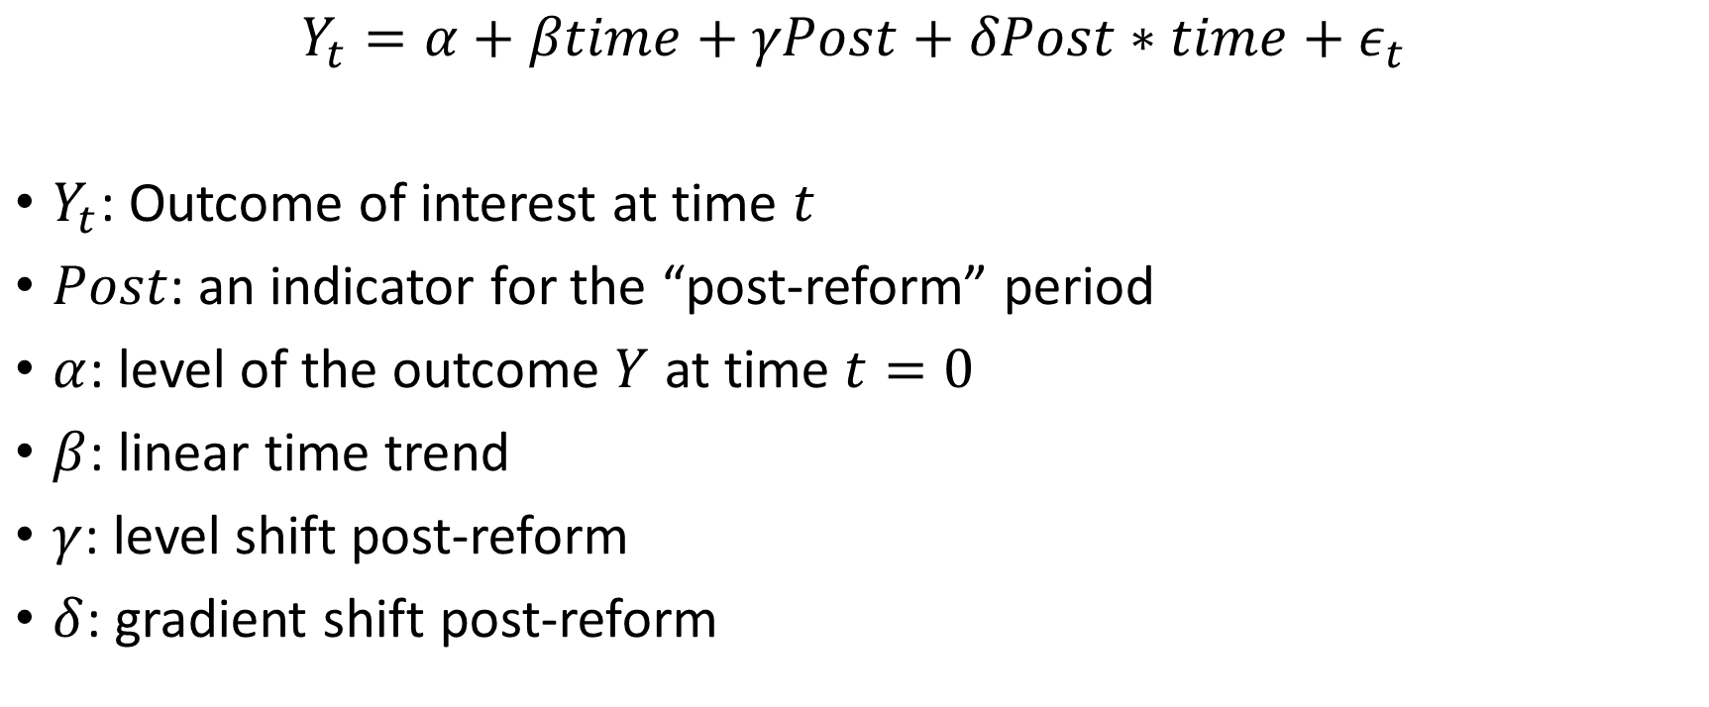
ITS specification
$$Y_{t}=α+βtime+γPost+δPost∗time+ε_{t}$$
$Y_{t}$: Outcome of interest at time $t$
$Post$: an indicator for the “post-reform” period
$α$: level of the outcome $Y$ at time $t=0$
$β$: linear time trend
$γ$: level shift post-reform
$δ$: gradient shift post-reform

Slide 58
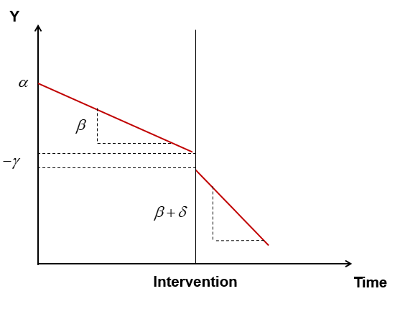
Interpretation of coefficients

Slide 59
Challenge: Getting the timing right
In some instances, the impact of the policy change should be immediate conditional on the policy being effectively implemented
For example: handwashing on diarrhea, or speeding laws on traffic accidents
In many other cases, it is not clear how soon we should expect an impact on outcomes
Particularly challenging for outcomes like cancer or children’s height which are the result of longer-term processes
There may possibly be anticipation effects as well
For example, if there’s an announced change in billing policies around the insertion of long-acting contraceptive methods, hospital practices may start to alter before the billing change goes into effect
We need to have a clear conceptual framework for when we would expect impact relative to the timing of the reform

Slide 60
Specifying the impact model
Before running actual regressions, we need to be clear regarding our hypotheses on how the policy change affected the outcomes of interest
Intercept shift: are we expecting an immediate shift in the outcome?
Slope shift: are we expecting outcome trajectories to change?
Timing and duration change: are we expecting changes to start immediately or to start with a lag? To last, or to fade out?

Slide 61
Difference in Differences

Slide 62
Difference-in-Differences logic
The real causal question is: How would the “treated” have done without the treatment?
Differences in differences assumes the control group can tell us what would have happened in the post intervention period in the treatment group with no intervention
The counterfactual is that if the treatment group had not got the treatment, the change we would have seen is the change observed in the control group over the same period

Slide 63
Difference in difference
B
DD: change in treated group relative to change in control
 | Treatment | Control
Before | A | C
After | B | D
Change | B-A | D-C
DD | ( B-A ) – ( D-C )
B-A: change in treated group
A
D
D-C: change in control group
C
Pre
Post
Did the outcomes in the treated areas improve by more than in the control areas?
DD = ( change in treatment ) – ( change in control ) = ( Treat^{post} - Treat^{pre} ) – (Control^{post} - Control^{pre} )

Slide 64
Key assumptions: Counterfactual
Key assumption in Difference-in-Differences
Treatment group would have followed the same trajectory as the control group in the post-intervention period if the intervention had not occurred
This counterfactual is not testable
This counterfactual may feel more believable if
Control and treatment areas are qualitatively similar before the intervention
The composition of control and treatment groups are not changing over time in different ways
The control and treatment group are on a similar trajectory before the intervention

Slide 65
Multiple groups and time periods
We need at least two groups – treatment and control – and two time periods – pre and post – to get a difference-in-differences estimator
Essentially at least four observations
However -- need more data for inference
With more data we can strengthen our belief in the assumptions that make DiD valid
Hard for one district to make a convincing control group → averaging across many districts together means the counterfactual assumption is more plausible
With just one observation from the pre-period, harder to know that we haven’t gotten noise → more pre-period data allows better modeling of trends and changes over time
DID is a flexible methodology we can extend in many ways
For example, we can include two post periods – an initial period of “transition” and a period where policy is fully implemented
We can use DiD strategies in settings where multiple groups implement at multiple times

Slide 66
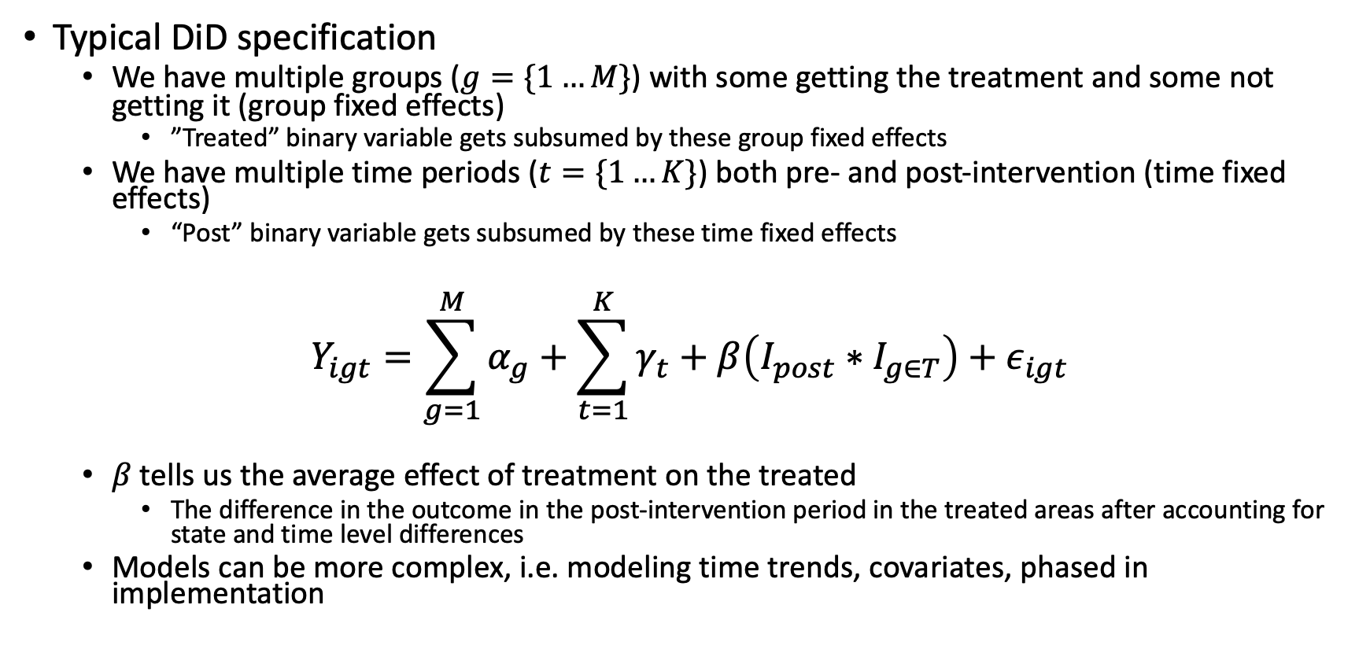
Multiple groups and time periods
Typical DiD specification
We have multiple groups ($g=\{1…M\}$) with some getting the treatment and some not getting it (group fixed effects)
”Treated” binary variable gets subsumed by these group fixed effects
We have multiple time periods ($t=\{1…K\}$) both pre- and post-intervention (time fixed effects)
“Post” binary variable gets subsumed by these time fixed effects
$$Y_{igt}=\sum_{g=1}^{M}{α_{g}}+\sum_{t=1}^{K}{γ_{t}}+β\left(I_{post}∗I_{g∈T}\right)+ε_{igt}$$
$β$ tells us the average effect of treatment on the treated
The difference in the outcome in the post-intervention period in the treated areas after accounting for state and time level differences
Models can be more complex, i.e. modeling time trends, covariates, phased in implementation

Slide 67
Difference in Difference estimation tips
Show lots of figures
Most reviewers want to see evidence of parallel pre-trends
Event study can be a nice way to show this
Carefully consider seasonality
Standard errors should be clustered at the level of “treatment”
Demonstrate no major differential compositional changes in population of treatment or control in post period
Do placebo/falsification tests
Fake time period for policy introduction
Outcome that shouldn’t be affected by treatment
Show impact estimates with and without controls
Controls only need to be group*time varying (all others will fall out because of group and time fixed effects)
Ideal to control for other programs that might have influenced outcome and show that the impact estimate doesn’t change
BUT – don’t throw in a kitchen sink of controls
If you “control” for things that are on the pathway of the treatment the results can be confusing and misleading

Slide 68
Difference-in-Differences vs. Interrupted Time Series
Conceptually similar: both used to estimate the effect of group level interventions by creating a counterfactual; what would have happened without the intervention
Structural differences
ITS uses aggregated data with one treated area time series whereas Difference-in-Differences usually keeps the data at the individual level and adjusts for within-group correlation.
ITS has one treatment group (and one control group in CITS) while Difference-in-Differences works well with multiple treated and control groups
ITS fits a (usually linear) time trend and extrapolates counterfactual whereas Difference-in-Differences uses time fixed effects and uses control group to generate counterfactual
ITS will be favored when change is expected to be immediate and large. DiD methods are better for changes that may be more subtle or phase in over time
Both methods are flexible – add some trends to a DiD and make an ITS post-period more non-parametric and the methods actually converge (Fry et al Birds of a Feather)

Slide 69
Continuous development of methods
The literature on each method advances rapidly over time
New sources of bias always being discovered!
Valid confidence intervals
Constructing valid confidence intervals requires additional assumption to those needed for having valid (consistent) estimates
Robust standard errors, clustering, small sample corrections (i.e. bootstrapping) relax additional assumptions needed for valid standard errors
Different estimation techniques
Minimize errors, maximum likelihood, method of moments (see extra slides for more)
Can have slightly different assumptions
Monte Carlo studies of method performance
Better algorithms for estimating coefficients
Faster computers allow brute force approach without assumptions to speed computation

Slide 70
Final thoughts
Econometrics provides great tools for thinking about causal questions
Using them often means narrowing your window of inquiry
Not – what is going on with the relationship between housing and health
But – what is the impact of specific housing policy x on health outcome Y
Pros: we get very specific about our assumptions, we can feel somewhat confident about the internal validity of our results
Cons: we aren’t always talking about the things that matter most to equity/outcomes

