Slide 1
2014/2015 Semester 2
Group Project
Assignment
Group Project
Knowledge-based Systems

Slide 2

Possible Project Topics
Identification Task:
Bird Species
Group Project
Knowledge-based Systems

Slide 3




Possible Project Topics
Identification Task:
Flowering House Plants
Group Project
Knowledge-based Systems

Slide 4
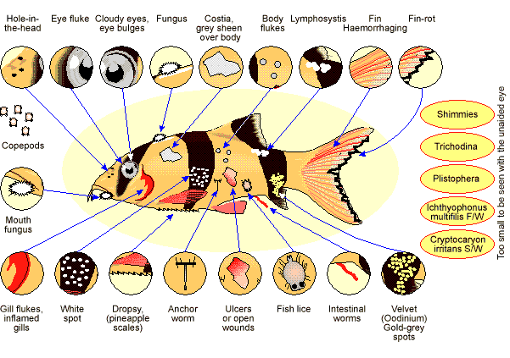



Possible Project Topics
Diagnosis Task
Group Project
Knowledge-based Systems

Slide 5
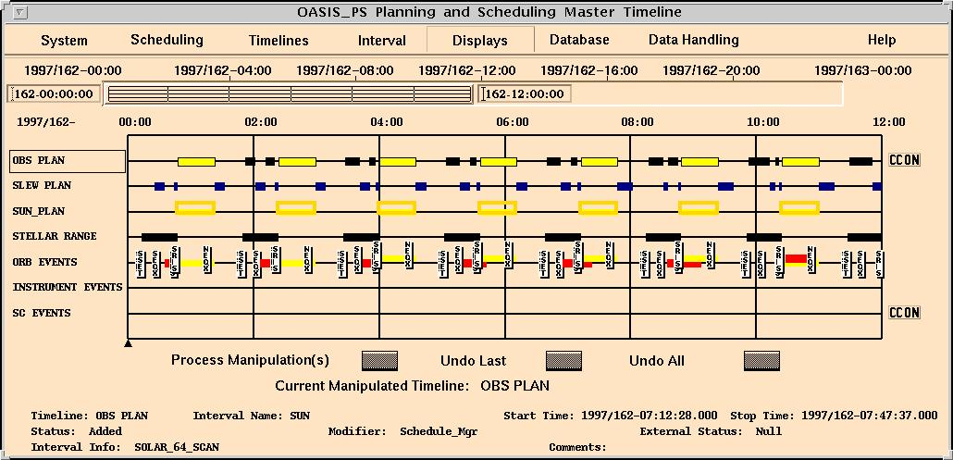
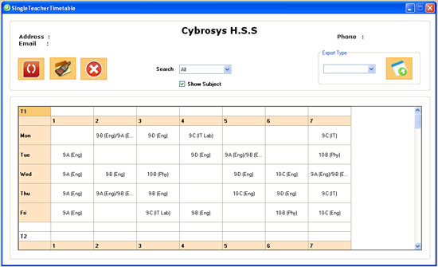
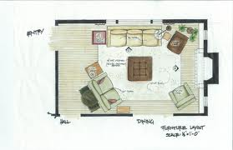
Possible Project Topics
Scheduling Task:
Group Project
Knowledge-based Systems

Slide 6


Possible Project Topics
Planning Task:
Group Project
Knowledge-based Systems

Slide 7


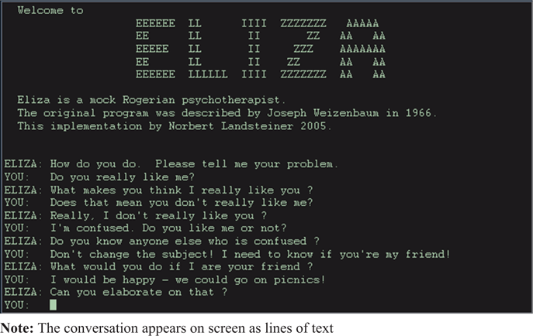
Possible Project Topics
AI Bot:
Group Project
Knowledge-based Systems

Slide 8
Group Project Assignment
Form a group of 3 or 4 students by 5 Feb (Friday) 11:59 pm
Submit Project Proposal to IVLE by 26 Feb (Friday) 11:59 pm
Submit Project Report to IVLE by 15 April (Friday) 11:59 pm.
Present Project on 20 April (Wed) (½ Hour)
Participate in 8th SOC Project Showcase 2016 on 20 April (Wed) 6:00 pm – 10:00 pm
Group Project
Knowledge-based Systems

Slide 9
Project Proposal due on 26 Feb
Title
Abstract (Not more than 100 words)
Group Leader
Objective / Motivation
Domain
Scope
Source of Expertise
Schedule and Work Load
Group Project
Knowledge-based Systems

Slide 10
Project Report due on 15 Apr
Title
Refinement (if any)
Rule Base
GUI (if any)
User Guide
Limitation and possible enhancement
Any other Information
Group Project
Knowledge-based Systems

Slide 11
Project Grading
Group Grading (15%)
  Proposal
  Report
  System (including GUI, if any) developed
  8th STePS feedback and prize (if any)
Individual Grading (10%)
  Presentation and Q&A
  Participation in 8th STePS
  Peer Assessments
Group Project
Knowledge-based Systems

Slide 12


6th SOC Project Showcase 2015
Group Project
Knowledge-based Systems

Slide 13
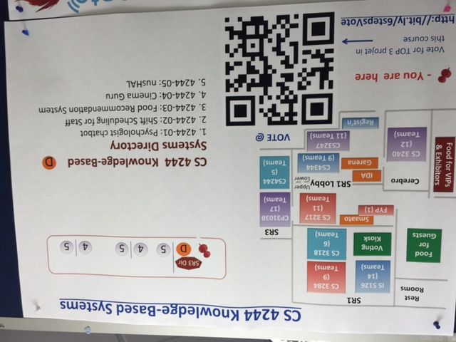
6th SOC Project Showcase 2015
Group Project
Knowledge-based Systems

Slide 14
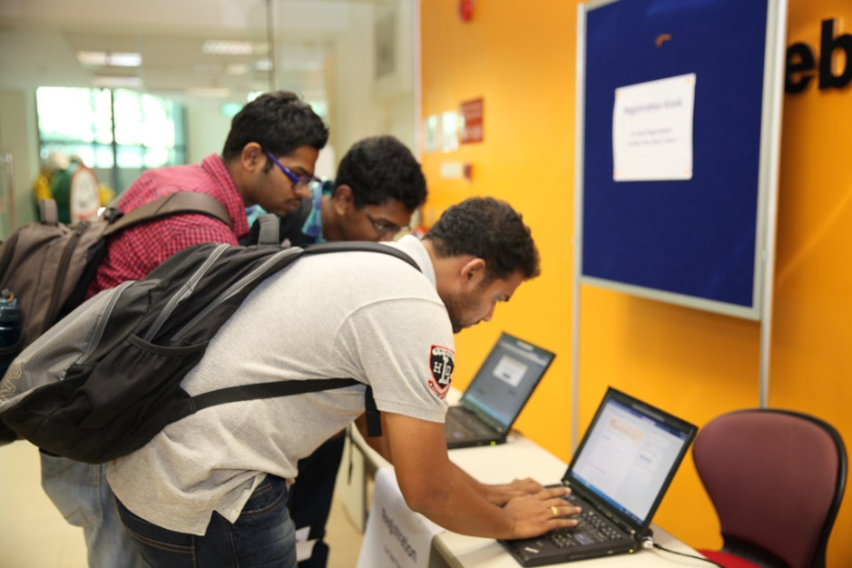
6th SOC Project Showcase 2015
Group Project
Knowledge-based Systems

Slide 15
8th SOC Project Showcase 2016
Date: 20 April 2016 (Wednesday)
Time: 6:00 pm – 10:00 pm
Venue: SOC COM1
Group Project
Knowledge-based Systems

