Slide 1
Project Presentation of Full Stack Engineering (FSE) (22CS037)
On
LMS Application
Submitted to: Mr. Rahul
Submitted by: Nutan (2210992005)
Palak (2210992011)
Parul (2210992033)
Payal (2210992037)
Prabhjeet (2210992051)
Department of Computer Science and Engineering,
Chitkara University, Punjab

Slide 2
Introduction
In today's digital era, the demand for online education has skyrocketed, leading to the need for efficient Learning Management Systems (LMS). This project is a Full Stack LMS Application that provides a seamless platform for students and instructors to interact, manage courses, track progress, and make payments securely. Developed using the MERN Stack (MongoDB, Express.js, React.js, Node.js), this LMS ensures smooth course management, authentication, and real-time data updates while maintaining an intuitive user experience. Unlike traditional learning methods, which often involve physical constraints and limited access to resources, this LMS offers flexibility, accessibility, and automation in education. By integrating powerful technologies like Stripe for secure payments, Cloudinary for media storage, and Redux for state management, this platform enhances the overall learning experience for students and provides instructors with tools to effectively manage courses. With a focus on scalability and user-friendliness, this LMS is designed to cater to the needs of educational institutions, independent instructors, and students worldwide.

Slide 3
What problem does this project solve ?
Traditional education systems face several challenges:
Lack of accessibility – Students may not easily access quality learning resources. This limits opportunities for skill development and career growth.
Manual course management – Manually managing courses, progress, and payments is time-consuming. Automation can save time and reduce administrative workload.
Inefficient student progress tracking – Hard to monitor student progress and engagement. Without insights, educators struggle to provide personalized support.
Complex payment processes – Lack of a streamlined, secure payment system for course purchases. This can lead to delays and discourage students from enrolling.
This LMS solves these issues by providing a centralized, automated, scalable learning platform that effortlessly connects students and educators.

Slide 4
Tech Stack
The LMS is built with modern web technologies:
1 Frontend (User Interface):
React.js (Vite setup for fast development)
Redux Toolkit (State management)
Tailwind CSS (Responsive and modern styling)
2 Backend (Business Logic & APIs):
Node.js with Express.js (Server-side logic)
MongoDB with Mongoose (Database for storing user and course data)
JWT Authentication (Secure user login/signup)
Cloudinary (Image storage for course thumbnails & profile pictures)
Stripe (Payment gateway for course purchases)
3 Tools & Libraries:
Nodemon (Development automation)
Postman (API testing)
Toast Notifications (User-friendly feedback)

Slide 5
Features
User Authentication – Ensures secure login and signup functionality using JWT authentication and cookies for session management.
Course Management – Provides a complete system to add, edit, update, and delete courses and lectures efficiently.
User Dashboard – Allows students to track their purchased courses, monitor progress, and easily access enrolled content.
Admin Dashboard – Offers a centralized panel to track and manage total sales, revenue, and course performance analytics.
Secure Payments – Seamlessly integrated Stripe payment gateway for hassle-free, secure, and encrypted transactions.
Search, Filters & Sorting – Enables users to find relevant courses quickly using keyword search, advanced filtering, and sorting options.
Dark Mode Toggle – Enhances user experience with a customizable dark mode for better readability and reduced eye strain.
Cloudinary Integration – Provides efficient cloud storage to upload, store, and retrieve course images with optimized performance.

Slide 6
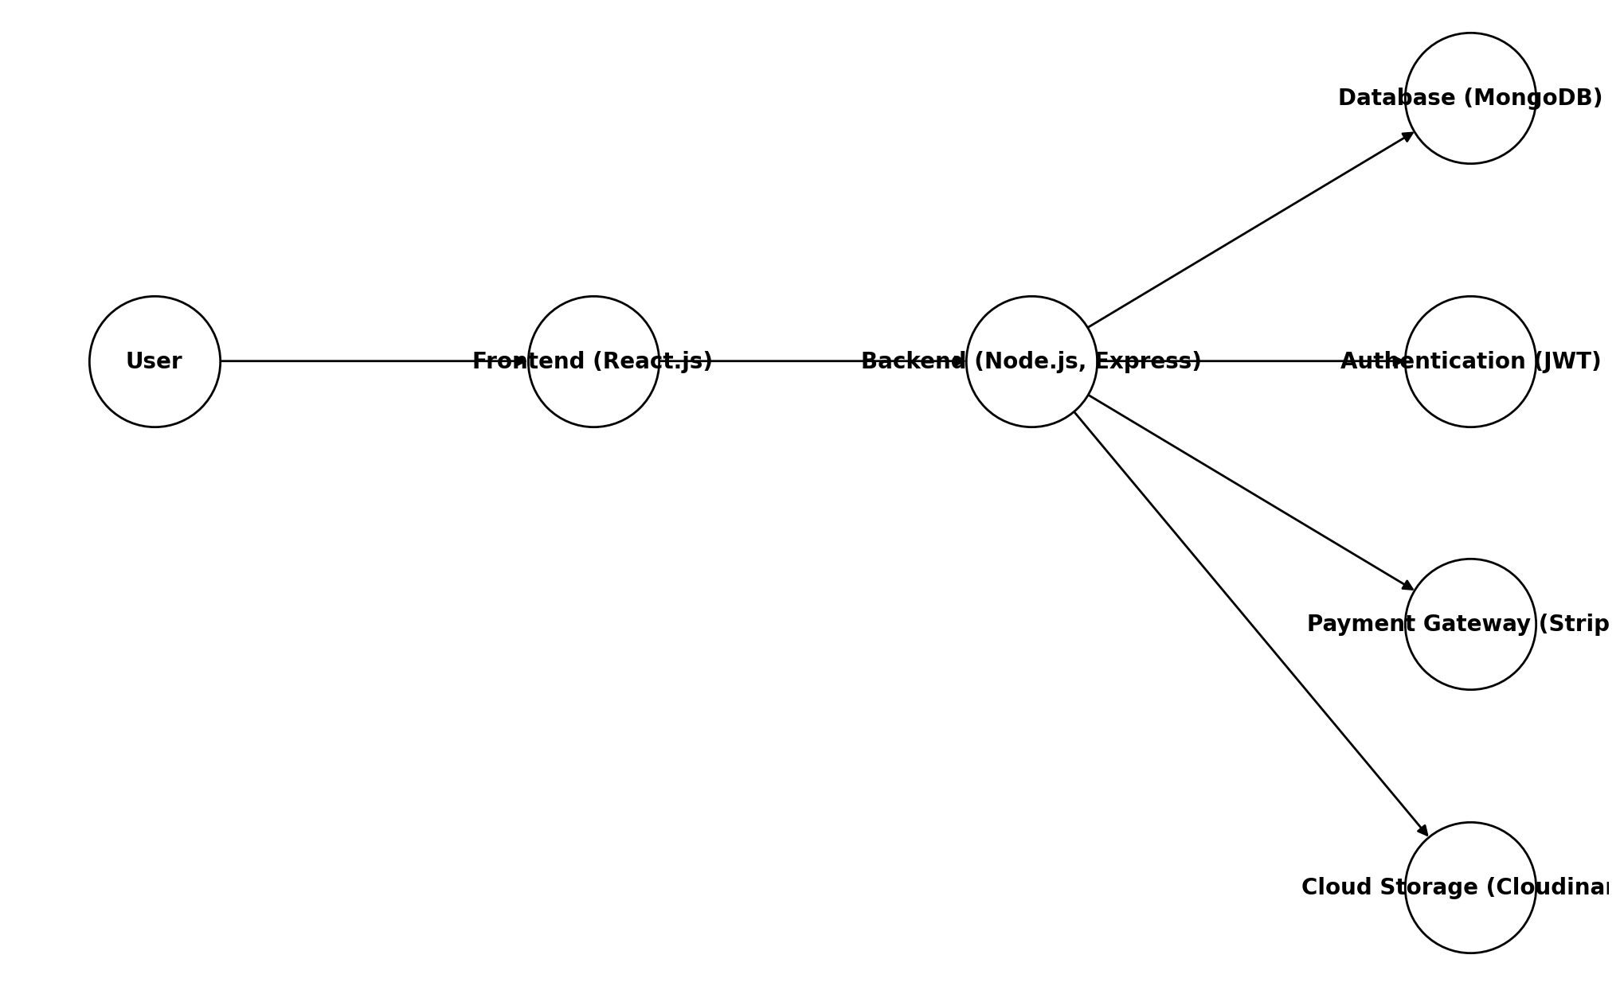
System Architecture

Slide 7
Conclusion
The Full Stack LMS Application successfully bridges the gap between educators and learners by providing a scalable, secure, and interactive e-learning platform. With essential features like user authentication, course management, payments, and real-time updates, this project ensures a smooth and engaging learning experience for students and instructors alike. This LMS not only simplifies online course management but also empowers students by providing on-demand learning, progress tracking, and a structured approach to education. The seamless integration of modern web technologies ensures high performance, security, and ease of use, making it a robust solution for the future of online education.
Additionally, the advanced analytics and reporting features help educators track student progress and optimize course content effectively. With its user-friendly interface and intuitive design, this LMS makes online learning accessible and efficient for all users.

Slide 8
Thank You

