Slide 1

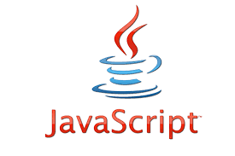





Marketplace Application –Prototype Architecture
Data Access Layer
Business Logic
Layer
Presentation
Layer
REST Client
DAO
Admin Services
Admin Controllers
Java
Java
REST over HTTP (JSON)
JPA
Java
End-User
Services
End-User Controllers
Java
Web
Client
Repositories
REST over HTTP (JSON)
JDBC
HTTP Server
static content (HTML)
DBMS

