Slide 1
MATCAP1
by Jas

Slide 2
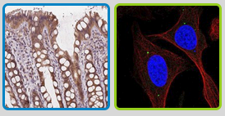
Abstract
MATCAP1 (KIAA0895L), or microtubule associated tyrosine carboxypeptidase 1, is a gene that codes the protein by the same name, which controls microtubule dynamics and their functions. It may be able to be utilized to suppress the proliferation of cancer cells.
NCBI
GEO Profiles
Human Protein Atlas
STRING
colon, human cells

Slide 3
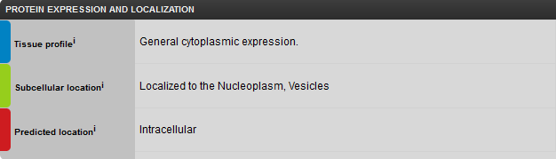
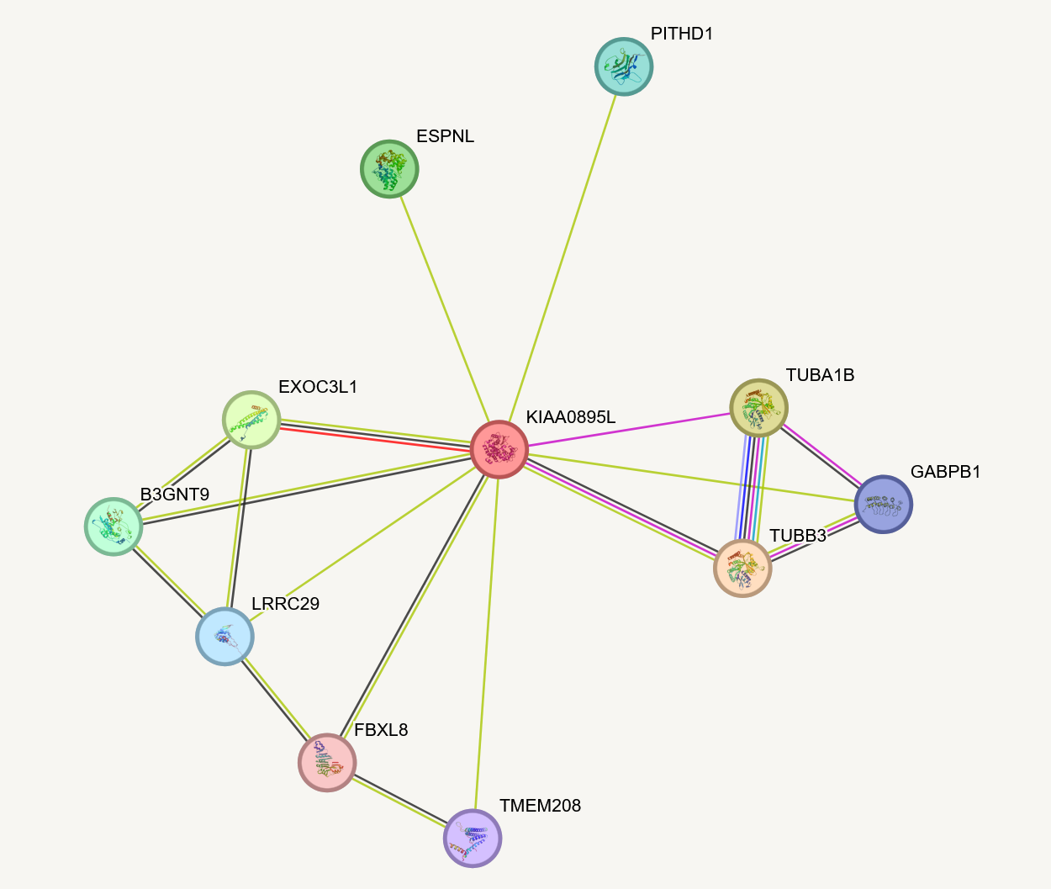
Intro
microtubule associated tyrosine carboxypeptidase 1
Known more frequently as KIAA0895L
Codes protein by same name (KIAA0895L)
Chromosome 16
regulates microtubule dynamics and function
Connected to many genes related to cytoskeleton formation and organization
e.g:
TUBA1B: formation of cytoskeleton
EXOC3L1: cytoskeleton organization

Slide 4
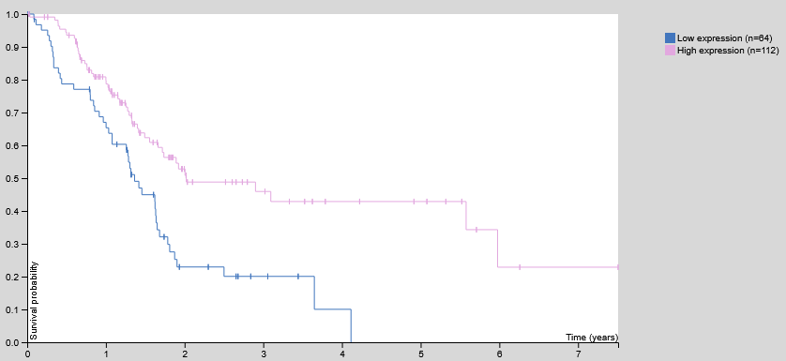
Pancreatic Cancer

Slide 5
Hypothesis #1:
MATCAP1 works to suppress pancreatic cancer cells

Slide 6
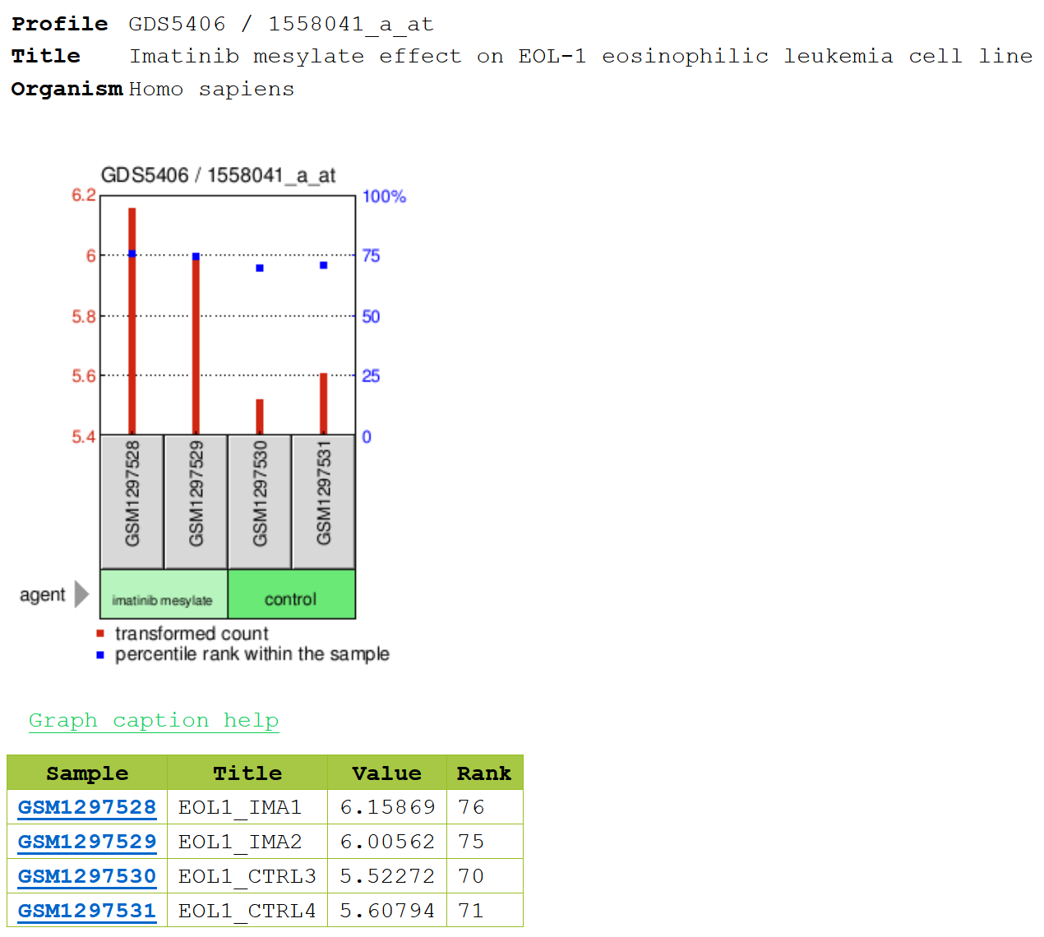
higher expression of MATCAP when imatinib mesylate present
imatinib mesylate treats leukemia (cancer in blood cells)

Slide 7
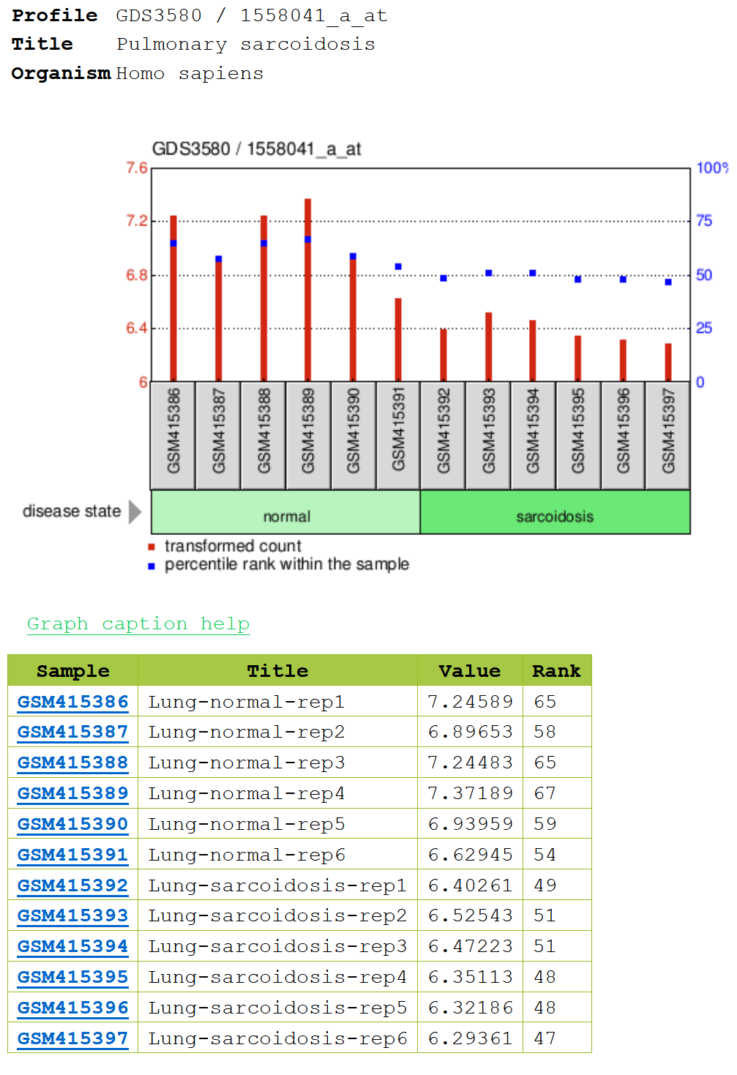
pulmonary sarcoidosis: small lumps of inflammatory cells in the lungs
lower expression of MATCAP1 when sarcoidosis is present

Slide 8
Hypothesis #2:
MATCAP1 is a tumor suppressor gene

Slide 9
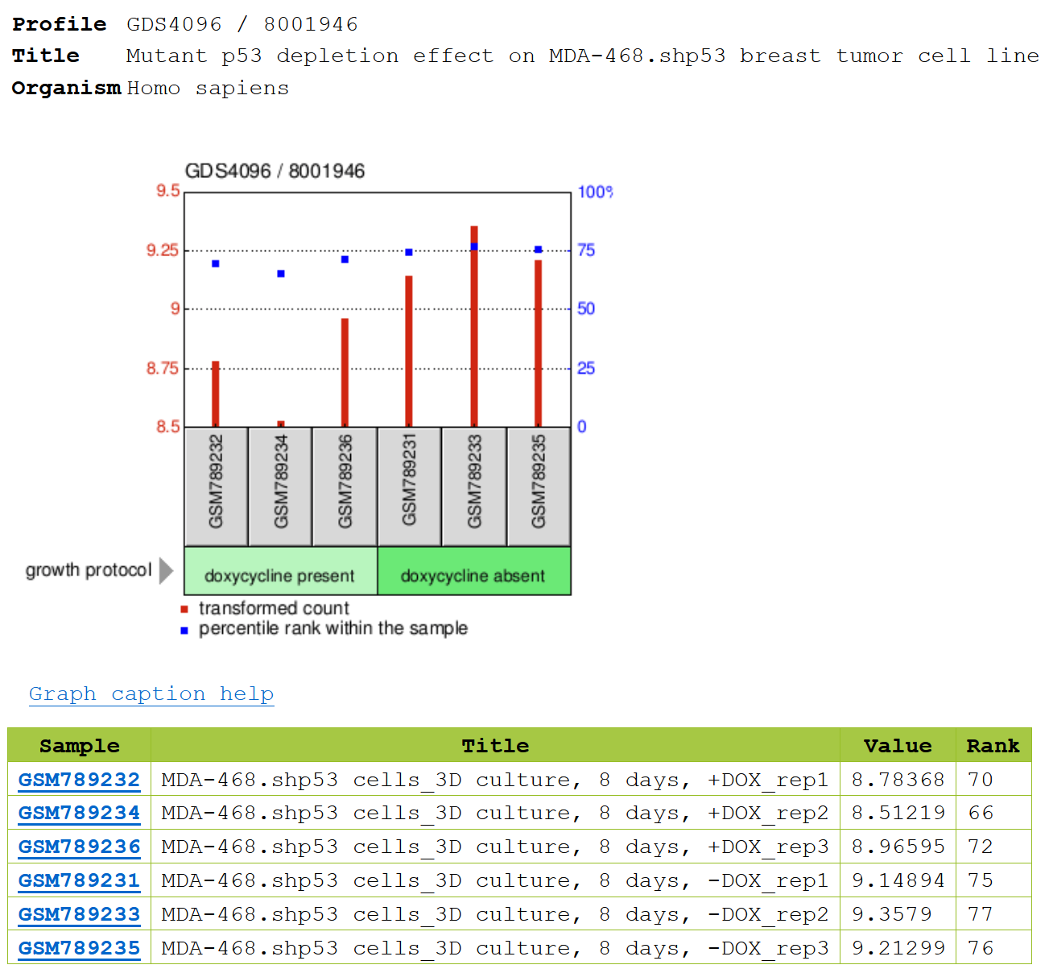
p53: encoded by tp53, tp53 is tsg
As mutant, lose tumor suppressor properties
doxycycline: anticancer properties, able to control cancer progression through different mechanisms
https://www.sciencedirect.com/science/article/abs/pii/S0014299923004612

Slide 10
Microtubules
Alters microtubule functions
Mitosis, cell migration, cell signaling and trafficking
If hijacked by cancer cells, would allow for proliferation
MTAs already cancer therapy
Control MATCAP1 to change function of microtubules to stop cancer
https://link.springer.com/article/10.1007/s00018-005-5330-x
https://www.sciencedirect.com/science/article/pii/S0171933520300145

Slide 11
Hypothesis #3:
MATCAP1 alters microtubule functions to prevent cancer proliferation

Slide 12
Conclusion
Knockout mouse
With doxycycline and without: what happens to MATCAP1 expression levels?
See if MATCAP1 can be altered to suppress cancer (microtubules)
Not only MTAs

Slide 13
Sources
https://www.ncbi.nlm.nih.gov/
https://www.proteinatlas.org/
https://string-db.org/cgi/input?sessionId=bwEGgF6y3rKg&input_page_show_search=on
https://scholar.google.com

Slide 14
Thank You!

Slide 15
