Slide 1

Review of Study Design in
Cherkasskiy L, Caffrey JP, et al. Patient-specific 3D models aid planning for triplane proximal femoral osteotomy in slipped capital femoral
epiphysis. J Child Orthop. <Vol>:1-7, 2017.
Charlene Xu and Jas Chan
7/17/2025
‹#›

Slide 2
Hypothesis / Problem Statement
H1: TPFO (triplane proximal femoral osteotomy) planned with the aid of patient-specific, plastic 3D printed models for mock-surgery practice would decrease surgery and fluoroscopy time without sacrificing radiographically assessed accuracy of the correction in treating SCFE (slipped capital femoral epiphysis).
Aims
A1: Evaluate the benefits of using 3D print technology to aid in surgical planning (decrease surgery time)
A2: Compare via surgical time, fluoroscopy time & estimated blood loss
‹#›

Slide 3
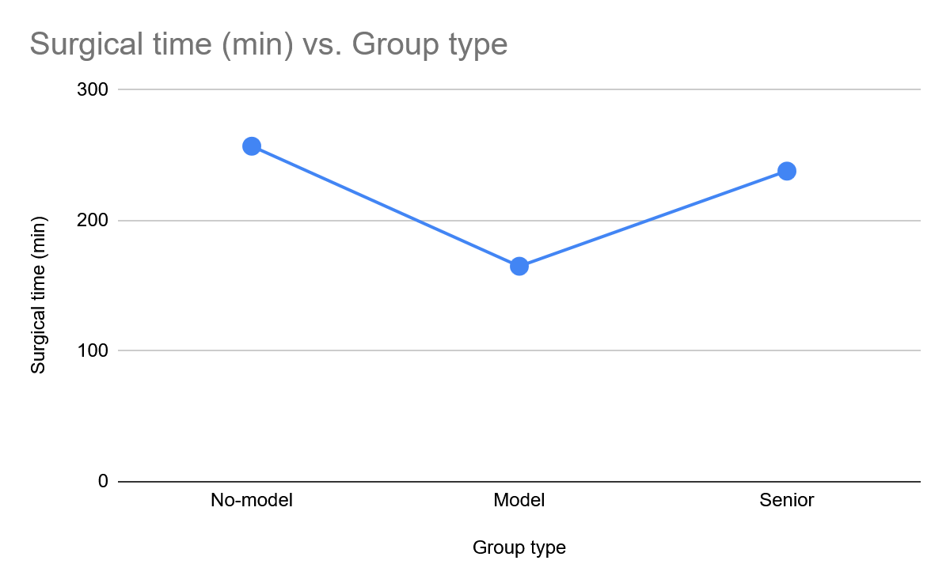
Team # - Charlene Xu and Jas Chan
JChildOrthop2017v011p0147_CherkasskiyCaffrey
Aim: Determine if surgical time is reduced
Metrics
Experimental Groups
1. Surgical time
Grp | Group type | Surgical time (min) | N
1 | No-model | 170.4 ± 76.4 (107 to 257) | 5
2 | Model | 125.8 ± 25.4 (101 to 165) | 5
3 | Senior | 163.8 ± 43.8 (125 to 238) | 5
Result
Statistical Analysis
1. Surgical time was significantly reduced in the model group
107 min in no-model group vs 101 min in model
‹#›

Slide 4
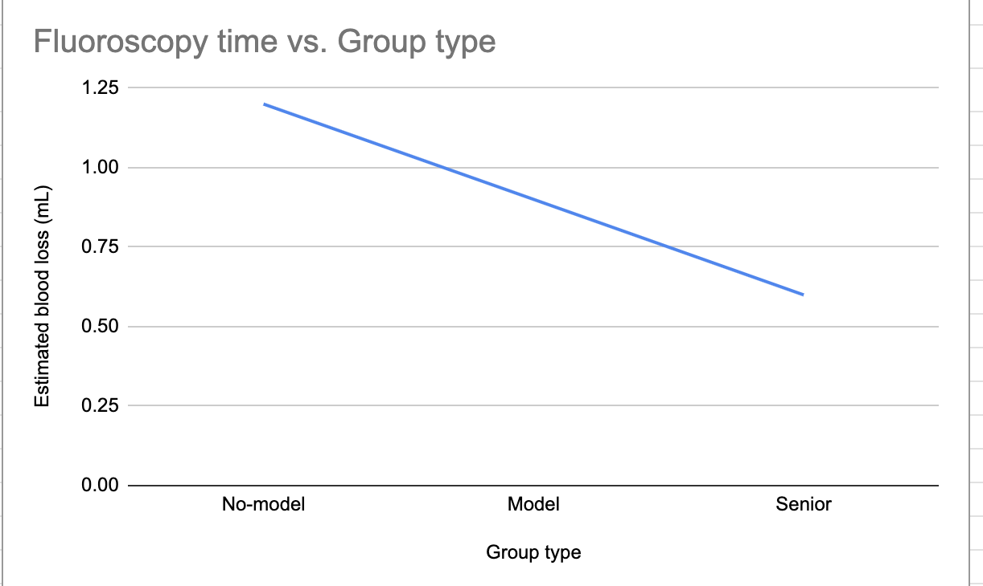
Team # - Charlene Xu and Jas Chan
JChildOrthop2017v011p0147_CherkasskiyCaffrey
Aim: Determine if fluoroscopy time is reduced
Experimental Groups
Metrics
1. Fluoroscopy time
Grp | Group type | Fluoroscopy time (min) | N
1 | No-model | 0.6 ± 0.4 (0.2 to 1.2) | 5
2 | Model | 0.3 ± 0.3 (0.1 to 0.9) | 5
3 | Senior | 0.4 ± 0.2 (0.2 to 0.6) | 5
Result
Statistical Analysis
1. Fluoroscopy time was significantly reduced in the model group
1.2 in the no-model group to 0.6 in the senior group
‹#›

Slide 5
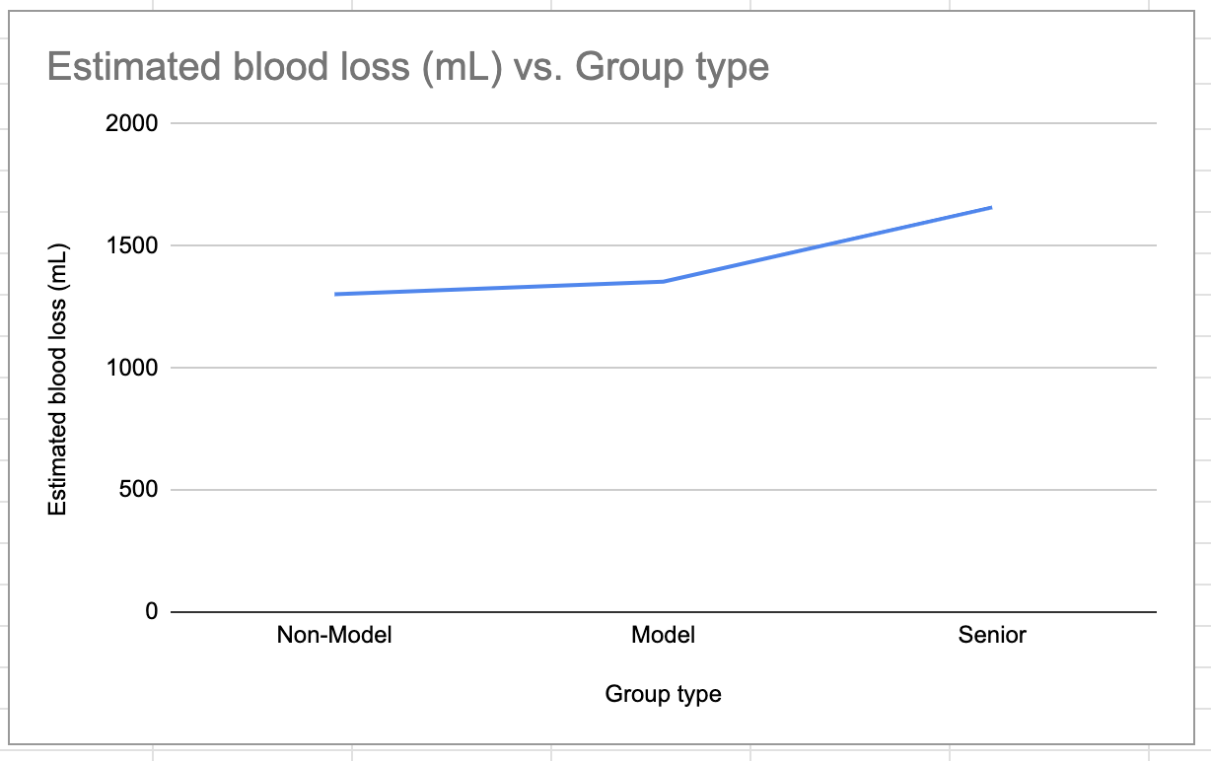
Team # - Charlene Xu and Jas Chan
JChildOrthop2017v011p0147_CherkasskiyCaffrey
Aim: Determine if estimated blood loss is affected by the 3D planning before surgery
Experimental Groups
Metrics
Grp | Group type | Estimated blood loss (mL) | N
1 | No-model | 962.6 ± 276.1 (626.8 to 1302) | 5
2 | Model | 979.8 ± 316.2 (694.5 to 1354.4) | 5
3 | Senior | 981.5 ± 534.4 (174.3 to 1658.5) | 5
1. Blood Loss
Result
Statistical Analysis
3 groups were tested, showed the 3D planning did not affect blood loss
(626.8-694.5 mL)
‹#›

Slide 6
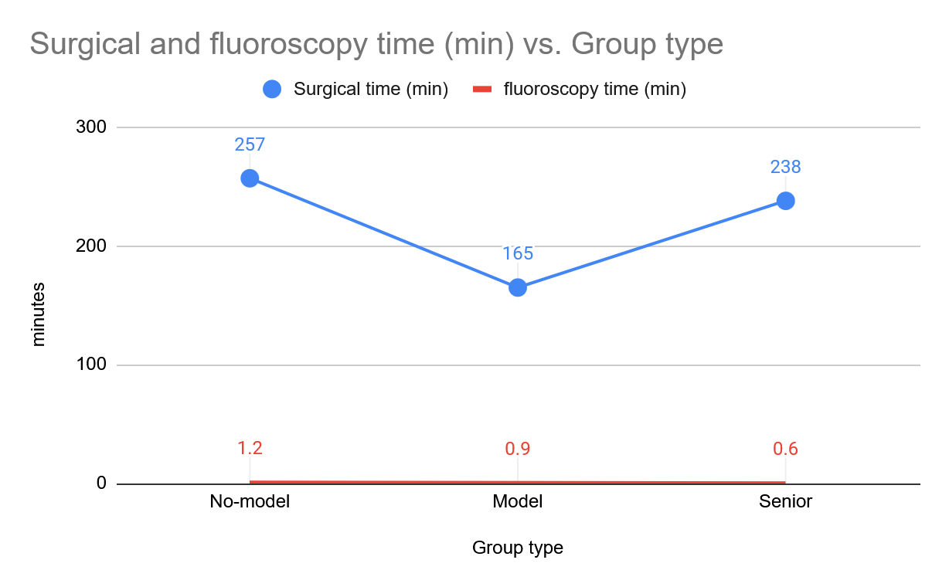
Key Results Statement 1
surgical time: model group had less surgical time than both senior and no-model
fluoroscopy time: senior group had least fluoroscopy time, model group had less time than no-model
Explanations
1. 3D models may decrease surgical time by approximately 45 minutes and cut fluoroscopy time in half while maintaining optimal surgical correction of the 3D SCFE deformity.
‹#›

Slide 7
Key Results Statement 2
Estimated blood loss vs. Group Type
Explanations
1. Estimated blood loss was similar across all three groups with no significant difference.
2. 3D planning mainly improves surgical efficiency and accuracy rather than blood loss
‹#›

