Slide 1
Efficacy of osteoarthritis treatments and possible advancements in the usage of NGF inhibition
Jasmine Chan (Team I)

Slide 2
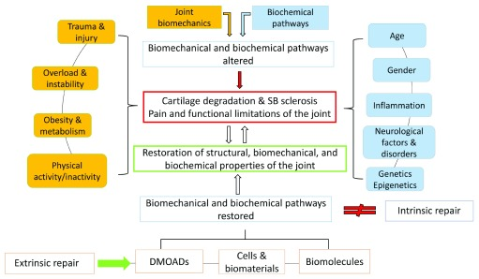
Background
current OA treatments limited (relieve pain, improve range of motion, promote partial regeneration)
Grässel, S., & Muschter, D. (2020). Recent advances in the treatment of osteoarthritis. F1000Research, 9, F1000 Faculty Rev-325. https://doi.org/10.12688/f1000research.22115.1

Slide 3
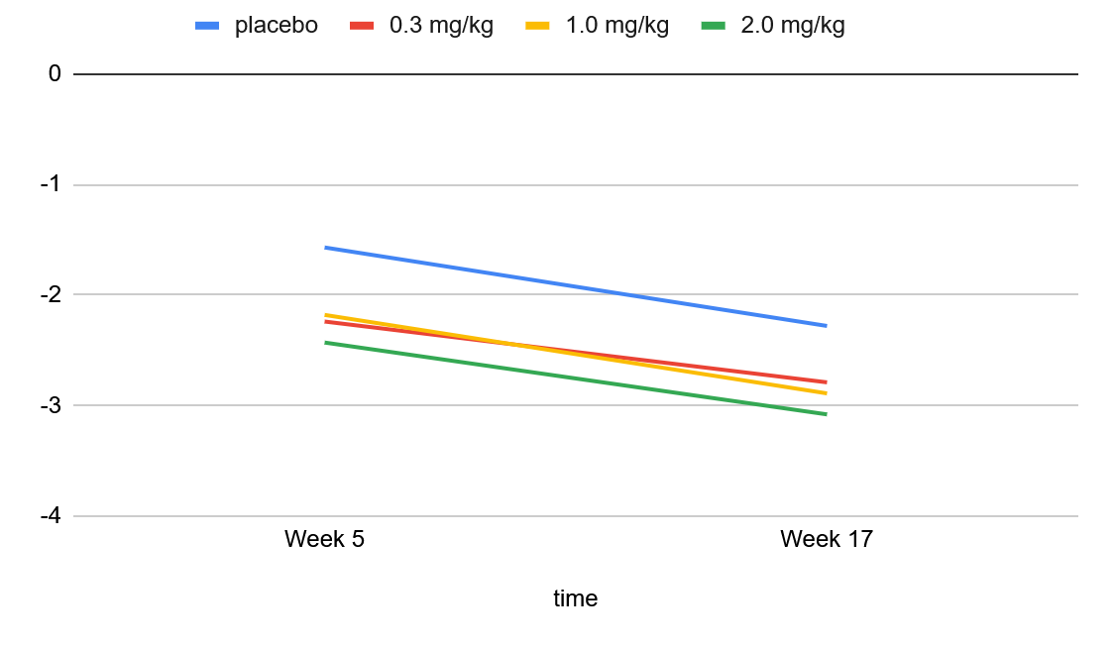
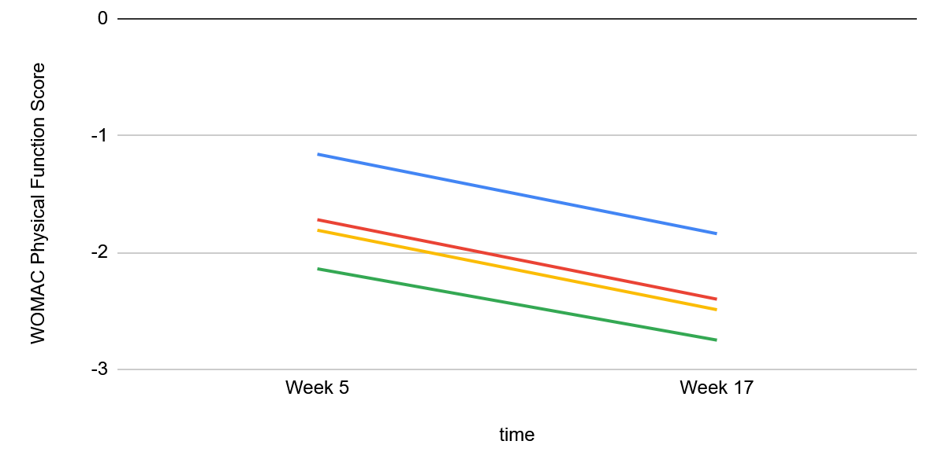
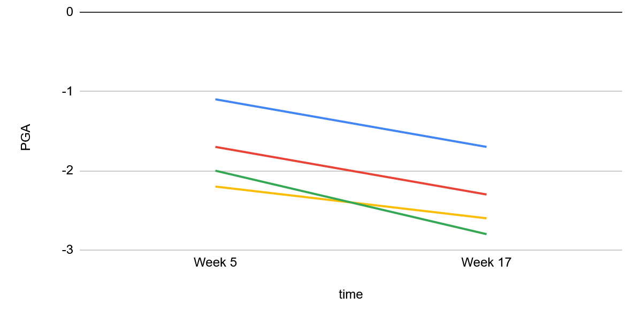
WOMAC Pain Score
WOMAC Physical Function Score
PGA (Patient General Assessment)
Philip G Conaghan, Ali Guermazi, Nathaniel Katz, Asger R Bihlet, Dror Rom, Michael C Perkins, Bernadette Hughes, Claire Herholdt, Iwona Bombelka, Simon Westbrook, OA04 A randomised controlled Phase II trial of LEVI-04, a novel neurotrophin-3 inhibitor, in knee osteoarthritis demonstrates substantially improved pain and function without deleterious effects on joint structure, Rheumatology, Volume 64, Issue Supplement_3, April 2025, keaf142.004, https://doi.org/10.1093/rheumatology/keaf142.004
abbreviation:
WOMAC = Western Ontario and McMaster Universities Arthritis Index

Slide 4
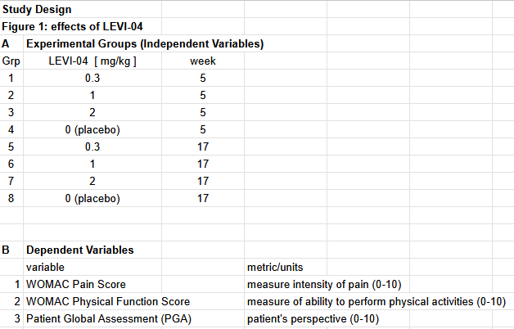
Paper Deconstruction
4-weekly IV of group amount from wk0-wk16
enrollment (N=518)
patients w/ knee OA
placebo
2.0 mg/kg LEVI-04
change in pain measure until wk17 endpoint
0.3 mg/kg LEVI-04
1.0 mg/kg LEVI-04
X-rays + MRI of knees at wk20
safety follow-up to wk30

Slide 5
Hypothesis + Aim
Hypothesis: NGF and other neurotrophic factors are main factors behind OA, so inhibition will be a more effective treatment than placebo or current physical therapy. Certain inhibitors will likely show less side effects based on previous studies, although efficacy may be more similar.
Aims: Compare various treatments, existing and experimental, of OA and determine efficacy of pain reduction and severity of effects

Slide 6
Study Design
metrics:
BRPS (Bristol Rabbit Pain Scale) 0-18
observation of whether movement worsens (gait analysis)
MRI + x-ray of joint
Experimental Groups
OA Rabbit w/ placebo
OA Rabbit w/ physical therapy
OA Rabbit w/ 5mg tanezumab
OA Rabbit with 2mg/kg LEVI-04
statistical analysis:
2-way ANOVA in comparison of variables in all four groups over time
methods:
randomize 40 mature rabbits induced with knee joint OA into the four groups
all groups with IV treatment required (placebo, tanezumab, LEVI-04) receive 4-weekly IV. physical therapy: acupuncture focused on the knee joint at regular intervals 2 times a week. all over span of 16 weeks.
measure BRPS weekly, scans prior and after experiment for comparison

Slide 7
Study Design (Flowchart)
rabbits with knee OA (N=40)
X-rays + MRI (wk 0)
4-weekly IV of group amount from wk0-wk16
measure BRPS weekly to mark change
2.0 mg/kg LEVI-04
X-rays + MRI of knees at wk16
placebo
process over 16 weeks
physical therapy
5 mg tanezumab
2-way ANOVA of BRPS over time
joint PT 2 times per week

Slide 8
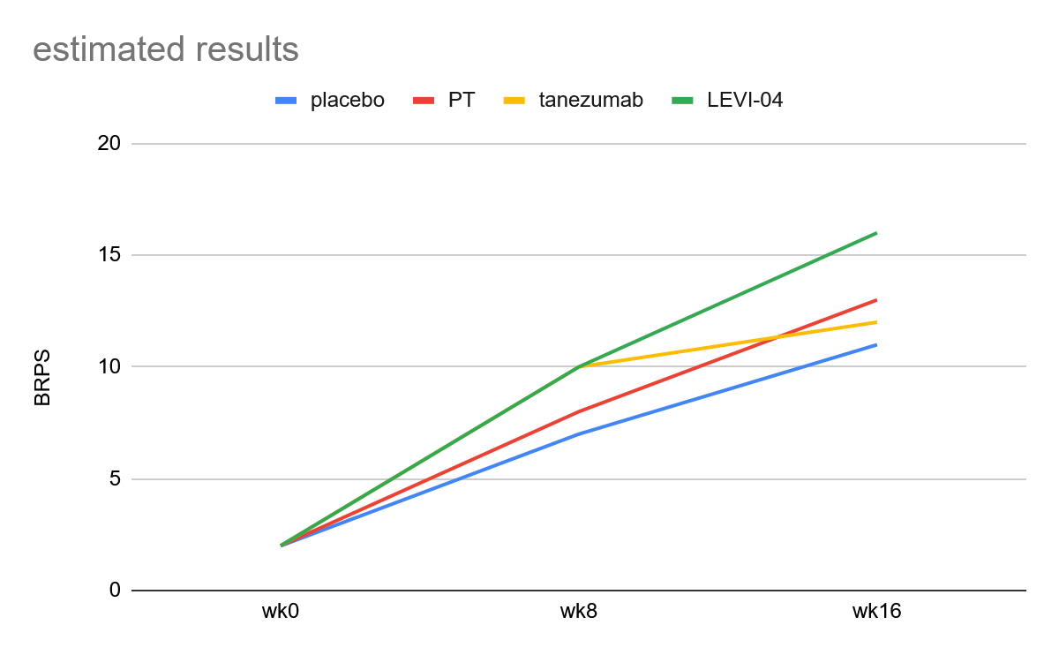
Anticipated Result
BRPS
 | wk0 | wk8 | wk16
placebo | 2 | 6 | 12
PT | 2 | 7 | 14
tanezumab | 2 | 10 | 12
LEVI-04 | 2 | 10 | 16
placebo some effect but not as strong
PT not as effective as inhibitors
tanezumab with more deleterious side effects

Slide 9
Discussion/Significance
advancement in current OA treatments
tanezumab vs LEVI-04 effects

Slide 10
Acknowledgements
Thank you to Professor Sah, team leader Justin Quon, and my teammates, as well as the contributions of the animals used.

Slide 11
Bibliography
Grässel, S., & Muschter, D. (2020). Recent advances in the treatment of osteoarthritis. F1000Research, 9, F1000 Faculty Rev-325. https://doi.org/10.12688/f1000research.22115.1
Ge, Zigang & Hu, Yang & Heng, Boon & Yang, Zheng & Ouyang, Hongwei & Lee, Eng & Cao, Tong. (2006). Osteoarthritis and therapy. Arthritis and rheumatism. 55. 493-500. 10.1002/art.21994.
Philip G Conaghan, Ali Guermazi, Nathaniel Katz, Asger R Bihlet, Dror Rom, Michael C Perkins, Bernadette Hughes, Claire Herholdt, Iwona Bombelka, Simon Westbrook, OA04 A randomised controlled Phase II trial of LEVI-04, a novel neurotrophin-3 inhibitor, in knee osteoarthritis demonstrates substantially improved pain and function without deleterious effects on joint structure, Rheumatology, Volume 64, Issue Supplement_3, April 2025, keaf142.004, https://doi.org/10.1093/rheumatology/keaf142.004
Gandek, B. (2015), Measurement Properties of the Western Ontario and McMaster Universities Osteoarthritis Index: A Systematic Review. Arthritis Care & Research, 67: 216-229. https://doi.org/10.1002/acr.22415
Nikiphorou, E., Radner, H., Chatzidionysiou, K. et al. Patient global assessment in measuring disease activity in rheumatoid arthritis: a review of the literature. Arthritis Res Ther 18, 251 (2016). https://doi.org/10.1186/s13075-016-1151-6
Miller, R. E., Block, J. A., & Malfait, A. M. (2017). Nerve growth factor blockade for the management of osteoarthritis pain: what can we learn from clinical trials and preclinical models?. Current opinion in rheumatology, 29(1), 110–118. https://doi.org/10.1097/BOR.0000000000000354

Slide 12
Bibliography (cont.)
Benato, L., Murrell, J. & Rooney, N. Bristol Rabbit Pain Scale (BRPS): clinical utility, validity and reliability. BMC Vet Res 18, 341 (2022). https://doi.org/10.1186/s12917-022-03434-x
Schnitzer TJ, Easton R, Pang S, et al. Effect of Tanezumab on Joint Pain, Physical Function, and Patient Global Assessment of Osteoarthritis Among Patients With Osteoarthritis of the Hip or Knee: A Randomized Clinical Trial. JAMA. 2019;322(1):37–48. doi:10.1001/jama.2019.8044
Fazeli MS, McIntyre L, Huang Y, Chevalier X. Intra-articular placebo effect in the treatment of knee osteoarthritis: a survey of the current clinical evidence. Therapeutic Advances in Musculoskeletal Disease. 2022;14. doi:10.1177/1759720X211066689
Ni, Xinxin MSa; Hu, Lianxin PhDa; Zhang, Xun PhDa,b; Wang, Zefeng PhDa,*; Yan, Cong PhDc; Peyrodie, Laurent PhDd; Lin, Minghai MSa; Wu, Xinyue MMc; Wang, Huajun MSa; Hu, Shijia MSa. Physical therapy options for knee osteoarthritis: A review. Medicine 103(30):p e38415, July 26, 2024. | DOI: 10.1097/MD.0000000000038415
P.G. Conaghan, A. Guermazi, N. Katz, A.R. Bihlet, D. Rom, C.M. Perkins, B. Hughes, C. Herholdt, I. Bombelka, S.L. Westbrook, LEVI-04, A NOVEL NEUROTROPHIN-3 INHIBITOR, DEMONSTRATED SIGNIFICANT IMPROVEMENTS IN PAIN AND FUNCTION AND WAS NOT ASSOCIATED WITH DELETERIOUS EFFECTS ON JOINT STRUCTURE IN PEOPLE WITH KNEE OA IN A PHASE II RCT, Osteoarthritis Imaging, Volume 5, Supplement 1, 2025, 100352, ISSN 2772-6541, https://doi.org/10.1016/j.ostima.2025.100352.

