Slide 1
AKAP11
by Jas

Slide 2
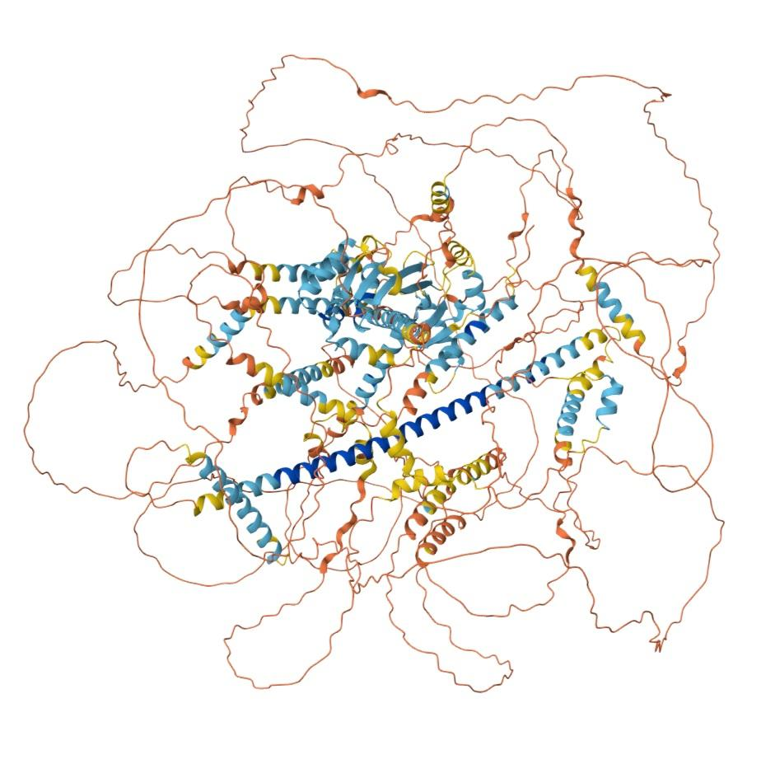
Background
A-kinase anchoring protein 11
protein-coding (codes AKAP11)
AKAP family (cAMP)
schizophrenia risk gene
expressed in (from Allen Brain Atlas):
diencephalon (less)
mesencephalon
somewhat in between at cerebellum
pons
bleeds over to myelencephalon
AlphaFold
experimental structure

Slide 3
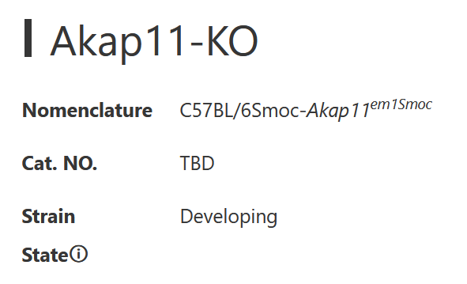
Knockout Mice
https://www.modelorg.us/portal/article/index/id/10909/post_type/3.html
https://www.cyagen.com/us/en/catalog-model-bank-us/S-KO-05497
still in development, none currently available (for now)

Slide 4
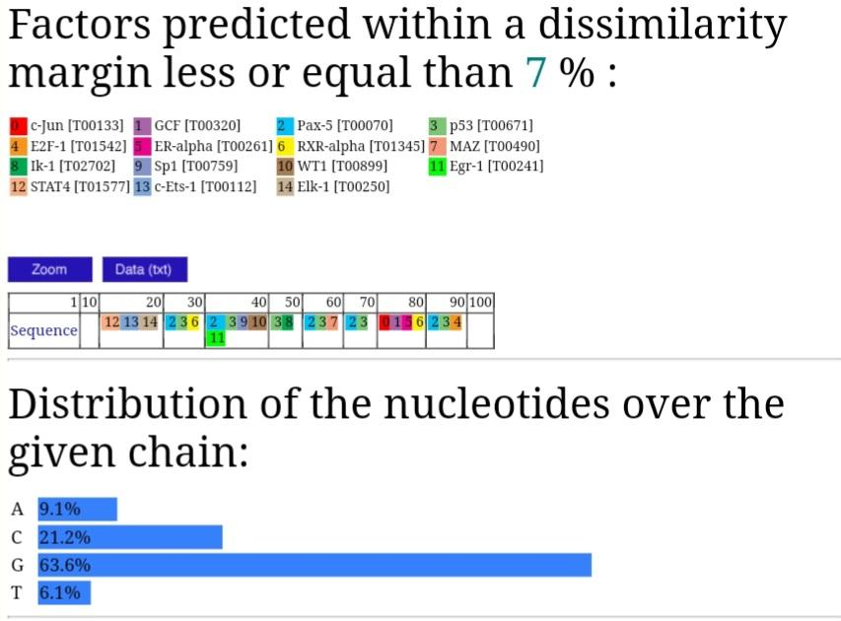
ALGGEN - PROMO

Slide 5
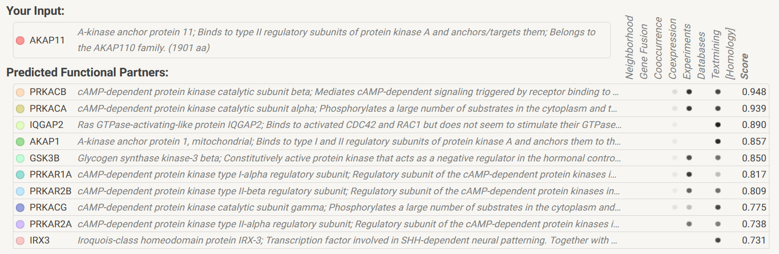
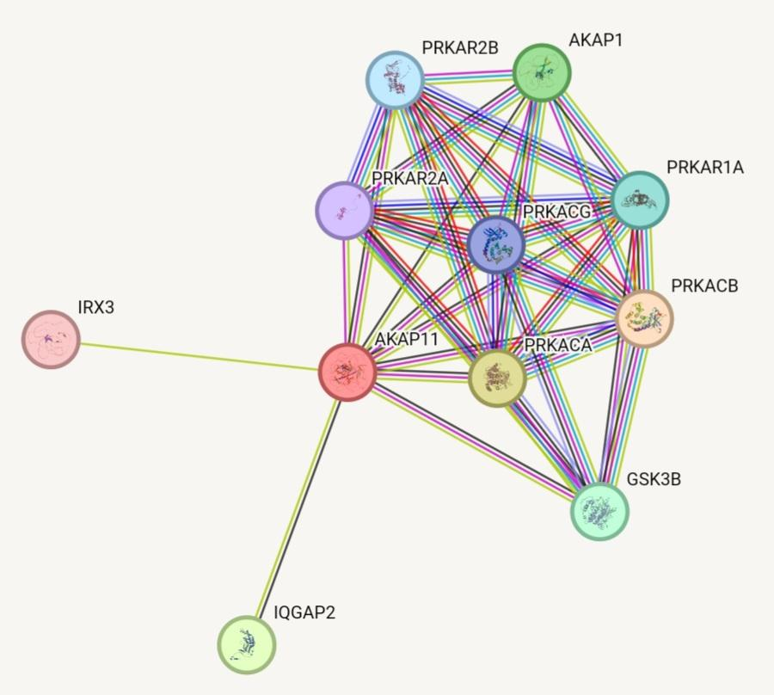
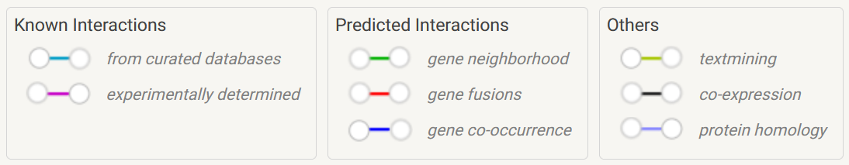
mostly co-expression + textmining
AKAP11 bonds: purely co-expression, textmining, experimentally determined
interwoven: gene fusions, gene co-occurrence, protein homology
overall seems unsure
most cAMP-related or dependent proteins

Slide 6
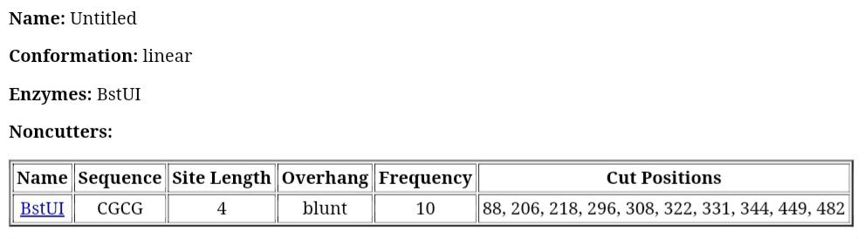
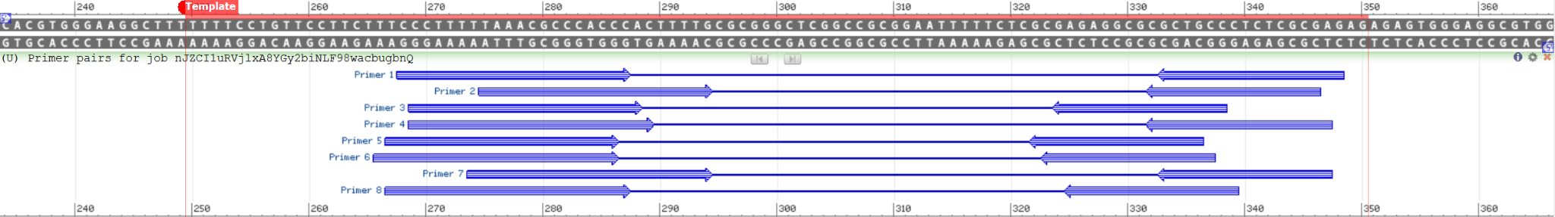
https://restrictionmapper.org/
NIH Primer-BLAST:
https://www.ncbi.nlm.nih.gov/tools/primer-blast/primertool.cgi?ctg_time=1722479772&job_key=nJZCI1uRVjlxA8YGy2biNLF98wacbugbnQ

Slide 7
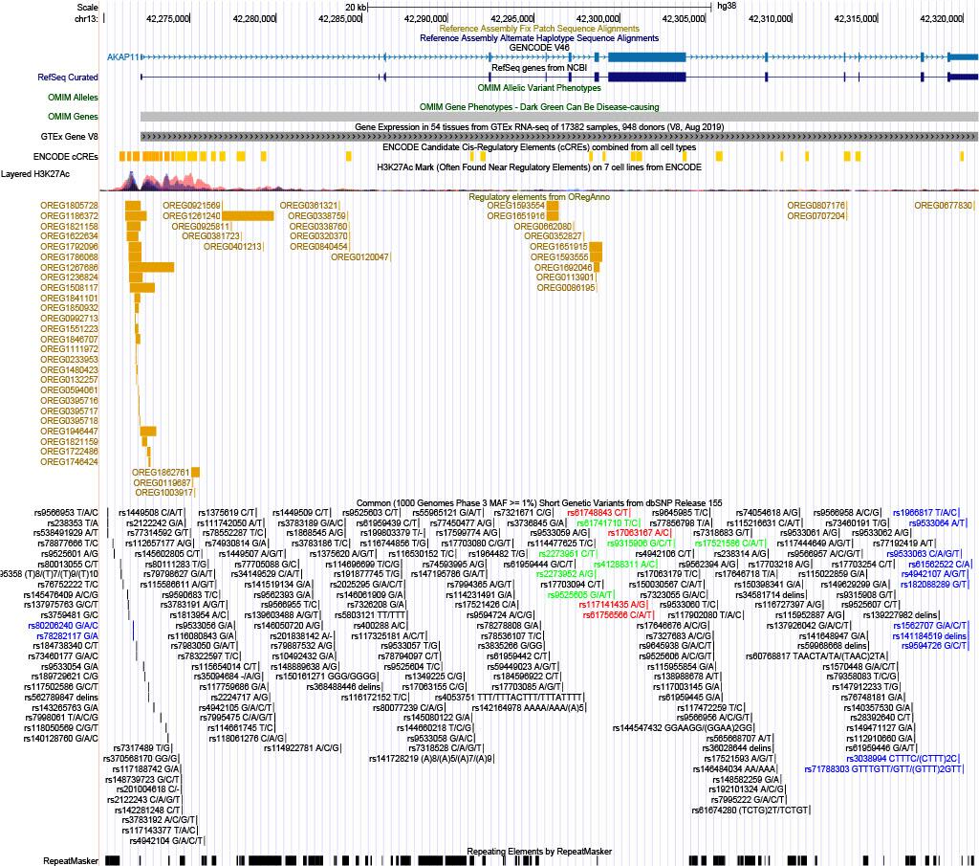
UCSC Genome Browser
promoter SNP:
e.g. rs238353 T/A
(possibly no active function as compared to others?)
upstream transcript variant, no reported clinical significance
coding SNP:
e.g. rs61748843 C/T
(protein-altering variants or splice site variants)
missense variant, benign
oddly large amount of UTR variants near end of gene (terminator)
most functional variants (protein-altering, splice site, or synonymous codon variants) in coding found within or around exon 8

Slide 8
Schizophrenia
+ Bipolar Disorder
risk gene in both schizophrenia and bipolar disorder
seem to be heavily related
AKAP11 deficiency as risk (besides protein alteration in both schizophrenia and bipolar)
schizophrenia:
mutant mice study: AKAP11 deficiency/mutant EEG scans parallel human schizophrenia (GRIN2A also)
bipolar:
AKAP11 interacts with GSK3B (hypothesized to be targeted by lithium)
lithium as existing BD treatment–AKAP11 or GSK3B possible drug targets?
still other possible factors…other genes…
neurological illnesses very complicated

Slide 9
Bibliography
https://pubmed.ncbi.nlm.nih.gov/36914870/
https://human.brain-map.org/microarray/search/show?exact_match=false&search_term=%22AKAP11%22&search_type=gene (Allen Brain Atlas)
https://www.ncbi.nlm.nih.gov/books/NBK551509/
https://www.ncbi.nlm.nih.gov/books/NBK234157/
https://alphafold.ebi.ac.uk/entry/Q9UKA4 (AlphaFold)
https://alggen.lsi.upc.es/cgi-bin/promo_v3/promo/promoinit.cgi?dirDB=TF_8.3 (ALGGEN - PROMO)
https://string-db.org/cgi/network?taskId=bNSGCkbOy2zl&sessionId=bbq44gFyXkS (STRING)
Eukaryotic Promoter Database–three possibilities (used AKAP11_1)
https://epd.expasy.org/cgi-bin/epd/get_doc?db=hgEpdNew&format=genome&entry=AKAP11_1
primers:
https://restrictionmapper.org/ (to find cut sites)
https://www.ncbi.nlm.nih.gov/tools/primer-blast/primertool.cgi?ctg_time=1722479772&job_key=nJZCI1uRVjlxA8YGy2biNLF98wacbugbnQ (actual primer results)

Slide 10
Bibliography (cont.)
https://genome.ucsc.edu/cgi-bin/hgTracks?db=hg38&lastVirtModeType=default&lastVirtModeExtraState=&virtModeType=default&virtMode=0&nonVirtPosition=&position=chr13%3A42269754%2D42320863&hgsid=2321212104_xLa0FhlxvTKtRaTCyUbX0AoFr0Yx (USCS Genome Browser)
https://www.ncbi.nlm.nih.gov/snp/rs238353
https://www.ncbi.nlm.nih.gov/snp/rs61748843
https://pubmed.ncbi.nlm.nih.gov/35410376/
https://pubmed.ncbi.nlm.nih.gov/36914641/
https://pubmed.ncbi.nlm.nih.gov/37171958/

Slide 11
End
Thank you!

