Slide 1
AI Equity Research Terminal Dashboard Project
1
NEXTHIKES PROJECT 9 - Jaspreet Kaur

Slide 2
Project Overview
AI powered dashboard for financial research
Collects real-time news using NewsAPI
Summarizes articles using Groq LLM
Performs sentiment analysis on news
Displays insights in an interactive dashboard
2

Slide 3
Problem Statement
Financial research requires analyzing large amounts of news
Manual analysis is slow and inefficient
Analysts need quick insights about companies and sectors
This project automates news analysis using AI
3

Slide 4
Technologies Used
NEXTHIKES PROJECT 9 - Jaspreet Kaur
Python
Streamlit Dashboard
Groq Large Language Models
NewsAPI for financial news
TextBlob for sentiment analysis
Plotly for visualizations
Pandas for data processing
4

Slide 5
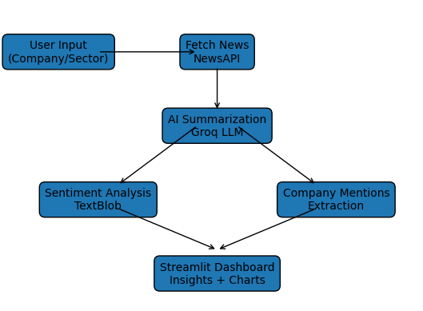
System Workflow
5

Slide 6
Dashboard Features
AI Generated Equity Research Report
Real-time Financial News Feed
Market Sentiment Analysis
Company Mention Tracking
AI Generated Market Insights
6

Slide 7
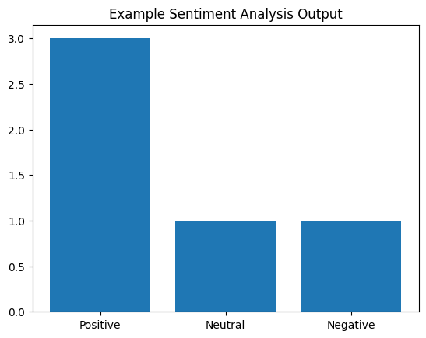
Sample Visualization
7

Slide 8
Challenges Faced
Model deprecation in Groq API
Code indentation errors
Handling missing news data
Managing API keys securely
Optimizing API response time
8

Slide 9
Solutions Implemented
Updated to latest Groq models
Refactored code structure
Added safe data handling
Used Streamlit secrets for API keys
Improved workflow efficiency
9

Slide 10
Conclusion
AI can significantly simplify financial research
Automated news analysis provides quick insights
Dashboard visualization improves decision making
Project demonstrates real-world AI application
10

