Slide 1
29
Smart System for Visually Impaired
Alan Pisano
Problem Statement
People with visual impairments cannot always navigate the world around them unassisted.
Obstructions and imperfections can be dangerous.
Current solutions may be difficult to use or maintain.
White canes are not hands free and require hand mobility.
Guide dogs must be taken care of and can be expensive.
Current solutions are limited in their ability to translate the world into something consumable for people with visual impairments.
A lot of navigational information is lost or not consumed at all by white canes or current wearable devices.
Accessibility is important to our society.

Slide 2
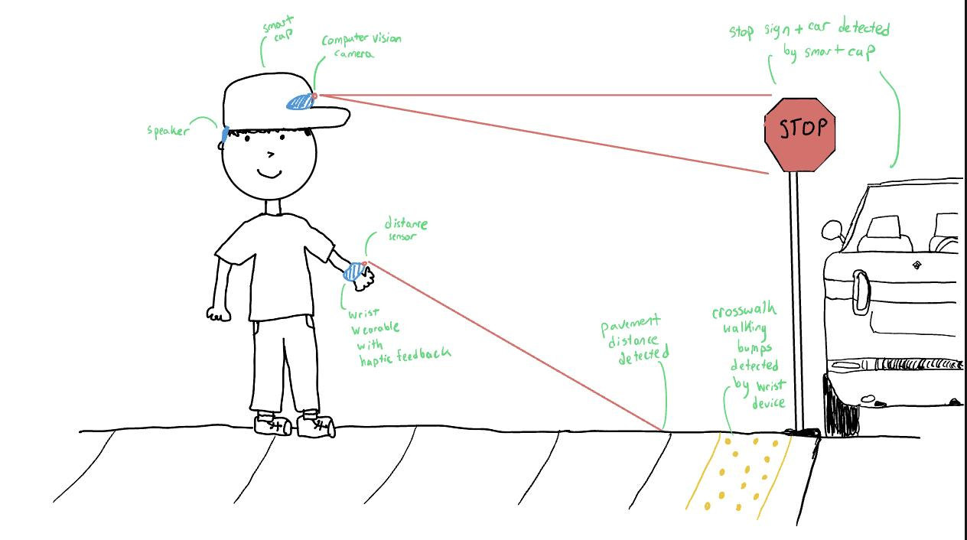
29
Smart System for Visually Impaired
Alan Pisano
Visualizations
smart cap
stop sign + car detected
computer vision camera
speaker
distance sensor
pavement distance detected
wrist-wearable
crosswalk bumps detected

Slide 3
29
Smart System for Visually Impaired
Alan Pisano
Deliverables
Our end deliverable includes a working prototype of a functional smart system that includes a pair of sensor-attached head and wrist wearable devices. The smart head and wrist wearable devices will utilize various feedback mechanisms to alert the user.
Our intermediate deliverables include a finalized list of sensors for both head and wrist devices and basic circuit visualization of the smart system.

Slide 4
29
Smart System for Visually Impaired
Alan Pisano
Requirements
Functions
Tactile Feedback: Deliver haptic signals to help users differentiate between various objects in the environment.
Camera-based Vision: Integrate a camera into headwear that audibly communicates text from signs or books to the user through real-time speech output.
Real-Time Feedback: Provide real-time responses (within 100 milliseconds) to object detection through auditory or tactile signals.

Slide 5
29
Smart System for Visually Impaired
Alan Pisano
Requirements
Objectives
Portability: The device should be lightweight and comfortable to wear for long periods.
Low Power Consumption: The system should operate for at least 12 hours on a single charge.
Ease of Use: The system must require minimal training for visually impaired individuals to operate effectively.
Non-Intrusive Feedback: Feedback should be non-disruptive, such as subtle vibrations or tones, without overwhelming the user.
Multi-environment Usability: The system should work effectively both indoors and outdoors, in different lighting and terrain conditions.

Slide 6
29
Smart System for Visually Impaired
Alan Pisano
Requirements
Constraints
Size and Weight: The device must not exceed 300 grams to ensure it is wearable and comfortable.
Battery Life: The system must run on a battery with at least a 12-hour capacity.
Durability: The device should withstand drops from 1.5 meters and be water-resistant to ensure usability in various weather conditions.
Safety: The feedback mechanism (vibration or sound) must not pose any risk of injury or discomfort to the user.

Slide 7
29
Smart System for Visually Impaired
Alan Pisano
Competing Technologies / Patents / Other Products
AiSee
Description: Wearable device with AI-powered camera, bone conduction audio, and Q&A capabilities
Limitations: Not commercially available, Short battery life, Long processing times
OrCam
Description: Wearable camera that attaches to glasses, provides audio descriptions of surroundings
Limitations: Short battery life, Connectivity issues, Struggles in low light conditions
BuzzClip
Description: Small wearable that uses ultrasound to detect obstacles and provides haptic feedback
Limitations: Limited range, Not resistant, requires the use of cane or guide dog

