Slide 1
CSC 360 Operating System Structures: From Processes to Threads

Slide 2
Threads
What is shareable with processes before threads?
Motivation for threads

Slide 3
Why Threads?
Thread
short for thread of control
the sequence of executed instructions in a program, representing a single path of execution
Many algorithms are easier to write (and maintain) with threads
Some algorithms run faster in a threaded implementation.
Notes:
A thread is the abstraction of a processor—it is a thread of control. We are accustomed to writing single-threaded programs and to having multiple single-threaded programs running on our computers. Why does one want multiple threads running in the same program? Putting it only somewhat over-dramatically, programming with multiple threads is a powerful paradigm. (One is tempted to say “new paradigm,” but the concept has been around since at least the 1960s—though only recently has it received serious vendor support.)
So, what is so special about this paradigm? Programming with threads is a natural means for dealing with concurrency. As we will see, concurrency comes up in numerous situations. A common misconception is that it is a useful concept only on multiprocessors. Threads do allow us to exploit the features of a multiprocessor, but they are equally useful on uniprocessors—in many instances a multithreaded solution to a problem is simpler to write, simpler to understand, and simpler to debug than a single-threaded solution to the same problem.

Slide 4
Single-thread vs. multithreaded process
Code
Data
Files
Code
Data
Files
Registers
PC
Stack
Registers
Registers
Registers
PC
PC
PC
Stack
Stack
Stack

Slide 5
Process vs. Thread
Processes have separate address spaces
Enforced by OS
Sharing memory amongst processes requires OS intervention (i.e., somewhat complex and expensive in time/CPU cycles)
Threads exist within a process
A process may have one or many threads
Each of these threads shares the same address space
That is, these threads by default share memory of their host process...
... and this sharing does not require the involvement of the kernel!
For threads this semester, we'll focus on POSIX threads (pthreads).

Slide 6
Benefits of Using Threads
Using threads is a natural way to achieve concurrency in programming
Threads enable us to take advantage of multiprocessor systems,…
but they are just as useful on uniprocessor systems
In many cases, a multithreaded solution is easier to develop, understand, and debug than its single-threaded counterpart
By allowing multiple tasks to run concurrently, threads improve program responsiveness and resource utilization

Slide 7


Motivation...
Server application
Example: remote login server
Other examples: web server; database server
Notes:
For a simple example of a problem that is more easily solved with threads than without, let’s look at a server application, in particular, a remote login server.

Slide 8
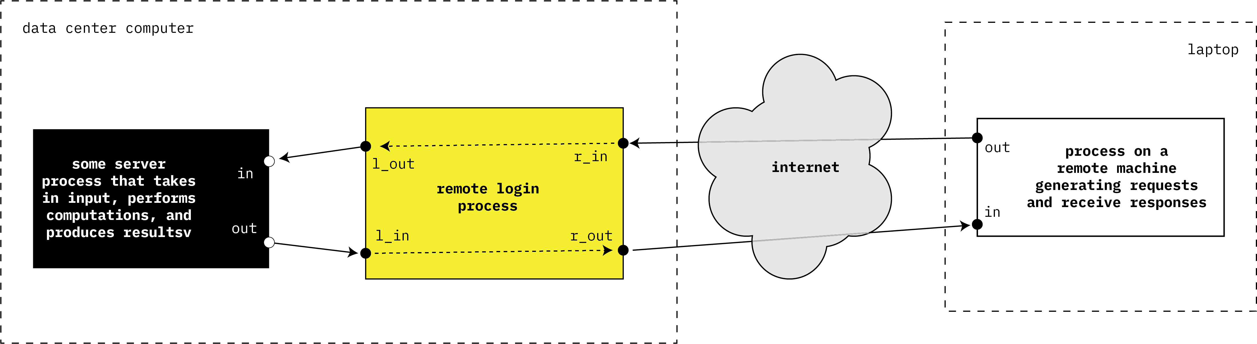
Describing action from the point of view of the remote login process. The names of the ports are are from the point of view of this process.
(B) Requests intended for server processing are sent out here.
(A) Incoming messages from remote machine for server processing arrive here
(C) Results produced by server processing are sent out here.
(D) Outgoing messages containing the results from server processing are sent out here.
Notes:
v

Slide 9
Purpose of a remote login server
This server (or daemon) acts as the go-between:
the computer outside the server machine, and ...
the processes within the server machine
Remote-login server receives incoming messages from remote computer, and sends them to a process within the server computer
Remote-login server receives responses from process within the server computer, and sends them to the remote computer
Also:
The r_in and l_out ports only have messages when the remote computer or server machine have something to send (i.e., remote login server may need to wait for message on those incoming message ports)
The l_in and r_out ports have outgoing message queues that might be full (i.e., remote login server may need to wait for outgoing message ports to have room for new messages)

Slide 10
One implementation approach (bad)
Remote login server (daemon) is organized around a polling loop
For each loop iteration, code examine each of the four ports
If a port requires servicing, then something is done
Otherwise return to top of loop
Observation: Given the speed of CPUs relative to the frequency of server events, most loop iterations will do no processing (i.e., nothing to do) ....
Therefore, CPU cycles are wasted
Polling is often used as a first approach to solving such coding problems...
... but the wasted CPU cycles can become a problem as more and more such daemons exists in a computer

Slide 11
Better implementation approach
We still use a loop, but its contents are very different (but still without threads...)
Code in loop uses system calls such that the OS:
Suspends the remote-login-daemon’s process when there is no work (i.e., no messages to relay from port to port)
Reawakens the remote-login-daemon’s process when there is a message to relay to a port
This is far, far better than a straight polling loop
When the daemon has “nothing to do”, the process does not consume CPU cycles
When the daemon does have something to do, it is normally
(1) moving messages from r_in to l_out, or
(2) moving messages from l_in to r_out
One issue, however, with respect to the design of our code:
If our process possesses a single thread, then the code of the loop must be carefully written to interleave actions (1) and (2)

Slide 12
Life Without Threads
logind(int r_in, int r_out, int l_in, int l_out) {
fd_set in = 0, out;
int want_l_write = 0, want_r_write = 0;
int want_l_read = 1, want_r_read = 1;
int eof = 0, tsize, fsize, wret;
char fbuf[BSIZE], tbuf[BSIZE];
fcntl(r_in, F_SETFL, O_NONBLOCK);
fcntl(r_out, F_SETFL, O_NONBLOCK);
fcntl(l_in, F_SETFL, O_NONBLOCK);
fcntl(l_out, F_SETFL, O_NONBLOCK);
while(!eof) {
FD_ZERO(&in);
FD_ZERO(&out);
if (want_l_read) FD_SET(l_in, &in);
if (want_r_read) FD_SET(r_in, &in);
if (want_l_write) FD_SET(l_out, &out);
if (want_r_write) FD_SET(r_out, &out);
select(MAXFD, &in, &out, 0, 0);
if (FD_ISSET(l_in, &in)) {
if ((tsize = read(l_in, tbuf, BSIZE)) > 0)
{
want_l_read = 0;
want_r_write = 1;
} else {
Is the purpose of the code immediately apparent?
Notes:
This slide shows a simplified excerpt from the rlogind program of Unix. It is not immediately apparent what it does (that’s the point): it reads characters typed by the remote user (arriving on r_in), outputs these characters to local applications (via l_out), reads characters output by local applications (arriving on l_in), and sends them to the remote user (via r_out). To make sure that we never block indefinitely waiting for I/O on any particular one of the four file descriptors, we make complicated use of non-blocking I/O and the select system call.

Slide 13
Life Without Threads
eof = 1;
}
if (FD_ISSET(r_in, &in)) {
if ((fsize = read(r_in, fbuf, BSIZE)) > 0)
{
want_r_read = 0;
want_l_write = 1;
} else
eof = 1;
}
if (FD_ISSET(l_out, &out)) {
if ((wret = write(l_out, fbuf, fsize)) == fsize) {
want_r_read = 1;
want_l_write = 0;
} else if (wret >= 0)
tsize -= wret;
else
eof = 1;
}
if (FD_ISSET(r_out, &out)) {
if ((wret = write(r_out, tbuf, tsize)) == tsize)
{
want_l_read = 1;
want_r_write = 0;
} else if (wret >= 0)
tsize -= wret;
else
eof = 1;
}
}
}
Is the purpose of the each “if” statement immediately apparent?
Notes:
This slide shows a simplified excerpt from the rlogind program of Unix. It is not immediately apparent what it does (that’s the point): it reads characters typed by the remote user (arriving on r_in), outputs these characters to local applications (via l_out), reads characters output by local applications (arriving on l_in), and sends them to the remote user (via r_out). To make sure that we never block indefinitely waiting for I/O on any particular one of the four file descriptors, we make complicated use of non-blocking I/O and the selected system call.

Slide 14
l_in: Local input l_out: Local output
r_in: Remote input r_out: Remote output
logind(int r_in, int r_out, int l_in, int l_out) {
fd_set in = 0, out;
int want_l_write = 0, want_r_write = 0;
int want_l_read = 1, want_r_read = 1;
int eof = 0, tsize, fsize, wret;
char fbuf[BSIZE], tbuf[BSIZE];
fcntl(r_in, F_SETFL, O_NONBLOCK);
fcntl(r_out, F_SETFL, O_NONBLOCK);
fcntl(l_in, F_SETFL, O_NONBLOCK);
fcntl(l_out, F_SETFL, O_NONBLOCK);
while(!eof) {
FD_ZERO(&in);
FD_ZERO(&out);
if (want_l_read) FD_SET(l_in, &in);
if (want_r_read) FD_SET(r_in, &in);
if (want_l_write) FD_SET(l_out, &out);
if (want_r_write) FD_SET(r_out, &out);
select(MAXFD, &in, &out, 0, 0);
if (FD_ISSET(l_in, &in)) {
if ((tsize = read(l_in, tbuf, BSIZE)) > 0)
{
want_l_read = 0;
want_r_write = 1;
} else {
Initially, we want to read from the local terminal & remote machine;
We do not write anything until we have data
Set Non-Blocking Mode; This ensures that read() and write() do not block execution
Monitoring I/O using select() system call; continuously monitors the file descriptors until at least one file descriptor is ready for reading or writing.
Read Data from Local Terminal
If l_in has data, we read it into tbuf;
We pause further reading (want_l_read = 0)
and prepare to write this data to the remote machine (want_r_write = 1)

Slide 15
eof = 1;
}
if (FD_ISSET(r_in, &in)) {
if ((fsize = read(r_in, fbuf, BSIZE)) > 0)
{
want_r_read = 0;
want_l_write = 1;
} else
eof = 1;
}
if (FD_ISSET(l_out, &out)) {
if ((wret = write(l_out, fbuf, fsize)) == fsize) {
want_r_read = 1;
want_l_write = 0;
} else if (wret >= 0)
tsize -= wret;
else
eof = 1;
}
if (FD_ISSET(r_out, &out)) {
if ((wret = write(r_out, tbuf, tsize)) == tsize)
{
want_l_read = 1;
want_r_write = 0;
} else if (wret >= 0)
tsize -= wret;
else
eof = 1;
}
}
}
Read Data from Remote Machine
If r_in has data, we read it into fbuf
We pause further reading from the remote (want_r_read = 0) and
prepare to write this data to the local terminal (want_l_write = 1).
Write Data to Local Terminal
If l_out is ready for writing, we send the data received from the remote machine.
Once the full message is sent, we resume reading from the remote.
Write Data to Remote Machine
If r_out is ready for writing, we send the data received from the local terminal.
Once the full message is sent, we resume reading from the local terminal.

Slide 16
Better implementation approach
Multithreading:
Our process will now consist of two separate threads
Both threads will share the processes global (i.e., program scope) variables/data...
... but each thread will have its own local variables.
The important idea:
One thread handles the message transfer from r_in to l_out...
... while the other thread handles the message transfer from l_in to r_out
(We will see later how to start these threads, but for now let us look at one possible version of their code)

Slide 17
Life With Threads
incoming(int r_in, int l_out) {
int eof = 0;
char buf[BSIZE];
int size;
while (!eof) {
size = read(r_in, buf, BSIZE);
if (size <= 0)
eof = 1;
if (write(l_out, buf, size) <= 0)
eof = 1;
}
}
outgoing(int l_in, int r_out) {
int eof = 0;
char buf[BSIZE];
int size;
while (!eof) {
size = read(l_in, buf, BSIZE);
if (size <= 0)
eof = 1;
if (write(r_out, buf, size) <= 0)
eof = 1;
}
}
Notes:
Here is a two-threaded implementation of the rlogind service. One thread simply reads from r_in and writes to l_out, while the other reads from l_in and writes to r_out. To an external observer, this solution and the previous one are equivalent, but with this implementation it is apparent how simple-minded the solution is. (In fact, were it not for other obscure things done in rlogind, what is shown here could just as well be written as two single-threaded processes as one two-threaded process.)

Slide 18
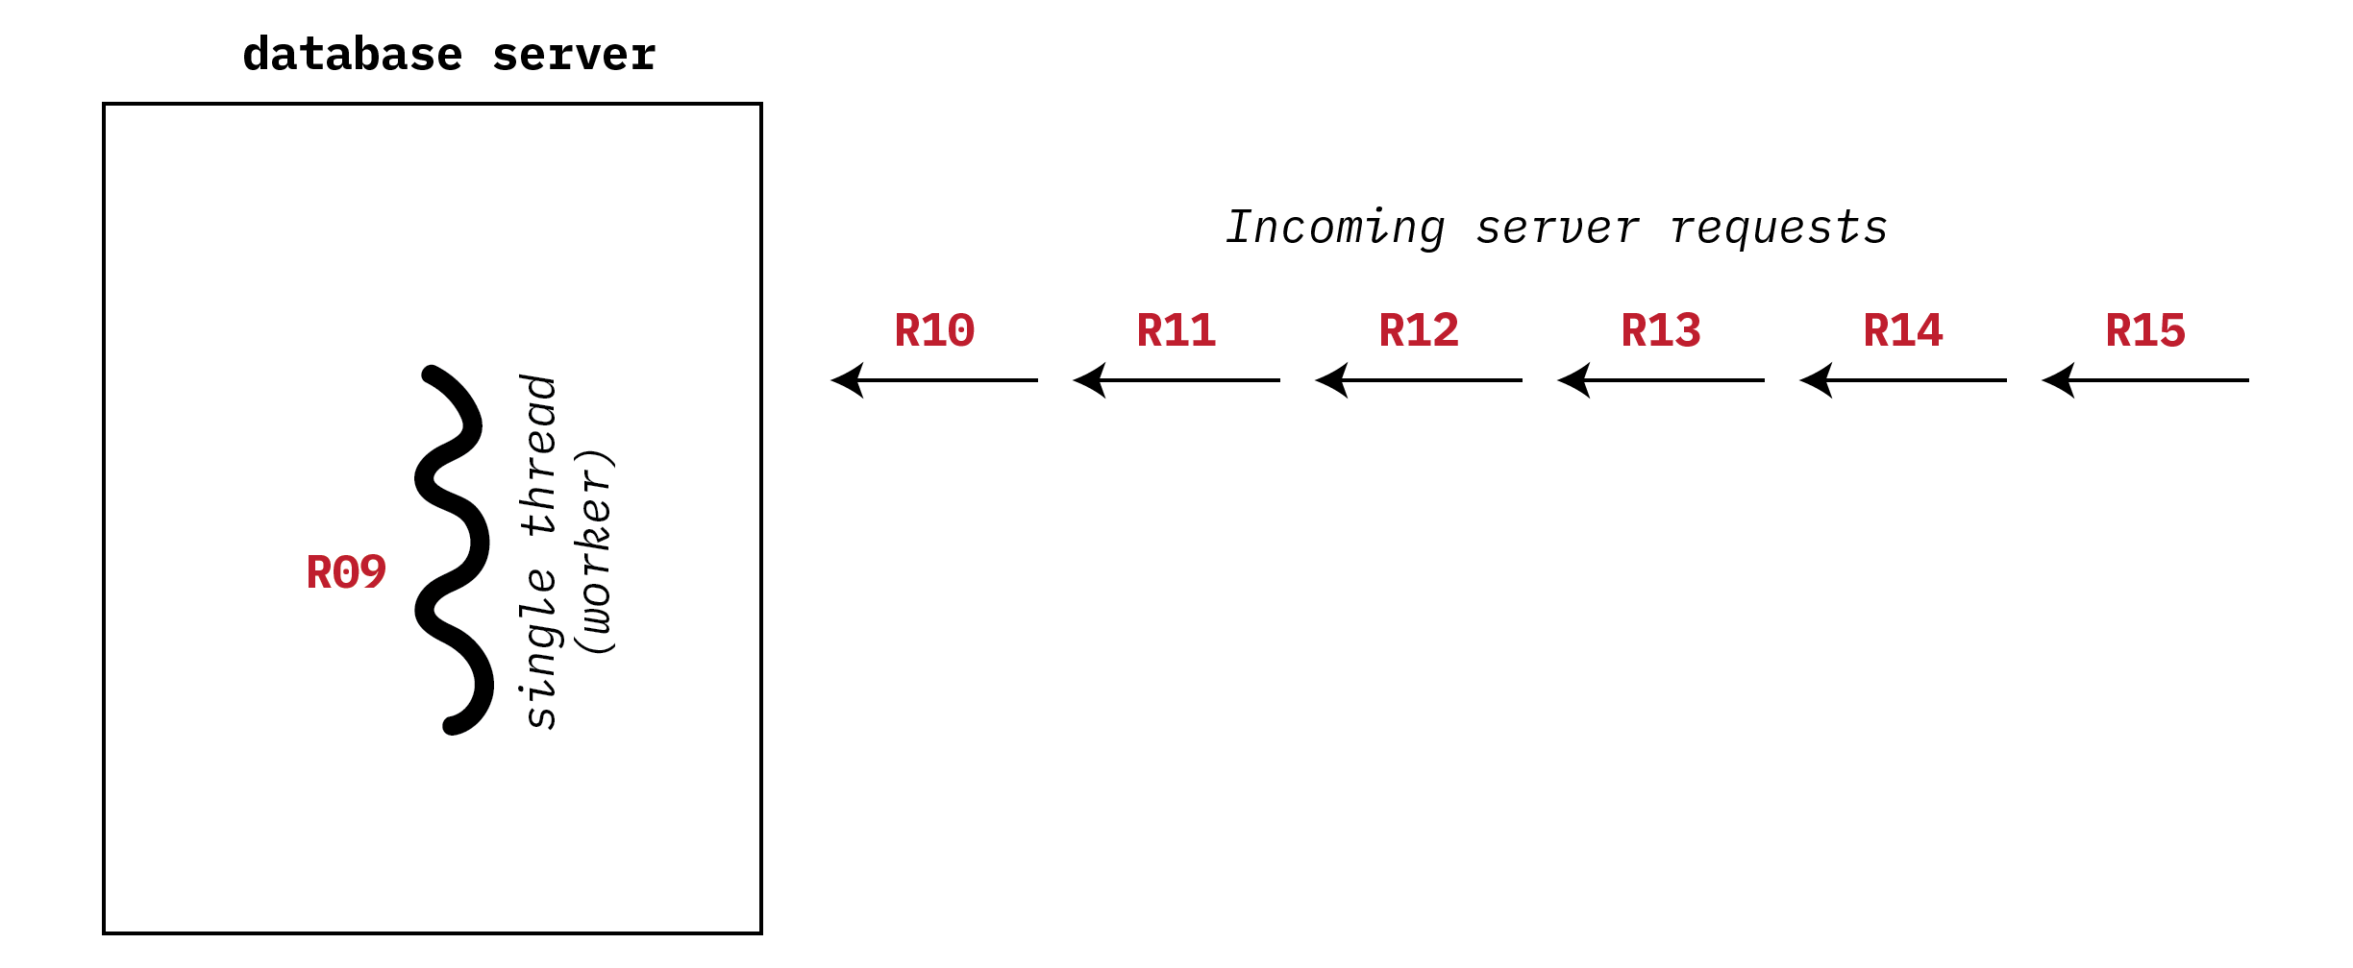
Single-Threaded Database Server
Notes:
Here is another server example, a database server handling multiple clients. The single-threaded approach to dealing with these requests is to handle them sequentially or to multiplex them explicitly. The former approach would be unfair to quick requests occurring behind lengthy requests, and the latter would require fairly complex and error-prone code.

Slide 19
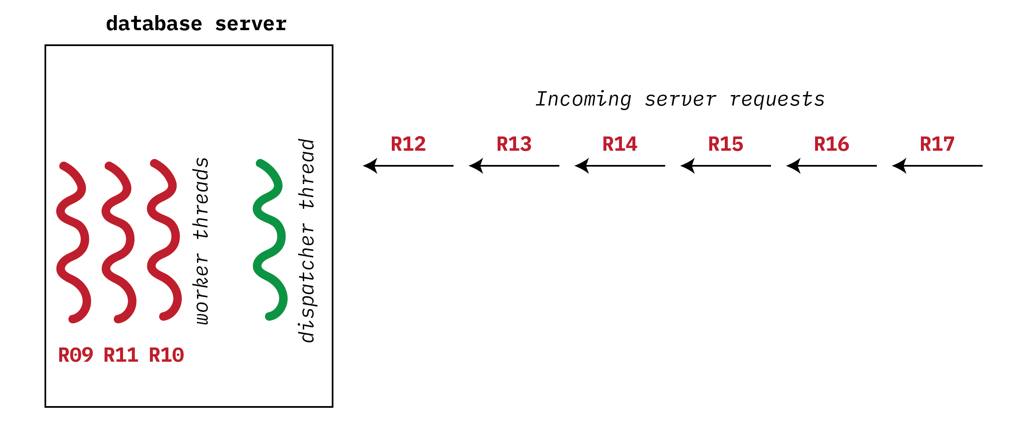
Multithreaded Database Server
Notes:
Here is another server example, a database server handling multiple clients. The single-threaded approach to dealing with these requests is to handle them sequentially or to multiplex them explicitly. The former approach would be unfair to quick requests occurring behind lengthy requests, and the latter would require fairly complex and error-prone code.

Slide 20
Benefits of threads
Responsiveness – may allow continued execution if part of process is blocked, especially important for user interfaces
Resource Sharing – threads share resources of process (open files, program-scope variables) which is easier to use than shared memory or message passing between processes
Economy – thread creation is “cheaper” than process creation; thread switching has lower overhead than context switching
Scalability – program in the process can be written to take advantage of multiprocessor architectures by adding and removing threads and processors become more or less available

Slide 21
Multicore Programming
Multicore or multiprocessor systems do, however, put pressure on programmers
Programming challenges include:
Dividing up activities
Balancing activities
Data splitting
Data dependency
Testing and debugging
Parallelism implies a system can perform more than one task simultaneously
Concurrency supports more than one task making progress
Single processor / core, scheduler providing concurrency

Slide 22
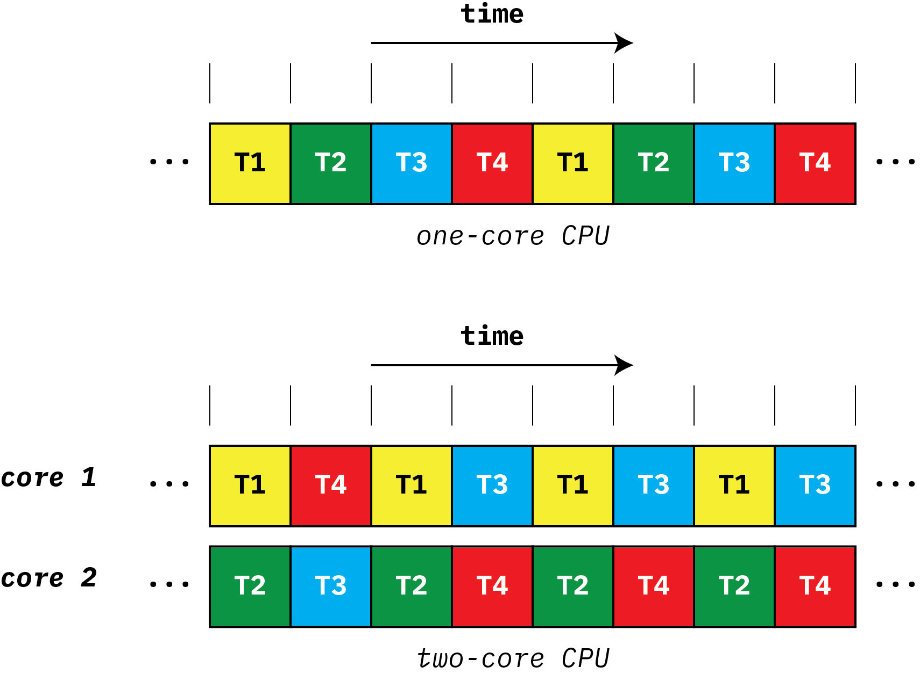
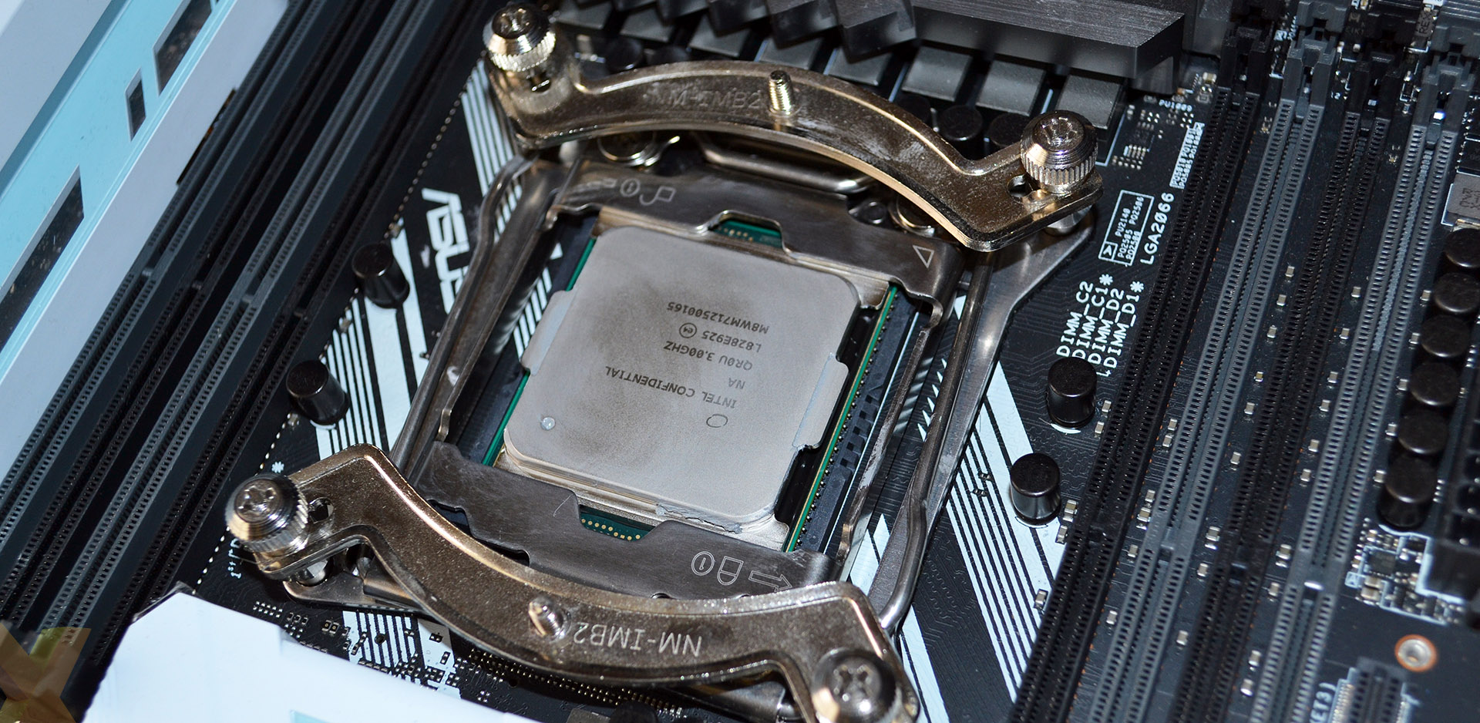
Multicore Programming (Cont.)
Types of parallelism
Data parallelism – distributes subsets of the same data across multiple cores, same operation on each
Task parallelism – distributing threads across cores, each thread performing unique operation
Hardware architecture support for software threads continues to increase over time
CPUs have cores as well as hardware threads
Example: Intel Xeon Platinum 8592+ processors has 64 cores (price: US$12K)
Note: hardware threads are not the same as the software threads we’re examining in this course.
Notes:
Spring 2021: Price of an i9-9980XE is around CDN$2000
Spring 2024: Price of an Intel Xeon Platinum 8592+ processor *(64 cores) is US$11,600
Spring 2024: Price of an Intel Xeon Silver 4314 processor (16 cores) is $1200

Slide 23
pthread (POSIX threads)
The creation and management of threads is normally done through a thread library
We will use POSIX threads (also known as pthreads)
Which means we will be using the pthread library installed with on jhub-cosi
In what follows we will look at some examples of pthread library calls
thread creation
parameterizing threads
thread attributes
and more...
More specific details on pthreads will eventually be provided as part of assignments and tutorials

Slide 24
Creating a POSIX Thread
void start_servers( ) {
pthread_t thread;
int i;
for (i=0; i<nr_of_server_threads; i++)
/* Making a biiiiiig assumption below, that thread
* creation always succeeds. More robust code
* must check value returned from pthread_create.
*/
pthread_create(&thread, /* pointer to thread ID */
0, /* default attributes */
server, /* start routine */
argument); /* pointer to any argument */
}
void *server(void *arg) { /* the worker thread */
for (;;) {
/* get and handle request */
}
}
Notes:
To create a thread, one calls the pthread_create routine. This skeleton code for a server application creates a fixed number of threads, each to handle client requests. If pthread_create returns successfully (i.e., returns 0), then a new thread has been created that is now executing independently of the caller. This new thread has an ID that is returned via the first parameter. The second parameter is a pointer to an attributes structure that defines various properties of the thread. Usually, we can get by with the default properties, which we specify by supplying a null pointer (we discuss this in more detail later). The third parameter is the address of the routine in which our new thread should start its execution. The last argument is the argument that is actually passed to the first procedure of the thread.
If pthread_create fails, it returns a code indicating the cause of the failure.
How it Works:
A loop runs nr_of_server_threads times.
Each iteration creates a new thread that starts executing server().
The pthread_create() function takes:
&thread → Pointer to a pthread_t variable (thread ID).
0 → Uses default thread attributes.
server → Function to execute (void *server(void *arg)).
argument → A pointer to any argument that needs to be passed to the thread (not defined in the provided code).
When to Use This Approach?
This is a multi-threaded server model, useful for handling multiple client connections in parallel.
Suitable when requests involve CPU-intensive tasks and multi-core processors can be utilized efficiently.

Slide 25
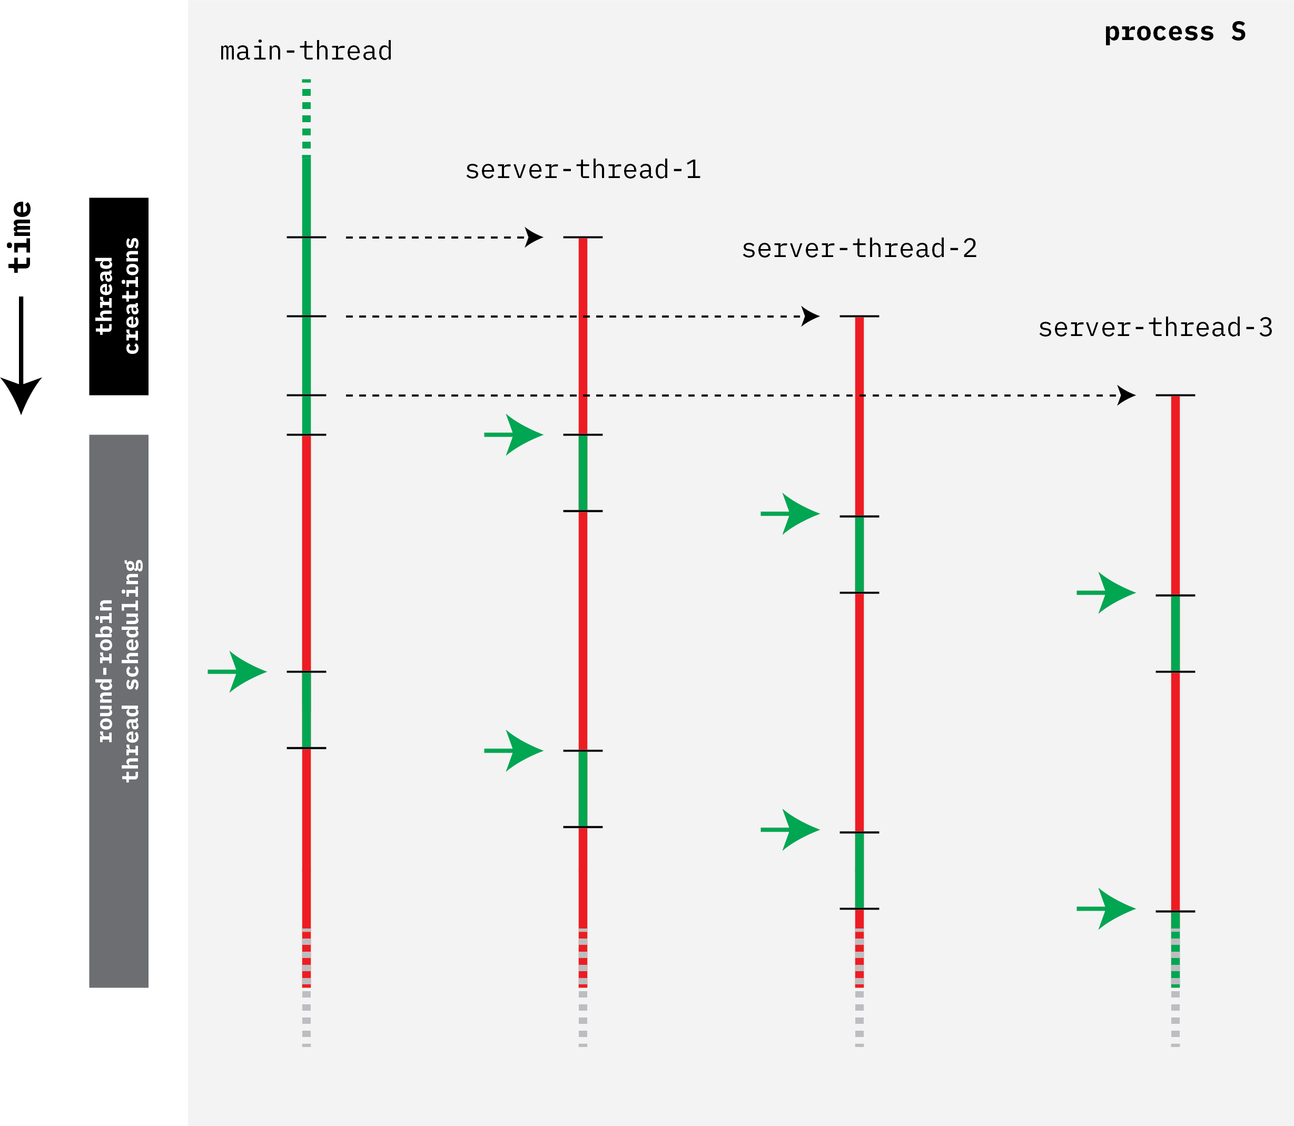
Threads in one process
Notes:
Here is another server example, a database server handling multiple clients. The single-threaded approach to dealing with these requests is to handle them sequentially or to multiplex them explicitly. The former approach would be unfair to quick requests occurring behind lengthy requests, and the latter would require fairly complex and error-prone code.

Slide 26
(a wee complication)
rlogind(int r_in, int r_out, int l_in, int l_out)
{
pthread_t in_thread, out_thread;
pthread_create(&in_thread,
0,
incoming,
r_in, l_out); /* Sadly, cannot do this... */
pthread_create(&out_thread,
0,
outgoing,
l_in, r_out); /* Can't do this, either... */
/* How do we wait till both threads are done? */
}
Notes:
An obvious limitation of the pthread_create interface is that one can pass only a single argument to the first procedure of the new thread. In this example, we are trying to supply code for the rlogind example of the previous module, but we run into a problem when we try to pass two parameters to each of the two threads.
A further issue is synchronization with the termination of a thread. For a number of reasons we’ll find it necessary for a thread to be able to suspend its execution until another thread has terminated.

Slide 27
Multiple Arguments
typedef struct {
int first, second;
} two_ints_t;
rlogind(int r_in, int r_out, int l_in, int l_out) {
pthread_t in_thread, out_thread;
two_ints_t in = {r_in, l_out}, out = {l_in, r_out};
pthread_create(&in_thread, 0, incoming, &in);
pthread_create(&out_thread, 0, outgoing, &out);
}
Notes:
To pass more than one argument to the first procedure of a thread, we must somehow encode multiple arguments as one. Here we pack two arguments into a structure, then pass the pointer to the structure. This technique at least does not produce any compile-time errors, but it has a potential serious problem.

Slide 28
When are the threads done?
void rlogind(int r_in, int r_out, int l_in, int l_out) {
pthread_t in_thread, out_thread;
two_ints_t in={r_in, l_out}, out={l_in, r_out};
pthread_create(&in_thread, 0, incoming, &in);
pthread_create(&out_thread, 0, outgoing, &out);
pthread_join(in_thread, 0);
pthread_join(out_thread, 0);
}
pthread_join() blocks execution until both threads complete their work.
Ensures that both threads finish before rlogind (mainline code) exits.
Notes:
In the previous example, the in and out structures are local variables of the “mainline” thread. Their addresses are passed to new threads. If the mainline thread returns from its rlogind procedure before the new threads terminate, there is the danger that the new threads may dereference their argument pointers into storage locations that are no longer active. This would cause a serious runtime problem that might be difficult to track down.
However, if we can guarantee that the mainline thread does not return from rlogind until after the new threads have terminated, then our means for passing multiple arguments is safe. In the example above, the mainline thread places calls to pthread_join, which does not return until the thread mentioned as its first argument has terminated. Thus the mainline thread waits until the new threads terminate and then returns from rlogind.
Placing pthread_join() at the end keeps the main thread alive and ensures proper execution of both worker threads before the program exits.

Slide 29
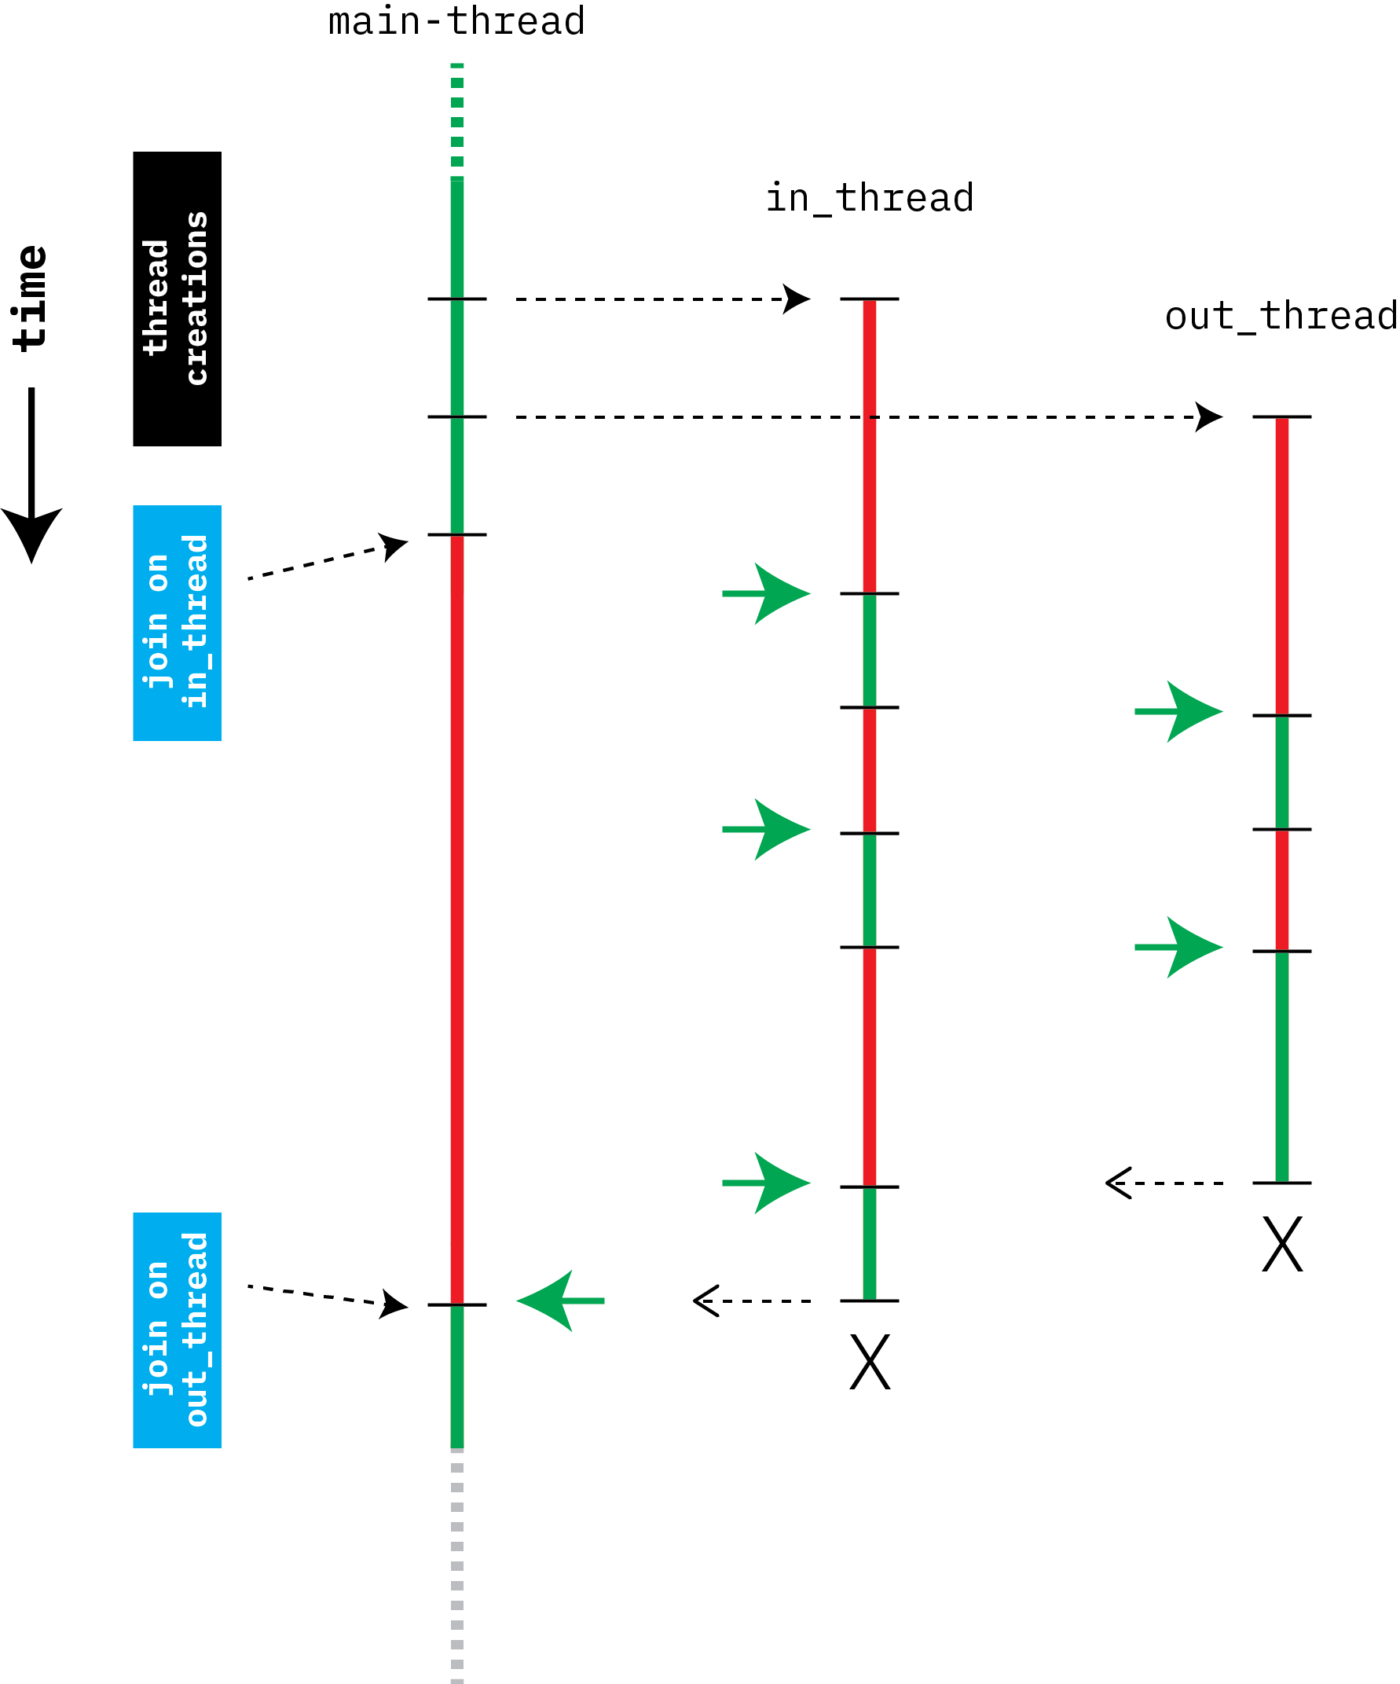
void rlogind(int r_in, ...
...
pthread_create(&in_thread, ...
pthread_create(&out_thread, ...
pthread_join(in_thread, 0);
pthread_join(out_thread, 0);
}
Notice that even though out_thread completes before in_thread, the main-thread is blocked until it joins with in_thread.

Slide 30
Termination
Careful use of several calls (signatures shown below)
#1 is completely different from regular process exit(1)
#2 may be needed to keep the compiler happy
#3 really only needed if the thread creator must explicitly wait for the created thread to complete its work.
/* 1 */ pthread_exit((void *) value);
/* 2 */ return((void *) value);
/* 3 */ pthread_join(thread, (void **) &value);

Slide 31
Detached Threads
void start_servers( ) {
pthread_t thread;
int i;
for (i=0; i<nr_of_server_threads; i++) {
pthread_create(&thread, 0, server, 0);
pthread_detach(thread);
}
...
}
server( ) {
...
}
Notes:
Thread state (TCB) is stored until the thread is cleaned-up. Normally this occurs after a join. (A thread may have terminated before its creator can call join.)
Detached: "I am interested in starting this thread, but I am not interested in joining it. Please perform any clean-up action for me, once the thread has terminated."

Slide 32
Thread Attributes
pthread_t thread;
pthread_attr_t thr_attr;
pthread_attr_init(&thr_attr);
...
/* establish some attributes */
...
pthread_create(&thread, &thr_attr, startroutine, arg);
...
pthread_attr_destroy(&thr_attr);
Notes:
A number of properties of a thread can be specified via the attributes argument when the thread is created. Some of these properties are specified as part of the POSIX specification, others are left up to the implementation. By burying them inside the attributes structure, we make it straightforward to add new types of properties to threads without having to complicate the parameter list of pthread_create. To set up an attributes structure, one must call pthread_attr_init. As seen in the next slide, one then specifies certain properties, or attributes, of threads. One can then use the attributes structure as an argument to the creation of any number of threads.
Note that the attributes structure only affects the thread when it is created. Modifying an attributes structure has no effect on already-created threads, but only on threads created subsequently with this structure as the attributes argument.
Storage may be allocated as a side effect of calling pthread_attr_init. To ensure that it is freed, call pthread_attr_destroy with the attributes structure as argument. Note that if the attributes structure goes out of scope, not all storage associated with it is necessarily released—to release this storage you must call pthread_attr_destroy.

Slide 33
Stack Size
pthread_t thread;
pthread_attr_t thr_attr;
pthread_attr_init(&thr_attr);
pthread_attr_setstacksize(&thr_attr, 20*1024*1024);
...
pthread_create(&thread, &thr_attr, startroutine, arg);
...
pthread_attr_destroy(&thr_attr);
Notes:
Among the attributes that can be specified is a thread’s stack size. The default attributes structure specifies a stack size that is probably good enough for “most” applications. How big is it? The default stack size is not mandated by POSIX. In Digital Unix 4.0, the default stack size is 21,120 bytes, while in Solaris it is one megabyte. To establish a different stack size, use the pthread_attr_setstacksize routine, as shown in the slide.
How large a stack is necessary? The answer, of course, is that it depends. If the stack size is too small, there is the danger that a thread will attempt to overwrite the end of its stack. There is no problem with specifying too large a stack, except that, on a 32-bit machine, one should be careful about using up too much address space (one thousand threads, each with a megabyte stack, use a fair portion of the address space).
More attributes:
scope (bound to a process? or not? -- equivalently, is the thread an LWP?)
detachstate (after thread terminates, is exit status and thread itself preserved?);
stackaddr (is the location of the thread's stack specifically assigned?);
stacksize (above);
inheritsched (does the thread inherit its parent's scheduling priority?);
schedpolicy (only used in Solaris)

Slide 34
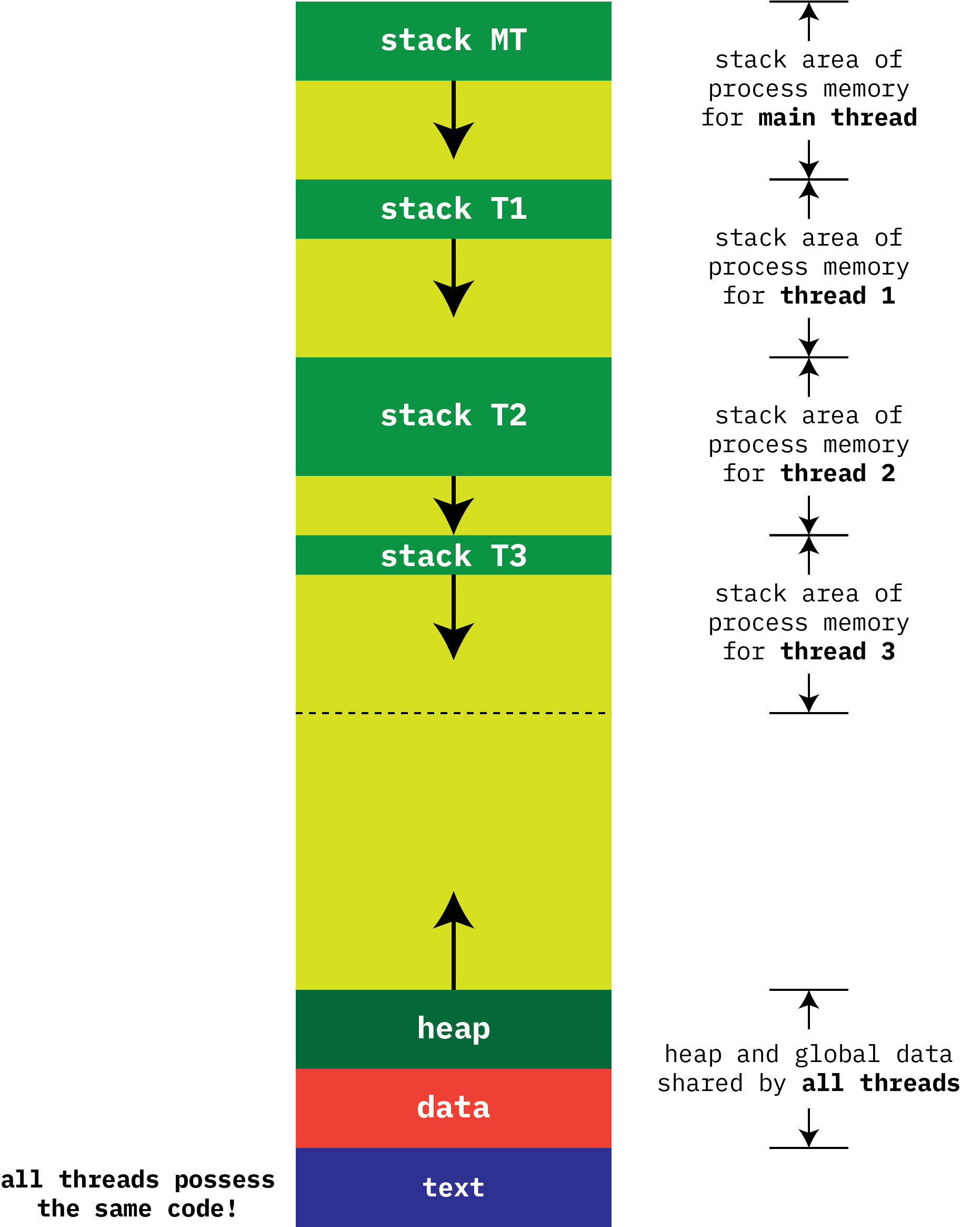
View of the process address space showing multiple local stacks.
Note: For simplicity, kernel portion of the address space is not shown.
Notes:
v

Slide 35
User Threads and Kernel Threads
User threads
Management performed by code in a user-level threads library
Kernel is not aware of threads (that is, any system call from any thread appears to the thread as if it comes from the whole process)
Three primary thread libraries:
Traditional POSIX Pthreads
Windows threads
Java threads (but this requires a Java VM)
Kernel threads
Supported by code in the kernel
Kernel is aware of system calls (including blocking ones) made by thread
Examples: virtually all general purpose operating systems, including
Windows
Solaris
Linux (i.e., pthread)
Tru64 UNIX
macOS

Slide 36
Multithreading Models
Many-to-One
Many user threads to one kernel thread
One-to-One
One user thread to one kernel thread
Many-to-Many
M user threads to N kernel threads

Slide 37
Many-to-One
Many user-level threads mapped to single kernel thread
One thread blocking causes all to block
Multiple threads may not run in parallel on a multicore system because only one may be in kernel at a time
Although this was the very first widely-implemented form of threading, few systems currently use this model
Examples:
Solaris Green Threads
GNU Portable Threads

Slide 38
One-to-One
Each user-level thread maps to kernel thread
Creating a user-level thread creates a kernel thread
More physical concurrency possible than many-to-one
Number of threads per process sometimes restricted due to overhead
Examples
Windows NT
Linux
Solaris 9 and later

Slide 39
Many-to-Many Model
Allows many user level threads to be mapped to many kernel threads
(Also known as an M to N -- or M:N model)
Allows the operating system to create a sufficient number of kernel threads
Solaris prior to version 9
Windows with the ThreadFiber package

Slide 40
Two-level Model
Similar to M:N, except that it allows a single user thread within a process to be bound to single kernel thread
That is, all threads are in the same process...
... but some are M:N, some are 1:1
Examples
IRIX
HP-UX
Tru64 UNIX
Solaris 8 and earlier

Slide 41
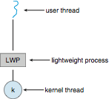
Scheduler Activations
Both M:N and Two-level models require communication to maintain the appropriate number of kernel threads allocated to the application
Typically use an intermediate data structure between user and kernel threads – lightweight process (LWP)
Appears to be a virtual processor on which process can schedule user thread to run
Each LWP attached to kernel thread
How many LWPs to create?
Scheduler activations provide upcalls
a communication mechanism from the kernel to the upcall handler in the thread library
This communication allows an application to maintain the correct number kernel threads

Slide 42
Linux Threads
Linux refers to them as tasks rather than threads
Thread creation is done through clone() system call
clone() allows a child task to share the address space of the parent task (process)
Flags control behavior
struct task_struct points to process data structures (shared or unique)

Slide 43
Summary
Threads are an important structural mechanism for programmatic expression of concurrency
Easier to write an application using multiple threads (i.e. compared with using multiple processes)
Threads can be implemented on top of a systems process model
There are many different realizations of threads
Our course will focus on POSIX threads (pthreads)
Different models represented different relationships between user-level threads and kernel-level threads
Creating threads is (oddly enough) the easy part!
Ensuring threads collaborate together in safe ways is the hard part.
We look next at this hard part...

