Slide 1
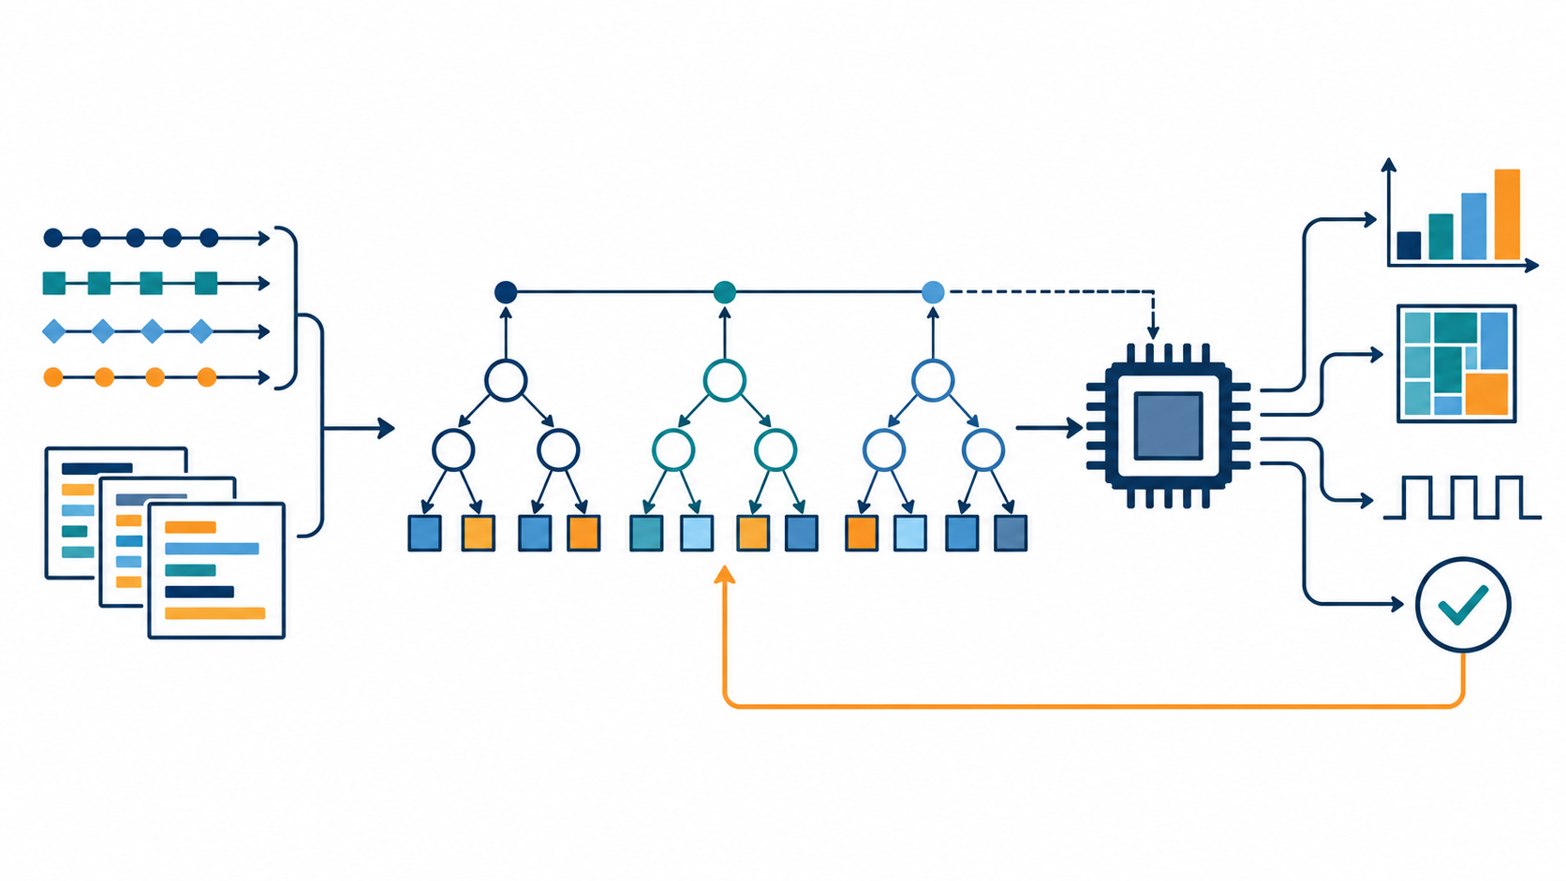
How ISAForge ranks custom-instruction candidates
Pairwise XGBoost learns candidate order from measured whole-program speedup labels.
The illustration shows 3 trees. The fitted pairwise ranker uses 80 depth-2 trees and outputs a rank, not a speedup estimate.
Training data: 35 candidate features and 122 verified measured-speedup labels across 14 workload groups.
Separate speedup model: 20 bootstrap XGBoost regressors. Their spread is model disagreement, not calibrated confidence.
A bounded selection policy requests PicoRV32 trials. Measured cycles, LUT4 area, routed Fmax, and correctness determine feasibility.
ISAForge / ECE 4803
Notes:
Explain the drawing as the current learned ranking model, not a neural network. The illustration uses three trees for readability. The fitted pairwise XGBoost ranker has 80 depth-2 trees and a rank:pairwise objective.
It uses 35 structural and workload-profile features. The current corpus contains 122 verified whole-program speedup labels across 14 workload groups. The output is a rank score that orders candidates, not a direct speedup prediction.
A separate ensemble of 20 bootstrap XGBoost regressors predicts the speedup ratio. Its spread represents model disagreement and is not calibrated uncertainty.
The bounded selection policy can request paid PicoRV32 measurements. Actual cycles, correctness, LUT4 area, and routed Fmax establish the outcome and feasibility. The current Codex chat pilot used archived EDN outcomes and did not launch native jobs.
Project references: docs/model-screen-2026-10-26.md; docs/codex-chat-selector-pilot.md; submissions/midterm-2026-10-28/README.md.

