Slide 1
Sales Data Dashboard Design
Using Tableau for Data Driven Insights
Jasmitha K | 25/04/25

Slide 2
Objective
Design an interactive dashboard for business stakeholders to
monitor key performance indicators (KPIs) related to
sales and profit, and enable data driven decisions.
Tools Used: Tableau
Dataset: Sales Dataset (sourced from Kaggle)

Slide 3
Key Features of the Dashboard
KPI Tracking: Sales, Profit, and Regional Performance
Time-Series Analysis: Monthly trend analysis of sales
Segment Analysis: Breakdown of sales by customer segment
Geographic Insights: Sales distribution by U.S. states
Interactivity: Filters by Region and Segment
Visual Elements: Bar charts, line charts, maps, and pie charts

Slide 4
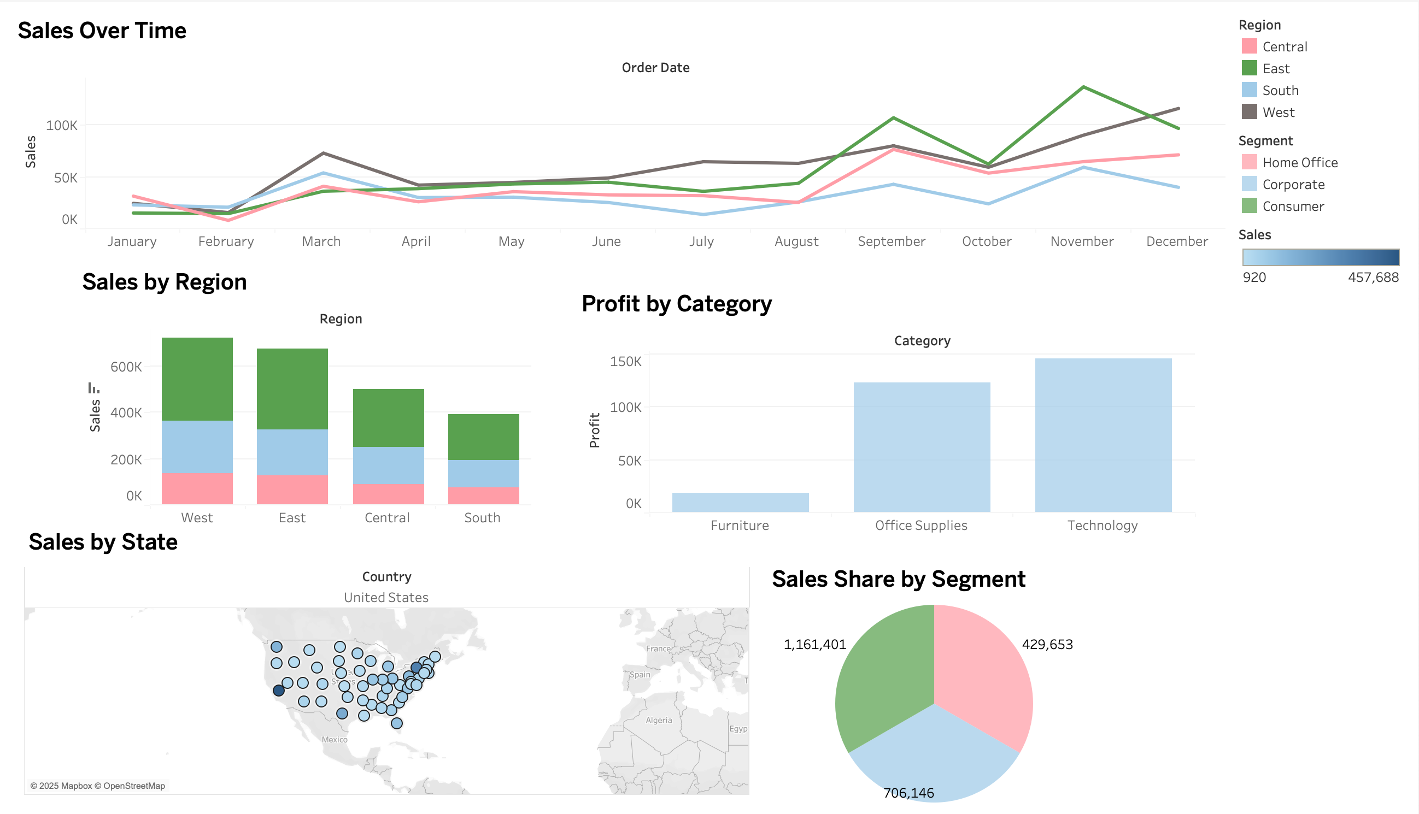
Dashboard Overview
The dashboard contains:
Sales Over Time (by region)
Sales by Region and Segment
Profit by Category
Sales by State (Map)
Sales Share by Segment (Pie Chart)

Slide 6
Key Business Insights
Sales Trends:
Strong spikes in March and September
West region leads overall sales
Segment Performance:
Consumer is the largest segment (1.16M sales)
Corporate and Home Office follow
Profitability:
Technology & Office Supplies drive most profit
Furniture lags in profitability
Geographic Sales:
Wide coverage across U.S. states
Some states have noticeably higher volumes

Slide 7
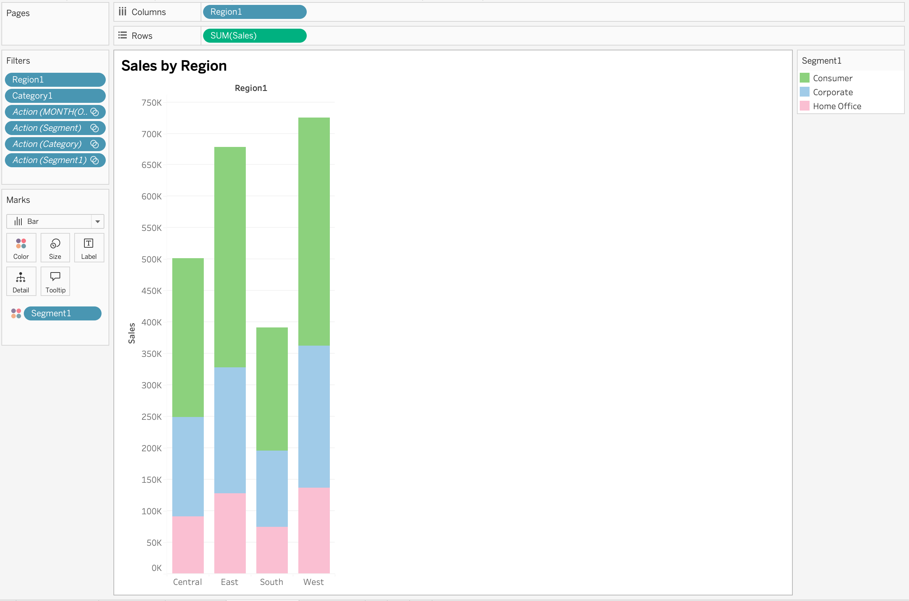
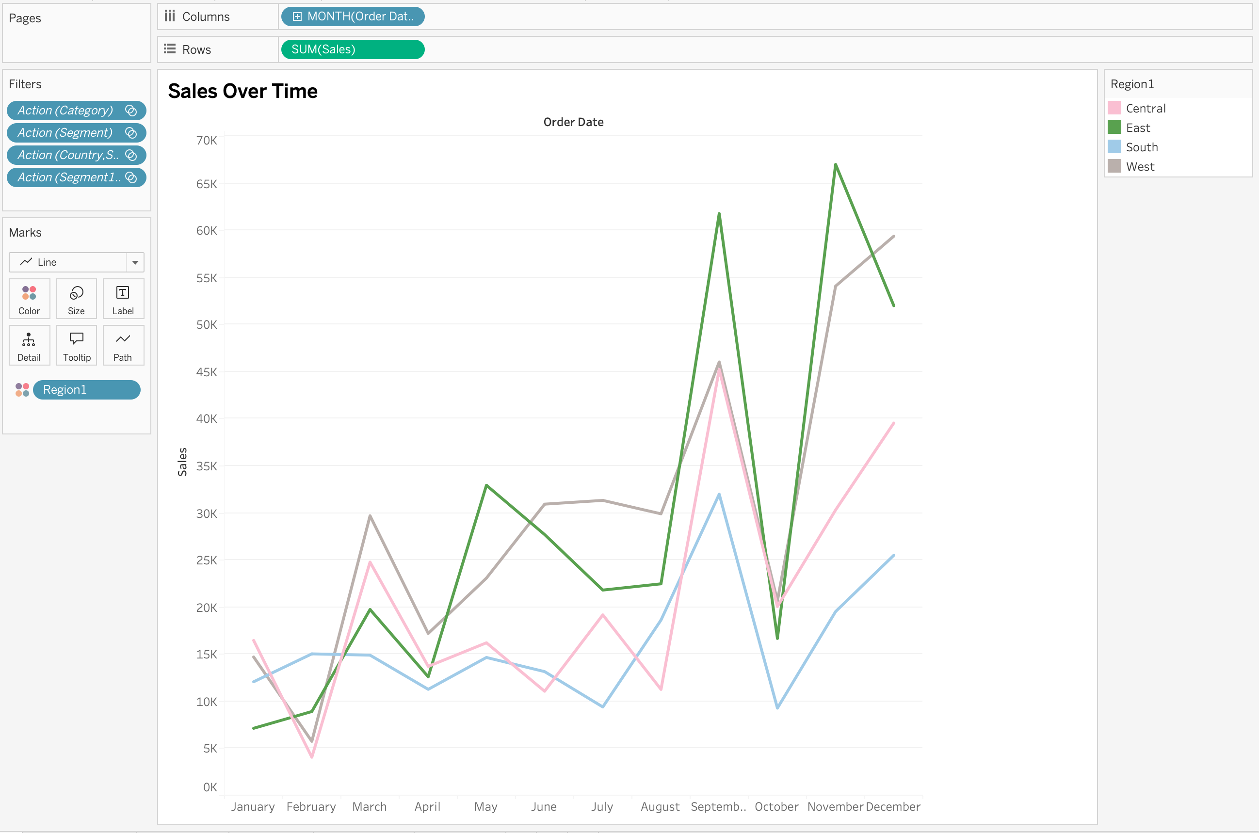
Sales Over Time
Sales by Region

Slide 8
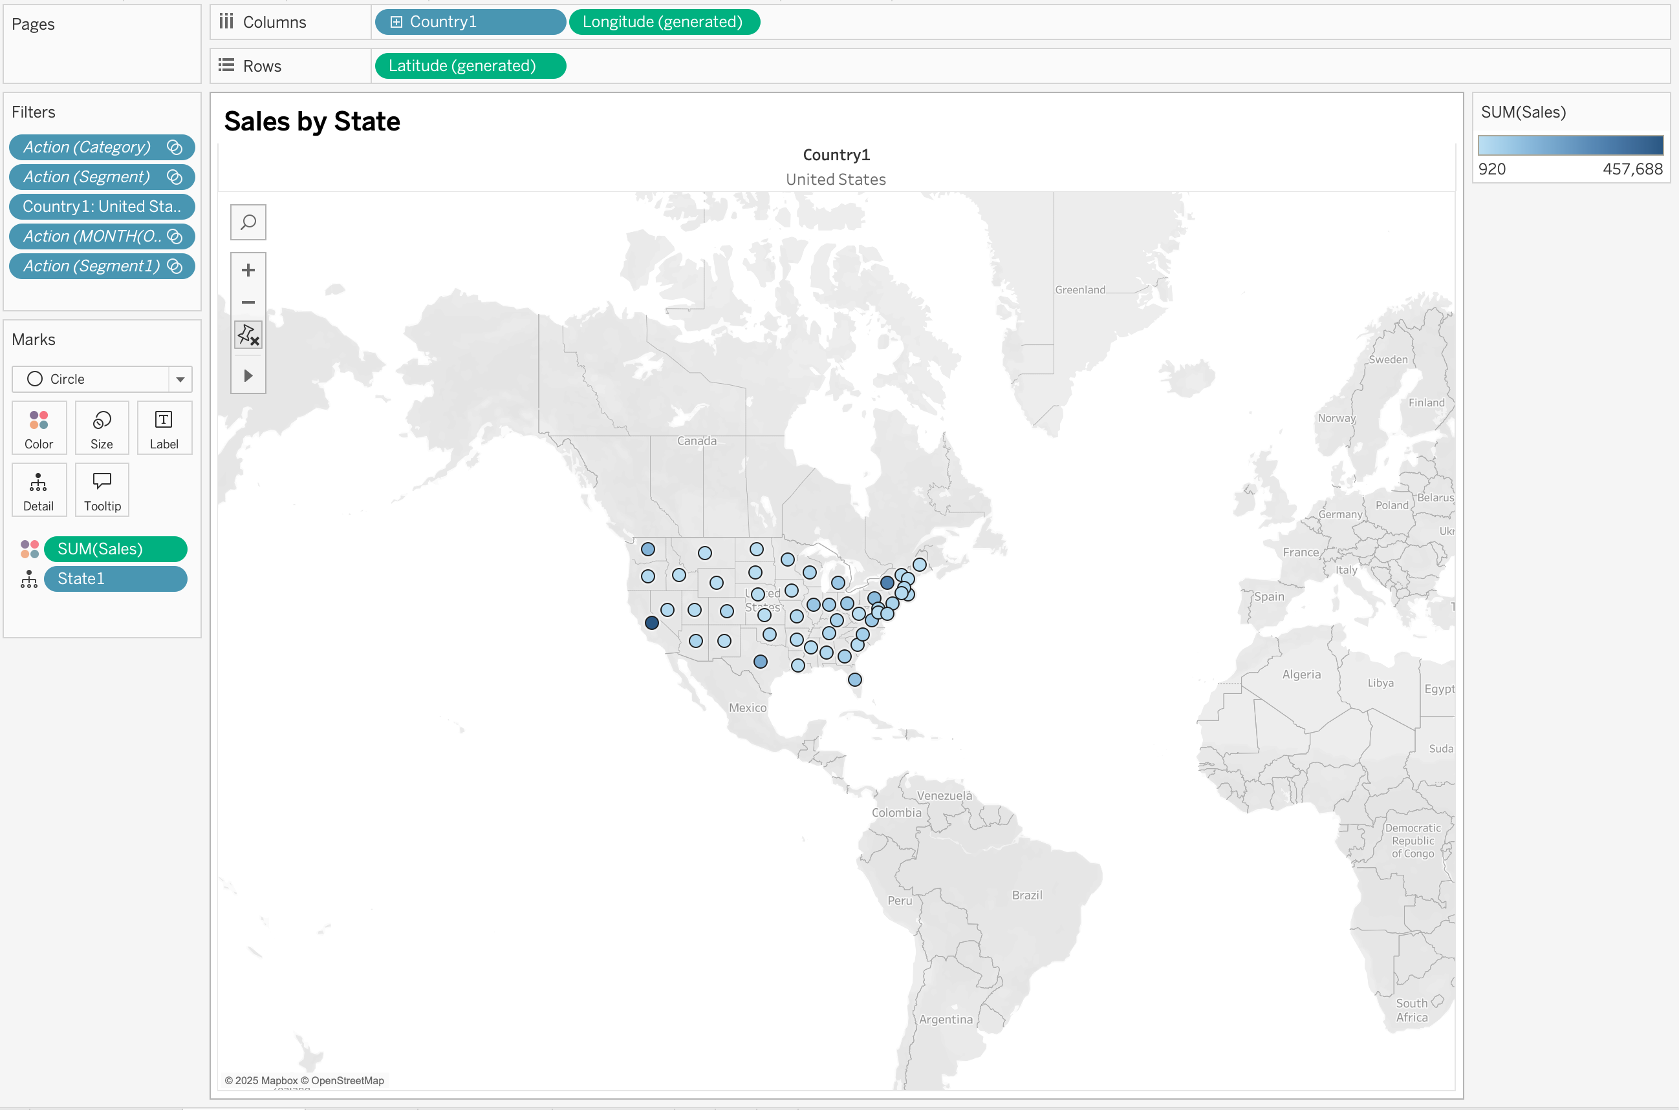
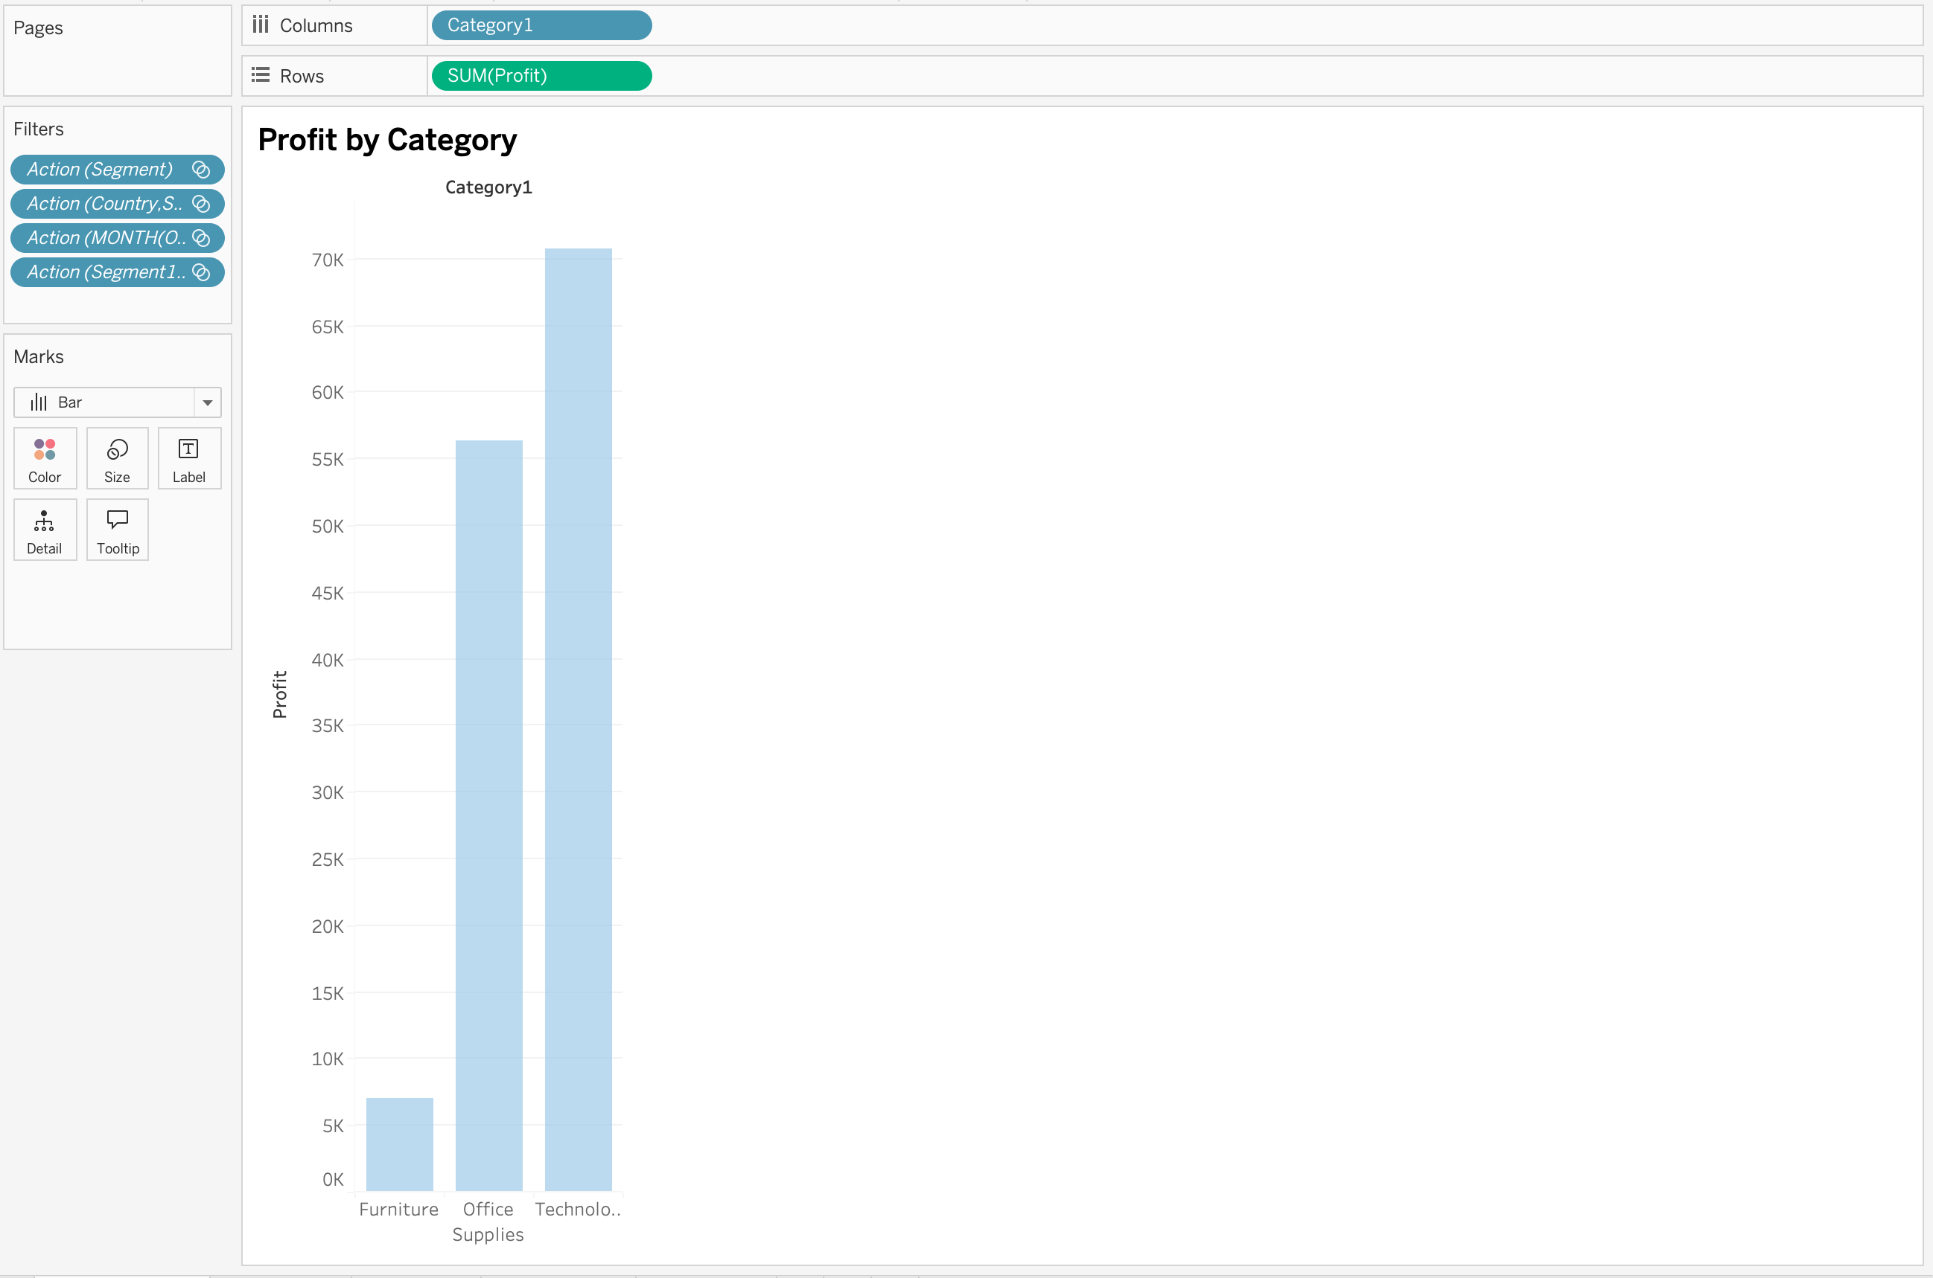
Profit by Category
Sales by State

Slide 9
Conclusion
The sales dashboard provides a comprehensive, interactive view of business performance across time, region, category, and customer segments.
It enables stakeholders to:
Monitor key KPIs like Sales and Profit
Identify high-performing regions and segments
Uncover trends and seasonal patterns
Support strategic planning with data-backed insights
Overall, this dashboard is a powerful tool for driving informed, impactful business decisions.

