Slide 1
ENGI 301 Synthesizer Proposal
10/20/2019
Josh Stelling

Slide 2
Background Information
The device I’d like to make would be a small, relatively portable synthesizer that allows for rapid music composition and playback. The device would have the ability to play a range of notes with the option to switch between octaves. The device would also have a built in, adjustable metronome.
Improvements
This device would have an integrated adjustable metronome as well as the ability to change the period over which a melody is repeated based on metronome beats. For example, a recording could be set to repeat after 6 beats of the metronome to allow for the ability to make a repeating 2-bar 3:4 melody.

Slide 3
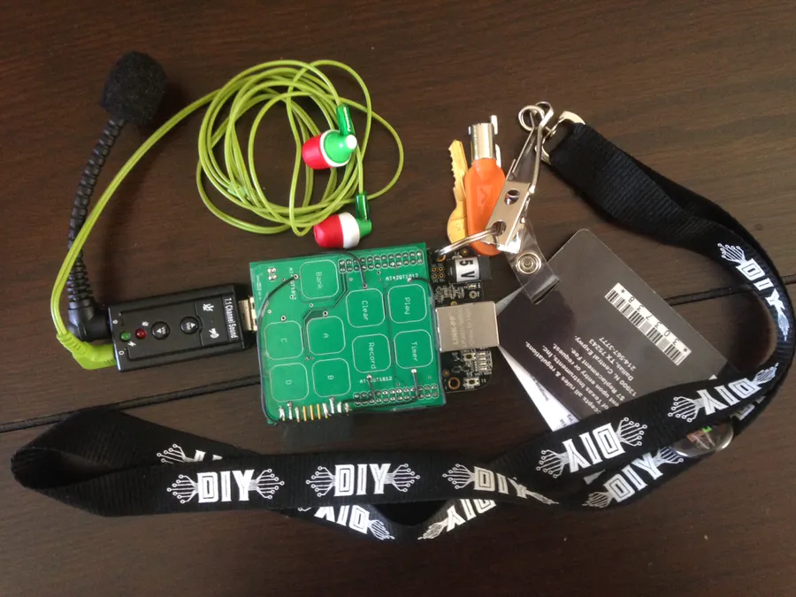
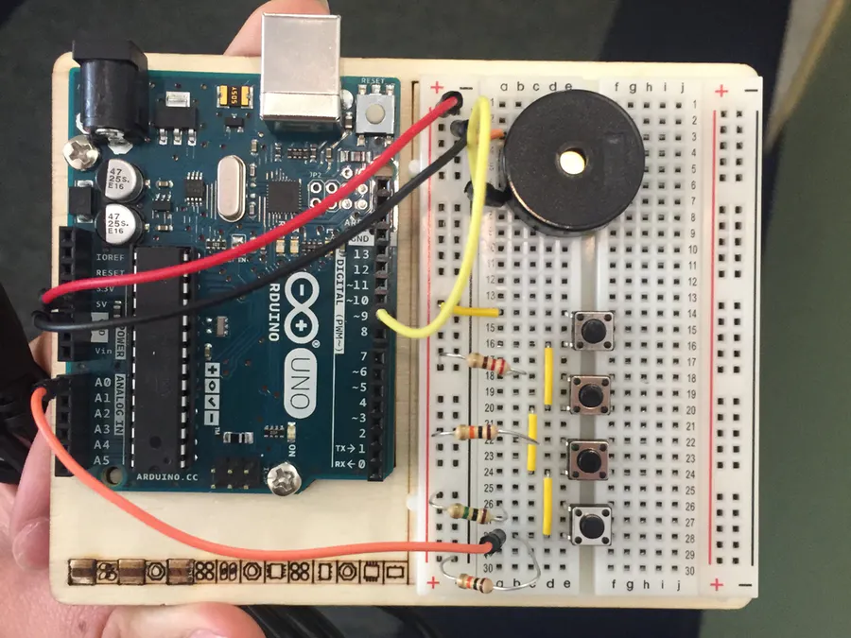
Background Information
What is being proposed?
https://www.hackster.io/team-sunshine/keychain-synth-376159
Example of some synthesizer functionalities
https://www.hackster.io/95016/keyboard-melodies-9ac4ab
Example keyboard setup

Slide 4
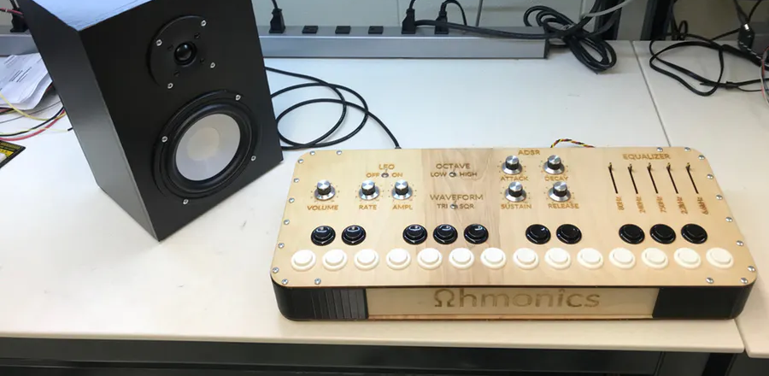
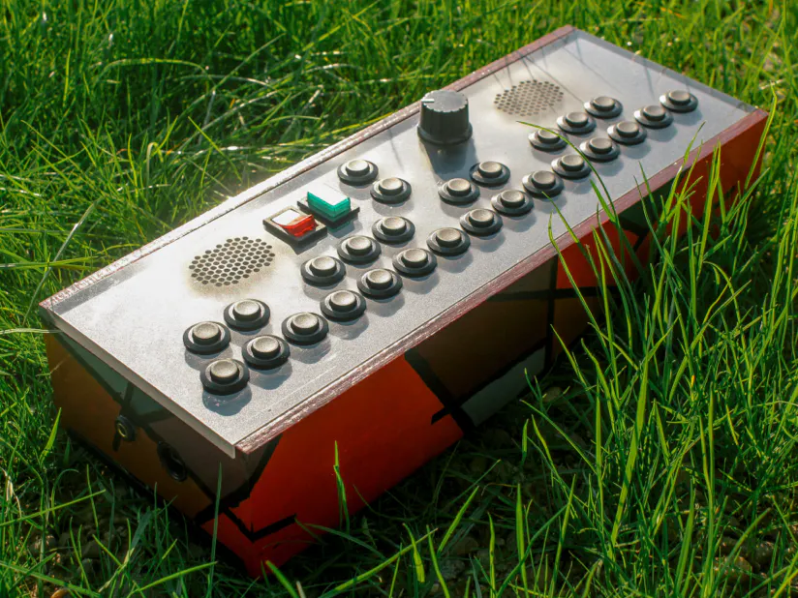
Background Information
https://www.hackster.io/the-ohmonics/the-ohminator-analog-synthesizer-142dc7
Very complex full synthesizer
https://www.hackster.io/etiennedesportes/pocket-synthesizer-785b50
Another very complex synthesizer

Slide 5


Display/Controls Layout (Not to scale)
Speakers (May need multiple to allow for multiple tones, like metronome, active, and playback)
Metronome BPM, LED, BPM slider, and volume slider
Volume Slider
120
Beagle Power in
Recording beat interval and slider
8
Clear Recording Button
Recording switch toggle
Octave Switch
Keys

Slide 6
Old System Block Diagram
Pocket Beagle
Speaker 1
PWM
GPIO_IN
Clear Button
Speaker 2
PWM
Speaker 3
PWM
ANALOG_IN
2 Potentiometers
4 Digit Display
I2C1
PWM
LED
4 Digit Display
I2C2
12 Keys
12 GPIO_INs
Record Switch
GPIO_IN
Octave Switch
GPIO_IN

Slide 7
Old Power Block Diagram
Pocket Beagle
Speaker 1
3.3 V, 140 mA
3.3V_OUT
3.3V, non-continuous
Clear Button
Speaker 2
3.3 V, 140 mA
PWM
Speaker 3
3.3 V, 140 mA
1.8V A ref
1.8V
2 Potentiometers
4 Digit Display
5 V, 2 200 mA
3.3 V, Current Unsure
SYS_VOUT
PWM
LED
5 V, 200 mA
4 Digit Display
12 Keys
3.3 V, Current Unsure
Record Switch
3.3 V, Current Unsure
3.3V_OUT
Octave Switch
3.3 V, Current Unsure

Slide 8
New System Block Diagram
Pocket Beagle
Speaker 1
PWM
Speaker 2
PWM
Speaker 3
PWM
2 ANALOG_IN
2 Potentiometers
12 Keys
12 GPIO_INs
Record Switch
GPIO_IN

Slide 9
New Power Block Diagram
Pocket Beagle
Speaker 1
3.3 V, 140 mA
Speaker 2
3.3 V, 140 mA
PWM
Speaker 3
3.3 V, 140 mA
1.8V A ref
1.8V
2 Potentiometers
12 Keys
3.3 V, Current Unsure
Record Switch
3.3 V, Current Unsure
3.3V_OUT

Slide 10
Components / Budget
Component | Need to Buy | Cost
BeagleBoard | 0
Adafruit Mini-Speaker (1898) | 3 | 1.85
Adafruit I2C 7-segment Display (878) | 1 | 9.95
Adafruit Slide Potentiometer (4272) | 4 | 1.95
Resistors | 0
Switches | Probably 0
Buttons | Probably 0
LED | 0
Wood for Box | Maybe

