Slide 1
RDMP Imaging

Slide 2
Use Cases
Derive Cohort
from complex DICOM metadata
from other data and simple DICOM metadata
from image pixel data
from structured reports
Anonymisation
DICOM images (by modality)
Anonymisation of structured reports
Metadata standardisation / sharing

Slide 3

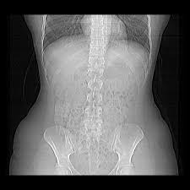


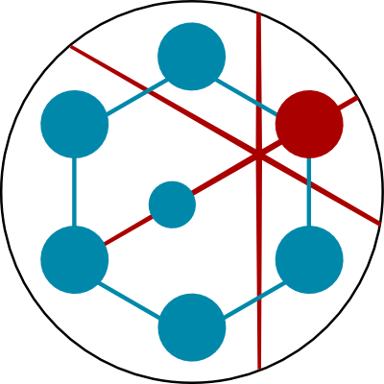
Other Datasets
Tags + Path
Anonymous
Project Images
Disk
Disk
Database
Metadata

Slide 4
Other Datasets
Tags + Path
Load Pipeline
PACS Source
Dicom Source
RDMP
Attacher
Anonymous
Project Images
Disk
Query by Hour
Filter by identifiers
Disk
Database
Modality Routing
Multiplicity/Sequences
JSON / File implementations
Tag Anonymisation on load
Metadata

Slide 5
Other Datasets
Tags + Path
Anonymous Project Images
Load Pipeline
Extraction Pipeline
PACS Source
Dicom Source
RDMP
Attacher
RDMP Source
Dicom Anon
RDMP
Dest
Disk
Query by Hour
Filter by identifiers
Disk
Database
Anonymisation Tool / API
Modality Routing
Multiplicity/Sequences
JSON / File implementations
Tag Anonymisation on load
Metadata
EHR extracted normally
Imaging datasets passed to anonymizer

Slide 6
Use Cases
Derive Cohort
from complex DICOM metadata
from other data and simple DICOM metadata
from image pixel data
from structured reports
Anonymisation
DICOM images (by modality)
Anonymisation of structured reports
Metadata standardisation / sharing

Slide 7
Progress
Tayside
From local PACS GODarts participants
Running as scheduled task since November 2018
Images loaded
220,317 CT
60,748 MR
17,424 OTHER
National
From Carestream extraction tool
MVP run for 3 months using microservices wrappers for pipelines
Images loaded
~17,200,000 CT

Slide 8
Future Goals
In order to support Natural Language / Pixel data processing
Curate results in relational database (for linkage / cohort creation)
Support diverse tech stack
Feed images/reports to algorithms in a predictable repeatable manner
What images / reports are suitable to be fed to algorithm?
What version of the algorithm was used?
What do the results mean?
Pixel data anonymisation (particularly ultrasound)
Validation tool (how effective was the anonymisation) using NLP / OCR tools
Synthetic data generation tool (assist with testing / demos)

Slide 9
Class Diagrams

Slide 10
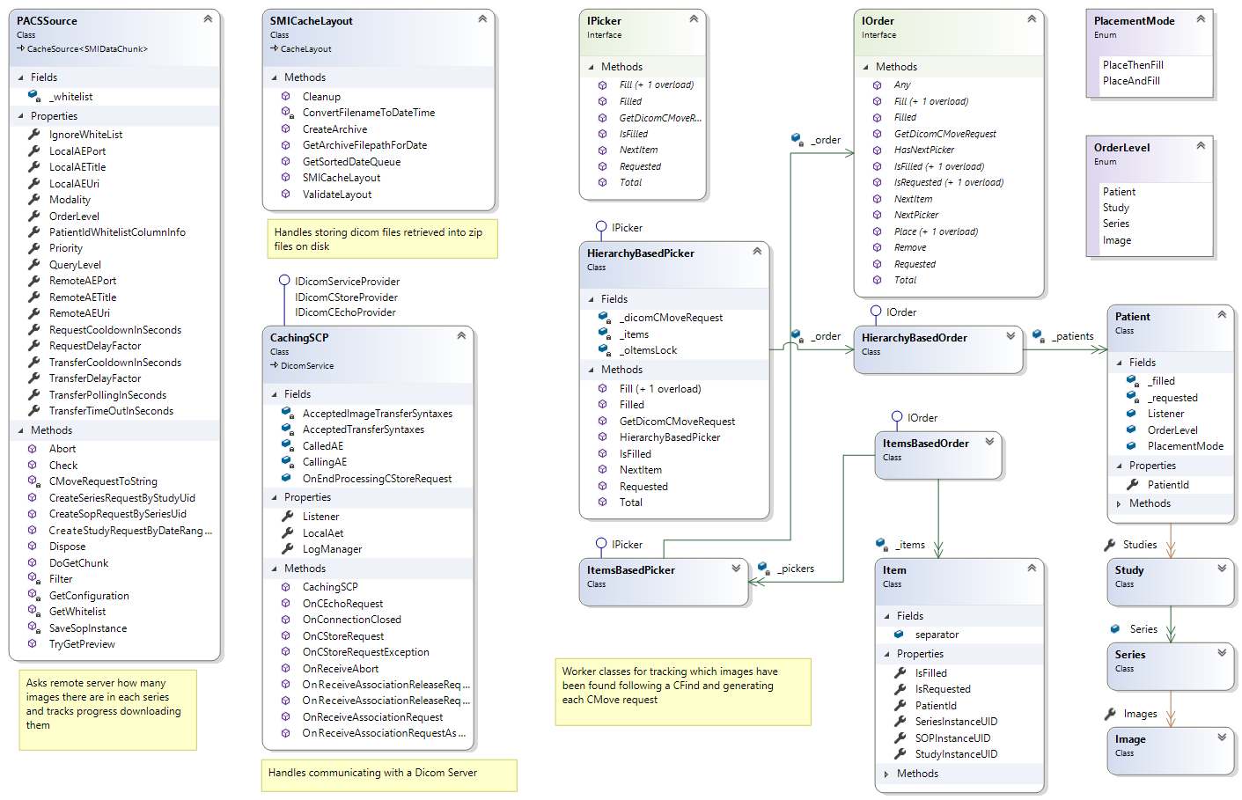

Slide 11
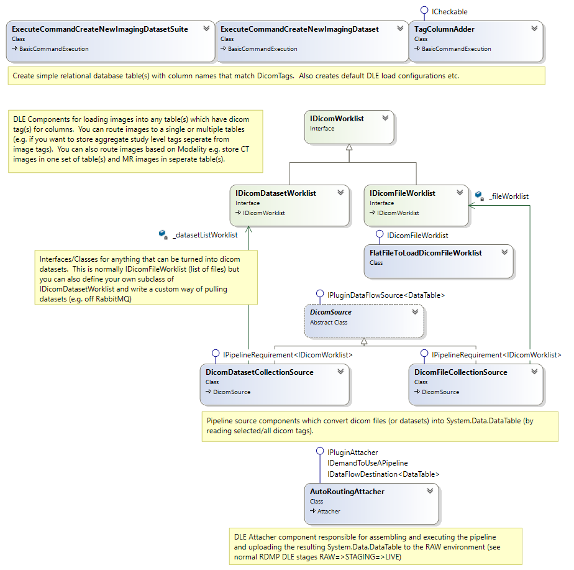

Slide 12
