Slide 1
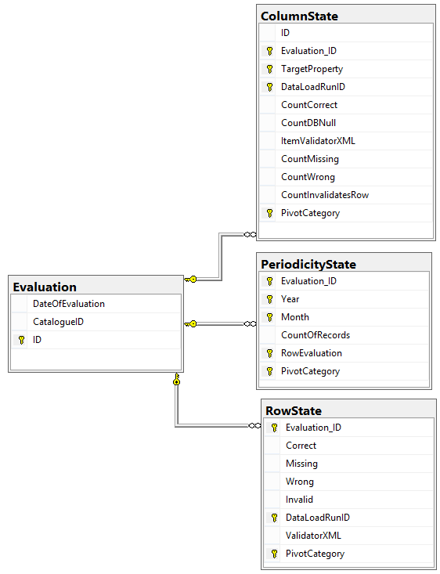
Col1 | Col2 | Col3 | Col4 | Pivot Col
Value | Value | Value | Value | T
Value failing validation
With ‘Wrong’ Consequence
Value
Worst Consequence
Value failing validation
With ‘Missing’ Consequence
Value

