Slide 1
MASTER'S THESIS · PRESENTATION DRAFT
Portfolio Optimization
Beyond Markowitz
Comparing Mean–Variance, Risk Parity, and Hierarchical Risk Parity
across Traditional (ETF) and Cryptocurrency Universes
Empirical Results & Findings
Presentation prepared for the thesis supervisor

Slide 2
01 · INTRODUCTION
TFM · Portfolio Optimization Beyond Markowitz
Research question & hypotheses
Can robust allocation methods beat the fragility of mean–variance optimization?
RESEARCH QUESTION
Does integrating validated investment signals into robust portfolio construction methods lead to more stable allocations and reduced drawdowns versus traditional mean–variance optimization — without significantly sacrificing risk-adjusted performance?
HYPOTHESIS H1
HYPOTHESIS H2
HYPOTHESIS H3
Allocation stability
Drawdown robustness
No material loss in Sharpe
Robust methods (RP, HRP) produce more stable portfolio weights than MVO under rolling estimation — measured by turnover and weight stability.
Robust allocation methods reduce maximum drawdown relative to MVO, particularly during periods of market stress and regime change.
Robust methods do not significantly deteriorate risk-adjusted performance — improved stability is not paid for in lost return per unit of risk.
2

Slide 3
02 · METHODOLOGY
TFM · Portfolio Optimization Beyond Markowitz
Methodology at a glance
Two-layer empirical framework: signal validation, then robust portfolio construction.
DATA
→
SIGNALS
→
VALIDATION
→
ALLOCATION
→
EVALUATION
ETF universe
/ Crypto universe
Momentum · Trend
Volatility regime
Rolling out-of-sample
Triple-barrier labeling
MVO · RP · HRP
Monthly rebalancing
Stability · Drawdown
Sharpe · Turnover
EXPERIMENTAL SETUP
ALLOCATION METHODS
Rolling estimation framework
Three approaches compared
Estimation window: 36 months of monthly returns for ETFs
Estimation window: 12 months of monthly returns for cryptocurrencies
Rebalancing: monthly, 1-month out-of-sample horizon
ETF universe: SPY, EFA, EEM, TLT, HYG, GLD (2010 – 2026)
Crypto universe: BTC, ETH, LTC, XRP, DOGE (2019 – 2026)
No look-ahead bias; transaction costs simplified
MVO — Markowitz mean–variance with constraints. Inverts Σ; sensitive to estimation noise.
RP — Risk Parity. Equalizes risk contribution; ignores expected returns.
HRP — Hierarchical Risk Parity. Clusters assets, then bisects recursively. Avoids Σ⁻¹.
3

Slide 4
PART I
Traditional Asset Universe
ETFs · 2010 – 2026
SPY · EFA · EEM · TLT · HYG · GLD

Slide 5
PART I · ETFS
TFM · Portfolio Optimization Beyond Markowitz
ETFs — performance overview
Headline numbers across MVO, Risk Parity and Hierarchical Risk Parity.
BEST SHARPE (MVO)
LOWEST DRAWDOWN (HRP)
LOWEST TURNOVER (RP)
1.08
−21.4%
0.017
vs 0.88 RP · 0.90 HRP
vs −22.2% MVO · −21.5% RP
vs 0.285 MVO (~16× higher)
Method | Annualized Return | Annualized Volatility | Sharpe Ratio | Max Drawdown | Avg Turnover | Weight Stability
MVO | 11.26 % | 10.47 % | 1.08 | −22.23 % | 0.285 | 0.143
RP | 7.90 % | 8.99 % | 0.88 | −21.45 % | 0.017 | 0.022
HRP | 7.40 % | 8.17 % | 0.90 | −21.35 % | 0.086 | 0.070
Takeaway: MVO wins on raw return and Sharpe, but RP and HRP achieve ~85% of its Sharpe with 16× lower turnover and 6× more stable weights.
5

Slide 6
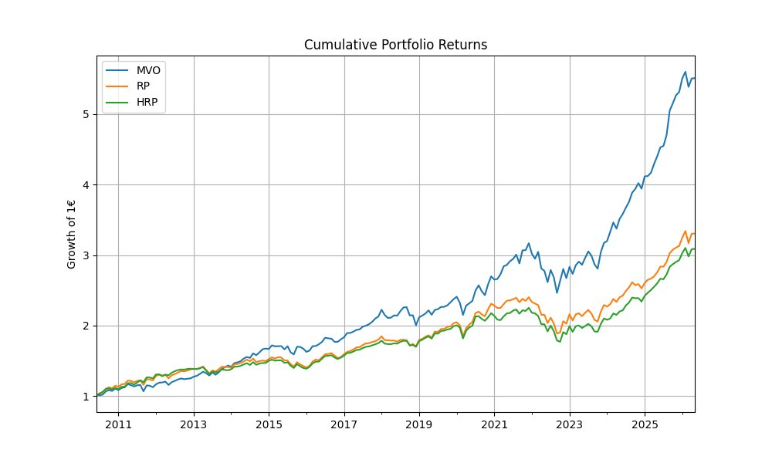
PART I · ETFS
TFM · Portfolio Optimization Beyond Markowitz
ETFs — cumulative returns
Growth of €1, 2010 – 2026 · MVO compounds aggressively; RP and HRP track each other closely.
OBSERVATIONS
What we see
MVO ends at ~5.5×, well above RP (~3.3×) and HRP (~3.1×).
Outperformance accelerates post-2020, driven by concentrated SPY exposure during the bull run.
MVO's return path is visibly more volatile — note the 2022 sell-off.
RP and HRP follow almost parallel paths, consistent with their common risk-based DNA.
6

Slide 7
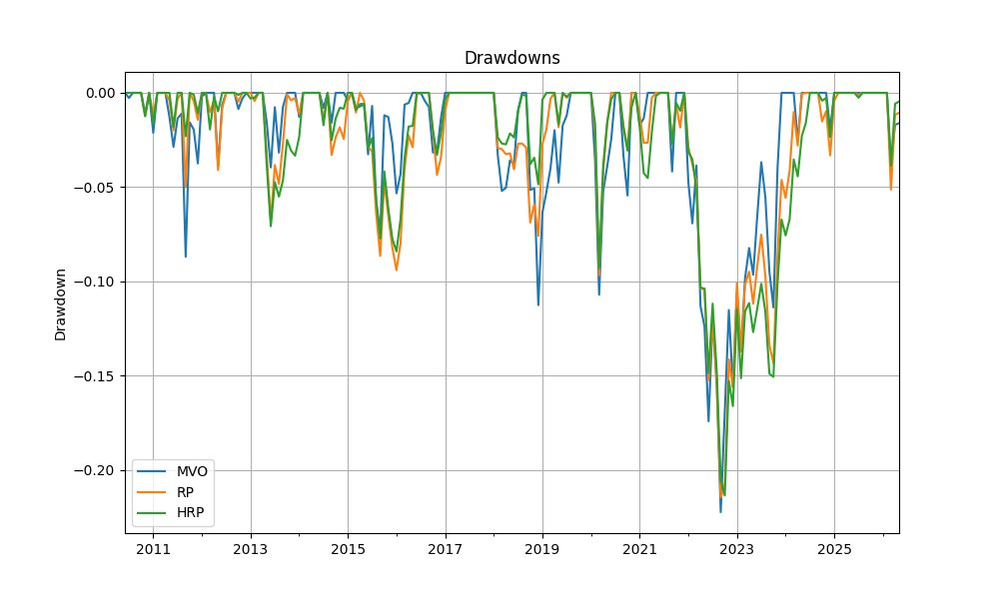
PART I · ETFS
TFM · Portfolio Optimization Beyond Markowitz
ETFs — drawdown analysis
Maximum drawdown is nearly identical across methods; HRP edges out by 9 bps.
DRAWDOWN INSIGHTS
Tight clustering
Max DD: −22.2% MVO · −21.5% RP · −21.4% HRP
Worst episode: 2022 rate-hike cycle hits all three within 1 percentage point.
MVO recovers faster but with sharper interim losses.
Conclusion: in a diversified ETF universe, drawdown protection from robust methods is marginal.
7

Slide 8
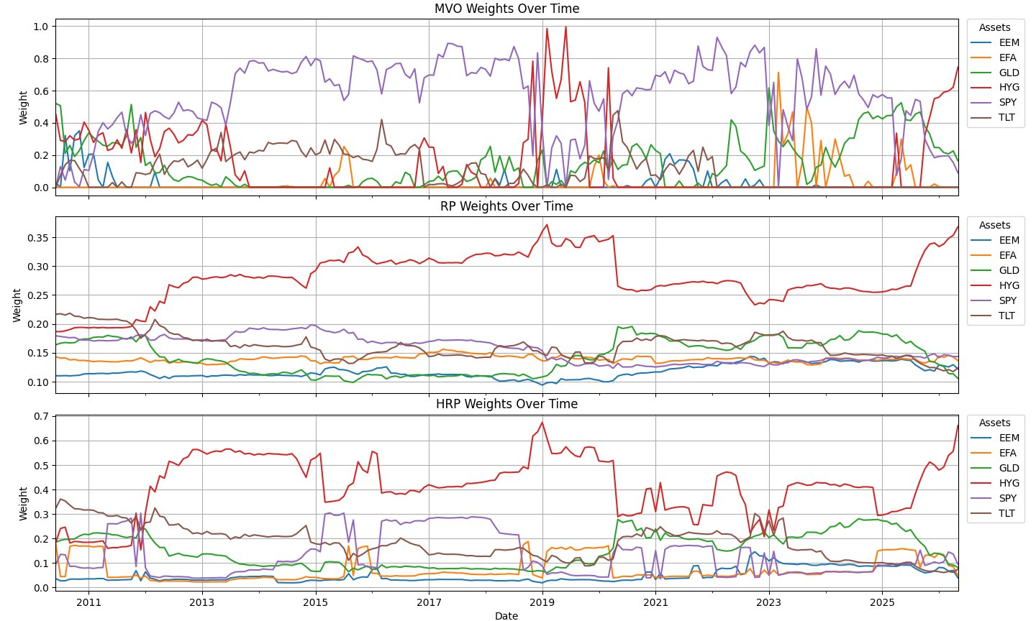
PART I · ETFS
TFM · Portfolio Optimization Beyond Markowitz
ETFs — allocation stability
The clearest empirical case for robust methods: weights, not returns.
MVO · UNSTABLE
Weights swing 0 → 100% across rebalances. Turnover 0.285, weight stability 0.143.
RP · SMOOTHEST
Slow, monotonic drift. Turnover 0.017 (16× lower than MVO), weight stability 0.022.
HRP · BALANCED
Cluster-driven; HYG dominates. Turnover 0.086, weight stability 0.070 — between RP and MVO.
8

Slide 9
PART II
Cryptocurrency Universe
Crypto · 2019 – 2026
BTC · ETH · LTC · XRP · DOGE

Slide 10
PART II · CRYPTO
TFM · Portfolio Optimization Beyond Markowitz
Crypto — performance overview
Same three methods, radically different ranking — robust methods now lead on every metric.
HIGHEST RETURN (HRP)
BEST SHARPE (RP)
BEST CALMAR (HRP)
+105.5%
0.81
1.52
vs 89.7% RP · 61.7% MVO
vs 0.80 MVO · 0.73 HRP
1.28 RP · 0.80 MVO
Method | Ann. Return | Ann. Volatility | Sharpe | Max DD | Calmar | Avg Turnover | Wt. Stability
MVO | 61.72 % | 77.37 % | 0.80 | −77.59 % | 0.80 | 0.607 | 0.225
RP | 89.74 % | 110.81 % | 0.81 | −69.87 % | 1.28 | 0.073 | 0.057
HRP | 105.53 % | 144.44 % | 0.73 | −69.60 % | 1.52 | 0.203 | 0.103
Takeaway: Ranking flips. MVO is now the worst performer on return, drawdown, and turnover. Robust methods dominate when the universe is high-vol and unstable.
10

Slide 11
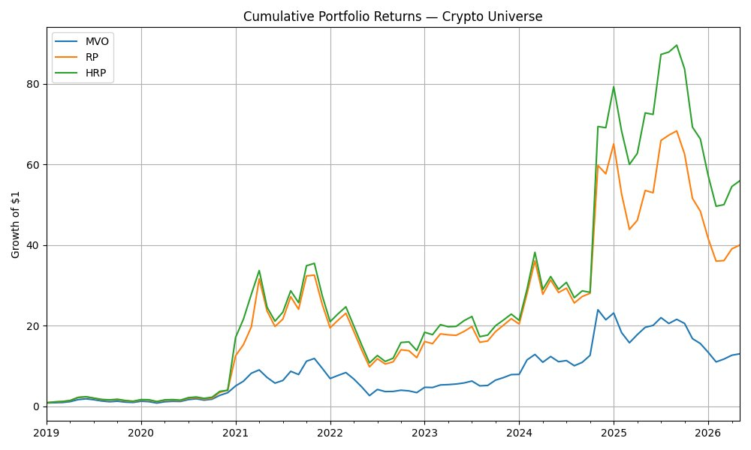
PART II · CRYPTO
TFM · Portfolio Optimization Beyond Markowitz
Crypto — cumulative returns
Growth of $1, 2019 – 2026 · HRP and RP leave MVO behind; the late-2024 rally drives the gap.
OBSERVATIONS
What we see
Final wealth: ≈ 55€ HRP · 40€ RP · 13€ MVO
MVO underperforms throughout — concentrated bets on the wrong coin at the wrong time.
Late-2024 spike triples HRP wealth via diversified upside capture (BTC + ETH + LTC).
Diversification — even passive, equal-risk diversification — compounds dramatically in fat-tailed markets.
11

Slide 12
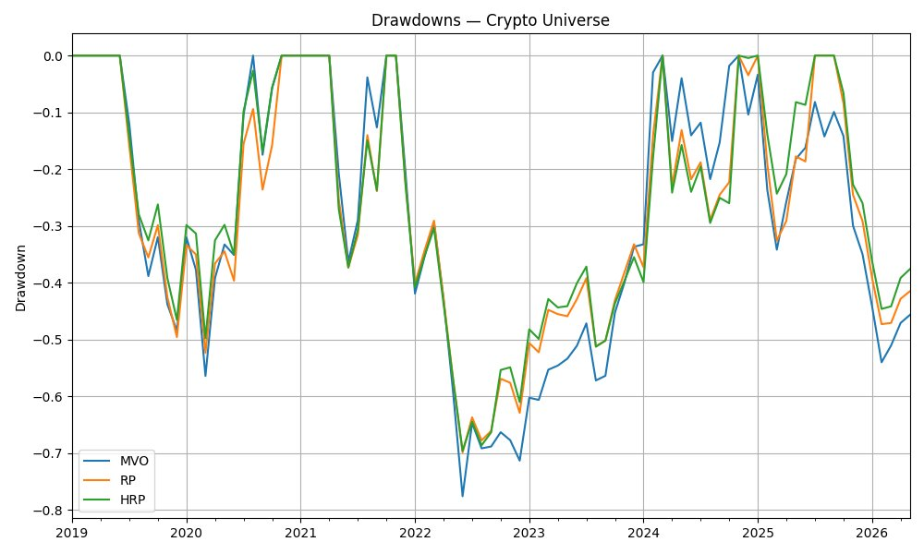
PART II · CRYPTO
TFM · Portfolio Optimization Beyond Markowitz
Crypto — drawdown analysis
MVO drawdowns deeper and longer; the 2022 crypto winter exposes its fragility.
DRAWDOWN INSIGHTS
Where MVO breaks
Max DD: −77.6% MVO · −69.9% RP · −69.6% HRP
MVO bottoms ~8 pp deeper in the 2022 drawdown — concentrated exposure punished hardest.
Calmar ratio gap: 1.52 (HRP) vs 0.80 (MVO) — robust methods deliver almost 2× the return per unit of drawdown.
H2 strongly supported in the crypto universe.
12

Slide 13
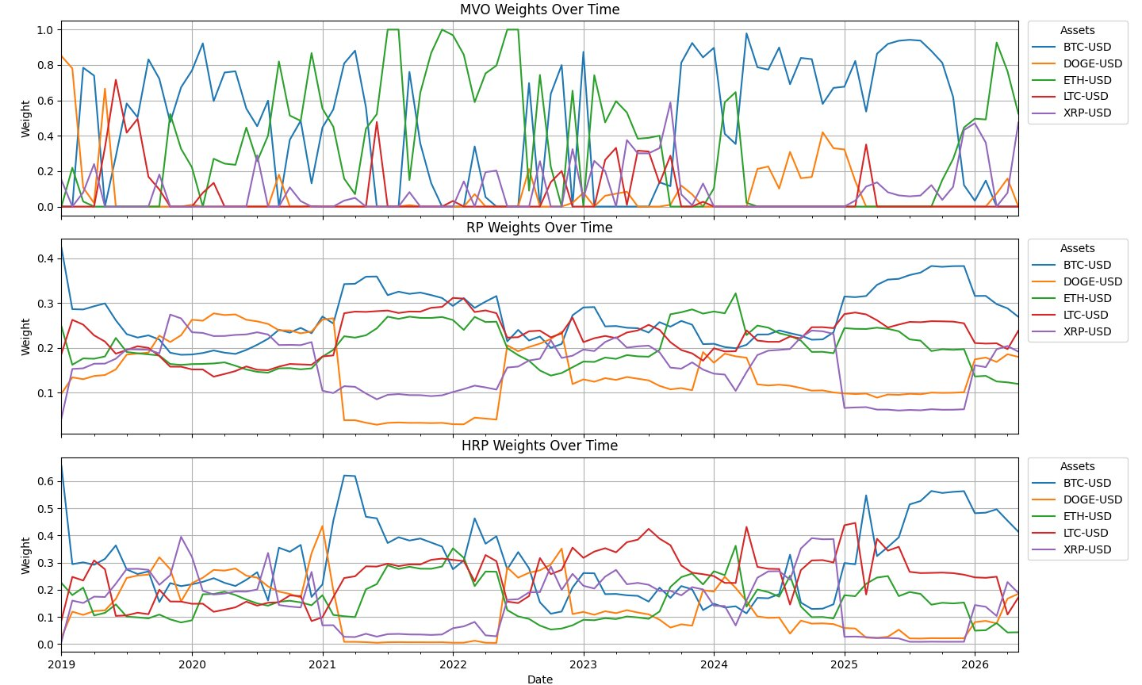
PART II · CRYPTO
TFM · Portfolio Optimization Beyond Markowitz
Crypto — allocation stability
MVO whipsaws between single-coin bets; RP and HRP stay diversified.
MVO · EXTREME
Frequently 100% in one coin. Turnover 0.607, weight stability 0.225.
RP · DIVERSIFIED
All five coins ~10–35%. Turnover 0.073 (8× lower than MVO), weight stability 0.057.
HRP · CLUSTERED
BTC anchors ~30–50%; correlation clusters drive the rest. Turnover 0.203, stability 0.103.
13

Slide 14
03 · COMPARISON
TFM · Portfolio Optimization Beyond Markowitz
ETFs vs Crypto — head to head
The same three methods give opposite verdicts depending on the asset universe.
Dimension | ETFs (Traditional) | Crypto | Verdict
Best Sharpe | MVO (1.08) | RP (0.81), MVO close 2nd | Universe-dependent
Lowest drawdown | All ≈ −21–22% (tied) | HRP (−69.6%), 8 pp better than MVO | Robust methods win in tail-risk regimes
Lowest turnover | RP (0.017) — 16× < MVO | RP (0.073) — 8× < MVO | RP wins everywhere
Weight stability | RP (0.022) — 6× more stable | RP (0.057) — 4× more stable | Robust methods win everywhere
Highest return | MVO (11.3%) | HRP (105.5%) — 1.7× MVO | Reverses across universes
Calmar ratio | Not reported | HRP 1.52 vs MVO 0.80 | Robust dominate on risk-adj. drawdown
THE CENTRAL INSIGHT
MVO's edge in stable, well-diversified universes evaporates — and reverses — when applied to volatile, high-tail-risk assets. Robustness is not a luxury; it is the binding constraint on practical implementability.
14

Slide 15
04 · RECOMMENDATION
TFM · Portfolio Optimization Beyond Markowitz
Key findings & thesis recommendation
Mapping empirical results back to the three hypotheses, and a recommendation for the supervisor.
H1 · STABILITY
H2 · DRAWDOWN
H3 · SHARPE
Strongly supported
Conditionally supported
Supported
Both universes: RP cuts turnover 8–16× vs MVO. HRP sits in between.
Weight stability improves 4–6× for both robust methods.
ETFs: MaxDD nearly identical (~21–22%). Tied.
Crypto: MVO −77.6%; HRP/RP −69.6/−69.9%. Robust methods avoid ≈8 pp of extra loss.
ETFs: MVO 1.08 vs RP 0.88 / HRP 0.90 — robust methods retain ~85% of MVO Sharpe.
Crypto: All three within 0.07 of each other; no material loss.
RECOMMENDATION FOR THE THESIS
Build the empirical core of the thesis on the crypto universe.
Why: the crypto results are economically more interesting and rhetorically stronger. They show the ranking flip — MVO loses on every dimension — which makes a sharper case for robust allocation than the ETF universe, where differences are mostly second-order. Use the ETF universe as a robustness check / control group demonstrating that robust methods don't break in well-behaved data, while the crypto universe carries the headline finding.
15

Slide 16
Thank you
Open to questions, suggestions and refinements.
Discussion points to consider:
Should both universes remain in the final thesis, or focus on crypto?
Add a transaction-cost stress test to harden the turnover argument?
Extend the comparison with a 1/N benchmark (DeMiguel et al., 2009)?

