Slide 1
Modelling Steam Plant Data Using Apache Spark
Abigail Emrey & Gajjan Jasani

Slide 2
Project Overview
Goal:
Our goal for this project was to understand and apply the principles of machine learning and big data processing on the steam plant dataset to address growing concerns about the interaction between climate change and steam plant efficiency.
Approach:
Acquire the dataset, clean/prepare it for analysis
Set up the cluster computing pipeline for data processing (Spark, Eclipse, SBT, GCP)
Apply the machine learning algorithms (Linear Regression, Decision tree)
Optimize the model for reliable and consistent results for making better decisions

Slide 3
Project Structure
Scala
SBT
Spark
Output
Data-Bricks
Eclipse
Google Cloud
Two approaches:
1) Using Google Cloud
Spark
Eclipse
SBT
GCP (Dataproc)
2) Using Databricks
Spark
Databricks

Slide 4
Last semester review
Wrangled the original dataset to better suit our purposes
Set up the development environment of integrated systems:
Spark + eclipse
SBT
Google Cloud Dataproc
Applied two machine learning algorithms to our data:
Basic Linear Regression
Decision Tree
Our models were producing unreliable results due to the way we are randomly splitting our data

Slide 5
Moscow Analysis
Must | Should | Could | Won't
Make improvements on our existing algorithms | Implement 1 additional algorithm | Implement 2 additional algorithms | Implement more than 2 additional algorithms
 | Visualize the results of our project
Repeat testing process a multitude of times | Test accuracy of models using a validation set | Relate our model to another (larger) dataset | [No restrictions as long as time permits]
Relate HDDs to BTU consumption | Draw heat load conclusions from data | Examine nuanced effects of non-HDD parameters on trends | [No restrictions as long as time permits]

Slide 6
Progress & Complications
Mission: Improve our regression models to produce functional results, reliably
New Resources: Resident statistics expert – Dr. Wagaman
We decided to look into three general approaches for improving the quality of our work: cross-validation, hyperparameter tuning, and more data wrangling
Cross-Validation
Type of model validation to assess how well the model fits to a generalized dataset. Produces a validation set to combat overfitting and determine the most effective of a set of algorithms.
Model Tuning
Apache Spark’s ML algorithms contain many parameters to be tuned in order to create the most effective model. Each algorithm has different parameters corresponding to how the algorithm works.
Data Wrangling
Process by which one makes modifications to the dataset, such as converting it to a more machine-readable format, or removing outliers.
Notes:
We have our algorithms already set up (for the most part), and we understand our environment now. Where to go next? More accurate and reliable results. Approaches. Cross-Validation: Lots of research to figure out how to do correctly & determining what kind of CV to use (k-folds, etc.); Model Tuning: Difficult to figure out the number and functions of parameters for Spark algorithms (poor documentation); Data Wrangling: Must be able to spot and remove outliers which could be causing your model to be trained incorrectly

Slide 7
Outcomes & Effectiveness
The outcome of this capstone was two approaches to modelling our data:
Linear Regression
Decision Tree Regression
Initially, we thought we’d try to use more algorithms, but…
These simple algorithms actually fit the data very well!
Got us thinking, maybe using Apache Spark for this data was overkill…
Ultimately, the effectiveness of our model turned out very strong.
On a trial of 300 runs over randomly selected data, 88% of our trials resulted in an r² of 0.9 or greater
Further, another 10% of these trials resulted in an r² between 0.8 and 0.9
This is a very strong relationship, indicative of powerful predictive ability
The results for our decision tree algorithm were also reliably good, but less so than those for our linear regression algorithm.

Slide 8
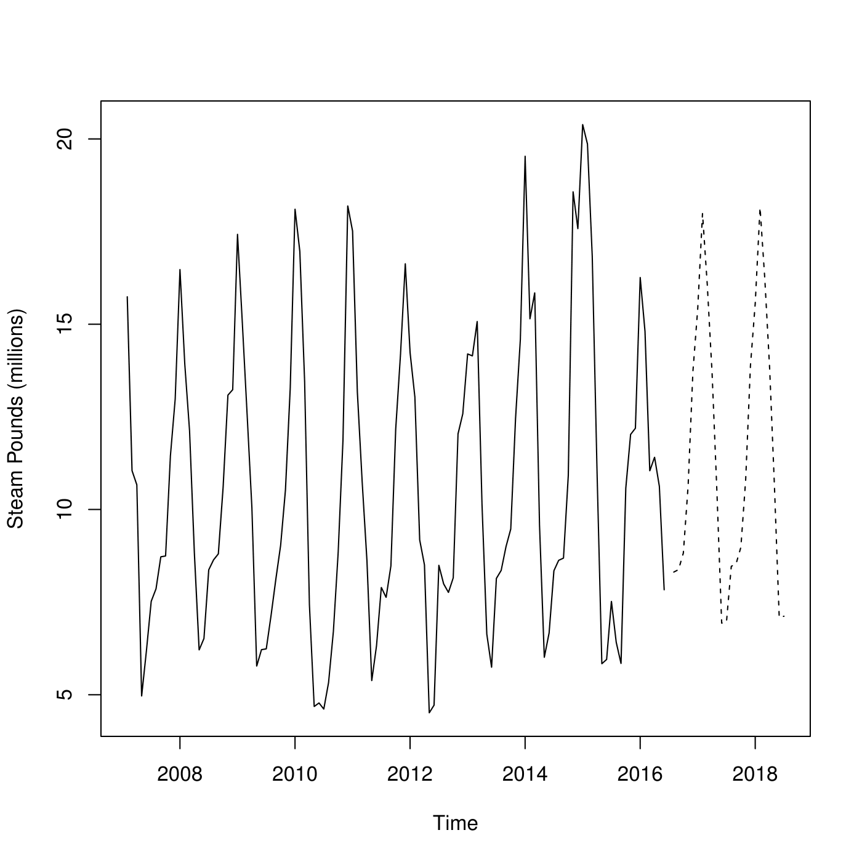
Future Perspectives
INVESTIGATION:
How well does our model predict actual future energy data?
Using our code, the Sustainability and Energy Management team at WCU will be able to accurately and reliably…
Predict future energy usage based off of HDD data
Topics for further study based on this project include:
Development of user-interactive software built around our code
Testing the model against new data
Enhancement of model accuracy
Predicting future energy usage based off of time/seasonal data
Notes:
The graph here is an example of what we would like to see done with our data in the future: testing our code against actual future data to assess practical accuracy.

Slide 9
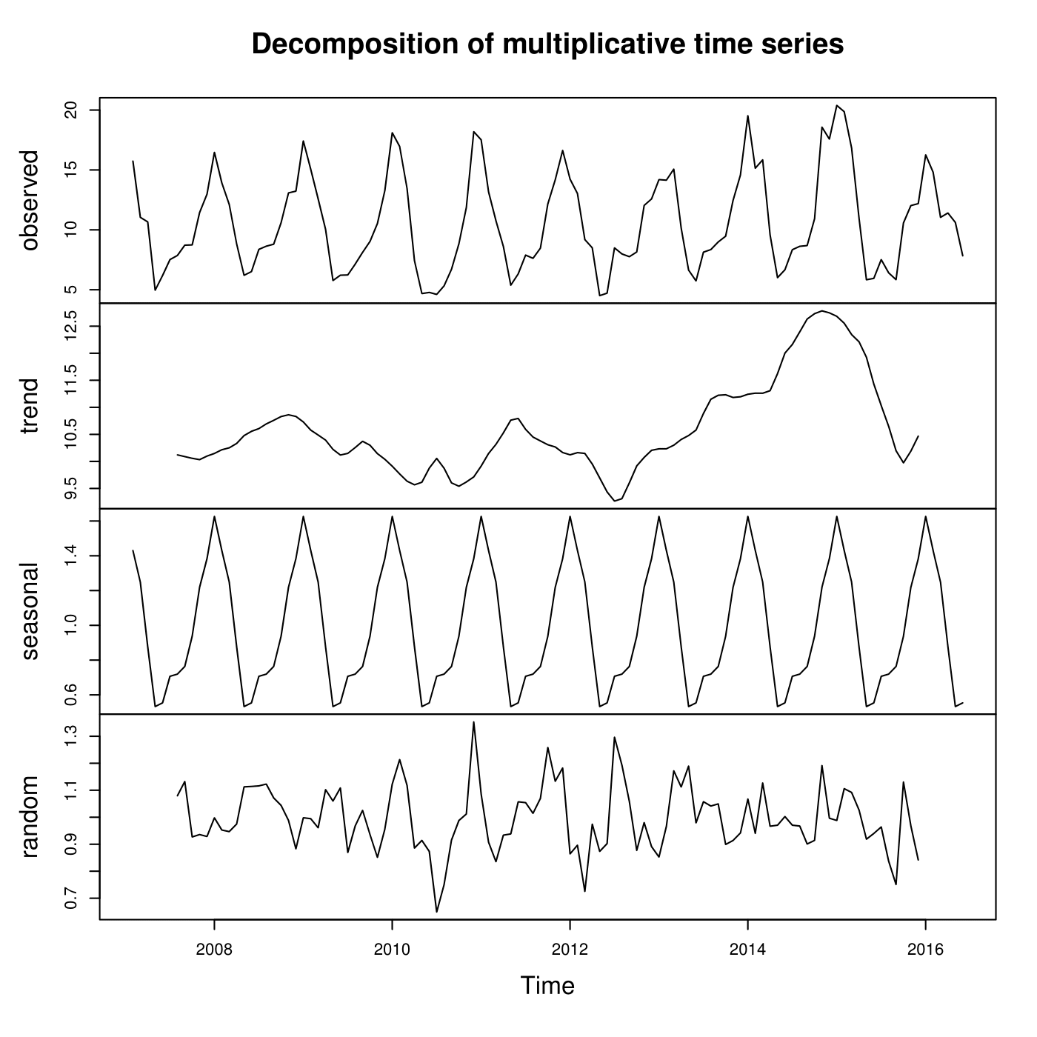
In the Future: Predicting with Data Periodicity
These graphs were generated independently by Dr. Wagaman using R to demonstrate the periodical nature of our data.
Observed: Graph of actual data
Trend: Changes in the data set over time
Seasonal: Repetitive changes in data over time
Random: The “leftovers” of the decomposition; The more random, the better
Notes:
This slide demonstrates the periodicity of our data. There is not much of an overall trend, but the data adheres fairly strictly to seasonal reoccurrences. This would be a more reliable method than predicting energy usage based upon HDD data, because HDD data must be predicted in turn (unlike seasonal data, which is always the same).

Slide 10
Demonstration Outline: Code Portion
Read & Schematize Data
Establish the Features & Label
Create the Testing & Training Sets
Cross Validation
Evaluate the Model’s Effectiveness
Fit and Transform

