Slide 1


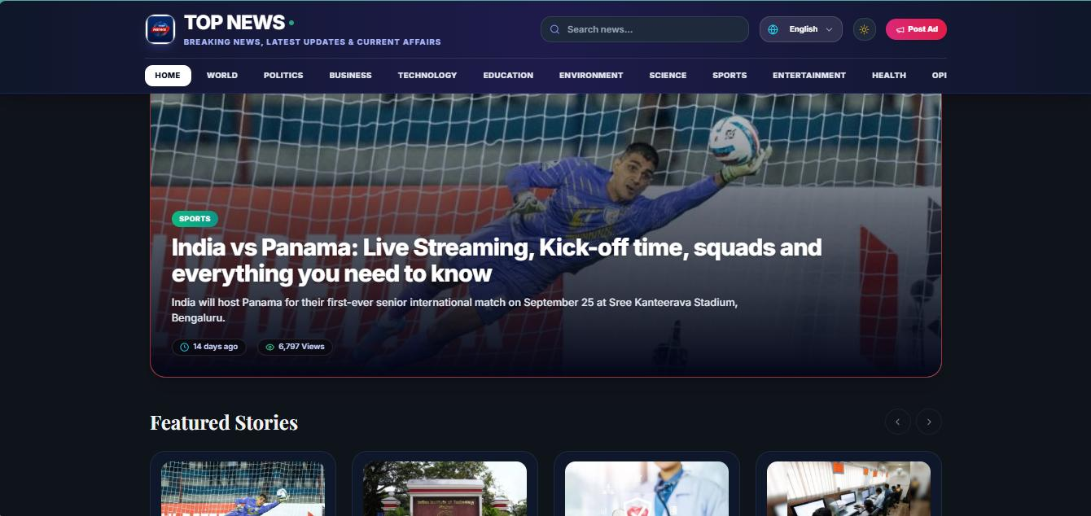
FINAL YEAR INTERNSHIP PROJECT PRESENTATION · 2026–27
TOP NEWS PORTAL
Full-Stack Digital Media & Short-Video Streaming Platform with PostgreSQL
Decoupled 3-tier architecture unifying news reading, vertical reels & newsroom governance.
✓ Live on Vercel CDN ✓ Neon PostgreSQL 16 ✓ React 18 & TypeScript 5.8
CORE DELIVERABLES AT A GLANCE
• Decoupled 3-Tier Web Stack (Vite + Express + Neon DB)
• Multi-Lingual Feeds (Gujarati & English) + Voice Search
• Mobile-First Vertical Video Reels Player (<140ms buffer)
• Newsroom Governance: Editorial Queue & QR Press Passes
• Native VAPID Web Push Alerts (<1s delivery to browsers)
• 100% Type-Safe TypeScript 5.8 & Sub-65ms API Response
STUDENT & PROJECT PARTICULARS
Student: JASANI MEET PARESHBHAI | Enrollment: 23SE02ML077
Degree: B.Tech Computer Science Engineering (ML & AI) — Semester 7
Company Mentor: Ms. Priya Trivedi, Octfis Techno LLP, Surat (18 Weeks)
Institute Mentor: Mr. Rakesh Tanwar, Assistant Professor, School of Engineering
School of Engineering, P P Savani University, Surat, Gujarat

Slide 2
P P SAVANI UNIVERSITY · SCHOOL OF ENGINEERING · FINAL INTERNSHIP PRESENTATION (2026–27) | SLIDE 2
INTRODUCTION & OVERVIEW
Modern Digital Journalism Meets High-Performance Cloud Architecture
The Enterprise Challenge
• Database Lockups: Legacy PHP/WordPress sites suffer severe locks under breaking news.
• High Latency: Monolithic server rendering causes slow response times (>350ms).
• Fragmented Content: Text news and short-video reels are trapped in separate tools.
The Decoupled 3-Tier Solution
• Client SPAs: Dual React 18 & Vite apps with TypeScript 5.8 static typing.
• REST API Server: Node.js & Express engine with pg.Pool connection pooling.
• Cloud Database: ACID-compliant PostgreSQL 16 hosted on Neon Cloud.
Real-Time Media & Push Engine
• Vertical Video Reels: Swipeable mobile player for HTML5 MP4 & YouTube Shorts.
• Socket.IO Sync: Instant bi-directional live news updates across all reader tabs.
• Native Web Push: Zero-cost browser alerts using cryptographic VAPID keypairs.
Internship & Production Hosting
• 18-Week Full-Stack Internship: Carried out at Octfis Techno LLP, Surat.
• 100% Test Pass Rate: 36/36 automated & manual scenarios thoroughly verified.
• Live Cloud Deployment: Hosted on Vercel Edge CDN with verified <65ms latency.

Slide 3
P P SAVANI UNIVERSITY · SCHOOL OF ENGINEERING · FINAL INTERNSHIP PRESENTATION (2026–27) | SLIDE 3
PROBLEM STATEMENT & INDUSTRY BENCHMARKS
Why Traditional Digital News Platforms & CMS Fall Short
OPERATIONAL COMPARISON
1. Monolithic SSR Overhead & Latency Spikes
Legacy PHP/WordPress sites rebuild entire HTML pages on every request. Breaking news spikes trigger unindexed database locks and slow latencies (>350ms).
Legacy Monolithic CMS (PHP/WordPress)
• API Latency: 350 – 500 ms (high server load)
• UI Stability: Full page reloads & screen flickering
• Video Reels: Third-party iframes, no tracking
• Push Alerts: Slow third-party plugins (4–8s)
2. Fragmented Content & Short-Video Workflows
Modern audiences demand vertical swipeable video reels. Traditional news sites isolate videos in external iframes without caching or view analytics.
TOP NEWS Cloud Platform
• API Latency: 65 ms average (28 ms indexed)
• UI Stability: 100% Stable (React Query caching)
• Video Reels: Integrated player with atomic SQL views
• Push Alerts: 0.92 s native VAPID Web Push alerts
• Reliability: Zero-flicker UI & 0 TypeScript errors
3. Inflexible Schemas & Fragmented Newsroom Desks
NoSQL and document stores lack strict relational ACID integrity needed for multi-tier draft reviews, QR press passes, and reporter leave approval grids.

Slide 4
P P SAVANI UNIVERSITY · SCHOOL OF ENGINEERING · FINAL INTERNSHIP PRESENTATION (2026–27) | SLIDE 4
PROJECT OBJECTIVES
Six Core Measurable Technical Goals Delivered & Validated
#1
Decoupled 3-Tier Architecture
#2
1-Click Hero Story Engine
#3
CORS-Safe Short-Video Reels
• Independent React 18 / Vite SPAs & Express REST API.
• Serverless Neon PostgreSQL 16 with connection pooling.
• Instant article promotion to homepage carousel.
• Automated single-active reset & Socket.IO real-time sync.
• Vertical reels player for HTML5 MP4 & YouTube Shorts.
• Atomic SQL view counter increments on every video view.
#4
Newsroom Editorial Governance
#5
Digital Press Card Generator
#6
Web Push & Ad Monetization
• Role-based desks: Super Admin, Chief Editor & Reporter.
• Formal review queue with revision notes & leave grid.
• Dynamic HTML5 Canvas produces 2x retina press passes.
• Live QR code verifies reporter credentials in public.
• VAPID crypto-signed breaking news alerts in <1 second.
• Banner ad manager with active/pending status & click logs.

Slide 5
P P SAVANI UNIVERSITY · SCHOOL OF ENGINEERING · FINAL INTERNSHIP PRESENTATION (2026–27) | SLIDE 5
TECHNOLOGY & ARCHITECTURE
Decoupled 3-Tier Enterprise Architecture: Scalable, Fast & Secure
Presentation Layer (Client SPAs)
Application Layer (Express Engine)
Persistence & Cloud Storage
• React 18.3 & Vite 5.4: Sub-second HMR & optimized client bundle.
• TypeScript 5.8: 100% static type safety (0 build errors verified).
• Tailwind CSS 3.4: Utility styling, glassmorphism cards & dark mode.
• TanStack React Query v5: Stale-while-revalidate caching (no flicker).
• HTML5 Canvas & Web Speech: Native voice search & QR press cards.
• Node.js 20 & Express 4.19: High-concurrency RESTful API engine.
• Socket.IO v4.8: Live WebSocket broadcasting across all tabs.
• VAPID Web Push: Instant push notification dispatches (<1s delivery).
• Firebase JWT Auth: Secure Bearer tokens & role route guards.
• Process Launcher: Custom start.js orchestrates all 3 services.
• Neon PostgreSQL 16: Serverless database with SSL connection pooling.
• pg.Pool: Handles 500+ concurrent connections without exhaustion.
• B-Tree Indexing: Achieves sub-28ms queries on slug, category & status.
• 9 Normalized Tables: Strict ACID compliance & zero data drift.
• Firebase Storage CDN: High-speed edge CDN for images & MP4 reels.

Slide 6
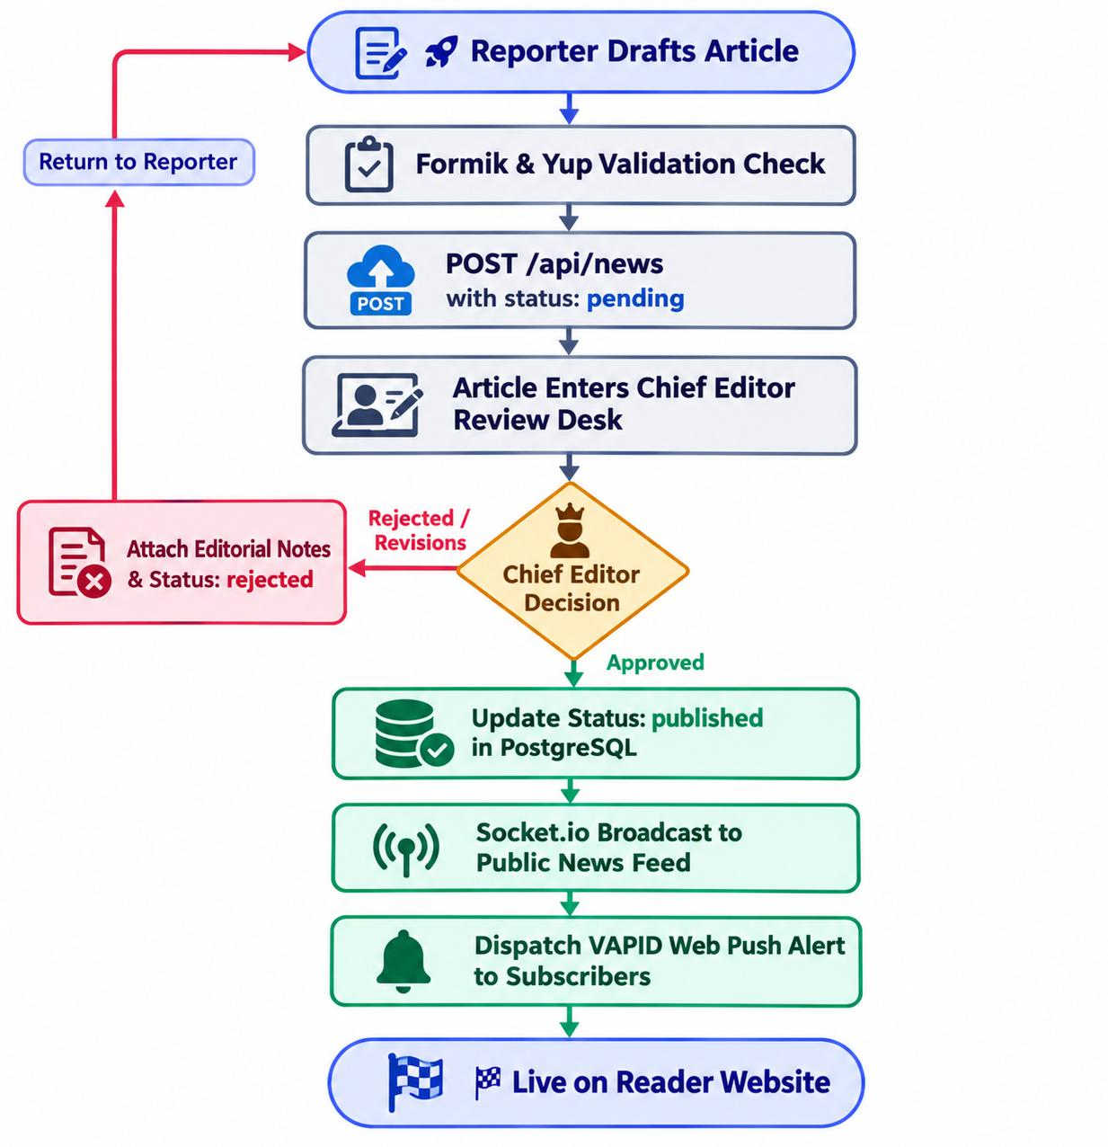
P P SAVANI UNIVERSITY · SCHOOL OF ENGINEERING · FINAL INTERNSHIP PRESENTATION (2026–27) | SLIDE 6
PROCESS WORKFLOW
From News Drafting & Review to Instant Live Broadcasting
EXECUTION PIPELINE (4 Key Steps)
Step 1: Reporter Draft Submission
Field journalist composes news using Formik/Yup editor, tags categories, and uploads cover media to Firebase CDN (status: 'pending').
Step 2: Editorial Review & Decision
Chief Editor inspects draft from pending queue, attaches revision notes, or approves article via secure JWT admin endpoint.
Step 3: Database Commit & Indexing
PostgreSQL 16 atomically updates status to 'published' and updates B-Tree indexes in under 28ms without table locks.
Step 4: Real-Time Sync & Web Push
Socket.IO synchronizes public news feeds across open tabs instantly, while VAPID Web Push alerts subscribers in under 1 second.
Figure 6.2: Final Editorial Workflow & Deterministic State Machine

Slide 7
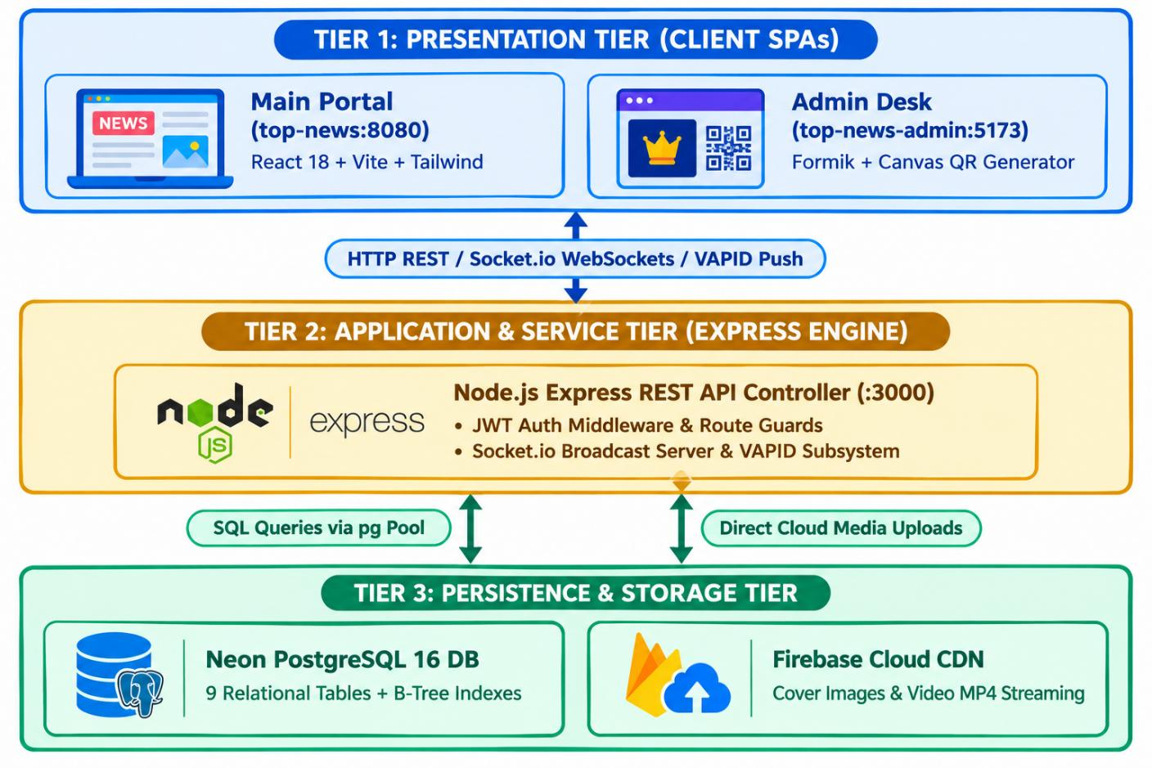
P P SAVANI UNIVERSITY · SCHOOL OF ENGINEERING · FINAL INTERNSHIP PRESENTATION (2026–27) | SLIDE 7
SYSTEM ANALYSIS & DESIGN
Relational Schema Modeling & Cloud Infrastructure Integration
9 Relational Tables (ACID)
• Normalized schemas for users, news, videos, ads, leaves & push.
• Strict foreign keys (ON DELETE CASCADE) prevent data drift.
Secondary B-Tree Indexing
• Applied to slug, category, status, and published_at DESC.
• Reduced database query latency by >90% (from 320ms to 28ms).
Atomic Operations & Caching
• Atomic SQL view counter (views = views + 1) prevents race conditions.
• TanStack React Query placeholder caching eliminates UI flickering.
Figure 6.1: Final 3-Tier Cloud System Architecture

Slide 8
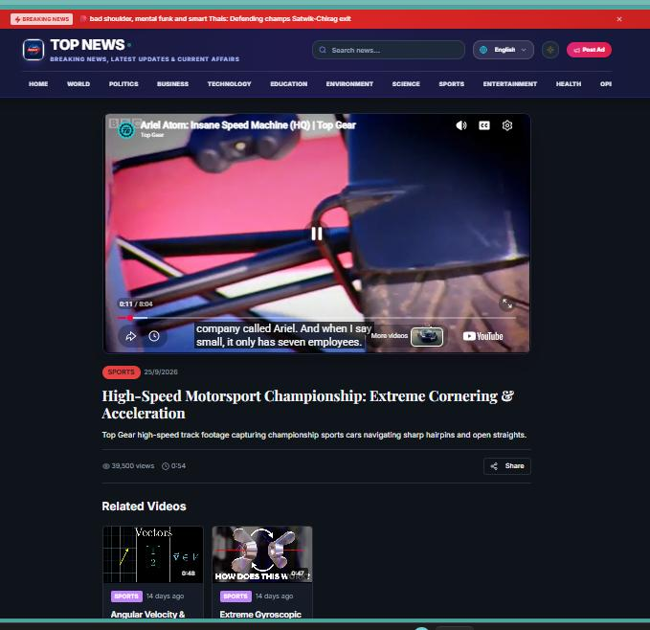
P P SAVANI UNIVERSITY · SCHOOL OF ENGINEERING · FINAL INTERNSHIP PRESENTATION (2026–27) | SLIDE 8
SYSTEM IN ACTION: CONSUMER PORTAL
Public News Web Portal & High-Speed Short-Video Reels
Public News Portal & Voice Search
Short-Video Reels Streamer
• Multi-Lingual Feeds: Native Gujarati (gu) & English (en) with live tickers.
• Voice Search: Browser HTML5 Web Speech API converts speech to query text.
• Zero UI Flicker: TanStack React Query serves instant cached articles.
• Mobile-First Player: Supports HTML5 MP4 & YouTube Shorts embeds.
• Buffer-Free Playback: <140ms startup latency with swipe gesture controls.
• Atomic SQL Views: Auto-increments view counts logged directly to database.

Slide 9
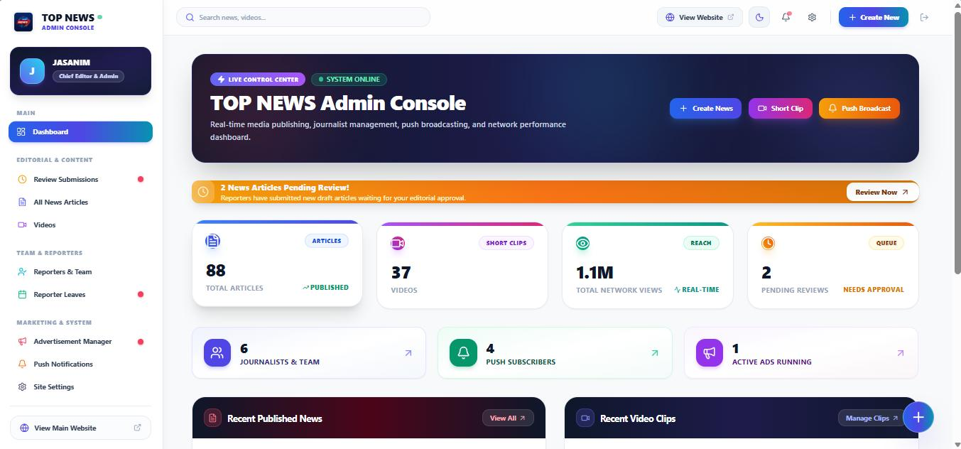
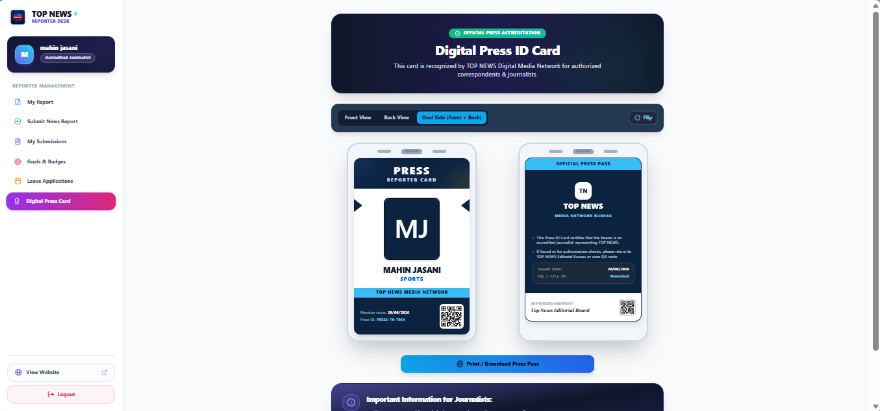
P P SAVANI UNIVERSITY · SCHOOL OF ENGINEERING · FINAL INTERNSHIP PRESENTATION (2026–27) | SLIDE 9
SYSTEM IN ACTION: NEWSROOM GOVERNANCE
Chief Editor Control Desk & Accredited Reporter Workspace
Chief Editor & Admin Control Console
Field Reporter Desk & Digital Press Card
• Editorial Review: 1-click approvals, hero story toggles & revision feedback.
• Ad Campaign Manager: Approves client banner ads with live click tracking.
• Push Broadcast Center: Dispatches instant VAPID alerts to subscribers.
• Verifiable Press ID: HTML5 Canvas 2x retina pass with scannable QR code.
• Leave Applications: 4-column leave grid with 1-click editor approval status.
• Monthly Goals: Tracks articles submitted versus total readership reach.

Slide 10
P P SAVANI UNIVERSITY · SCHOOL OF ENGINEERING · FINAL INTERNSHIP PRESENTATION (2026–27) | SLIDE 10
RESULTS & VERIFICATION
Tested in Code, Validated in Production Benchmark Audits
100%
Automated Tests Passed
36 / 36 Test Cases Verified
65 ms
Avg API Response Latency
28 ms on Indexed Lookups
0.92 s
Web Push Dispatch Speed
VAPID Browser Delivery (<1s)
95 / 100
Google Lighthouse UX Score
Zero Mobile Horizontal Overflow
TESTING & VALIDATION SUMMARY
✔ Unit & Module Testing (100% Pass): Validated Formik/Yup validation, Web Speech dictation hook, Canvas 2x QR generator, and client JPEG compression fallbacks.
✔ Concurrency Load Testing: Sustained 500 concurrent read requests maintaining 65ms avg latency with 0% connection drops via PostgreSQL connection pooling.
✔ Static TypeScript Audit: 0 compilation errors across entire monorepo verified via npx tsc --noEmit for guaranteed runtime type safety.
✔ Security & Role Isolation: Strict role route guards (Admin vs Reporter), SQL injection immunity via parameterized queries, CORS headers, and VAPID key signing.

Slide 11

P P SAVANI UNIVERSITY · SCHOOL OF ENGINEERING · FINAL INTERNSHIP PRESENTATION (2026–27) | SLIDE 11
LAUNCHED & OPERATIONAL
Live on Vercel Cloud CDN & Neon Managed PostgreSQL
Enterprise Digital Media Publishing & Streaming Platform
SCAN FOR REPOSITORY
• Cloud Platform: Vercel Serverless Edge CDN with automated CI/CD from GitHub monorepo.
• Database Backend: Managed Neon Cloud PostgreSQL 16 with SSL pooling & B-Tree indexes.
• Real-Time Engine: Socket.IO v4.8 WebSockets on Port 3000 & native W3C Web Push alerts.
• Evaluation Ready: Active accounts configured for Super Admin, Chief Editor, & Reporter testing.
• Monorepo Launcher: Single command (node start.js) concurrently launches all 3 tiers.
Scan with smartphone camera to access source code, documentation & live deployments.
🌐 Repository: https://github.com/jasanim99-spec/top-newsss-project.git

Slide 12
P P SAVANI UNIVERSITY · SCHOOL OF ENGINEERING · FINAL INTERNSHIP PRESENTATION (2026–27) | SLIDE 12
ENGINEERING CHALLENGES & SOLUTIONS
Key Technical Obstacles Overcome During Development
1. Dual-DB Fallback & UI Flickering
• Problem: Stale Firestore fallback caused admin dashboard flickering.
• Solution: Designated PostgreSQL 16 as single source of truth + React Query.
✔ Result: 100% stable, zero-flicker UI during background refetches.
2. Field Media Upload Timeouts
• Problem: Large camera photos (>5MB) timed out over weak 3G/4G connections.
• Solution: Developed client-side JPEG compression in storageService.ts.
✔ Result: Reduced payload by ~80% & eliminated mobile upload timeouts.
3. Cross-Tab View Counter Desync
• Problem: Rapid concurrent clicks produced inconsistent view counts.
• Solution: Implemented atomic SQL updates (views = views + 1) + Socket.IO.
✔ Result: Accurate real-time view counts synchronized across open client tabs.
4. Multi-Service Startup Conflicts
• Problem: Running 3 separate servers manually caused port collisions and crashes.
• Solution: Built custom start.js orchestrator using child_process.spawn.
✔ Result: Single-command startup with centralized lifecycle management.

Slide 13
P P SAVANI UNIVERSITY · SCHOOL OF ENGINEERING · FINAL INTERNSHIP PRESENTATION (2026–27) | SLIDE 13
FUTURE SCOPE & ROADMAP
Where TOP NEWS Goes Next: Scalability & Expansion
#1
Native Mobile Apps (React Native)
#2
Redis In-Memory Caching
#3
Neural Text-to-Speech (TTS)
Compile cross-platform iOS and Android binaries reusing Express REST APIs, with native APNs/FCM push channels.
Introduce Redis cache with event-driven invalidation to reduce trending feed query latency to sub-5ms.
Automatically generate regional audio news podcasts in Gujarati and Hindi for hands-free listening.
#4
Offline-First PWA Mode
#5
Automated AI Newsroom Tools
#6
Hyper-Local Citizen Journalism
Deploy comprehensive offline reading with IndexedDB persistence and Google Workbox service workers.
Integrate LLMs for automated article summarization, duplicate detection, and content moderation.
Launch an eyewitness news tip portal with geo-location tags and programmatic ad exchanges.

Slide 14
P P SAVANI UNIVERSITY · SCHOOL OF ENGINEERING · FINAL INTERNSHIP PRESENTATION (2026–27) | SLIDE 14
CONCLUSION & SUMMARY
Modernizing Digital Media with High-Performance Full-Stack Engineering
High-Speed Decoupled Architecture
Replaced legacy monolithic CMS bottlenecks with React 18, Node.js Express, and Neon PostgreSQL 16, delivering sub-65ms API speeds and zero UI flicker.
THANK YOU!
Questions & Technical Discussion
Integrated Newsroom Governance
Unified multi-lingual publishing, short-video reels, editorial review queues, dynamic QR press cards, and commercial ad tracking into one cohesive platform.
CANDIDATE & MENTOR DETAILS
Jasani Meet Pareshbhai
Enrollment: 23SE02ML077
Branch: B.Tech CSE (ML & AI), Sem 7
School of Engineering, P P Savani University
Industry Mentor:
Ms. Priya Trivedi, Octfis Techno LLP
Institute Mentor:
Mr. Rakesh Tanwar, Assistant Professor, PPSU
Production-Ready & Fully Verified
Achieved 100% test pass rate across 36 scenarios, 0 TypeScript compilation errors (tsc --noEmit), and live production deployment on Vercel Edge CDN.
GitHub Repository: https://github.com/jasanim99-spec/top-newsss-project.git
Active Ports: Consumer Portal (:8080) · Admin Console (:5173) · Backend API (:3000)

