Slide 1


Credit Card Fraud Detection
Goal: Detect fraudulent transactions in a highly imbalanced dataset using classification models.
Sushil Dhital
Jason Araujo
Group 19

Slide 2
Table of Contents
1. Problem & Motivation
The problem we aim to solve and why fraud detection matters
2. Data Preprocessing & EDA
Dataset structure, cleaning, class imbalance, and analysis
3. Modeling & Evaluation
Three classifiers and metrics for imbalanced data
4. Interpretations & Conclusion
Best model, trade-offs, limitations, and next steps

Slide 3
Problem & Motivation : Problem Definition & Motivation
Credit card fraud creates financial loss for banks and customers.
The task is to classify each transaction as normal (0) or fraud (1).
Fraud detection is difficult because fraudulent cases are extremely rare compared with normal transactions.
A useful model must catch fraud without flagging too many normal transactions as suspicious.
Research Question:
Which classification model performs best for detecting fraudulent credit card transactions in a highly imbalanced dataset?
Target outcome:
Select the model that provides the best balance between detecting fraud and minimizing false alarms.
DATA 3421 Final Project • Group 19

Slide 4
Data Preprocessing & EDA : Dataset Overview
Source:
Kaggle's "Credit Card Fraud Detection" dataset (European cardholders).
Variables:
31 columns total
V1–V28 are anonymized PCA-transformed features
Time and Amount are original numeric variables
Class (Target)
Observation | Value
Original rows | 284,807
Columns | 31
Missing values | 0
Duplicate rows | 1,081
Rows after cleaning | 283,726
Normal transactions | 283,253
Fraud transactions | 473
Fraud rate after cleaning | 0.16671%
DATA 3421 Final Project • Group 19

Slide 5
Data Preprocessing & EDA : Data Cleaning & Preprocessing
1. Inspect structure
Checked shape, variable names, data types, and first rows of the dataset.
2. Quality check
Verified that the dataset had no missing values and counted duplicates.
3. Remove duplicates
Dropped 1,081 duplicated transactions before model training.
4. Train/test split
Used an 80/20 split with stratification to preserve the fraud ratio.
5. Scale features
Standardized only Time and Amount using StandardScaler.
6. Handle imbalance
Used class_weight = "balanced" in all three models.
DATA 3421 Final Project • Group 19

Slide 6
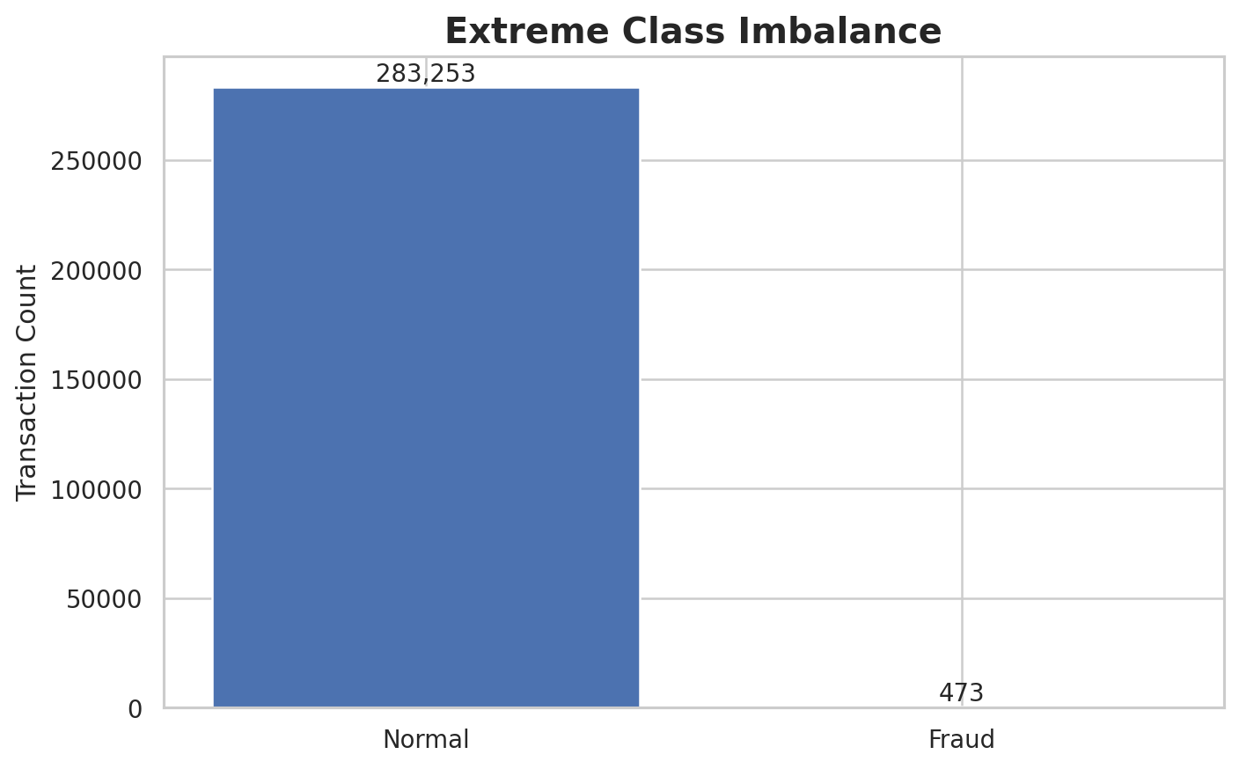
Data Preprocessing & EDA : Class Imbalance - The Main Challenge
What the chart shows
After cleaning, only 473 out of 283,726 transactions are fraud.
That means fraud cases represent only 0.16671% of the data.
A model that predicts "normal" almost every time would still appear accurate.
Because of this, recall and F1-score are more informative than accuracy alone.
DATA 3421 Final Project • Group 19

Slide 7
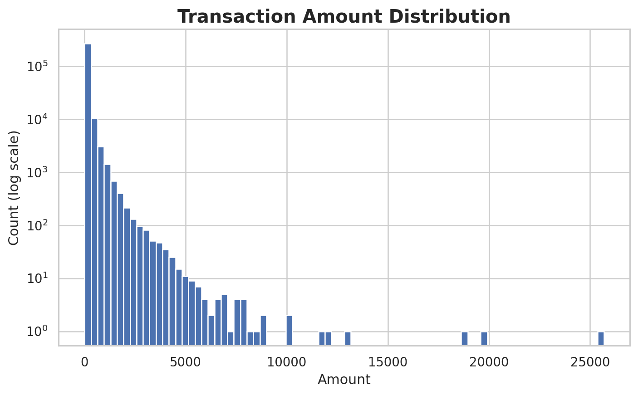
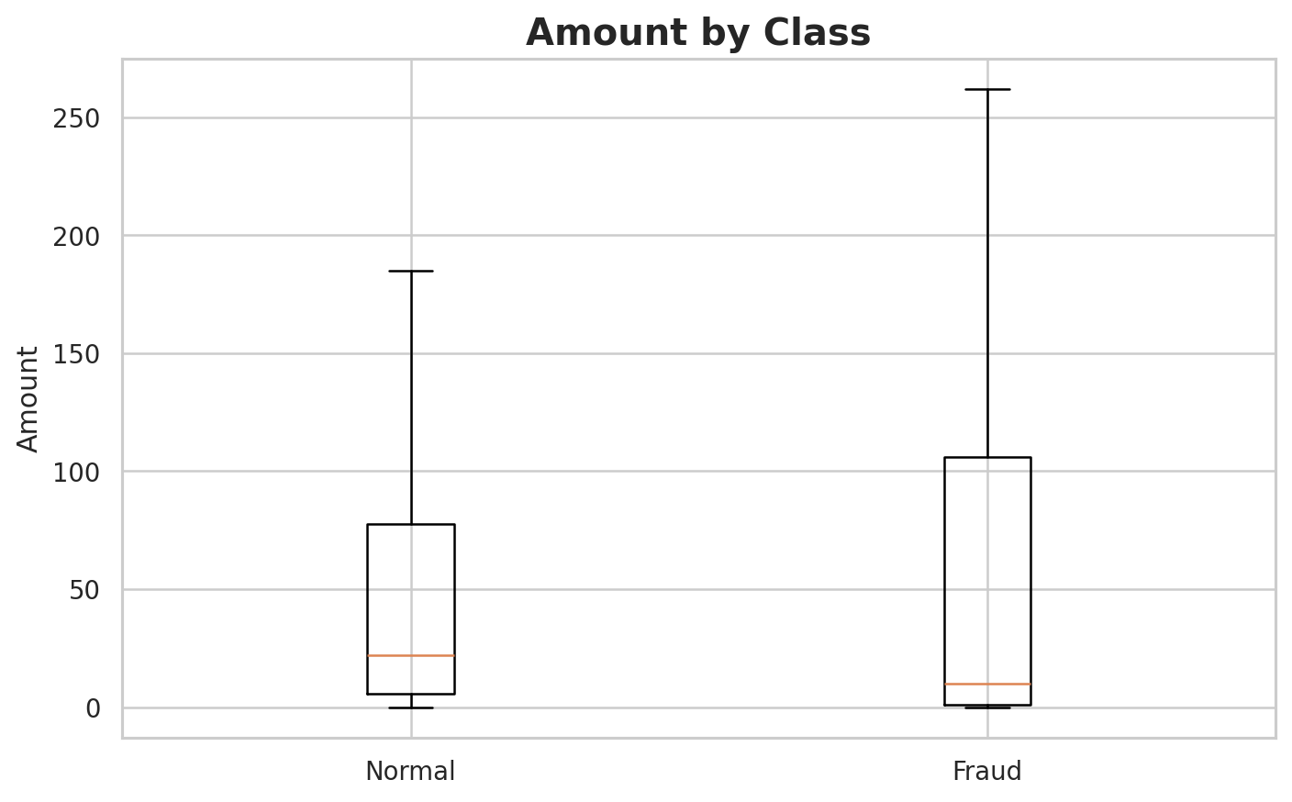
Data Preprocessing & EDA : EDA - Transaction Amount
Most transactions are low-value, with a long right tail of large amounts.
Fraud and normal transactions both show outliers; amount alone does not separate the classes well.
DATA 3421 Final Project • Group 19

Slide 8
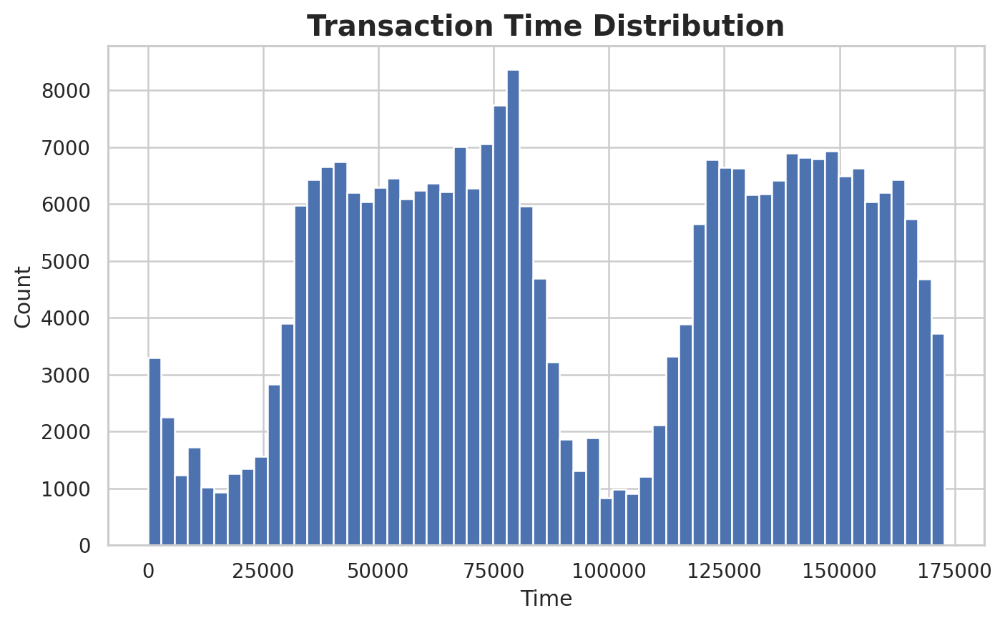
Data Preprocessing & EDA : EDA - Transaction Time
Transactions are spread across the two-day observation window rather than concentrated at a single point.
The distribution has repeating peaks and valleys, which likely reflect daily customer activity patterns.
Time is informative but not obviously sufficient by itself to identify fraud.
This is why Time was scaled and kept as one feature among many.
Histogram of transaction time across the observation period.
DATA 3421 Final Project • Group 19

Slide 9
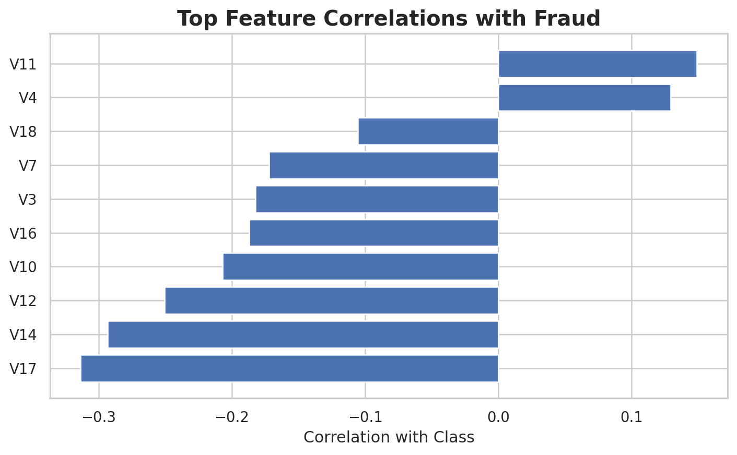
Data Preprocessing & EDA : Feature Relationships with Fraud
Most features are anonymized PCA components, so interpretation is limited.
Instead of explaining each feature individually, we looked at how strongly each feature correlates with the fraud label.
Features such as V14, V12, V17, and V10 show stronger relationships with fraud than most others.
This supports using machine learning models that combine many variables at once.
Top absolute correlations with the fraud class.
DATA 3421 Final Project • Group 19

Slide 10
Modeling & Evaluation : Modeling Pipeline
Clean Data
Split
Data
Scale Features
Train Models
Evaluate
Remove
duplicates &
check
missing values
80/20 stratified
train/test split
Precision
Recall
F1-score
ROC-AUC
Standardize
Time
& Amount
LR
DT
RF
Why these models?
Logistic Regression gives a simple baseline, Decision Tree provides interpretable nonlinear rules, and Random Forest is a stronger ensemble classifier.
DATA 3421 Final Project • Group 19

Slide 11
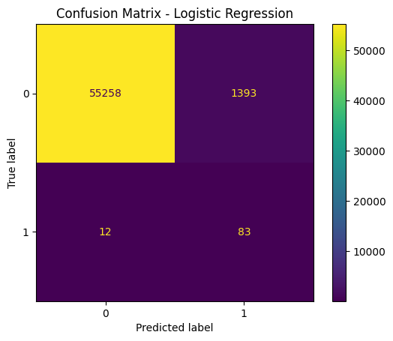
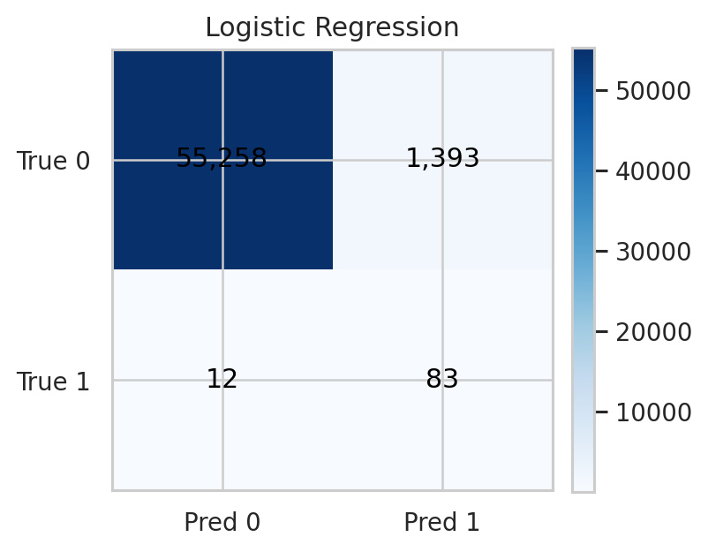
Modeling & Evaluation : Model 1 - Logistic Regression
Test-set Metrics
Confusion Matrix – Logistic Regression
Confusion matrix
Accuracy
0.9752
Precision
0.0562
Recall
0.8737
F1-score
0.1057
ROC-AUC
0.9658
Interpretation
It catches many fraud cases (high recall) but triggers many false positives, so precision is very low.
DATA 3421 Final Project • Group 19

Slide 12
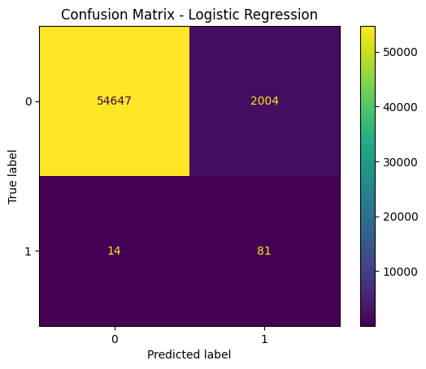
Modeling & Evaluation : Model 2 - Decision Tree
Test-set Metrics
Confusion Matrix - Decision Tree
Confusion matrix
Accuracy
0.9644
Precision
0.0388
Recall
0.8526
F1-score
0.0743
ROC-AUC
0.9061
Interpretation
The tree also finds many frauds, but it produces even more false alarms and has the weakest F1-score.
DATA 3421 Final Project • Group 19

Slide 13
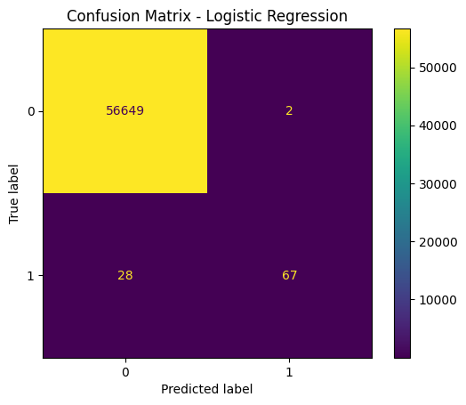
Modeling & Evaluation : Model 3 - Random Forest
Test-set Metrics
Confusion Matrix - Random Forest
Confusion matrix
Accuracy
0.9995
Precision
0.9710
Recall
0.7053
F1-score
0.8171
ROC-AUC
0.9246
Interpretation
Random Forest gives the strongest balance: very high precision with solid recall, producing the best F1-score.
DATA 3421 Final Project • Group 19

Slide 14
Modeling & Evaluation : Model Comparison Summary
The best model should balance fraud detection with false-alarm control.
Model | Accuracy | Precision | Recall | F1-score | ROC-AUC
Random Forest | 0.9995 | 0.9710 | 0.7053 | 0.8171 | 0.9246
Logistic Regression | 0.9752 | 0.0562 | 0.8737 | 0.1057 | 0.9658
Decision Tree | 0.9644 | 0.0388 | 0.8526 | 0.0743 | 0.9061
Decision
Random Forest is the best overall model because it achieved the highest F1-score and extremely high precision while still identifying most fraud cases.
DATA 3421 Final Project • Group 19
15

Slide 15
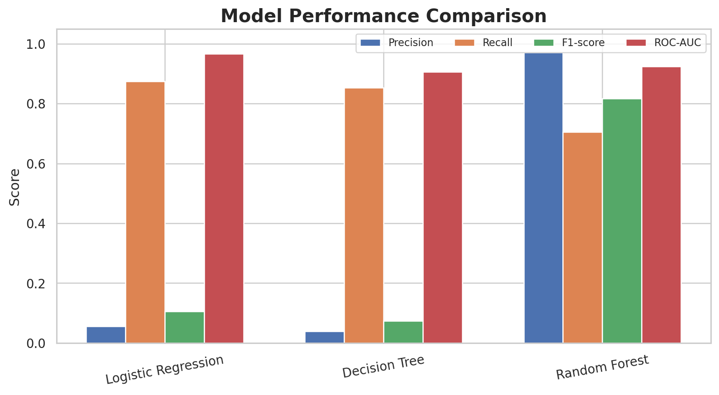
Modeling & Evaluation : Why Random Forest Won
Logistic Regression has the highest recall, but precision is too low for practical use.
Decision Tree performs worse than Logistic Regression on precision and F1-score.
Random Forest sharply reduces false positives while keeping recall at a useful level.
That trade-off produces a much stronger F1-score than the other two models.
Comparison of precision, recall, F1-score, and ROC-AUC across models.
DATA 3421 Final Project • Group 19

Slide 16
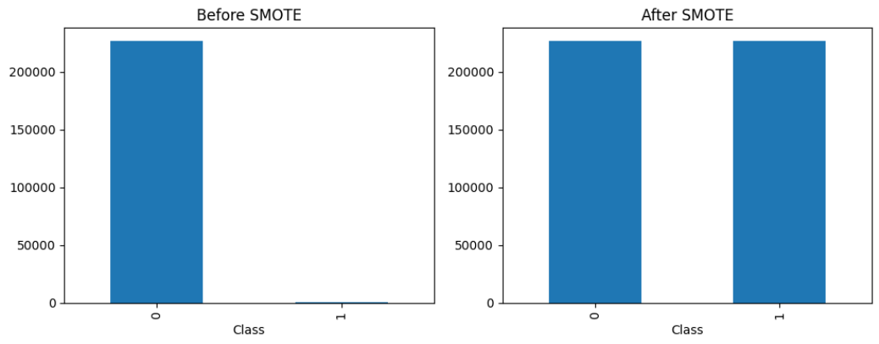
Modeling & Evaluation : Modeling Results From Original to SMOTE
Results may differ because:
class_weight adjusts learning
SMOTE changes the data
Model | Precision | Recall | F1-score | ROC-AUC | Accuracy
Decision Tree | +0.39 | -0.14 | +0.46 | -0.05 | 0.03
Logistic Regression | 0.00 | 0.00 | -0.01 | 0.00 | 0.00
Random Forest | -0.06 | +0.05 | +0.01 | 0.04 | 0.00
Green – Increase From Original
Red – Decrease From Original
Black – No Change / Negligible Change From Original
DATA 3421 Final Project • Group 19

Slide 17
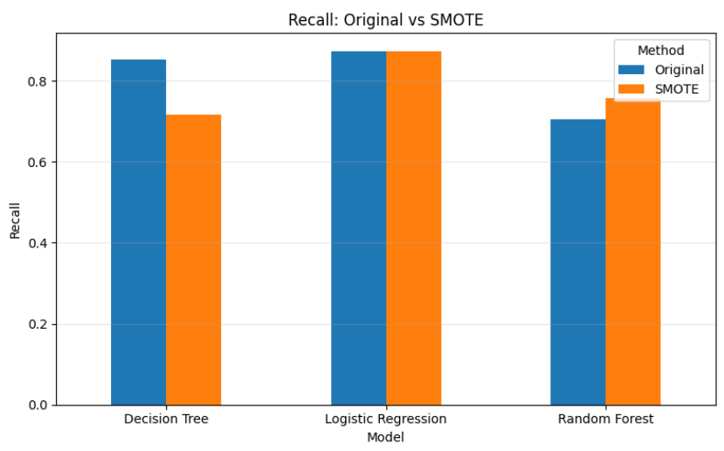
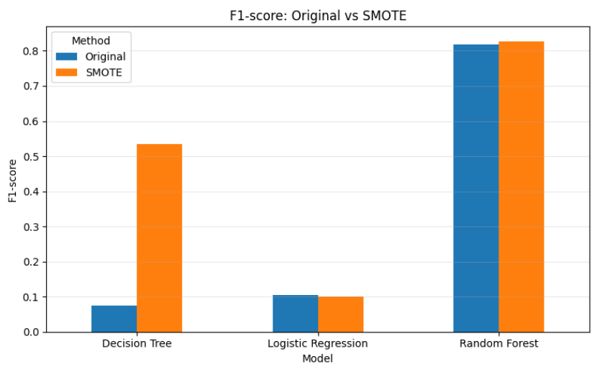
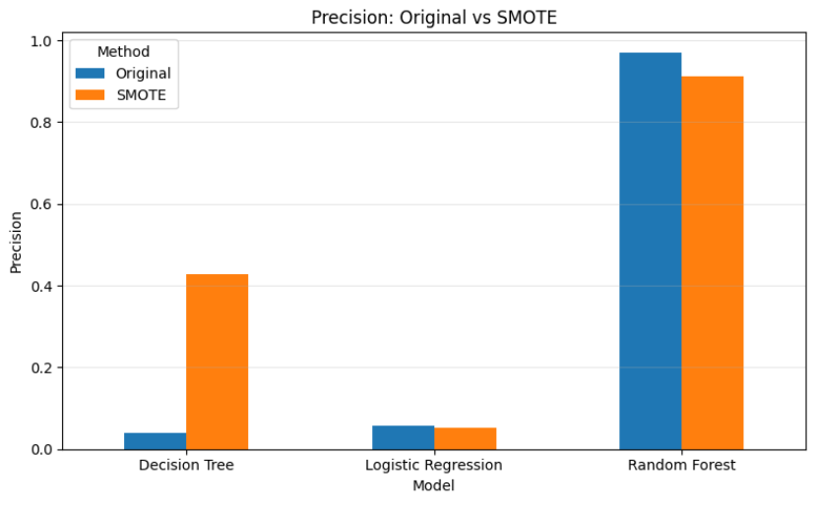
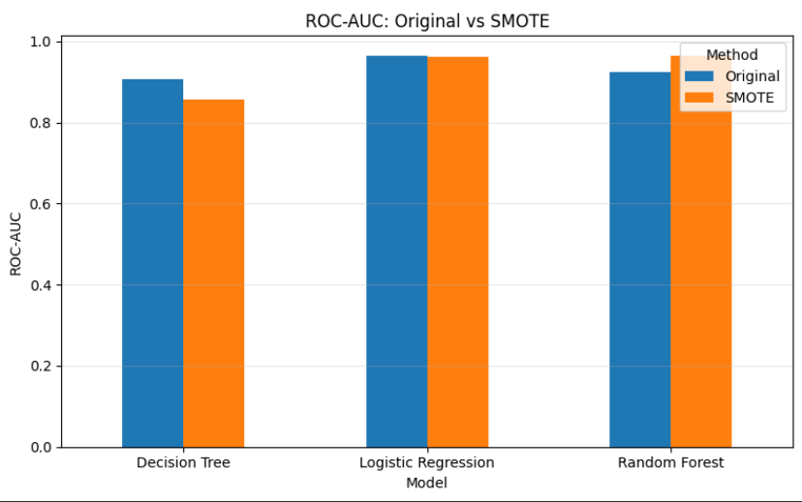
Modeling & Evaluation : Final Decision With SMOTE Unchanged
DATA 3421 Final Project • Group 19

Slide 18
Interpretations & Conclusion : Discussion - Limitations & Improvements
Current limitations
The dataset is already anonymized, so feature interpretation is limited.
Only three supervised models were tested in this presentation.
Threshold tuning was not explored, even though it can improve fraud-recall trade-offs.
Possible next steps
Try gradient boosting methods or anomaly detection models.
Tune hyperparameters more systematically.
Use precision-recall curves to choose the best probability threshold for deployment.
DATA 3421 Final Project • Group 19

Slide 19
Interpretations & Conclusion : Conclusion
Among the three models tested, Random Forest performed best for this dataset.
The dataset had no missing values, but it did have duplicate rows that were removed.
Fraud detection was challenging because the fraud class represented only 0.16671% of transactions after cleaning.
Random Forest delivered the best balance of precision and recall, leading to the highest F1-score.
This suggests that an ensemble approach is more effective than a simple linear model or a single decision tree for this problem.
Recommended Model
Random Forest
Reason for selection
Highest F1-score (0.8171)
Extremely high precision (0.9710)
Still detects most fraud cases
DATA 3421 Final Project • Group 19

Slide 20
References
Kaggle. “Credit Card Fraud Detection” dataset by MLG-ULB. Used for all analysis and plots in this presentation.
scikit-learn documentation for Logistic Regression, Decision Tree, Random Forest, StandardScaler, and model evaluation metrics.
DATA 3421 Final Project • Group 19

Slide 21
Any Question
End of presentation
Thank you

