Slide 1

Database
TONČICA BULIČIĆ bulicic.toncica@nsoft.com

Slide 2


What are databases ?
A database is an organized collection of data.
A database is a collection of information that is organized so that it can be easily accessed, managed and updated.

Slide 3
Why do we need databases ?
To solve next problems:
Size (search, slow)
Updating
Accuracy (validation)
Security (permissions)
Redundancy
Importance

Slide 4
What is database management system ?
A database management system (DBMS) is a collection of programs which enables its users to access database, manipulate data, help in representation of data
A database model is a type of data model that determines the logical structure of a database and fundamentally determines in which manner data can be stored, organized and manipulated
Database management systems are often classified according to the database model that they support:
Relation DBMS
Hierarchial DBMS
Network DBMS
Object-Oriented DBMS
NoSQL DBMS (Not only SQL)
Popular DBMS : Oracle, SQL Server, MySQL, PostgreSQL, MongoDB, Elasticsearch

Slide 5
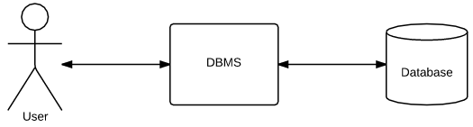
What is database management system ?

Slide 6
Relational database
is a database whose organization is based on the relational model of data
this model organizes data into one or more tables (or "relations") of columns and rows, with a unique key identifying each row
each table represents one "entity type" (such as customer or product)
the rows represent instances of that type of entity (such as "Lee" or "iPhone 6")
the columns representing values attributed to that instance (such as address or price)
the most popular database

Slide 7
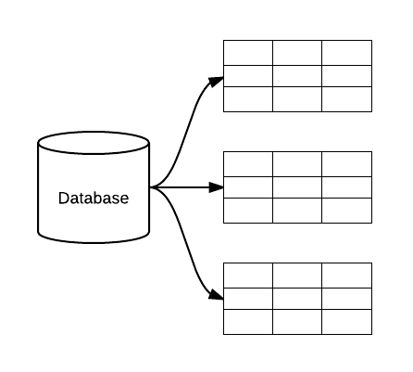
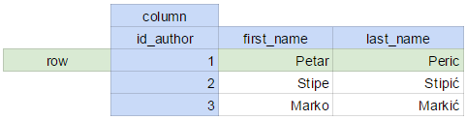
Relational database

Slide 8
Column
columns names are unique
columns store a single type of information
column data types:
TINYINT
SMALLINT
MEDIUMINT
INT
BIGINT
DATE
DATETIME
VARCHAR
TEXT
...

Slide 9
Row
each row in a table represents a set of related data
every row in the table has the same structure

Slide 10
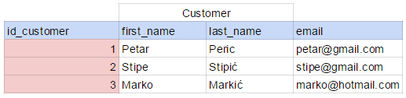
Primary Key
a key identifies one particular row in a table
a primary key cannot be null
each table cannot have more than one primary key
must be unique

Slide 11
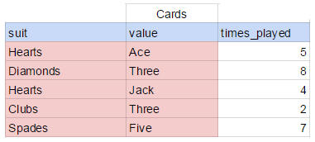
Composite Key
is a key that consists of two or more simple keys that uniquely identify an entity occurrence

Slide 12
Relationships
types:
One-to-One
One-to-Many
Many-to-Many
implemented with keys

Slide 13
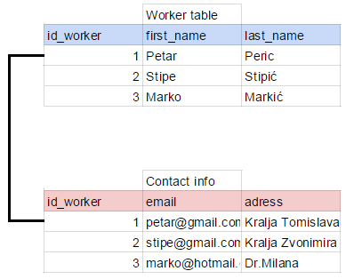
One to one

Slide 14
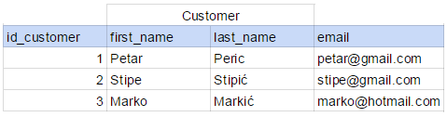
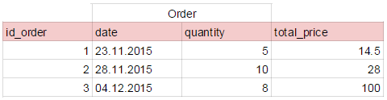
One to many

Slide 15
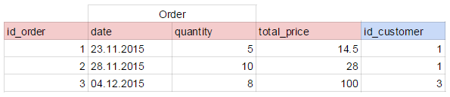
One to many

Slide 16
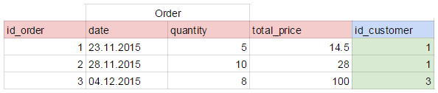
Foreign Key
is a field (or collection of fields) in one table that uniquely identifies a row of another table
is not unique
can be named different than primary key from referenced table

Slide 17
Many to many

Slide 18
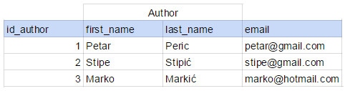
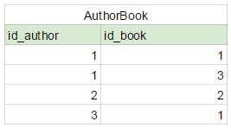
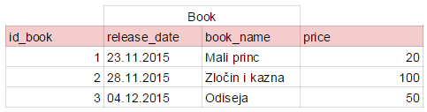
Many to many

Slide 19
Normalization
is the process of organizing the columns (attributes) and tables (relations) of a relational database to minimize data redundancy
goals:
reduce duplication
easier modifications
easier selection
improve maintenance
Normalization types:
First Normal Form (1NF)
Second Normal Form (2NF)
Third Normal Form (3NF)
Fourth Normal Form
Fifth Normal Form
Sixth Normal Form

Slide 20
First Normal Form (1NF)
For a table to be in the First Normal Form, it should follow the following 4 rules:
It should only have single(atomic) valued attributes/columns.
Values stored in a column should be of the same domain
All the columns in a table should have unique names.
And the order in which data is stored, does not matter.
Multiple values in same column:
- difficult to search
- difficult to sort
- difficult to maintain

Slide 21
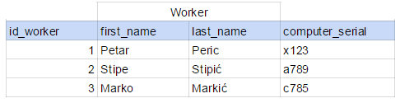
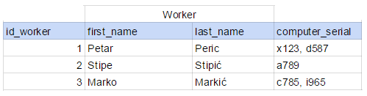
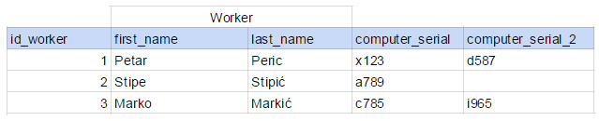
First Normal Form (1NF)
mu multiple values
repeating groups

Slide 22
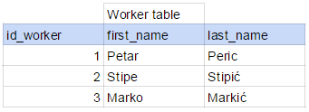
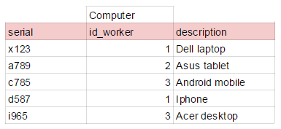
First Normal Form (1NF)

Slide 23
Second Normal Form (2NF)
It should be in the First Normal form.
any non-key field should be dependent on the entire primary key
we only have it when we have composite key

Slide 24
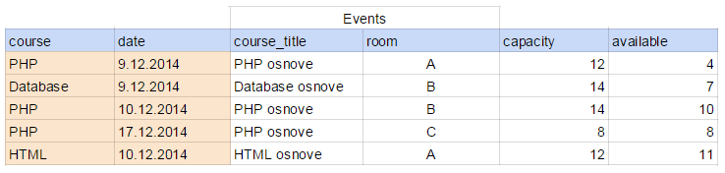
Second Normal Form (2NF)

Slide 25
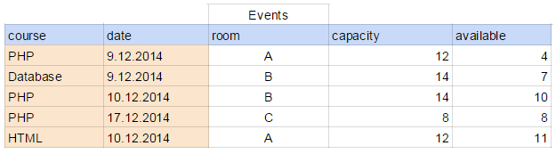
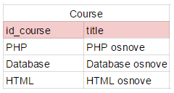
Second Normal Form (2NF)

Slide 26
Third Normal Form (3NF)
It is in the Second Normal form.
No non-key field is dependent on any other non-key field

Slide 27
Third Normal Form (3NF)

Slide 28
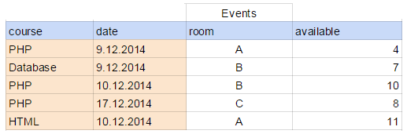
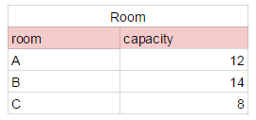
Third Normal Form (3NF)

Slide 29
Denormalization
is the process of attempting to optimize the read performance of a database by adding redundant data or by grouping data

Slide 30
SQL
Structured Query Language
SQL is a declarative query language, not a procedural, imperative language
Used by the DBMS to interact with the database
Lets you access and manipulate databases

Slide 31
Data definition language (DDL)
change database schema
statements :
CREATE
ALTER
DROP

Slide 32
CREATE
table
db
index
Syntax
CREATE TABLE table_name
(
column_name1 data_type(size),
....
);
CREATE TABLE `departments` (
`id_department` int(11) NOT NULL AUTO_INCREMENT,
`department_name` varchar(128) NOT NULL,
PRIMARY KEY (`id_department`)
);

Slide 33
ALTER
is used to add, delete, or modify columns in an existing table
add column
ALTER TABLE table_name ALTER TABLE employee
ADD column_name datatype ADD email VARCHAR(100);
delete column
ALTER TABLE table_name ALTER TABLE employee
DROP COLUMN column_name DROP COLUMN email
modify column
ALTER TABLE table_name ALTER TABLE employee
MODIFY COLUMN column_name datatype MODIFY COLUMN email INT(11)

Slide 34
DROP
table
index
view
DROP TABLE table_name
DROP TABLE employee

Slide 35
Data manipulation language(DML)
modify stored data but not the schema or database objects
statements :
SELECT
INSERT
UPDATE
DELETE

Slide 36
INSERT
INSERT INTO table_name
(column1,column2,column3,...)
VALUES (value1,value2,value3,...);
INSERT INTO workers
(first_name, city)
VALUES
(“Petar”, “Mostar”);

Slide 37
UPDATE
use where to update only specific rows, otherwise every row will be updated
UPDATE table_name
SET column1=value1,column2=value2,...
WHERE some_column=some_value;
UPDATE cities
SET city_name = “Mostar”
WHERE city_name = “Mosstar”
UPDATE workers
INNER JOIN citities ON citities .id_city = workers.id_city
SET salary = “200”
WHERE city_name = “Mostar”

Slide 38
DELETE
use where to delete only specific rows, otherwise every row will be deleted
DELETE FROM table_name
WHERE some_column=some_value;
DELETE FROM workers
WHERE first_name = “Petar”;

Slide 39
ALIAS
are used to temporarily rename a table or a column heading
column
SELECT column_name AS alias_name
FROM table_name;
SELECT first_name AS name
FROM workers;
table
SELECT column_name(s)
FROM table_name AS alias_name;
SELECT first_name
FROM workers AS w

Slide 40
SELECT
is used to select data from a database
SELECT column_name,column_name
FROM table_name
SELECT first_name, city
FROM worker;
selects all the columns from the table:
SELECT *
FROM table_name;

Slide 41
WHERE
is used to filter records
SELECT column_name,column_name
FROM table_name
WHERE column_name operator value;
SELECT first_name, city
FROM worker
WHERE salary > 500

Slide 42
Operators
=
<
>
<>
<=
>=
BETWEEN
LIKE
IN
IS
IS NOT
AND
OR
...

Slide 43
AND - OR - IN
SELECT *
FROM worker
WHERE salary = 500 AND salary = 400;
SELECT *
FROM worker
WHERE salary = 500 OR salary = 400;
SELECT *
FROM worker
WHERE salary IN (500, 400 );

Slide 44
ORDER BY
is used to sort the result-set by one or more columns
order
ASC - default
DESC
SELECT column_name, column_name
FROM table_name
ORDER BY column_name ASC|DESC, column_name ASC|DESC;
SELECT *
FROM workers
ORDER BY salary DESC;

Slide 45
LIKE
is used to search for a specified pattern in a column
wildcard:
% a substitute for zero or more characters
_ a substitute for one character
[charlist] characters to match
SELECT column_name
FROM table_name
WHERE column_name LIKE pattern;
SELECT *
FROM worker
WHERE first_name LIKE ‘pet%’;
SELECT *
FROM worker
WHERE first_name LIKE ‘pe_ar’;

Slide 46
BETWEEN
SELECT column_name
FROM table_name
WHERE column_name BETWEEN value1 AND value2;
SELECT *
FROM workers
WHERE salary BETWEEN 100 AND 500;
SELECT *
FROM workers
WHERE salary NOT BETWEEN 100 AND 500;

Slide 47
FUNCTIONS
SQL has many built-in functions for performing calculations on data
Character functions:
LOWER, UPPER, SUBSTR, CONCAT, CONCAT, REPLACE...
Number functions:
ROUND, ABS…
Date and time functions:
NOW, MONTH, DAY, DATE, TO_DAYS…
Control flow functions:
CASE, IF...
Comparasion functions:
COALESCE, ISNULL..

Slide 48
DISTINCT
can be used to return only distinct (different) values
SELECT DISTINCT column_name,column_name
FROM table_name;
SELECT DISTINCT id_city
FROM workers

Slide 49
ROUND() , NOW()
SELECT ROUND(column_name,decimals)
FROM table_name;
SELECT ROUND(salary, 2)
FROM workers
NOW() function returns the current system date and time
SELECT NOW()
FROM table_name;
SELECT NOW()
FROM workers

Slide 50
Aggregate functions
or gruping functions
is a function where the values of multiple rows are grouped together
perform on one column
common aggregate functions:
COUNT()
SUM()
AVG()
MIN()
MAX()

Slide 51
COUNT()
returns the number of rows that matches a specified criteria
SELECT COUNT(*)
FROM
table_name;
SELECT COUNT(*)
FROM
workers;

Slide 52
AVG()
returns the average value of a numeric column.
SELECT AVG(column_name)
FROM
table_name;
SELECT AVG(salary)
FROM
workers;

Slide 53
MIN()
returns the smallest value of the selected column
SELECT MIN(column_name)
FROM
table_name;
SELECT MIN(salary)
FROM
workers;

Slide 54
SUM()
returns the total sum of a numeric column
SELECT SUM(column_name)
FROM
table_name;
SELECT SUM(salary)
FROM
workers;

Slide 55
GROUP BY
is used in conjunction with the aggregate functions to group the result-set by one or more columns
every column in SELECT statement (except aggregate function) must be also in GROUP BY statement
HAVING - used for group filtering
SELECT column_name, aggregate_function(column_name)
FROM table_name
WHERE column_name operator value
GROUP BY column_name;

Slide 56
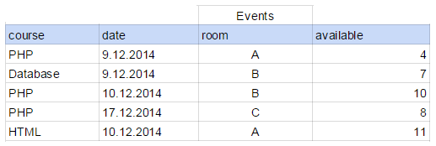
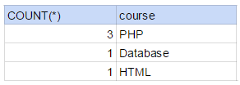
GROUP BY
SELECT COUNT(*), course
FROM events
GROUP BY course

Slide 57
HAVING
SELECT column_name, aggregate_function(column_name)
FROM table_name
WHERE column_name operator value
GROUP BY column_name
HAVING aggregate_function(column_name) operator value;
SELECT course, COUNT(*)
FROM events
GROUP BY course
HAVING COUNT(*) > 0

Slide 58
Joining tables
are used to combine rows from two or more tables
types:
INNER
LEFT OUTER
RIGHT OUTER
FULL OUTER

Slide 59
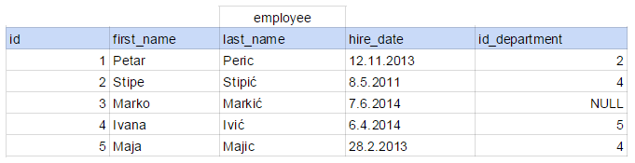
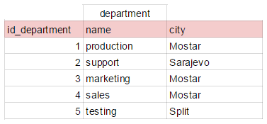
Joining tables

Slide 60
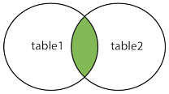
INNER JOIN
selects all rows from both tables as long as there is a match between the columns in both tables

Slide 61
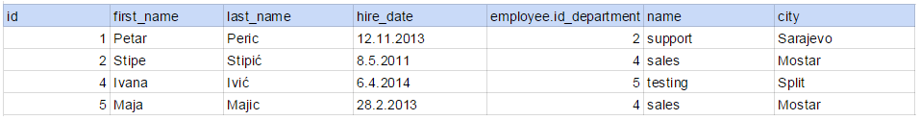
INNER JOIN
SELECT column_name(s)
FROM table1
INNER JOIN table2
ON table1.column_name=table2.column_name;
SELECT first_name, last_name, hire_date,
employee.id_department, name, city
FROM employee
INNER JOIN department
ON employee.id_department = department.id_department

Slide 62
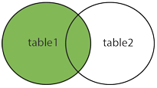
LEFT OUTER JOIN
returns all rows from the left table, with the matching rows in the right table

Slide 63
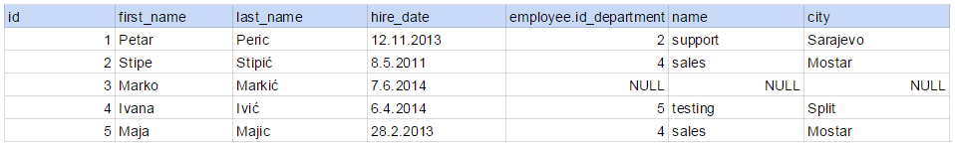
LEFT OUTER JOIN
SELECT column_name(s)
FROM table1
LEFT OUTER JOIN table2
ON table1.column_name=table2.column_name;
SELECT first_name, last_name, hire_date,
employee.id_department, name, city
FROM employee LEFT OUTER JOIN department
ON employee.id_department = department.id_department

Slide 64
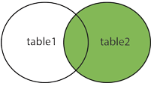
RIGHT OUTER JOIN
returns all rows from the right table, with the matching rows in the left table

Slide 65
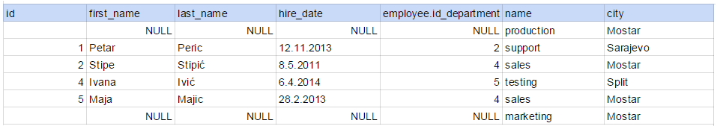
RIGHT OUTER JOIN
SELECT column_name(s)
FROM table1
RIGHT OUTER JOIN table2
ON table1.column_name=table2.column_name;
SELECT first_name, last_name, hire_date,
employee.id_department, name, city
FROM employee RIGHT OUTER JOIN department
ON employee.id_department = department.id_department

Slide 66
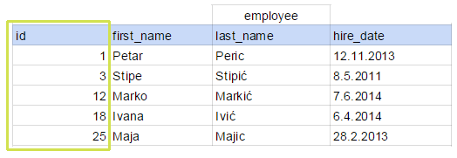
INDEX
allow the database application to find data fast, without reading the whole table
Clustered Index
With a clustered index the rows are stored physically on the disk in the same order as the index
base index
usually primary key
only one

Slide 67
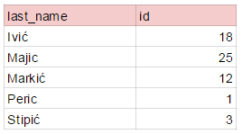
INDEX
Non-Clustered Index
multiple

Slide 68
INDEX
index every column ?
indexing is not just "upfront" work
indexing is a trade-of
faster reads
slower writes

Slide 69
TRANSACTION
A sequence of operations performed (using one or more SQL statements) on a database as a single logical unit of work
The effects of all the SQL statements in a transaction can be either all committed or all rolled back
A database transaction must be atomic, consistent, isolated and durable. Later we have discussed these four points.

Slide 70

That‘s all folks!

