Slide 1
Deployment
02476 Machine Learning Operations
Nicki Skafte Detlefsen,
Postdoc
DTU Compute
Loosely based on https://www.youtube.com/watch?v=2awmrMRf0dA

Slide 2
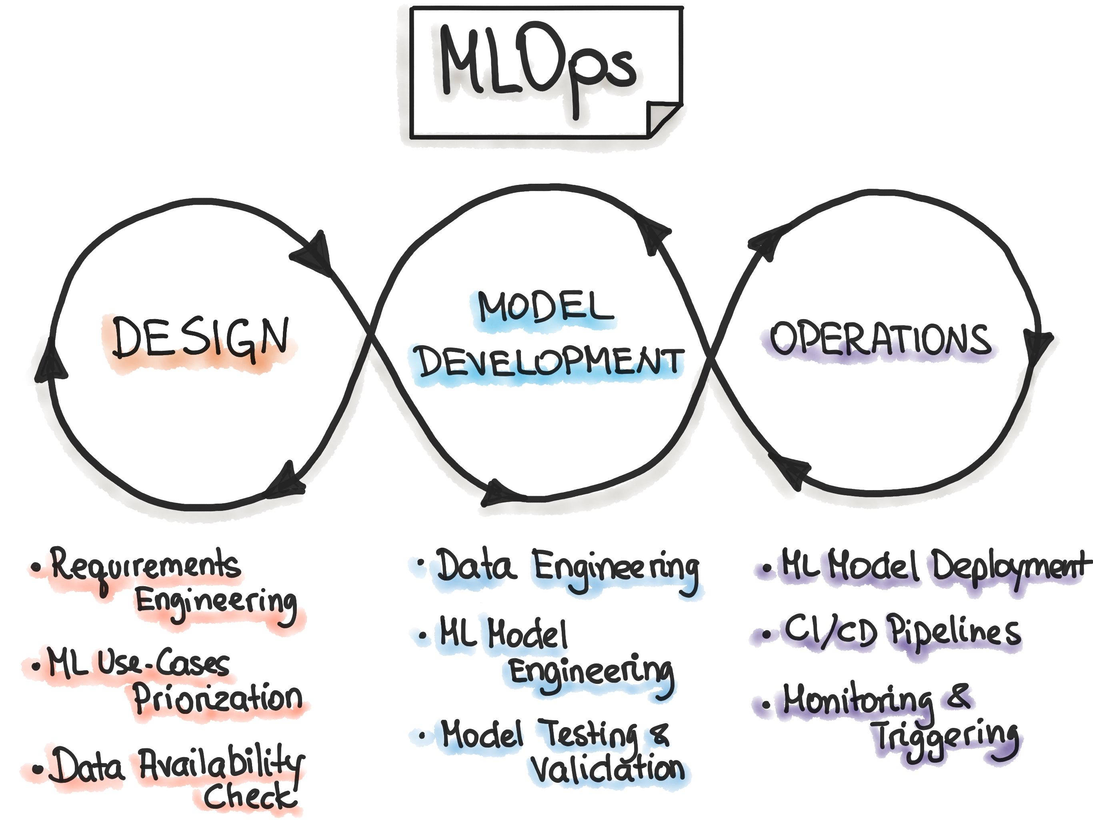
Freeing the model
Model deployment is part of the operations in MLOps
In a nutshell: make the model available to others

Slide 3
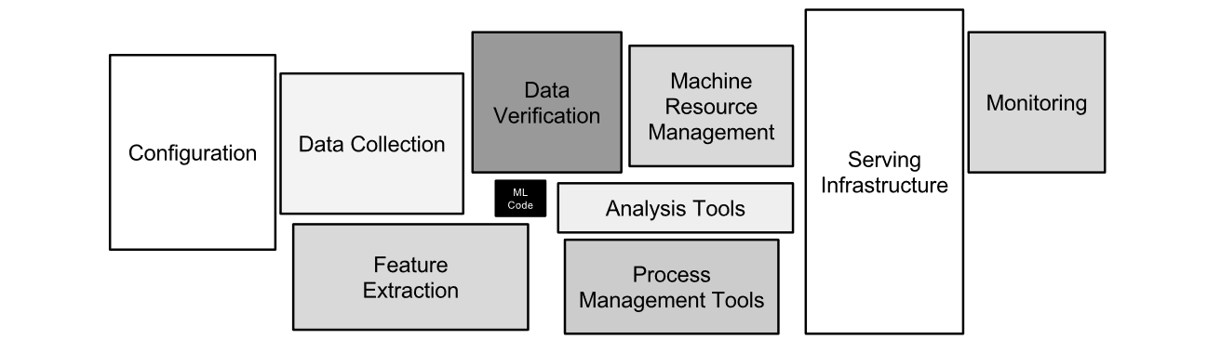
Remember this?
This is big for a reason

Slide 4
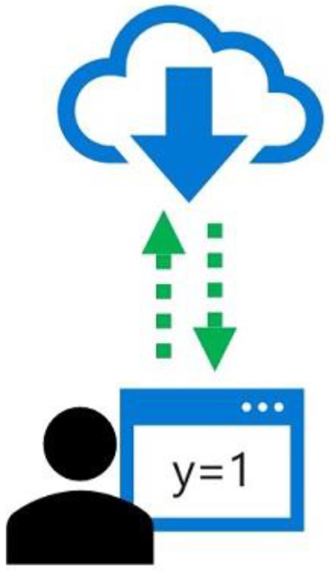
What do we want to deploy
In ML, inferencing refer to the use of a trained model to predict labels for new data on which the model has not been trained

Slide 5
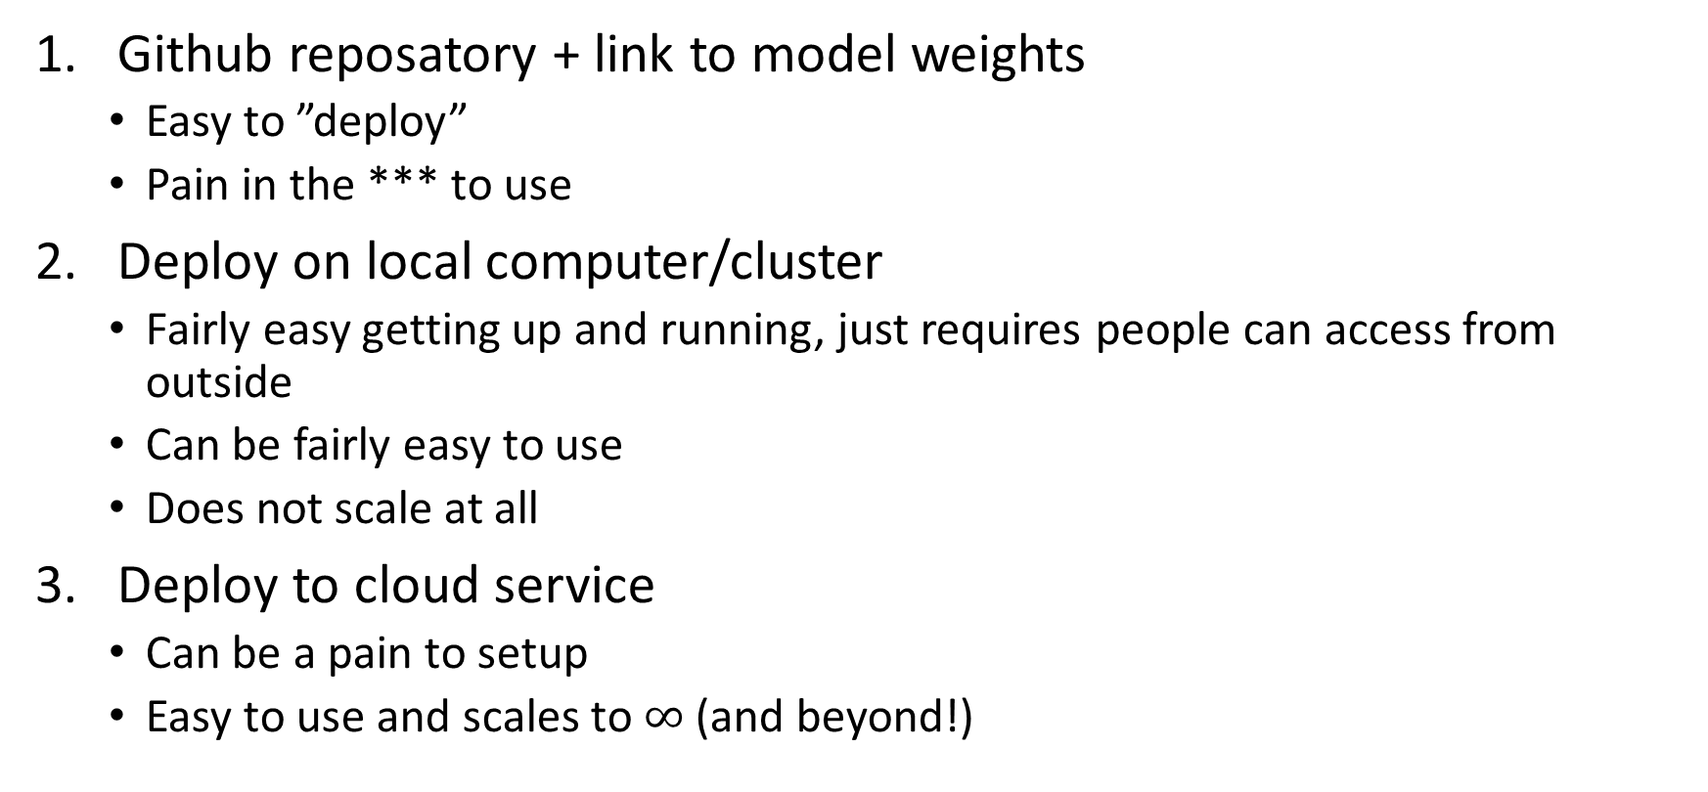
Many levels of deployment (within machine learning)
Github reposatory + link to model weights
Easy to ”deploy”
Pain in the *** to use
Deploy on local computer/cluster
Fairly easy getting up and running, just requires people can access from outside
Can be fairly easy to use
Does not scale at all
Deploy to cloud service
Can be a pain to setup
Easy to use and scales to $∞$ (and beyond!)

Slide 6
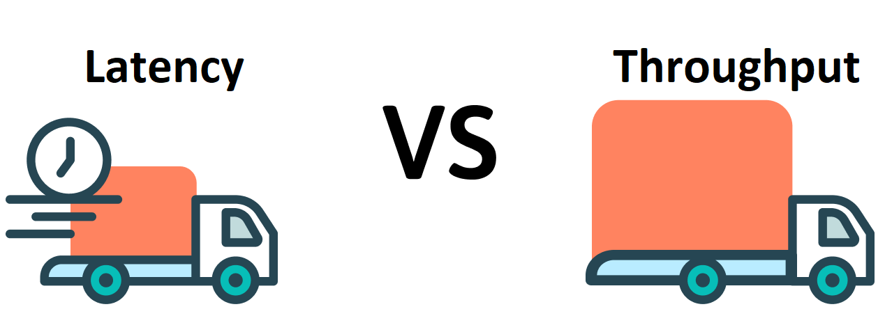
Production requirements
Portability
Models should be exportable to wide variety of enviroments, from C++ servers to mobile
Performance
We want to optimize common patterns in neural networks to improve inference latency and throughput

Slide 7
Choosing the right service
Yes: Local deployment
Traditional ML (low throughput): Kubernetes cluster using cpu
High availability: what kind of workload?
First time deploying?
Latency: high availability or minimal cost?
Deep learning ML (high throughput): Kubernetes cluster using gpu
No: Are you prioritizing low latency or throughput?
Low cost: Cloud Run or Cloud Functions
Throughput: use batch inference

Slide 8
What are the challenges with Pytorch in production
Pytorch is a dynamic framework (uses a dynamic graph)
This is not great in production as we need to know sizes etc. for compilation and optimization
Why not use a static framework (Tensorflow 1.x, Caffe2 etc.)?
Do you really want to port all your work?
What can we do to solve this?

Slide 9
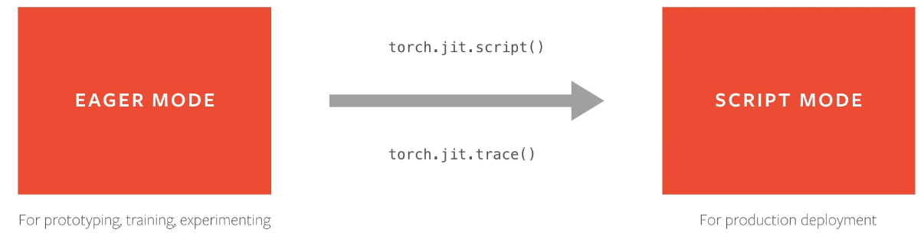
Convert to script mode!

Slide 10
Serilization
torch.jit.script serialize the model, but what does it mean?
Serilization essentially encodes all modules methods, submodules, parameters, and attributes into a byte stream
This makes the encoded model independent of python!
This is basically just ”pickling” and “unpickling”.

Slide 11
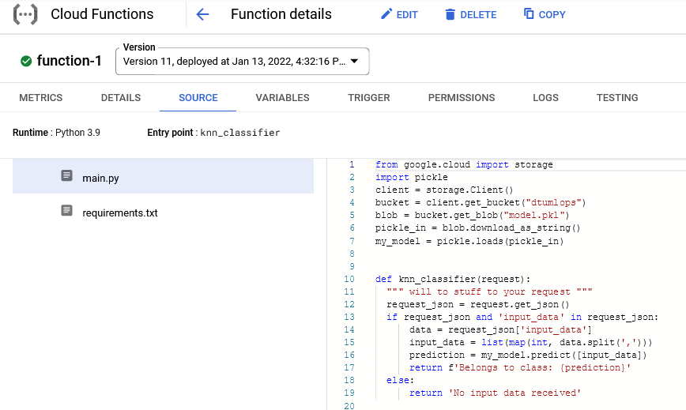
Cloud functions
Simple one script files for deployment

Slide 12

Meme of the day

