Slide 1
Deployment
02476 Machine Learning Operations
Nicki Skafte Detlefsen,
Postdoc
DTU Compute
Loosely based on https://www.youtube.com/watch?v=2awmrMRf0dA

Slide 2
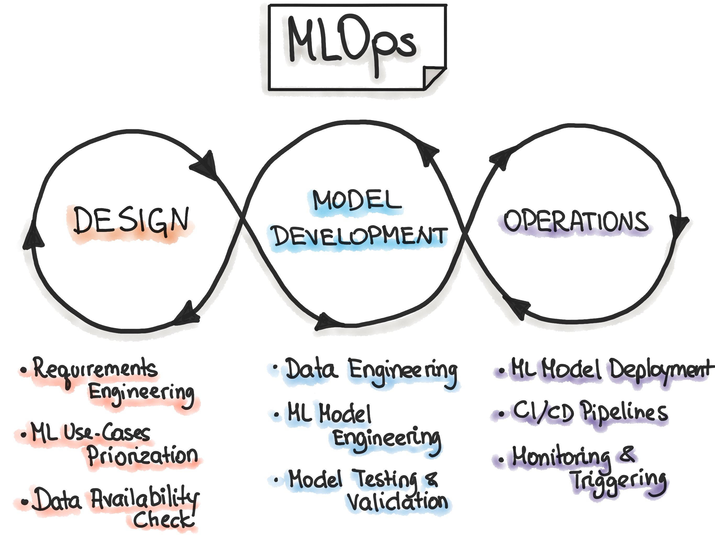
Freeing the model
Model deployment is part of the operations in MLOps
In a nutshell: make the model available to others

Slide 3
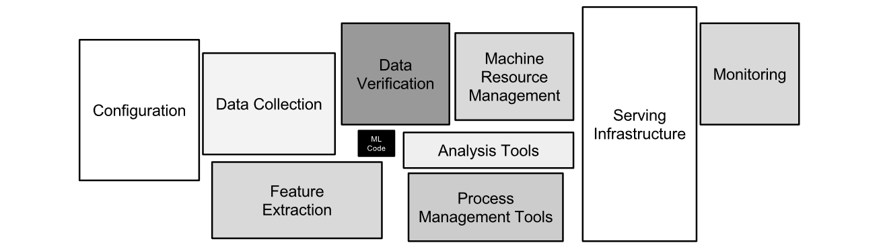
Remember this?
This is big for a reason

Slide 4
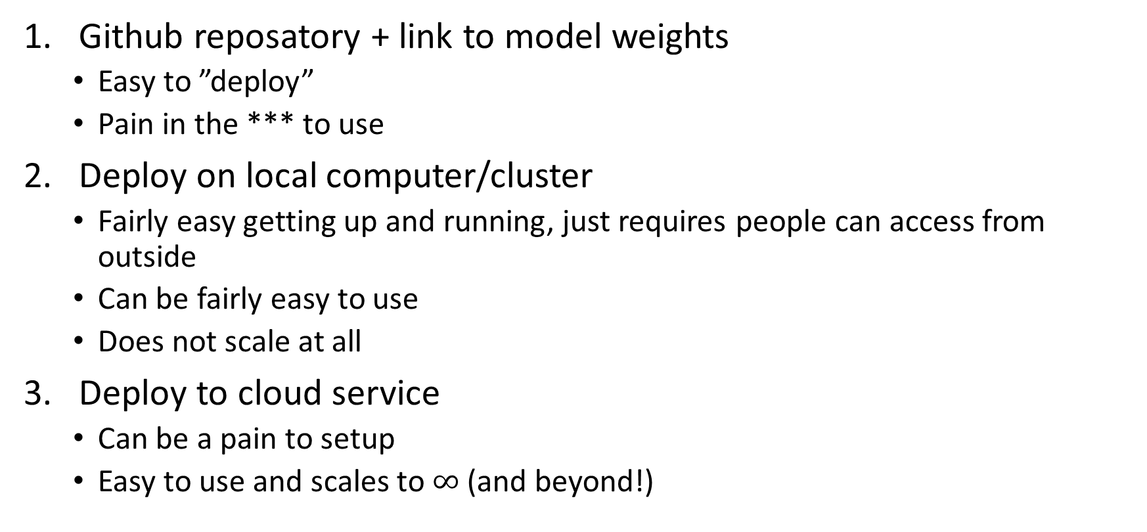
Many levels of deployment (within machine learning)
Github reposatory + link to model weights
Easy to ”deploy”
Pain in the *** to use
Deploy on local computer/cluster
Fairly easy getting up and running, just requires people can access from outside
Can be fairly easy to use
Does not scale at all
Deploy to cloud service
Can be a pain to setup
Easy to use and scales to $∞$ (and beyond!)

Slide 5
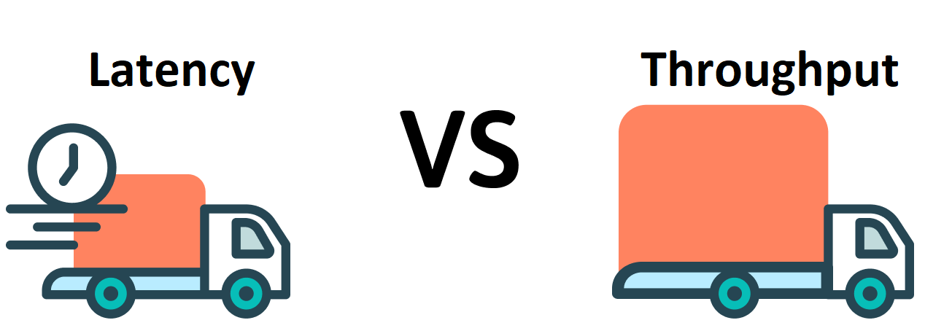
Production requirements
Portability
Models should be exportable to wide variety of enviroments, from C++ servers to mobile
Performance
We want to optimize common patterns in neural networks to improve inference latency and throughput

Slide 6
What are the challenges with Pytorch in production
Pytorch is a dynamic framework (uses a dynamic graph)
This is not great in production as we need to know sizes etc. for compilation and optimization
Why not use a static framework (Tensorflow 1.x, Caffe2 etc.)?
Do you really want to port all your work?
What can we do to solve this?

Slide 7
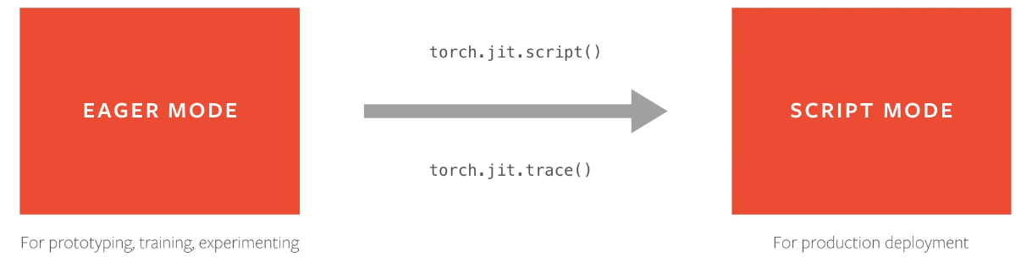
Convert to script mode!

Slide 8
Serilization
torch.jit.script serialize the model, but what does it mean?
Serilization essentially encodes all modules methods, submodules, parameters, and attributes into a byte stream
This makes the encoded model independent of python!
This is basically just ”pickling” and “unpickling”.

Slide 9
Cloud functions

Slide 11
Meme of the day

