Slide 1
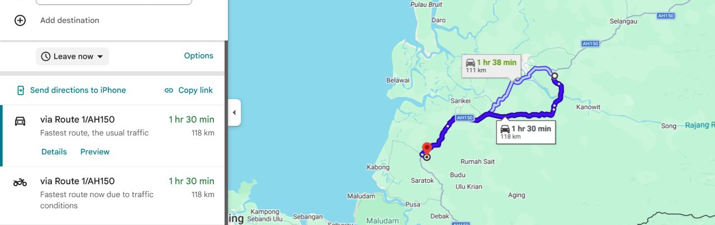
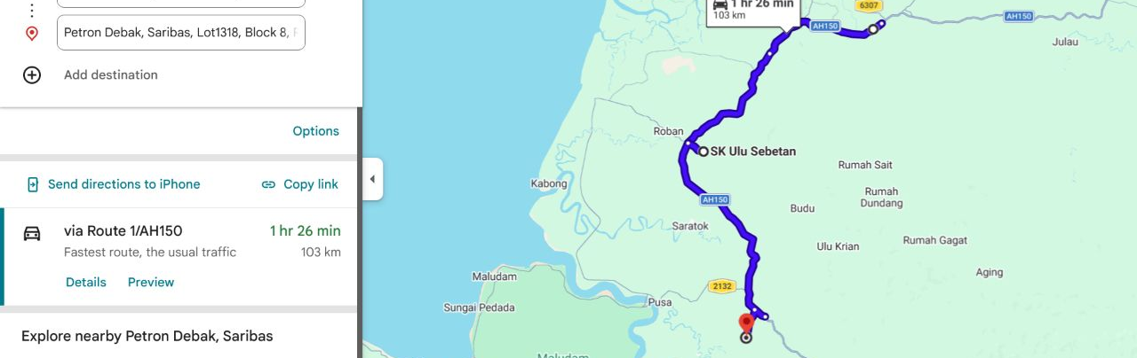
W H E R E W E ’ R E G O I N G
Project Location
SK Ulu Sebetan & Rh Flora, Sebetan area, Saratok district, Sarawak
1
Sibu Airport → SK Ulu Sebetan
118 km · ~1 hr 30 min
Fastest route via Route 1 / AH150
SIBU AIRPORT → SK ULU SEBETAN | 118 KM · ~1 HR 30 MIN
2
Petron Pakan → SK Ulu Sebetan → Petron Debak
103 km · ~1 hr 26 min
Pakan–school 52.7 km · School–Debak 50.0 km
PETRON PAKAN → SK ULU SEBETAN → PETRON DEBAK | 103 KM
CSR Borneo 2026
Project Location
3 / 20

