Slide 1

mvp
carnegie mellon university | policy innovation lab | spring 2020
jennifer sciullo | sharleen devjani | anna gipsov | katherina konst

Slide 2
contents
1. Value Proposition
2. Understanding the Focus
3. Existing & Potential Resources
4. Precedent MVP
5. Proposed MVP
MVP Opportunities & Challenges
Implementation Strategy
6. Measuring Success
7. Appendix (Brainstorming)

Slide 3
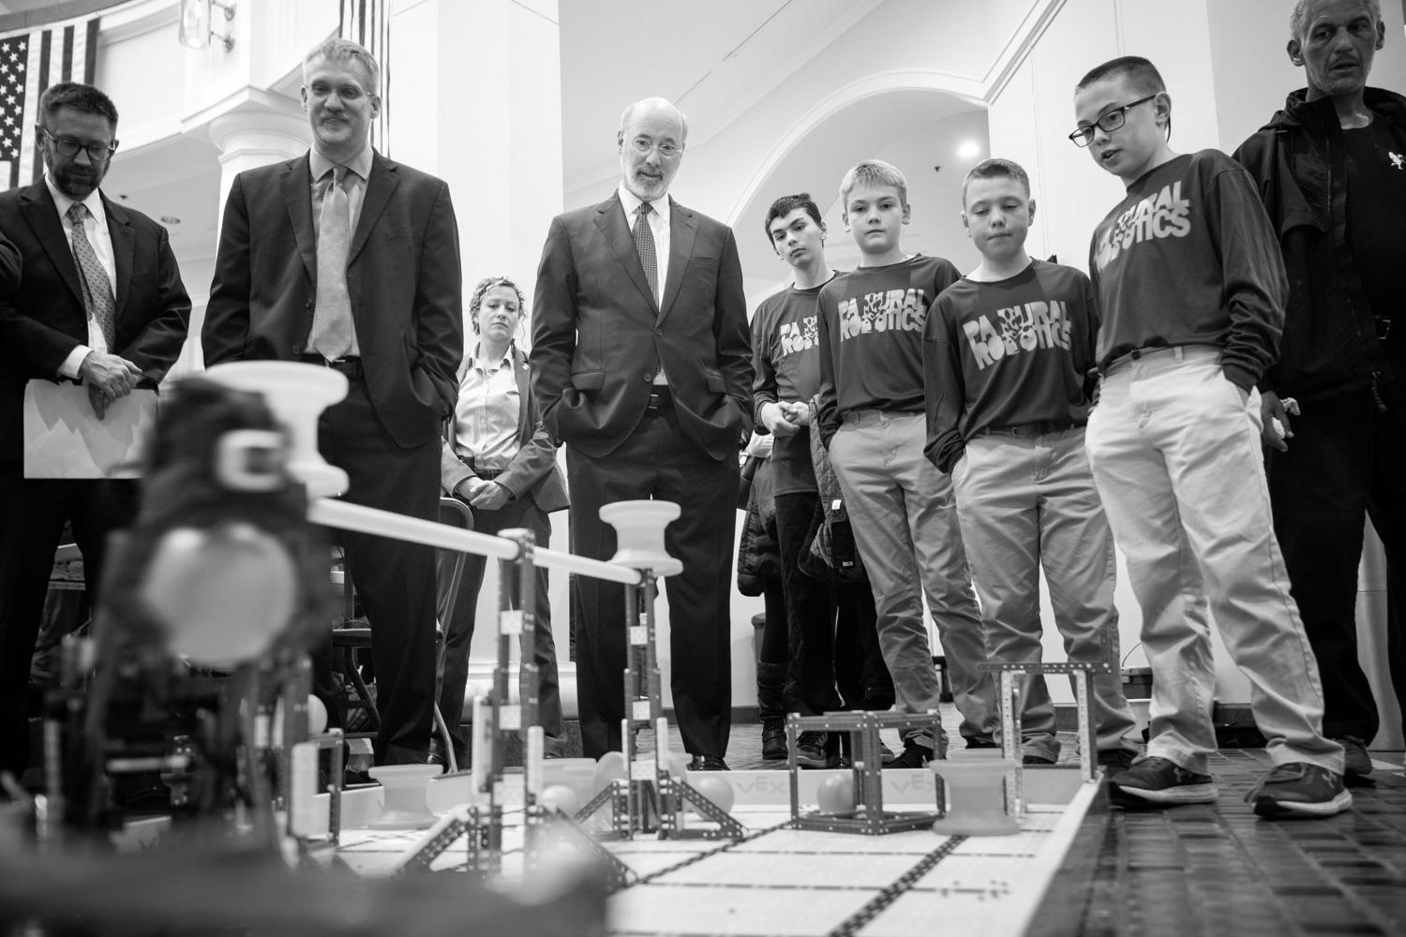
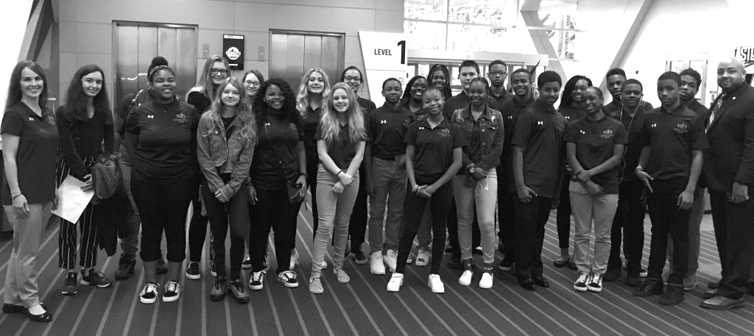
value proposition
Sustainable uniqueness
Stakeholder insights
Unmet needs

Slide 4

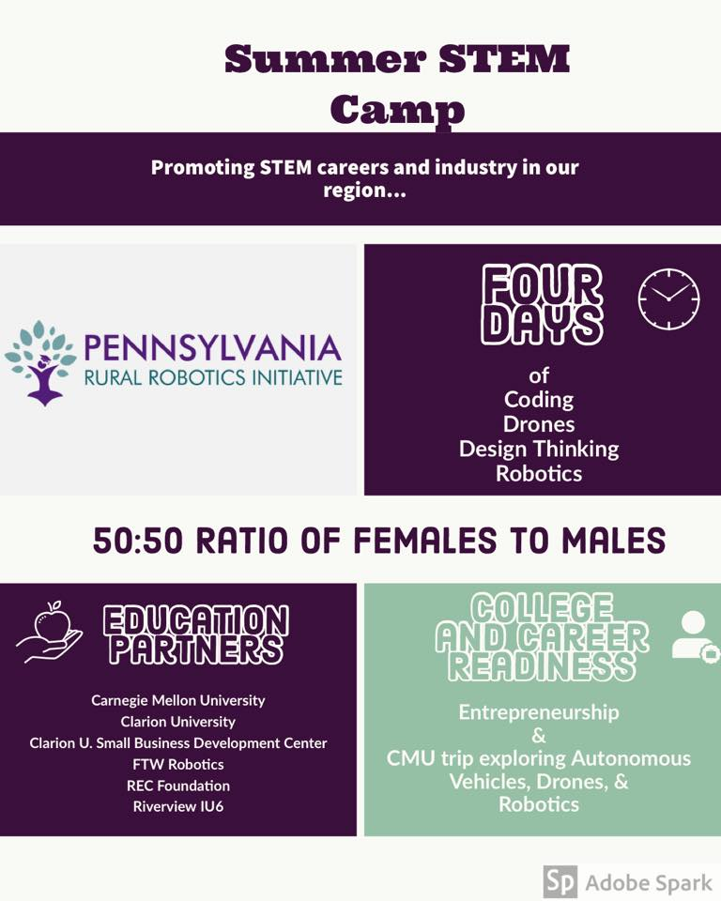
value proposition
PA Rural Robotics and Communitopia have identified their niche in programming for schools and students with regard to STEM and climate action education. They have effectively leveraged partnerships with several regional stakeholders that have allowed both organizations to continue to grow. Since the state of PA does not have a standardized curriculum for STEM or climate action subject matter, there is a wide variance in the nature of education provided to students. Both organizations are in a position to help lead and make an impact on how our region educates this generation and generations to come about critical issues related to workforce development, sustainable business practices, and eco-conscious solutions in their backyard and beyond.
User research findings identified an appreciation for the accomplishments, aspirations, and challenges of both organizations, and provided insight into opportunities for continued relationship building, as well suggestions for addressing potential roadblocks to success.
Both partners identified a shared unmet need for their organizations - resource management. They work with others to meet and exceed their promised deliverables, but from an operational standpoint they are one-person shows.
Notes:
PA Rural Robotics and Communitopia have identified their niche in programming for schools and students with regard to STEM and climate action education. They have effectively leveraged partnerships with several regional stakeholders that have allowed both organizations to continue to grow. Since the state of PA does not have a standardized curriculum for STEM or climate action subject matter, there is a wide variance in the nature of education provided to students. Both organizations are in a position to help lead and make an impact on how our region educates this generation and generations to come about critical issues related to workforce development, sustainable business practices, and eco-conscious solutions in their backyard and beyond.
User research findings identified an appreciation for the accomplishments, aspirations, and challenges of both organizations, and provided insight into opportunities for continued relationship building, as well suggestions for addressing potential roadblocks to success.
Both partners identified a shared unmet need for their organizations - resource management. They work with others to meet and exceed their promised deliverables, but from an operational standpoint they are one-person shows.

Slide 5
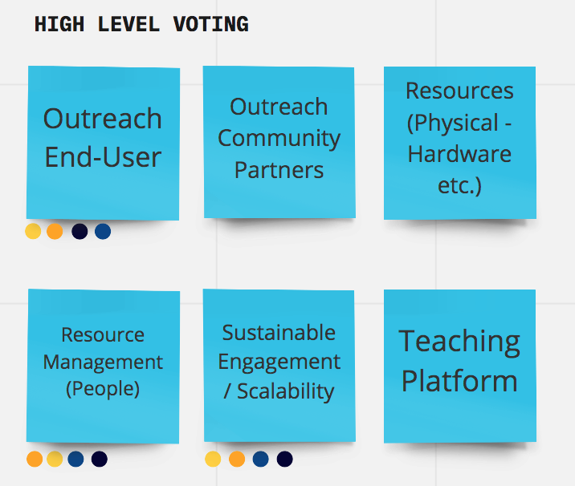
understanding the focus
Insights from conversations with our partners led us to affinity map high-level challenges that helped us organize our thoughts and prepare to prototype. These were the top 6 focus areas.
Engagement and scalability were the main areas that Katie and Tim said they wanted solutions for, and we thought that these tied in with having strong outreach potential to engage with stakeholders. At the same time, scalability and managing platforms is heavily tied into utilization of manpower, having people to update all of the platforms currently in use would have the strongest impact on all of the other focus areas.

Slide 6
existing & potential resources
Existing: Website, Facebook, WOM
Potential: Instagram (stories, live, etc)
Existing: Emailing, Facebook
Potential: Google Forms, MailChimp, NGO Management Platforms
Existing: Facebook, WOM
Potential: Social Media, Additional Site Features
Our group then began to brainstorm and organize a potential Minimum Viable Product solution targeting these three focus areas. For the product requirements, we compiled insights and suggestions from our user research. Primarily, the MVP would need to be a management tool to help keep track of volunteers, their availability and tasks, and updated statuses on progress.
Additionally, we recognize the potential challenges posed by adopting a new resource management platform and have outlined the pros and cons of using an integrated approach into the existing website(s) vs. a new platform.

Slide 7
existing & potential resources
Option 1: Integrating a Resource Management Tool into the Existing Websites
pros
Stakeholder websites already exist, therefore only a little additional time and cost is required to integrate new resource management tools
Minimal learning curve as stakeholders are already used to managing their own websites
One platform = less integration issues
cons
Upkeep of the website is the stakeholders responsibility
Cloud/data storage is also the stakeholders responsibility
Stakeholder must keep an eye out for when certain features of the website are not working as well as intended and develop a new solution
Option 2: Adopting a Ready-Made (New) Resource Management Tool
pros
Already built-in resource management platform for the stakeholders to use
Less upkeep required as it is managed by the chosen company
Tried and tested by various organizations
cons
Potentially steep learning curve for the stakeholders, as they would need to learn a new software in addition to managing their existing websites
Possible integration difficulties with existing websites, would need to troubleshoot a lot to make sure the two platforms blend seamlessly

Slide 8
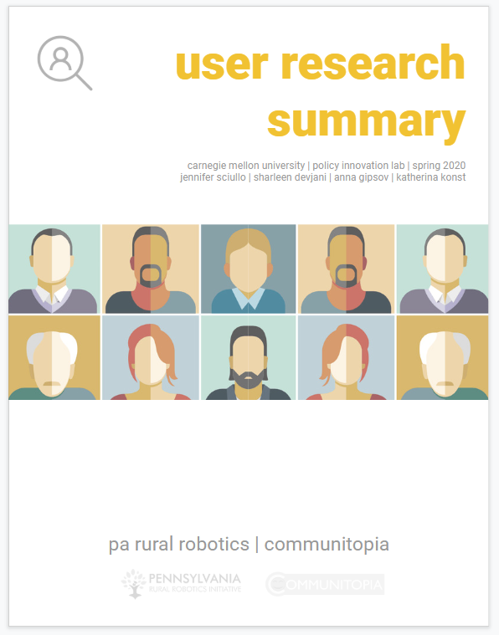
The process of conducting user research helped our group refine our MVP. As part of our final deliverable to our partners are sharing additional information about the user research process and findings.
https://docs.google.com/presentation/d/1B4iHqWGR0ba-4_IhfJ40lXsVuMw5z_wsZn-geVJFDRY/edit#slide=id.g8425f13f28_11_0

Slide 9
We looked back at the organizations that we have chosen to volunteer with in the past, to understand why they appealed to us and what the experience of signing-up with them was like. Our teammate’s experience with volunteering with SOSD (Save Our Street Dogs) in Singapore was used as reference. She recalls it being a pleasant experience due to the following factors:-
As a full-time employee, she was looking for volunteering options where the time commitment was clearly indicated beforehand
The volunteer sign-up form obtained a lot of information in the beginning, thus reducing the need for excessive correspondence for both herself and the organization
She could easily see what the responsibilities of each volunteer team was, and shortlist the areas that she could contribute to
Additionally, we referenced websites such as the UN Volunteer site. Similarly, it also provides a very detailed breakdown of the opportunities available, along with the position requirements and time commitment. This helps cater to people with differing amounts of time available for volunteer work.
SOSD Website: https://sosd.org.sg/
UN Volunteers Website: https://www.unv.org/
mvp precedent

Slide 10
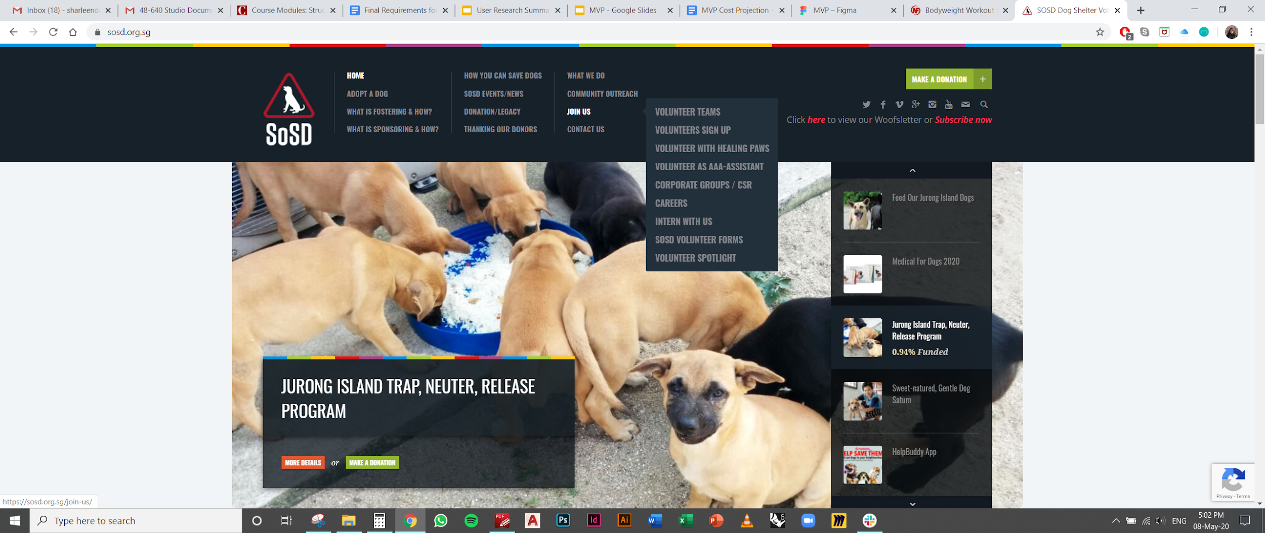
mvp precedent
Shown above is a screenshot of SOSDs website indicating how stakeholders might highlight openings for volunteers. At the top of the page, there are multiple fields for different kinds of volunteers, showing that people with varying availability can join the group. This flexibility is inviting for people to want to help out, and potentially feel like a part of the organization.

Slide 11
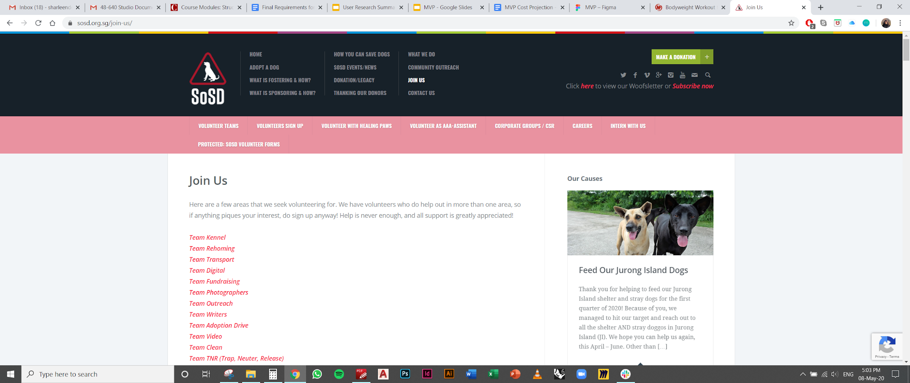
mvp precedent
The options for teams to join are broken up by many smaller tasks people can sign up for. This may also be more inviting since people will know what exactly their tasks are, and they can effectively share what they are interested in doing.

Slide 12
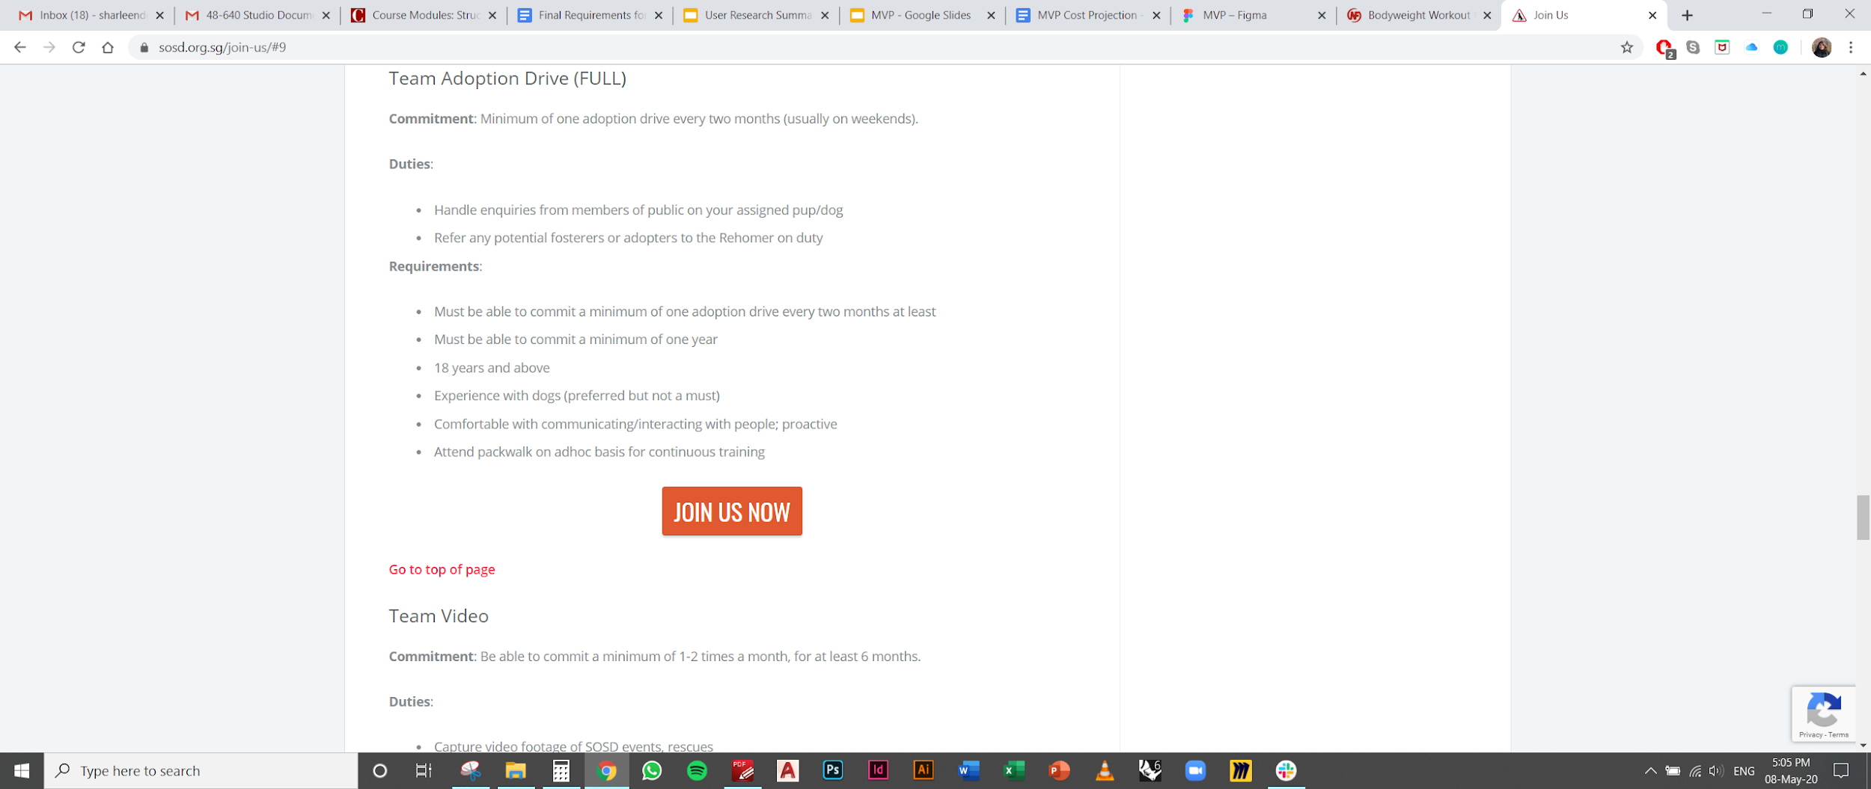
mvp precedent
The time commitment, duties and requirements are clearly outlined for each team. Additionally, they also indicate whether these teams are full and thus reduce the need for time-consuming correspondence with the stakeholders.

Slide 13
mvp proposed

Slide 14
Make the banner dynamic. Link to latest news or stories related to the organization
  We recommend reducing the current banner size to prevent obstructing information on the page.
Put a Donation button in the navigation bar
Put Social media buttons in the navigation bar
Page for Community and Corporate partners
Page for volunteering and Internship opportunities
  Including a form for someone to submit an application to intern. This form should interact with a suitable backend. this could be quite variable (site's database, Google form + Google sheet combo, Mailchimp), and one should choose something both convenient and provide accessible notification upon receipt.
Careers Page
  For paid positions, a place to post descriptions and instructions for applying (usually more formal and initiated via email, so no form needed here)
Consider soliciting suggestions and feedback. Might be a natural extension to existing Contact Us page
mvp features
communitopia

Slide 15
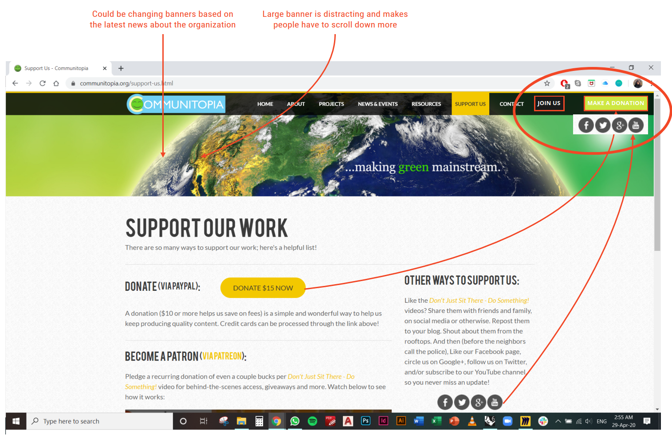
mvp
The availability of a donation button is an option the groups may choose to implement. It will be straightforward to receive funding with this, and make it easier for visitors to support the group online through the other platforms.

Slide 16
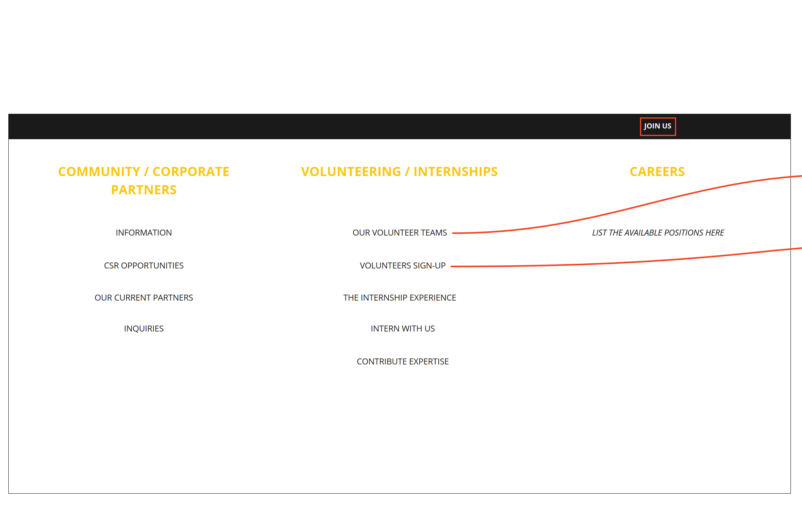
mvp

Slide 17
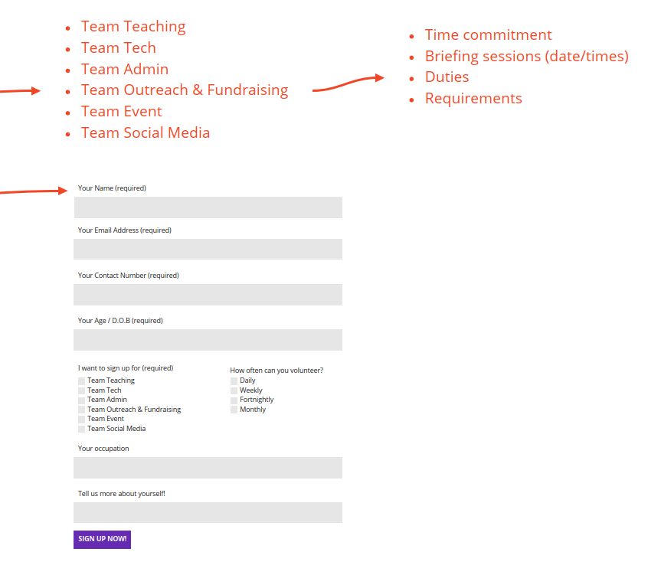
mvp
Providing up-front information about the volunteering tasks will have the impact of being more inviting, as potential visitors can see themselves doing the tasks and will know exactly what they are signing up for.
One example would be someone signing up to host an online lecture [Team Teaching, or Team Event]. After filling this form, you would see their entry, and send a follow-up telling them the format (length of presentation, templates) and dates available. They could send a copy of their presentation for review before this date.
Social media interns could be given responsibility to create 1-2 posts at a time (graphics would be reviewed by Communitopia), and they would be in charge of responses and further engagement on the posts. With access to the account, they can also like and repost content from the community for higher outreach and engagement. Features such as “Stories” or “Pinned” can be used to make strings of informative/educational graphics for student followers.

Slide 18
Put a ‘Join Us’ button in the navigation bar
Put a Donation button in the navigation bar
Page for Community and Corporate Partners
Page for Volunteering and Internship Opportunities
  Broken down into teams & tasks
  Including a form for someone to submit an application to intern. This form should interact with a suitable backend. this could be quite variable (site's database, google form + google sheet combo, Mailchimp), and one should choose something both convenient and provide accessible notification upon receipt.
Careers Page
  For paid positions, a place to post descriptions and instructions for applying (usually more formal and initiated via email, so no form needed here)
Consider soliciting suggestions and feedback. Might be a natural extension to existing Contact Us page
mvp features
pa rural robotics

Slide 19
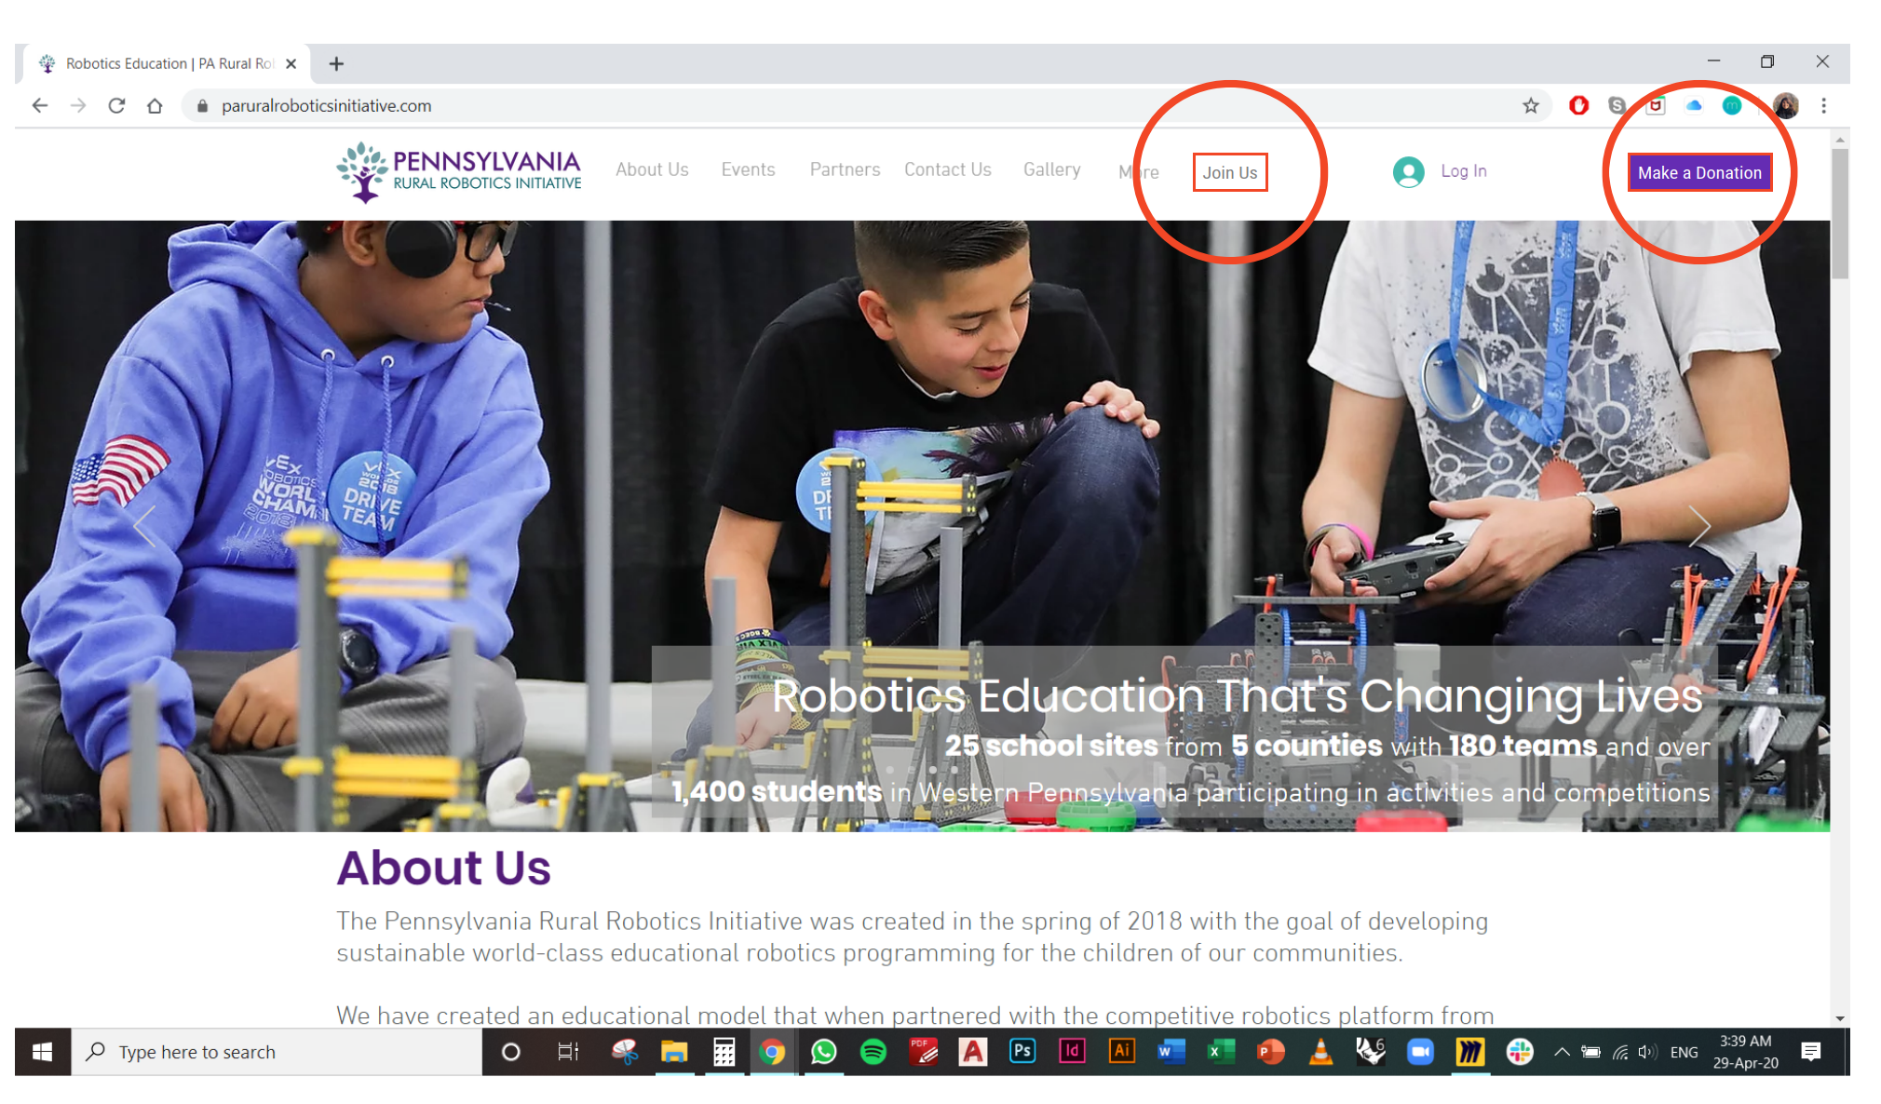
mvp

Slide 20
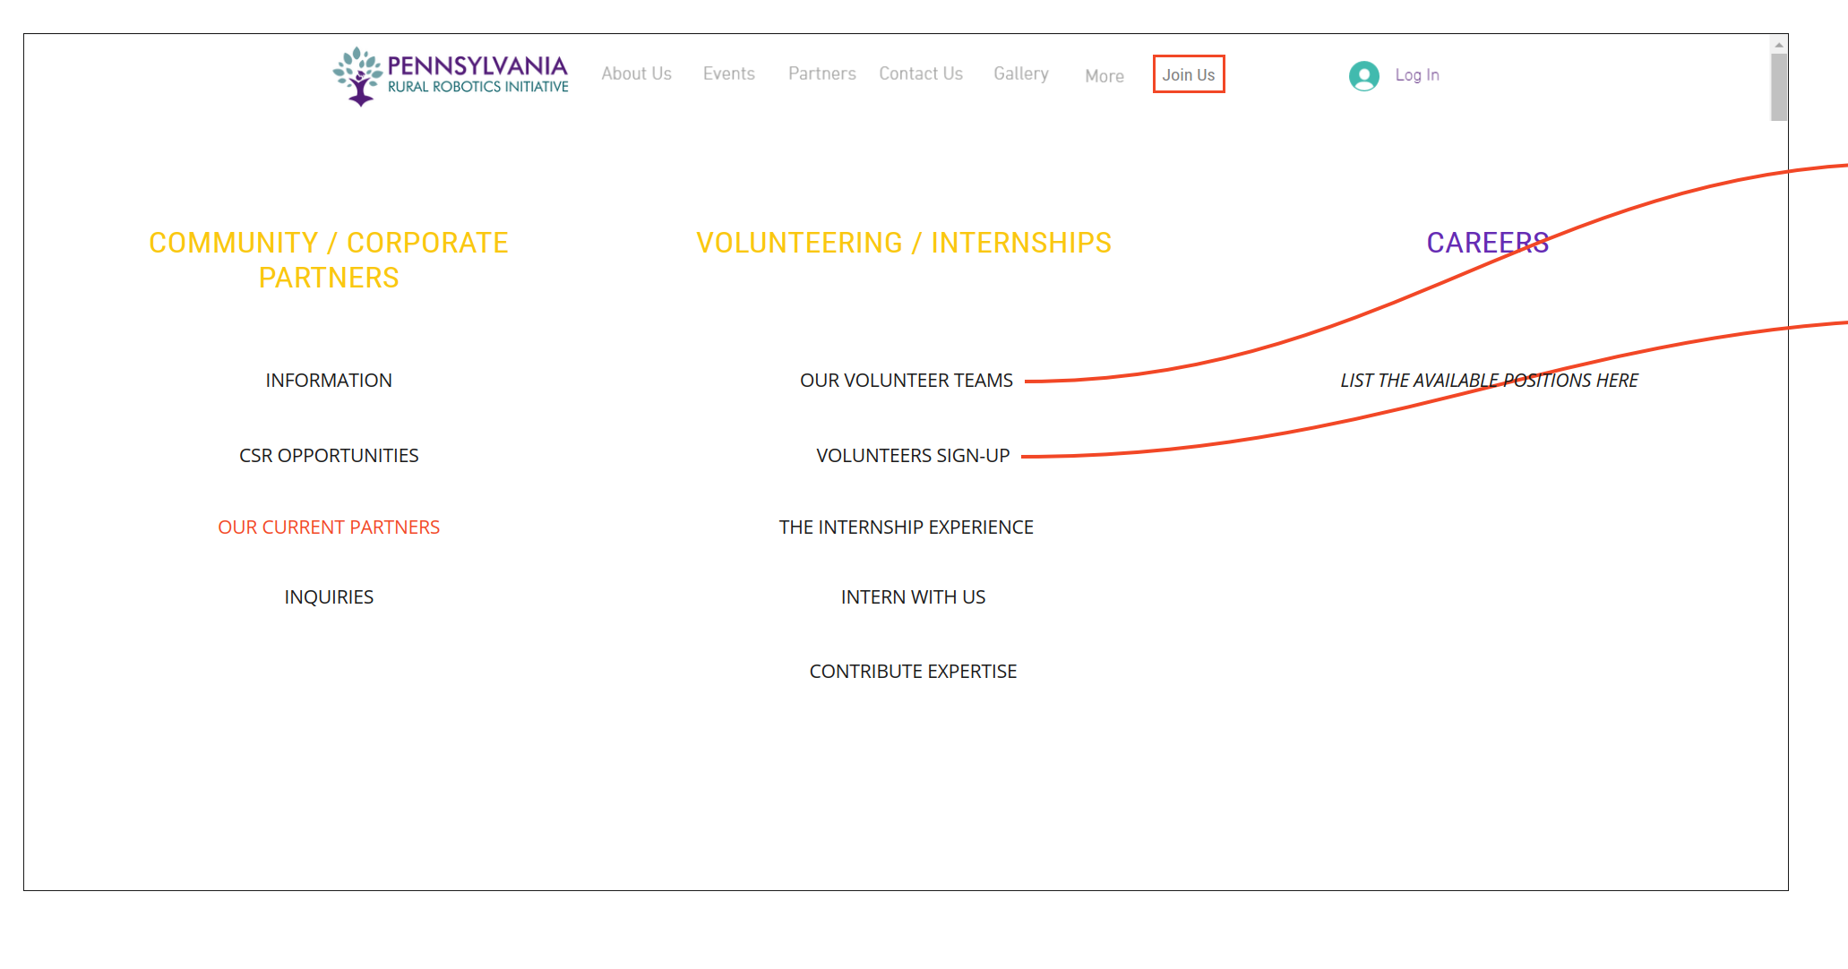
mvp

Slide 21
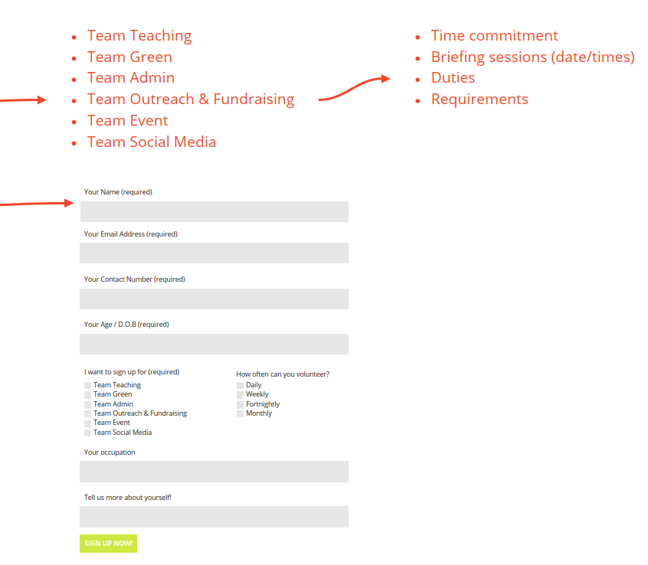
mvp
Providing up-front information about the volunteering tasks will have the impact of being more inviting, as potential visitors can see themselves doing the tasks and will know exactly what they are signing up for.
One example could be a drop-down menu under “Events” to show the upcoming events, and parents or other community members could volunteer to come help out at a competition. Professional volunteers could be given options to judge the event or walk around to give consults to students.
The social media interns would be given tasks to update the pages and interact with community members for higher outreach and engagement. They could also continuously share current news and innovation in the field for educating the student followers of the page.
Notes:
The MVP is the integration of this

Slide 22
mvp opportunities & challenges
Opportunities
Maximizing the potential of an existing platform
Reduction in concentrated effort and time by partners (delegation of responsibilities)
Increased stakeholder outreach
Establishment of a user feedback loop to encourage engagement and recognize potential areas for further development
Increased community engagement
Challenges
Configuration of website infrastructure
Need for attracting website visitors
Maintenance and updating of the website (whose responsibility is it?)
Communication with new volunteers
Managing growth & training new volunteers

Slide 23
mvp implementation strategy
Website Development
Recruit Volunteers
Data Collection
Data Storage
Resource Management
Hire or engage an existing website developer to add new components to the current websites.
This process can also account for any tweaks or changes required by the stakeholders to better suit their specific needs.
Clear direction to where visitors can sign up to volunteer, including tasks and roles with different time commitments.
Differentiation for student or adult volunteers.
Links from Facebook and other Social pages
The form entries can collect to Google Forms, the embedded system of the website, or a third party platform for organizing the entries.
Data from entries could be organized in a spreadsheet kept by administrators.
Depending on setup and volume, it could be Cloud stored.
Organizing volunteer tasks through an existing Google Drive system or other platforms.
Allow signup for events, managing social media, volunteering to create content or give talks to students.

Slide 24
measuring success

Slide 25
key performance indicators
Primary Focus
ROI
Community/ Corporate Partner Growth
Reduced Stakeholder Involvement (Time)
Website Efficiency (Communication & UX)
Volunteer Growth
Report will provide more detail on ROI based on costs and time required to develop existing resources
# Community partners joining the network and being able to coordinate with the 2 programs
Katie and Tim spend less time coordinating potential volunteers and their tasks
Experience navigating the site and effectiveness of communication; how well can they find what they’re looking for?
# Volunteers signed up and retained, attending events and contributing content, uploading on social media, etc

Slide 26
key performance indicators
Secondary Focus
Web & Social Media Engagement
Use of Data Collected
Outreach Growth
Sustained Community/Corporate Partner Relationships
General Attitude
Engagement on online media: likes, follows, watches, comments, page visits
Does the data from the form entries correspond to actual attendance and efficiency of tasks done by volunteers?
Student attendance at events, length of sessions and discussions, number of events held
Consistent and quality partnerships, connected community within these fields
Students’ general attitude toward the program topics and the meaning they get from it

Slide 27
return on investment
cost
Estimated cost to complete: varies from $750 - $1,500
Web Designer - $75-100 per hour (approx.) (depends on the experience level of the designer)
Cost of Cloud or other data storage - depends on data quantity.
time
Estimated time to complete: 10-20 hours
This is variable, and subject to:
Quality of hire. Experience in solving similar problems.
Familiarity with systems involved.
Pre-existing knowledge of tools.
Preparation of content and clear expression of the job to be done. Reduce the amount of back and forth iteration.

Slide 28
appendix
brainstorming

Slide 29
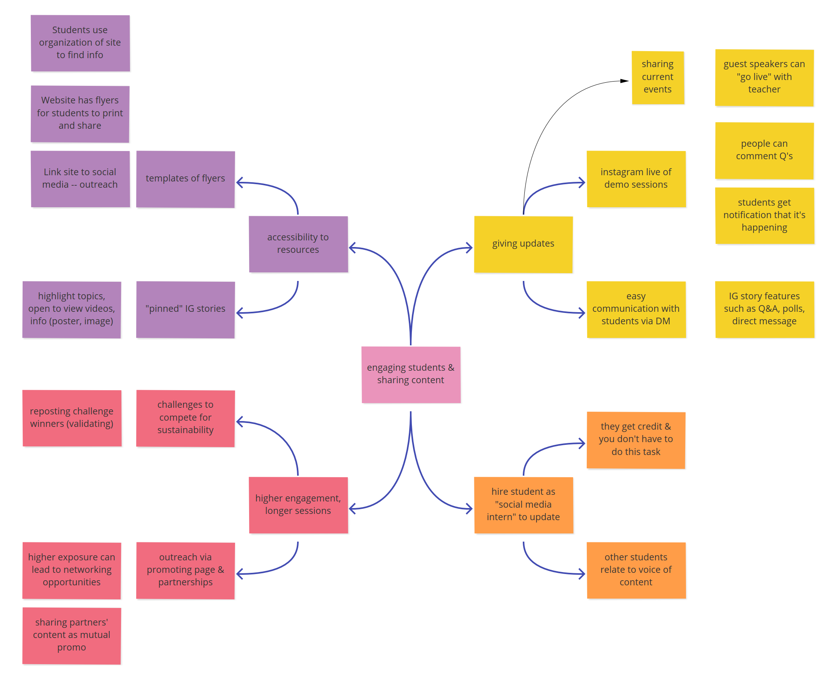
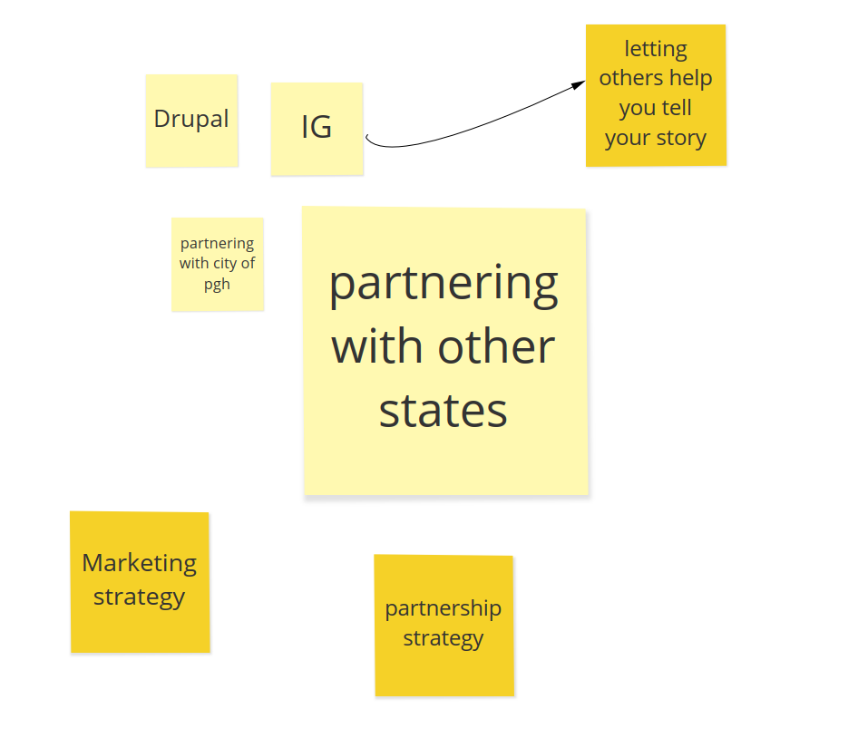
brainstorming

Slide 30
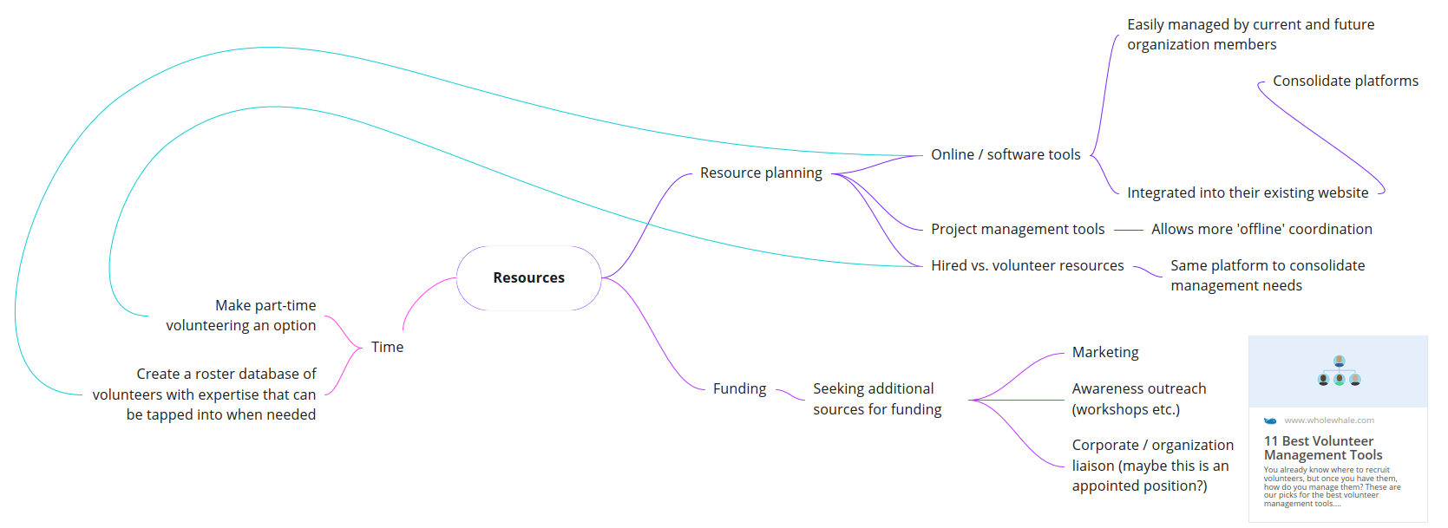
brainstorming

Slide 31
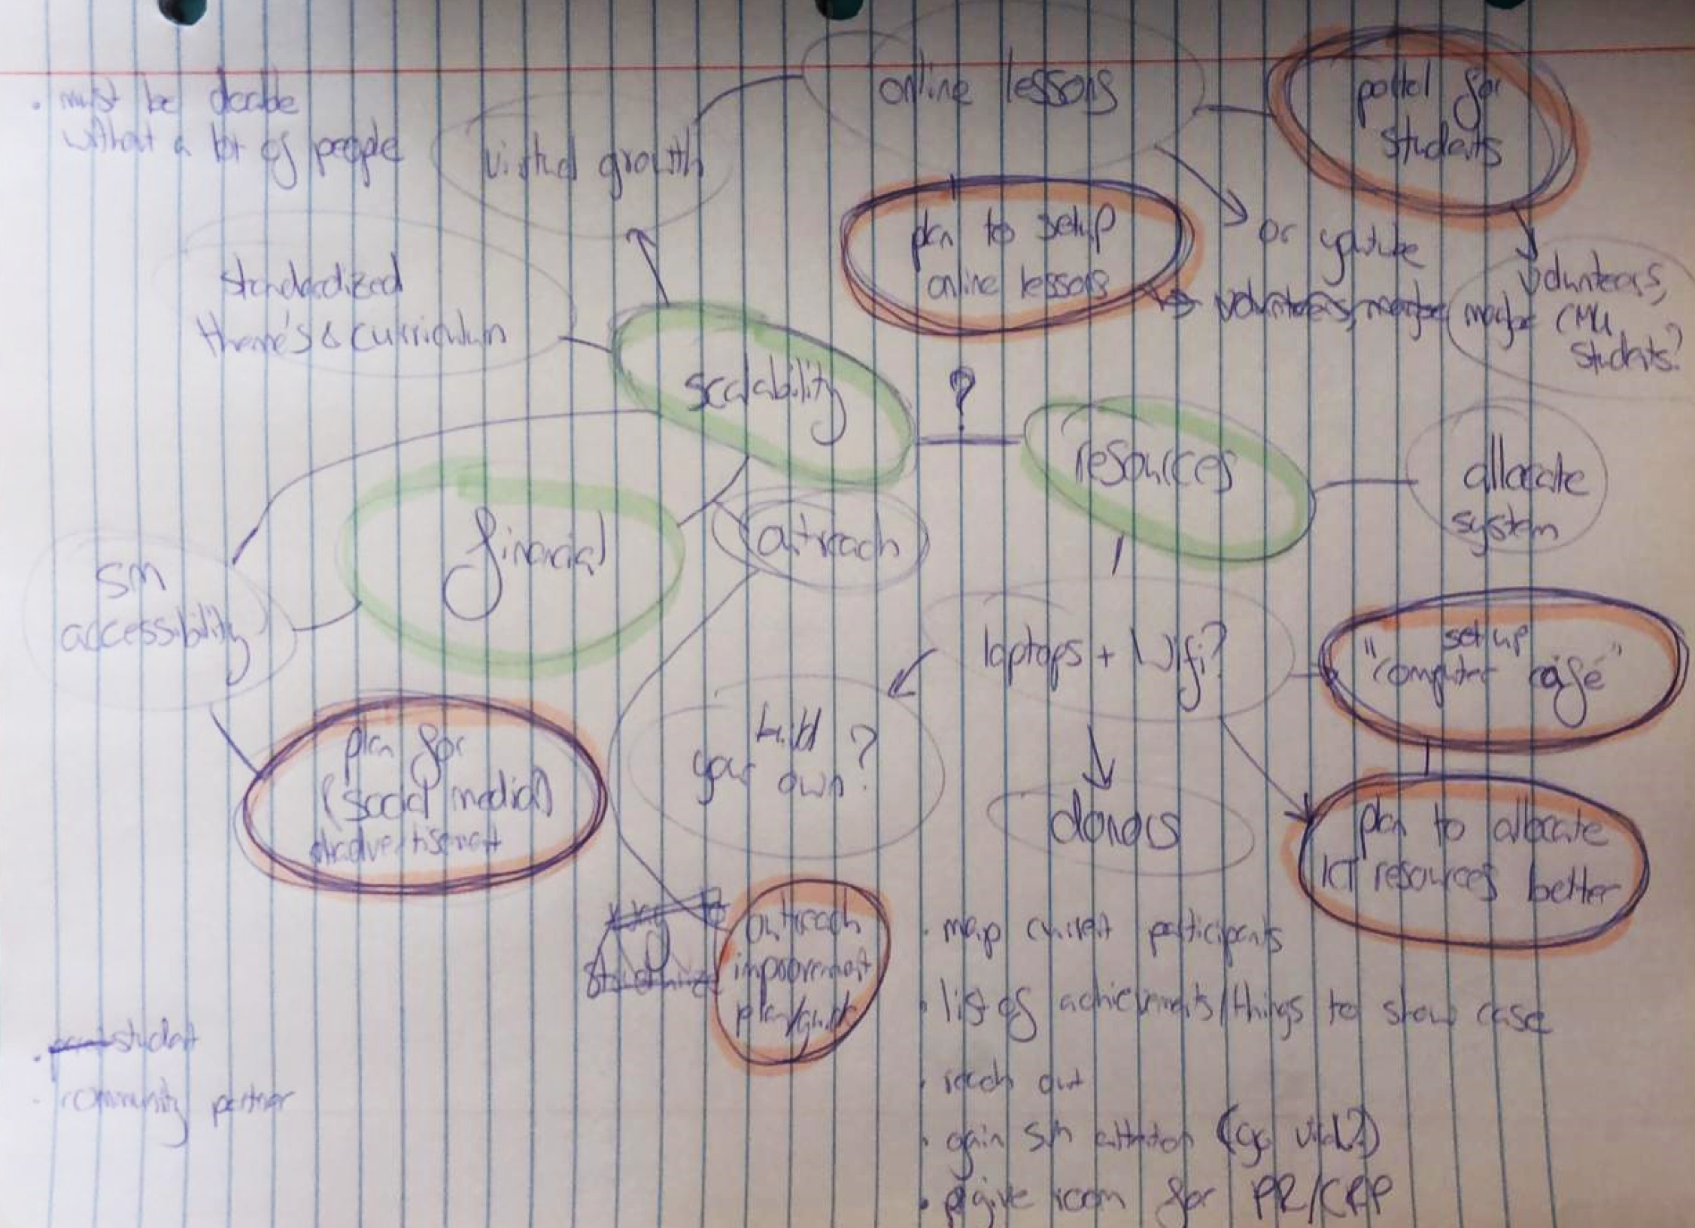
brainstorming

Slide 32

A Carnegie Mellon University Project,
Heinz College of Information Systems and Public Policy
For Policy Innovation Lab: Climate Resiliency Futures - Spring 2020,
taught by Christopher Goranson, Smita Satiani & Sean Cuff (TA)
Stakeholders: Communitopia (Katie Modic) & PA Rural Robotics Initiative (Timothy Heffernan)
Team Members: Jennifer Sciullo, Sharleen Devjani, Anna Gipsov & Katherina Konst

