Slide 1

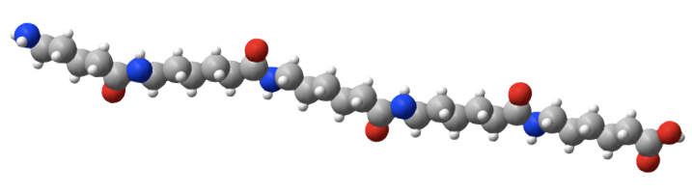
Prediction of Polymer Product Quality in an Industrial Reactor using Recurrent Neural Networks
Presented by
Jasdeep Singh Chhabra
13045114

Slide 2
The Journey
The Problem
The Process
Steady-state linear model-An ineffective solution
Neural Networks-What are they?
Recurrent Neural Network-A bit complex!
Internally Recurrent Neural Network Model-An effective solution
An experimental comparison
Conclusions
References

Slide 3
The Problem
Polymers are sold to customers based on some specifications for the quality of polymer products(melt index,polymer density,colour etc.)
These quality variables are difficult to control due to high degree of non-linearity,complexity and rapidity,widely differing operating regions required for polymerisation reactions.
This control is made more difficult by lack of reliable and timely measurements of key polymer quality variables close to reactor.
Often product samples are collected an quality variables measured in a laboratory which may take several hours.Thus this measurement arrives too late to provide useful feedback for control.

Slide 4
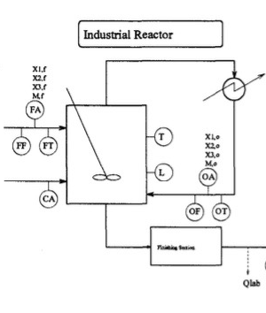
The Process
FF-reactor feed flow rate
FT-feed temperature
Mf-monomer concentration in feed stream
Xi,f-disturbances(impurities) affecting product quality.
CA-feed rate of polymerisation catalyst.
T-temperature of reactor
L-Liquid level in reactor
OF,OT-Recycle flow rate and temperature.
The final polymeric product is sampled and sent to lab(Qlab) for quality measurements taking 4-6 hours.
We are looking to minimise this time.

Slide 5
Steady-State linear model
A fairly straightforward approach to solve the problem is to model the product quality in a separate linear steady state model for each of the several main polymer grades.
The major drawbacks of this model were-
The individual models were only accurate over limited operating ranges and did not account properly for the dynamics of process.
General trends were accurately predicted but transition between grades was not smooth.

Slide 6
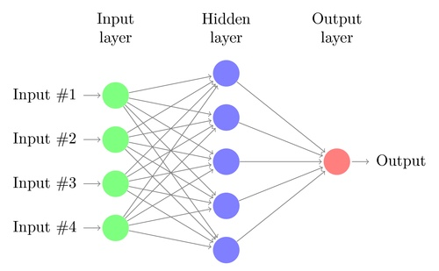
Neural Networks-What are they?
Made up of neurones.Each connection represent a weight which is optimised using trial and error process called back-propagation(Mathematically Gradient-descent).

Slide 7
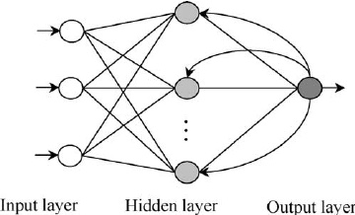
Recurrent Neural Networks-A bit complex!
It is similar to vanilla Neural network.The difference is that outputs are sent as inputs to previous layers.

Slide 8
Internally Recurrent Neural Network Model(IRN)
Why IRN?
IRN are capable of representing the behaviour of non-linear dynamic process.The industrial polymerisation reactor manufactures several polymer grades over which the process is highly non-linear.
IRN have also been shown to be capable of modelling process with variable dynamics.This situation can occur when feed flow rate(FF) changes.
Thus IRN seem to be ideal modelling tool for the prediction of polymer quality from other reactor conditions.

Slide 9
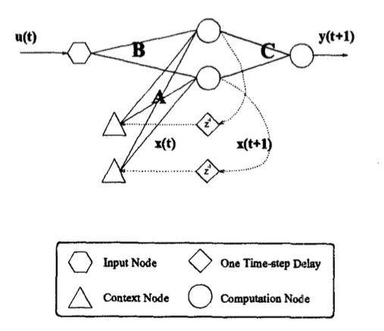
The network used are IRN with sigmoidal activation function in hidden layer and linear activation function in output layer.
IRN structure is capable of modelling dynamic systems due to the feedback of the internal states in the network.

Slide 10
Mathematically, this can be described as-
xt+1=sigma(Axt+But)
yt+1=Cxt+1
where xt+1 is network’s internal state prediction at time t+1 and yt+1 is network prediction of the vector of process outputs.sigma() is the nonlinear sigmoidal activation function.A,B,C are weight matrices which are trained using historical data.
The input to the IRN model consist of the measurements FF,CA,Mf,Xi,f,T and Mo

Slide 11
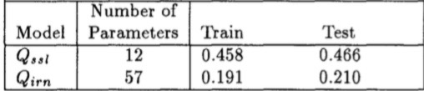
An Experimental Comparison
Comparing IRN model with Steady state linear model under following parameters-
Predictions for steady state linear models adjusted for 6 hour pure time delay are designated Qssl
The IRN model trained for 10000 hours of data collected and tested using 2000 hours of data.Predictions designated by Qirn
The error model used is root mean squared error.

Slide 12
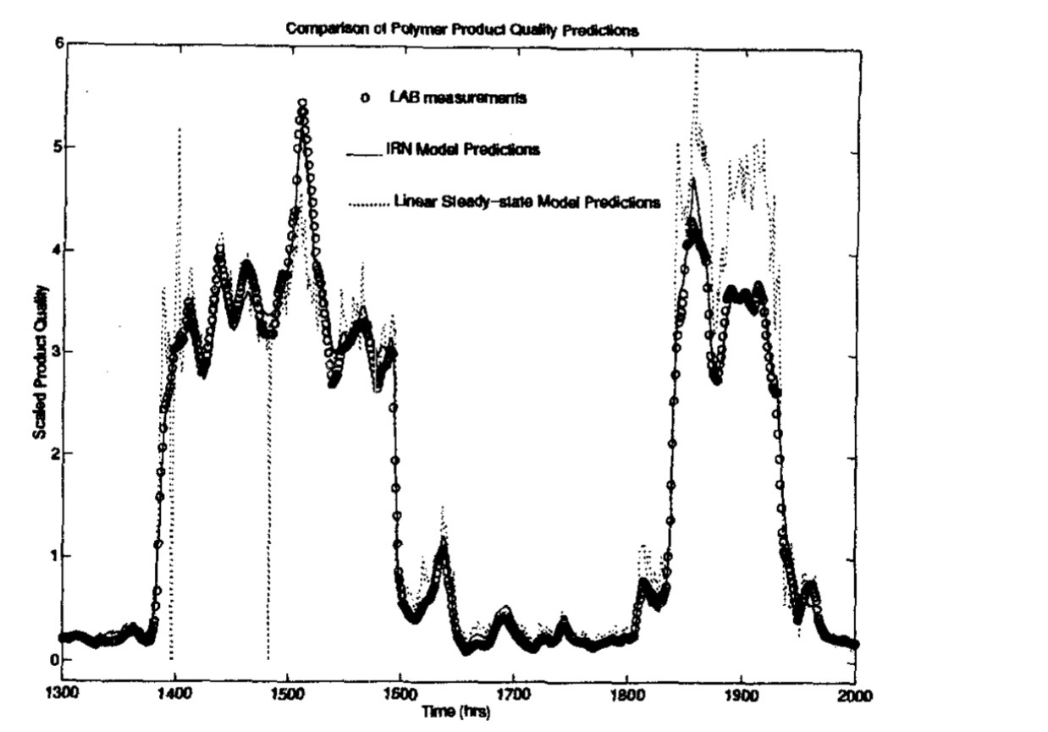

Slide 13
Conclusion
The IRN model predicts quality of polymer with a high accuracy even in transition ranges and is almost as good as the observations of laboratories.
It performs better than the steady state linear model by a huge margin.
IRN can be used to develop suitable control strategies for directly controlling product quality.

Slide 14
References
Process Systems Analysis and Control by Donald R. Coughanowr and Steven E. LeBlanc(3rd Edition)
Prediction of polymer product quality Randall S. Barton and David Himmelblau

Slide 15
Thank you!Have a nice day ahead!

