Slide 1
MEEN 689 – Final Project
Humayun Akhtar
Sanket Khullar
Jasdeep Bajaj

Slide 2
Problem Statement
To fuse noisy IMU sensors(to replicate physical scenarios) for Simultaneous localization and mapping (SLAM)

Slide 3
What we did?
Replicated the physical environment using the Gazebo virtual simulator.
Implemented Extended Kalman Filter to fuse multiple IMUs for pose estimation
Used pose estimation and lidar data for SLAM
Compared the occupancy grid map with the floor map created in Gazebo.

Slide 4
Approach
Compiled the URDF (referring from turtlebot3 burger robot) to make a two wheeled robot with additional IMU sensors.
Added different Gaussian noise and update rates to the sensors (to replicate real sensors).

Slide 5
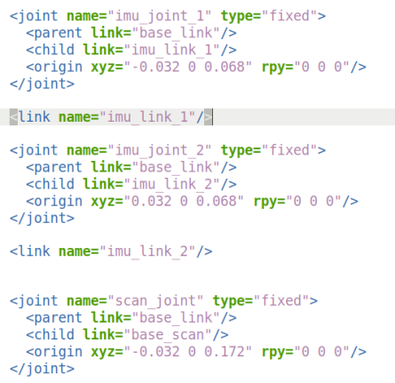
Approach
Added IMU joint and link tag in URDF file

Slide 6
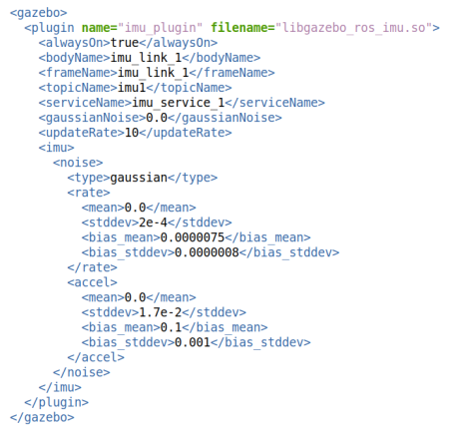
Approach
Added Gazebo plugins to give noise and desired update rates to the sensors.

Slide 7
Approach
Created ROS node to implement the Extended Kalman Filter.
The EKF ROS node publishes the current pose of the robot which is used with the LIDAR data for simultaneous localization and mapping.

Slide 8
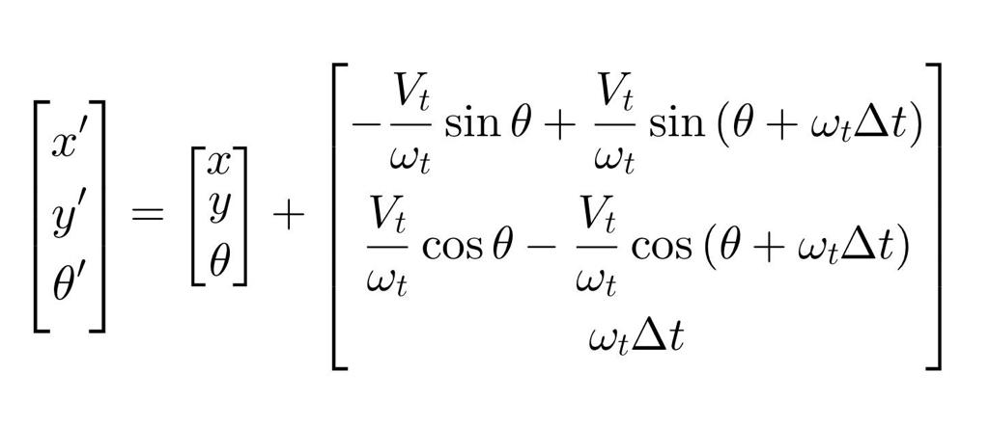
Velocity Motion Model

Slide 9

Jacobian of the Motion Model Equation
F =

Slide 10
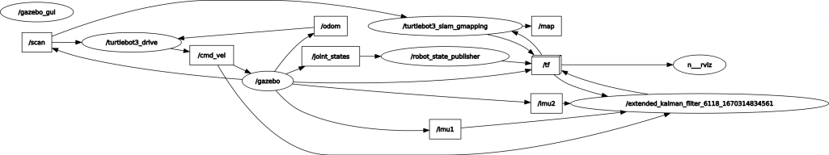
Approach
Rqt_graph

Slide 11
EVALUATION

Slide 12
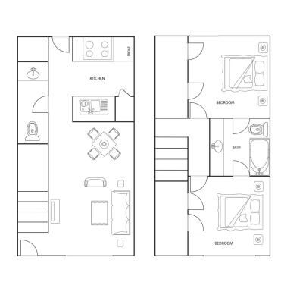
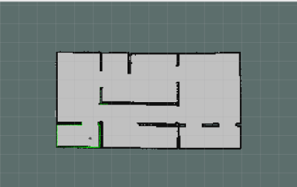
Evaluation
Occupancy Grid Map
Ground Truth

Slide 13

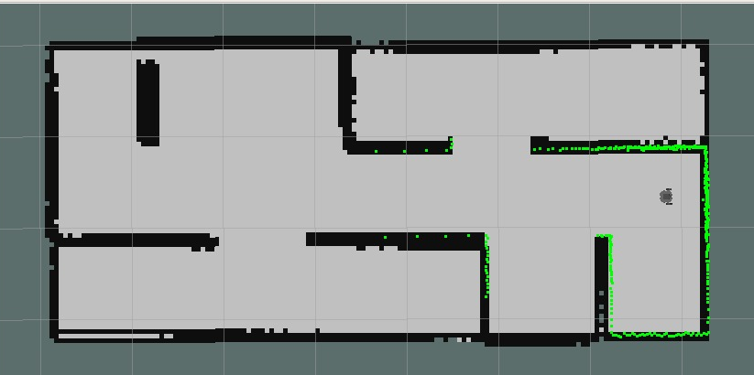
Evaluation
Occupancy Grid Map
Ground Truth

Slide 14
Thank You

