Slide 1
Enable HTTPS on a Spring Boot Application

Slide 2
Setting up HTTPS for Spring Boot
Setting up HTTPS for Spring Boot requires two steps:
getting an SSL certificate
configuring SSL in Spring Boot.

Slide 3
Setting up HTTPS
HTTPS is a secure version of HTTP designed to provide Transport Layer Security (TLS) [the successor to Secure Sockets Layer (SSL)]
The padlock icon in the address bar that establishes an encrypted connection between a web server and a browser.
HTTPS encrypts every data packet to transmit in a secure way and protects sensitive data from an eavesdropper or hacker.
You can implement HTTPS by installing the SSL certificates on your web application.
You can use either certificate issued by trusted Certificate Authorities (CA) or Self-Signed Certificate.

Slide 4
Self-Signed Certificate
You can generate the certificates by using Keytool located under the JDK bin folder.
There are two Self-Signed Certificates that are available, as shown below.
JKS(Java Key Store) is easy to access from your own Java apps. JKS is limited only to Java and not accessible from outside Java.
PKCS12: Public Key Cryptographic Standards, on the other hand, are a language-neutral way to store encrypted private keys and certificates and have been around long enough that it's supported just about everywhere.

Slide 5
Self-Signed Certificate
Use the keytool command as below
keytool -genkeypair -alias selfsigned_localhost_sslserver -keyalg RSA -keysize 2048 -storetype PKCS12 -keystore ssl-key.p12 -validity 3650

Slide 6
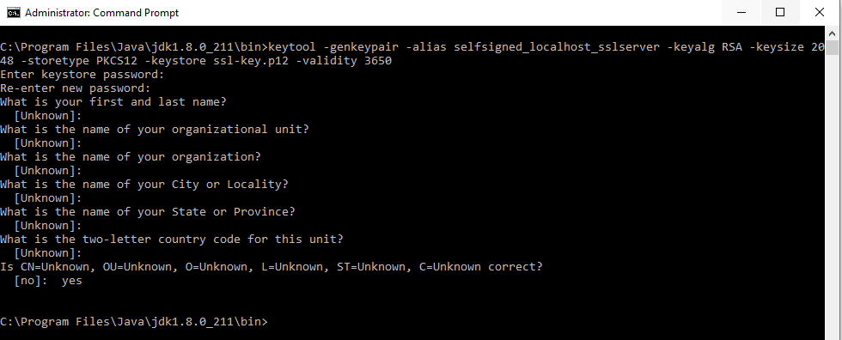
Self-Signed Certificate

Slide 7
Self-Signed Certificate
genkeypair: generates a key pair;
alias: the alias name for the item we are generating;
keyalg: the cryptographic algorithm to generate the key pair;
keysize: the size of the key. We have used 2048 bits, but 4096 would be a better choice for production;
storetype: the type of keystore;
keystore: the name of the keystore;
validity: validity number of days;
storepass: a password for the keystore.

Slide 8
Applying the SSL to Spring Boot Application
Copy the ssl-key from the JDK bin folder and place it under the src/main/resources on your Spring Boot Application.
Add the SSL Key information into application.properties as shown below.
#SSL Key Info security.require-ssl=true server.ssl.key-store-password=jasdhir server.ssl.key-store=src/main/resources/ssl-key.p12 server.ssl.key-store-type=PKCS12

