Slide 1
Spring Overview

Slide 2
Spring in a Nutshell
Very popular framework for building Java applications.
Initially a simpler and lightweight alternative to J2EE.
Provides a large number of helper classes … makes things easier

Slide 3
Why Spring?
Simplify Java Enterprise Development
Spring Website – Official
https://spring.io/

Slide 4
Goals of Spring
Lightweight development with Java POJOs (Plain-Old-Java-Objects)
Dependency injection to promote loose coupling
Declarative programming with Aspect-Oriented-Programming (AOP)
Minimize boilerplate Java code

Slide 5
Spring Architecture
The Spring Framework consists of features organized into about 20 modules.
These modules are grouped into
Core Container
Data Access/Integration
Web
AOP (Aspect Oriented Programming)
Instrumentation
Test.

Slide 6
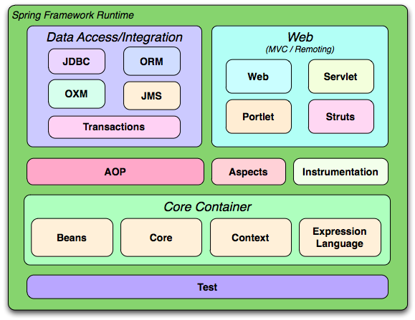
Spring Architecture

Slide 7
Coding Scenario
App should be configurable
Easily change the coach for another sport
Track and Field, Hockey, Cricket, Tennis, Gymnastics etc …
getDailyWorkout()
MyApp
BaseballCoach

Slide 8
Coding Scenario
MyApp.java: main method
BaseballCoach.java
Coach.java
TrackCoach.java

Slide 9
Inversion of Control (IoC)
The approach of outsourcing the construction and management of objects.

Slide 10
Inversion of Control (IoC)
Obtain a Coach Object
MyApp
Object Factory
configuration
BaseballCoach
TrackCoach
TennisCoach

Slide 11
Inversion of Control (IoC)
Obtain a Coach Object
MyApp
Spring
Object Factory
configuration
BaseballCoach
TrackCoach
TennisCoach

Slide 12
Spring Container
Primary functions
Create and manage objects (Inversion of Control)
Inject object’s dependencies (Dependency Injection)
Spring
Object Factory

Slide 13
Configuring Spring Container
XML configuration file (legacy, but most legacy apps still use this)
Java Annotations
Java Source Code

Slide 14
Spring Development Process
Configure your Spring Beans
Create a Spring Container
Retrieve Beans from Spring Container

Slide 15
Configure your Spring Beans
<beans …>
<bean id="myCoach" class="com.jasdhir.springdemo.BaseballCoach"> </bean> </beans>

Slide 16
Create a Spring Container
Spring container is generically known as ApplicationContext
Specialized implementations
ClassPathXmlApplicationContext
AnnotationConfigApplicationContext
GenericWebApplicationContext

Slide 17
Create a Spring Container
ClassPathXmlApplicationContext context = new ClassPathXmlApplicationContext("applicationContext.xml");

Slide 18
Retrieve Beans from Container
// retrieve bean from spring container
Coach theCoach = context.getBean("myCoach", Coach.class);
<bean id="myCoach" class="com.jasdhir.springdemo.BaseballCoach"> </bean>

Slide 19
Spring Dependency Injection
The dependency inversion principle.
The client delegates to calls to another object the responsibility of providing its
dependencies.

Slide 20


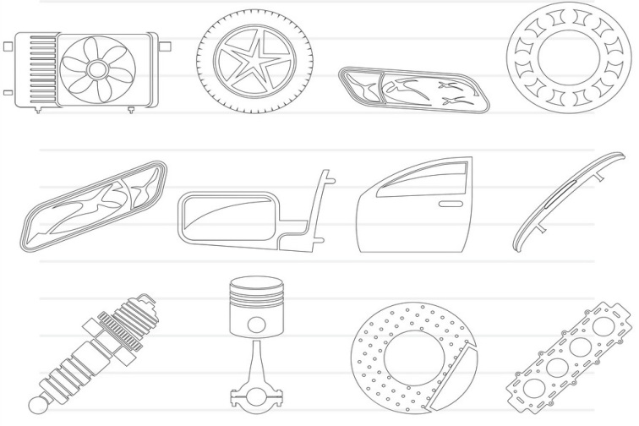
Spring Dependency Injection (Car Factory)
Obtain a Car Object
Spring
Car Factory
Dependencies

Slide 21
Spring Container
Primary functions
Create and manage objects (Inversion of Control)
Inject object’s dependencies (Dependency Injection)

Slide 22
Example
Our Coach already provides daily workouts
Now will also provide daily fortunes
New helper: FortuneService
This is a dependency
Coach
FortuneService

Slide 23
Injection Types
There are many types of injection with Spring
The two most common
Constructor Injection
Setter Injection

Slide 24
Spring Configuration with Java Code
Instead of configuring Spring container using XML
Configure the Spring container with Java code

Slide 25
Development Process
Create a Java class and annotate as @Configuration
Add component scanning support: @ComponentScan (optional)
Read Spring Java configuration class
AnnotationConfigApplicationContext context =
new AnnotationConfigApplicationContext(SomeConfig.class);
Retrieve bean from Spring container
Coach theCoach = context.getBean("tennisCoach", Coach.class);

